Slide 1
Guide to Interpreting Your Employee Engagement Report

Slide 2
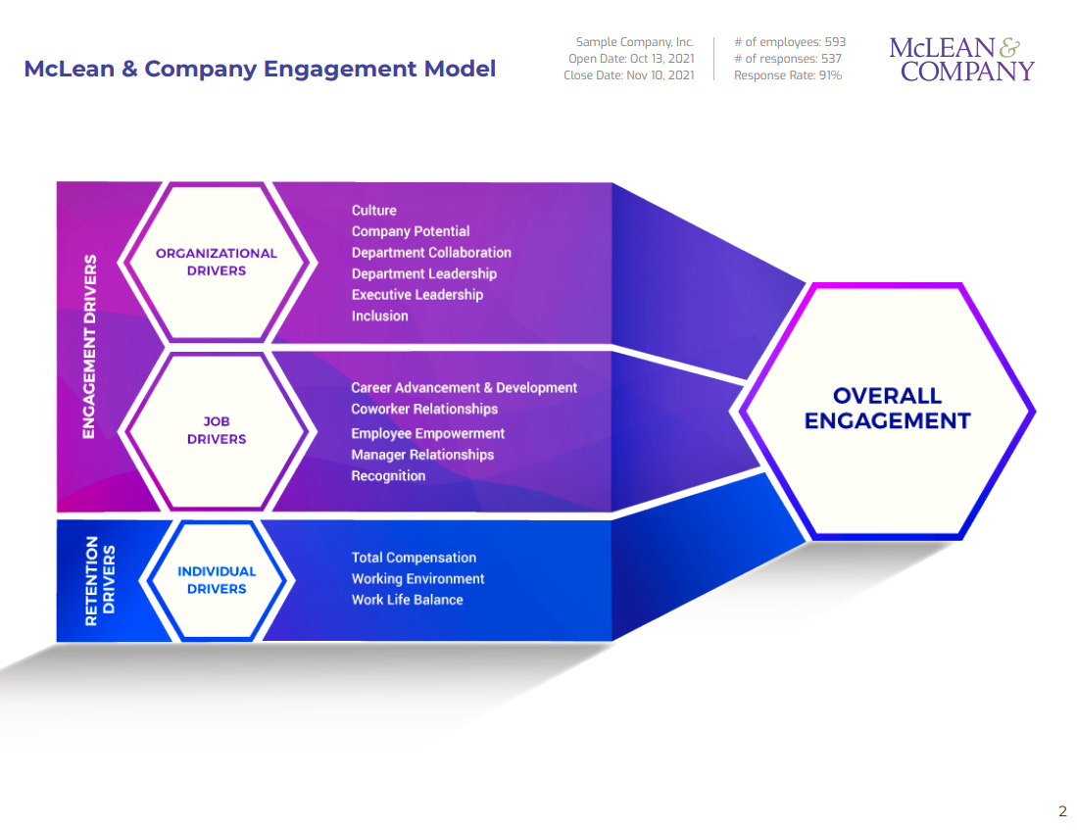
McLean & Company’s Model of Engagement
The second page illustrates all the components that make up Mclean & Company’s Model of Employee Engagement.
Engaged employees feel energized, passionate, and dedicated. They are highly involved with their work and the organization.
Organizational Engagement Drivers are areas that influence an employee’s happiness and commitment to their organization.
Job Engagement Drivers are areas that influence an employee’s happiness and commitment with their day-to-day role.
Retention Drivers are areas that influence an employee’s desire and likelihood to stay at an organization. An organization cannot get to engagement without satisfying a minimum requirement in these areas.

Slide 3
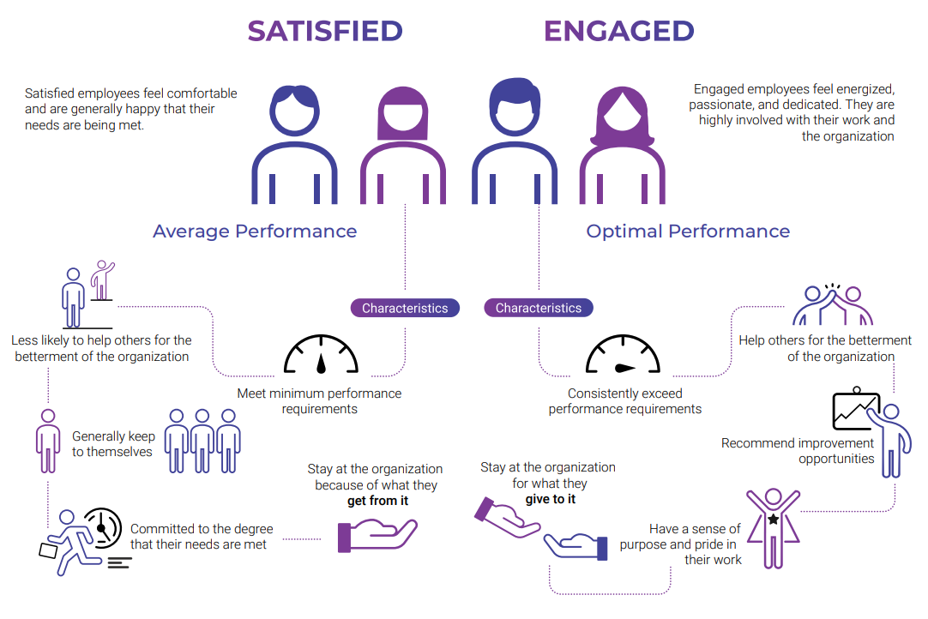
Engaged employee vs. satisfied employee
At McLean & Company we differentiate between engaged employees and satisfied employees.

Slide 4
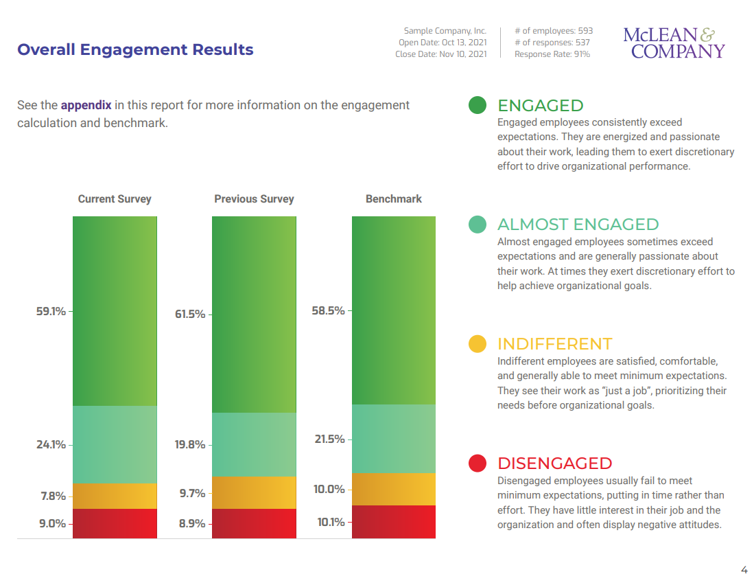
Overall engagement levels
This page outlines employee engagement levels for the overall organization.
In this example:
59.1%
of respondents had an average score of 5.01 to 6 from the 14 engagement measure questions.
24.1%
of respondents had an average score of 4.51 to 5.0 from the 14 engagement measure questions.
7.8%
of respondents had an average score of 4.01 and 4.5 from the 14 engagement measure questions.
9.0%
of respondents had an average score of 4 or less from the 14 engagement measure questions.
Previous Survey refers to the results from the organization’s last survey (if applicable).
The benchmark score is the mean score of all organizations that have taken the McLean & Company Employee Engagement Survey. It is not specific to any size, industry, or geography. It is useful as a point of comparison.

Slide 5
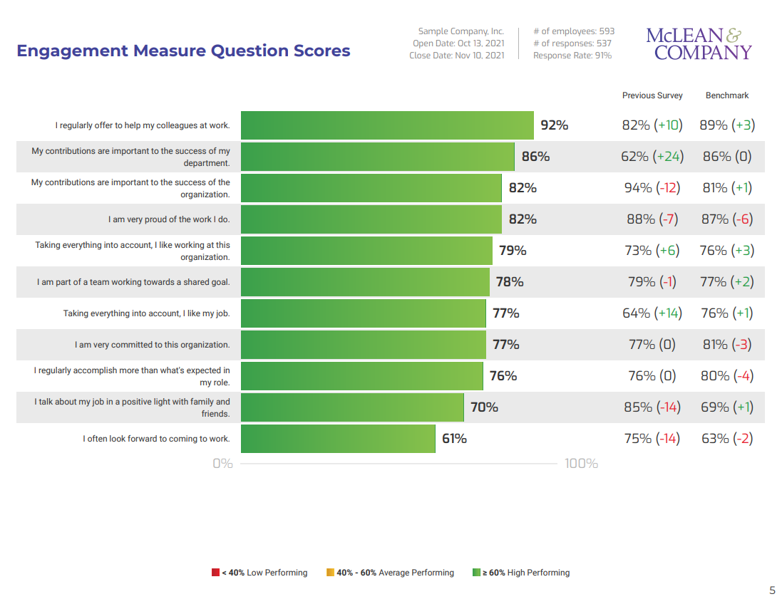
Engagement measure questions
The 11 engagement measure questions determine the overall engagement results. They assess the satisfaction, feelings of energy and purpose, and demonstrated engagement employees have for their role and organization.
For each engagement measure question employees are asked to indicate the extent to which they agree or disagree to each statement by choosing a number from 1 to 6 on a six-point scale (Figure Below). A 1 indicates they strongly disagree to the statement, while a 6 indicates they strongly agree to the statement.
1= Strongly Disagree
6= Strongly Agree
1 2 3 4 5 6
Bottom Box
Top Box
Scores are displayed as a top-box score, which is the % of employees who answered “Agree or Strongly Agree” (5 or 6 on the six-point scale). Employees that have responded “N/A – Not Applicable” are not included in the top-box score calculation.

Slide 6
Question trending, benchmarks, and performance levels
In this example:
The statement “I am very proud of the work I do” scored 82%, meaning 82% of respondents answered “Agree” or “Strongly Agree” to this statement.
Previous Survey score of 88% means that last year, 88% of respondents answered “Agree” or “Strongly Agree.” There is a -7 percentage point difference between the Previous Survey and the current survey.
Benchmark 87% (-6) means that the current survey’s result of 82% is 6 percentage points lower than the benchmark score.
Every statement in the report is color coded based on its top-box score.
Statements are considered low performing if less than 40% of respondents rated it Agree or Strongly Agree.
Statements are considered average performing if between 40% and 60% of respondents rated it Agree or Strongly Agree.
Statements are considered high performing if more than 60% of respondents rated it Agree or Strongly Agree.

Slide 7
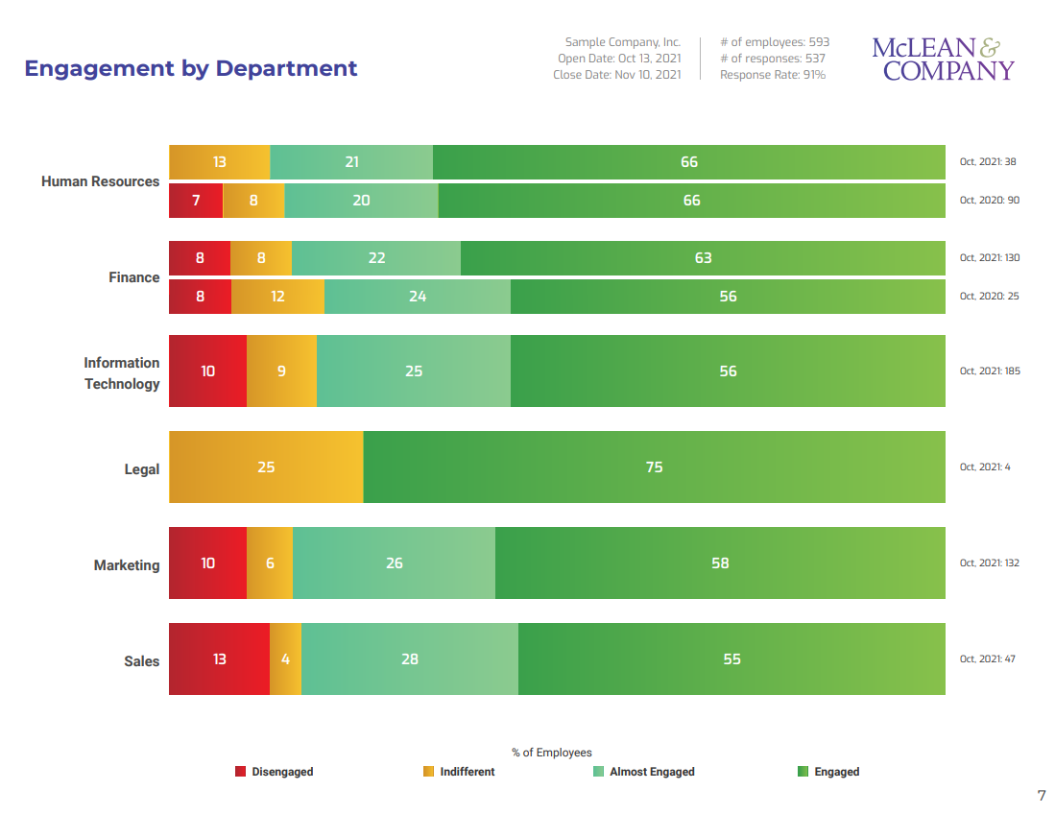
Engagement levels by department
This page illustrates the highest and lowest scoring departments, ordered specifically by the % of engagement.
The percentage of respondents are color coded based on their levels of engagement.
Engaged
Almost Engaged
Indifferent
Disengaged
Pay attention to the relative size of each department when making comparisons.
Refrain from directly comparing engagement levels of departments with significantly different employee counts.

Slide 8
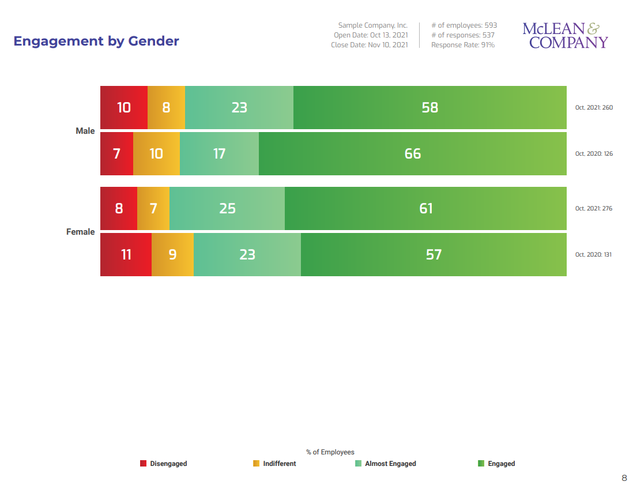
Engagement levels by demographic category
This section of the report illustrates engagement levels by demographics.
The percentage of respondents are color coded based on their levels of engagement.
Engaged
Almost Engaged
Indifferent
Disengaged
Pay attention to the employee count and relative size of each category when making comparisons.

Slide 9
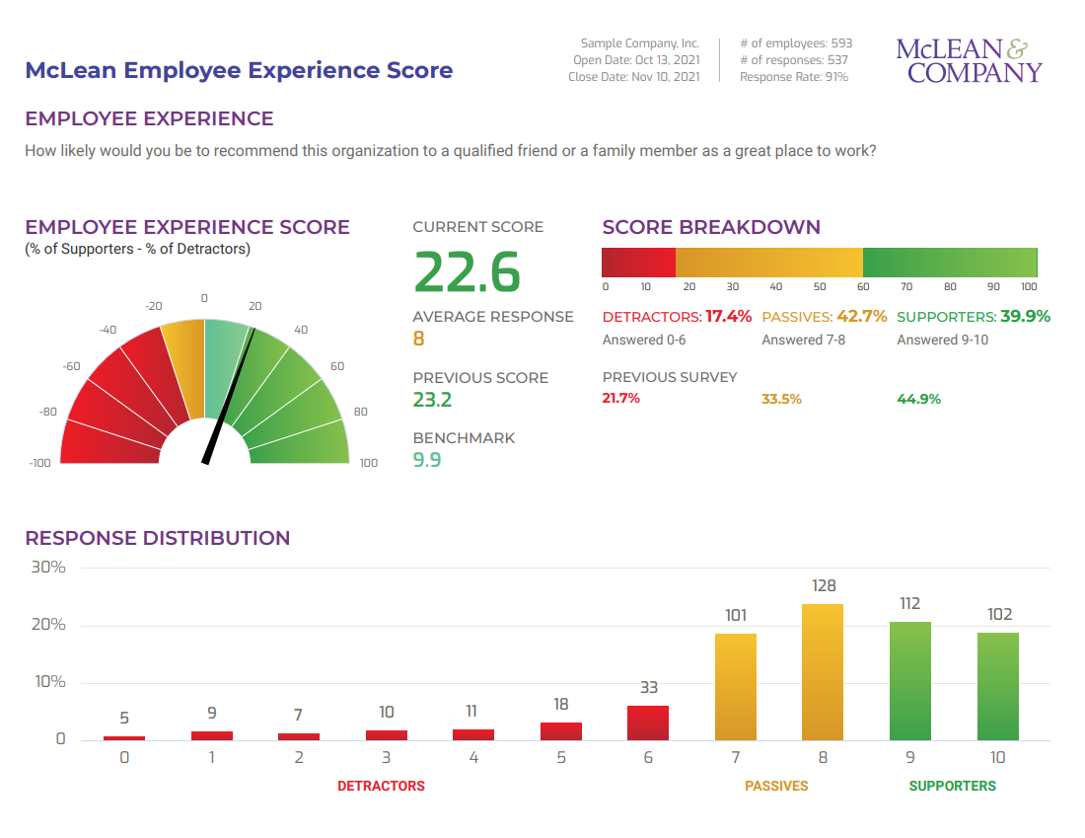
Measuring engagement with the Employee Experience Monitor
The Employee Experience Monitor (EXM) is a single question that delivers powerful feedback correlated to employee engagement.
Respondents are asked the following question:
How likely would you be to recommend this organization to a qualified friend or family member as a great place to work?
They respond on a 11-point scale from 0 to 10:
0 = Not Likely 10 = Very Likely
They are placed in one of these three categories based on their response:
Detractor | Passive | Supporter
0-6 | 7-8 | 9-10
The EXM score can range from -100 to +100.
A positive score indicates there are more Supporters than Detractors.
A negative score indicates there are more Detractors than Supporters.
Passives are considered “Neutral” and are not included in the calculation.
The EXM Score is calculated using the formula:
% of Supporters - % of Detractors

Slide 10
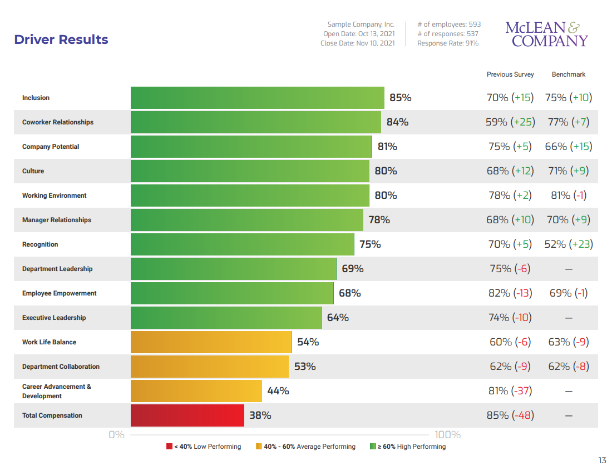
Engagement drivers ranked by their average score
Organizational, job, and retention drivers are displayed on this page. Organizational and job drivers influence an employee’s level of engagement, while retention drivers influence an employee’s intent to stay within an organization. Refer to McLean & Company’s Model of Engagement on slide 2 for more details.
Driver scores are displayed…
As the average score (top box) for all the statements within the particular driver.
By color to indicate the driver’s performance level.
With comparisons to the previous year (if applicable) and the McLean Benchmark.
In the order of the highest to lowest scoring driver.

Slide 11
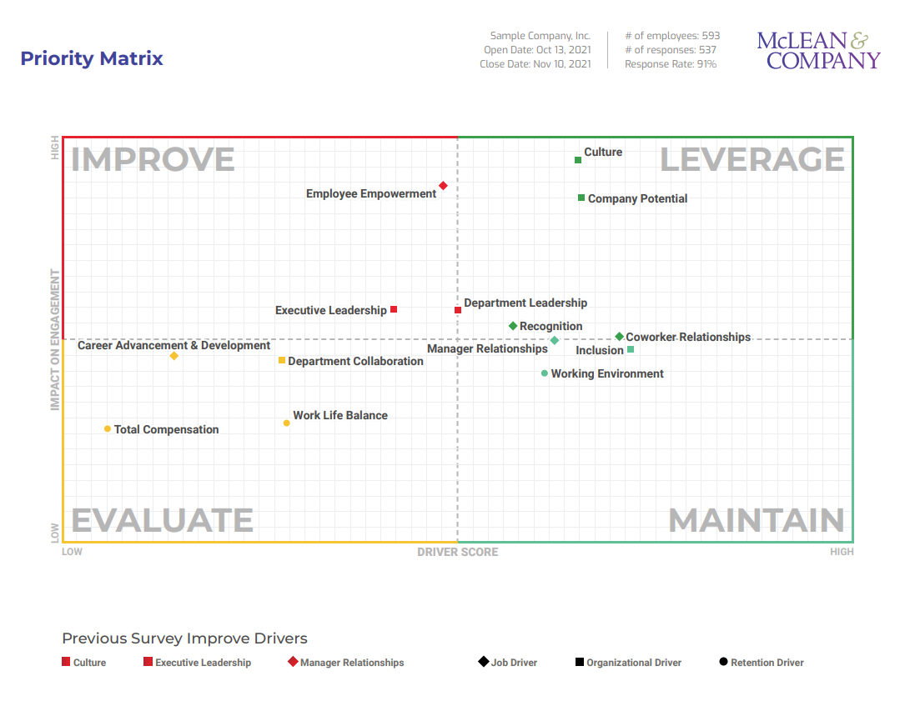
Selecting priority drivers for action planning
The purpose of the Priority Matrix is to help identify the three drivers that – if improved – will have the biggest impact on engagement in your organization. The prioritization grid is created by plotting the top-box scores for each driver on the horizontal axis and the impact of each driver on engagement on the vertical axis.
Priority Matrix Quadrant Definitions
Improve – Drivers in this quadrant have relatively lower top-box scores, but relatively higher impacts on engagement. Improvement in these drivers will likely have a bigger impact on engagement than improvement in the other drivers.
Evaluate – While these drivers have lower top-box scores, they have relatively less of an impact on engagement. You will want to evaluate whether or not they should be a focus of action planning based on other factors within the organization.
Maintain – These drivers have relatively high top-box scores, but lower impacts on engagement. They will likely not be a focus for action planning. Your goal with these drivers is to maintain their scores.
Leverage – These are high-scoring drivers that have a relatively high impact on engagement. They are your strengths. Try to leverage these strengths to make changes in other drivers.
When selecting priority drivers, take into account your current organizational context, what you’ve done in the past, your current strategic priorities, and other relevant factors.

Slide 12
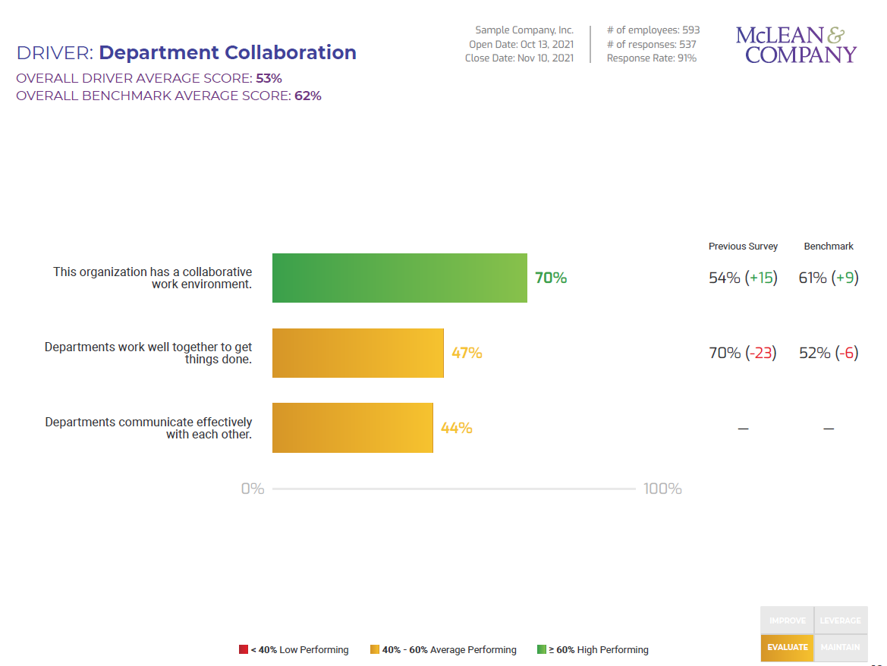
Driver scores in detail
The next section of the report goes into detail in each of the drivers. Department Relationships is shown as the example below.
Statement scores are displayed…
As a top-box score – the % of respondents who answered “Agree” or “Strongly Agree” to the statement.
By color to indicate performance level.
With comparisons to the previous survey (if applicable) and the McLean Benchmark.
In order of the highest to lowest scoring statement.
The box in the right-hand corner indicates where the driver fell in the Priority Matrix. In this example Department Collaboration was in the Evaluate Quadrant.

Slide 13
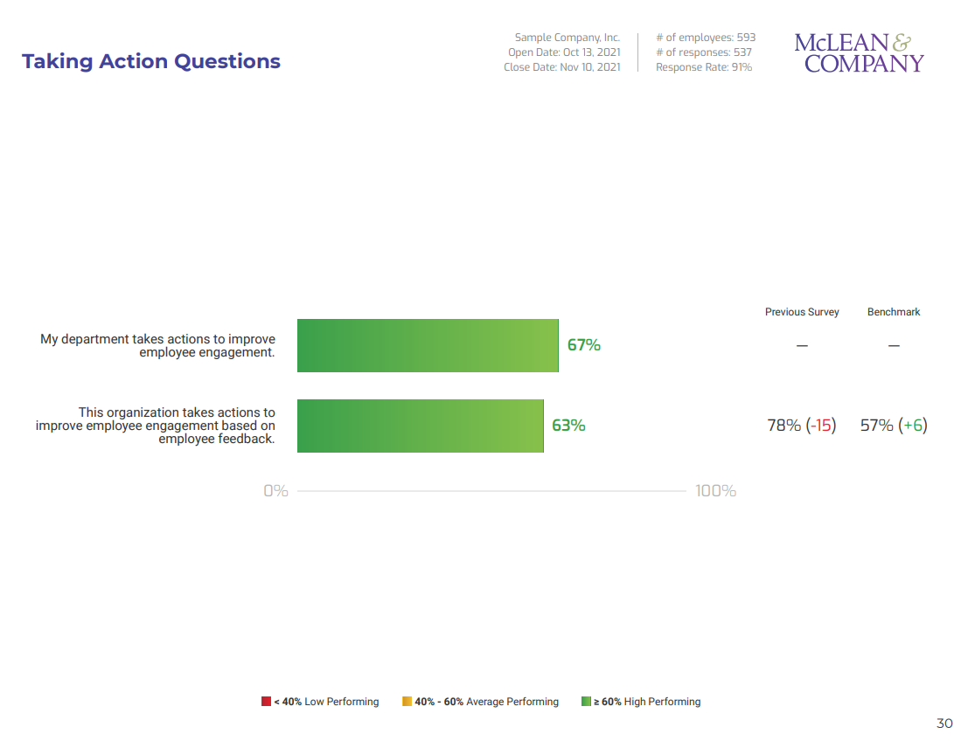
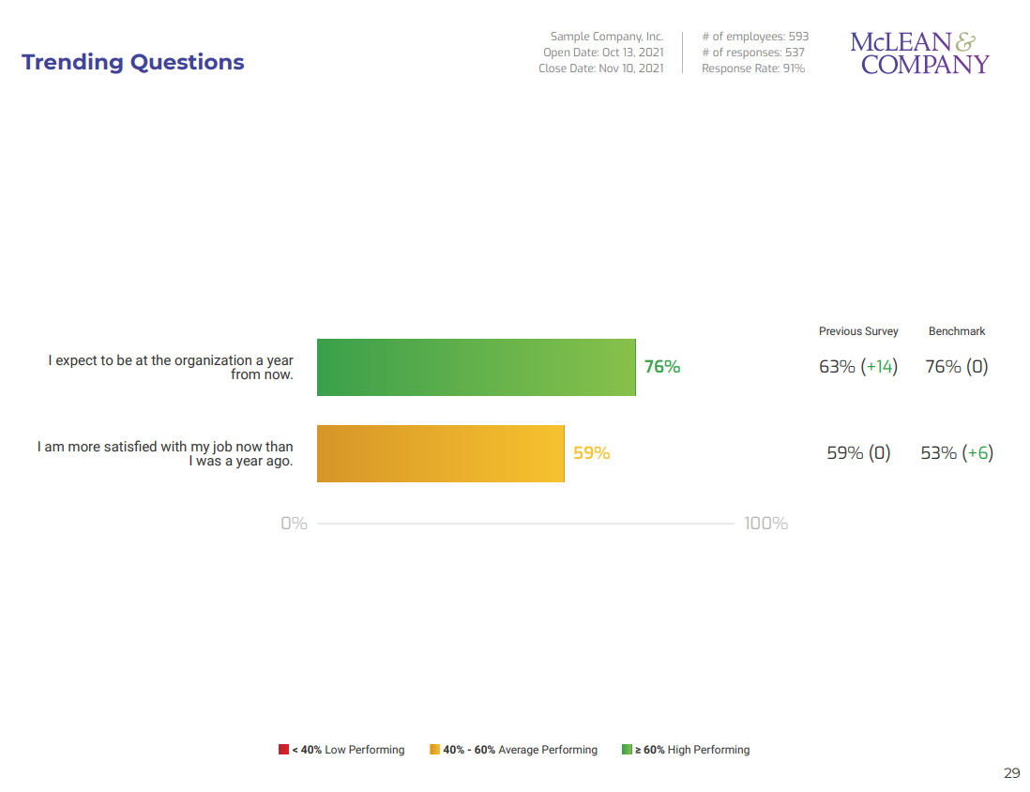
Organization-wide trending questions
These scores provide a snapshot of general employee satisfaction and can be used as an indicator of retention and to help determine the success of employee engagement strategies since the previous survey.
Statement scores are displayed…
As a top-box score – the % of respondents who answered “Agree” or “Strongly Agree” to the statement.
By color to indicate performance level.
With comparisons to the previous year (if applicable) and the McLean Benchmark.

