Slide 1
I’m thinking about retirement now what?
Your Complete Guide to Retirement from UTHSC
Presented by UTHSC Benefits Office

Slide 2
Topics of discussion
Selecting a retirement date-things to consider
Money matters!
Retiree Benefits
Working after retirement
UTHSC Retirement Perks
When to Begin the Retirement Process

Slide 3

Selecting your Date
What should you consider?

Slide 4
Things to consider before selecting a date
  All employees should consider the following when selecting their retirement date:
      Longevity
      Leave Balances
      Health & other Insurance continuation for you and your dependent
      Understand your years of service. Years of service may not equal your years in the retirement plan
  In addition employees in the TCRS plan should also consider the following:
      The difference in early/full retirement
      Qualification for the annual cost of living adjustment

Slide 5
Things to consider before selecting a date
  Early Retirement: TCRS (Legacy)
          Any age with 25 years of creditable service
          Age 55 with at least 10 years of service
          Early Retirees will have a permanent .04% reduction.
  Full Retirement
          Any age with 30 years of creditable service
          Age 60 with at least 5 years of service
  Cost of Living Adjustments
          Employee’s must retire by June 30th of any given year in order to qualify for any cost of living adjustment (1-3%) that may be given in July of the following year.
  Early Retirement: ORP (Legacy)
        Early Retirement: Prior to age 59 ½
        Early withdrawal penalties: generally 10%
        Cost of living increase is based on market performance

Slide 6
Things to consider: Longevity
  Longevity- You must be in active pay status the day before the last day of the month directly prior to the month of your longevity eligibility in order to receive the payment. If you are NOT in active pay status on this date you forfeit your entire longevity payment.
    Example: You were hired June 17th. Your longevity date is June 1st. You must be in active pay status as of May 30th in order to qualify for your longevity in July.
  Faculty retiring June 30 will receive longevity pay if their longevity anniversary month is July, August or September (October for part-time faculty).

Slide 7
Things to consider: leave accruals
  Annual Leave
    Retirees will be paid for unused annual leave not to exceed the maximum allowable accumulation. The maximum amount for any retiree is 336 hours. Any amount in excess of the 336 will be rolled into your sick leave balance.
    If December retiree; can request A/L payout in January to avoid additional tax penalties
  Sick Leave
    Is creditable for retirement service for TCRS members.
    ORP members sick leave is only applicable toward total years of service for retiree insurance eligibility and may lower insurance premium.
  Personal day
    Non-exempt retirees should take personal day prior retirement.

Slide 8

Money Matters
Understanding your income in retirement

Slide 9

Money Matters- ORP
Optional Retirement Program (ORP)
ORP is a market driven defined contribution plan. The amount of your income at retirement is based on the value of your account and your age.
Employee’s in the ORP plan will work with their individual provider to begin distribution of their funds.
TIAA, VOYA, VALIC will provide payout options to the member at the time of retirement. Options may include:
  Interest only-Fixed options only
  Monthly benefits
  Quarterly or yearly benefits
Employees in the ORP are not required to begin drawing a benefit until age 701/2. But may do so at anytime after separation from employment.

Slide 10
Money Matters-ORP
Who to Contact?
What happens next?
Will receive counseling on payout options
Will complete paperwork to start annuity payouts
Process takes approximately 30 days.
Deposits are based on payout selection
May use checking or savings account
TIAA: 800-842-2252
  Local Rep: Brian Nanney
VALIC: 800-448-2542
  Local Rep: Scot Brothers
VOYA(ING): 800-525-4225
  Local Rep: Calvin Reid

Slide 11
Money Matters- TCRS
Tennessee Consolidated Retirement System (TCRS)
TCRS is a defined benefit plan. Employees will receive a monthly benefit after retirement for the remainder of their life.
  TCRS provides the following payment plan selections
    Regular Maximum
    Social Security Leveling (if under age 62)
    Survivor Options I-IV
  Go to: mytcrs.tn.gov and register to view your statements and estimates

Slide 12
Money Matters- TCRS
TCRS Retirement Options
UT Retiree has 29 years of service and beneficiary is 60 years old
  Regular Maximum-monthly benefit payable to you for a lifetime. Beneficiary receives last monthly benefits at retirees death.
  Option I-monthly benefit to beneficiary the same as your benefit, should they pre-decease you, your benefit remains the same.
  Option II- monthly benefit to beneficiary equal to 50% of your benefit, should they pre-decease you, your benefit remains the same.
  Option III-monthly benefit to beneficiary the same as your benefit, should they pre-decease you, your benefit reverts to the regular maximum.
  Option IV- monthly benefit to beneficiary equal to 50% of your benefit, should they pre-decease you, your benefit reverts to the regular maximum

Slide 13
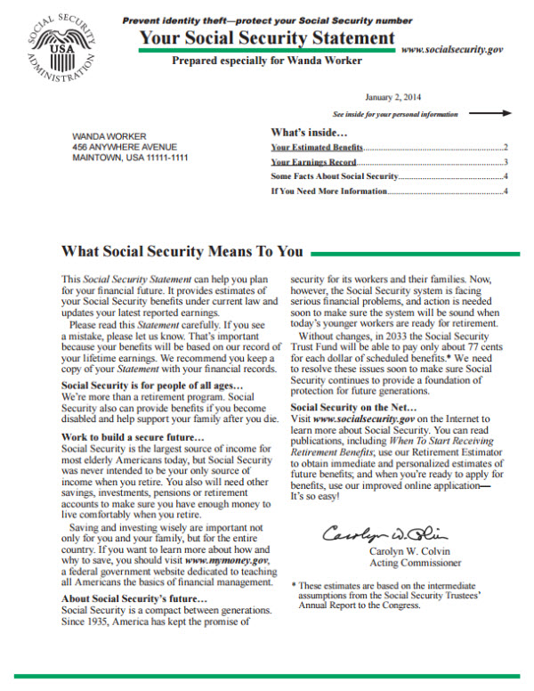
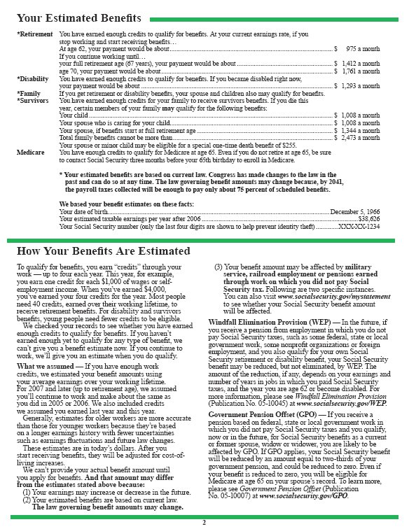
Money Matters-TCRS
TCRS: Social Security Leveling
Social Security Leveling
  An increased in TCRS benefit until you reach age 62.
  At age 62 the TCRS benefit will reduce, and you will be eligible to begin receiving your Social Security benefit.
  Must provide the most recent Social Security Statement.

Slide 14

Money Matters-TCRS
TCRS Beneficiary Selection at Retirement
Regular Maximum
Beneficiary can only be changed if the option is selected.
    Beneficiary is eligible for one TCRS payment in the event of your death.
Options I-IV New! Multiples Beneficiaries
  Beneficiary can be changed due to death or divorce.
    Allowed 60 days after TCRS Notice of Retirement has been received to change beneficiary.
    If changed due to divorce a copy of the final divorce decree is required.
    Benefits will not be recalculated
    Beneficiary will not be entitled to a lifetime benefit.
Social Security Leveling
    All benefits cease at death

Slide 15

Money Matters-TCRS
TCRS benefits are paid on the last working day of the calendar month.
  You will be given the option to provide checking or savings account information for direct deposit of your benefit.
  TCRS will issue debit card if no account is available
  Your benefit is subject to Federal income tax.
  Please consult your tax preparer or financial advisor for advice regarding taxes.

Slide 16
Additional retirement savings
Contributory Plans
Employees making contributions to any of the following contributory plans will be provided with the contact information for their provider. Employees must work directly with the provider to begin any form of distribution or rollover of the funds in these plans. Please be aware that there are tax implications involved based on the employees age at retirement.
    401k
    401k Roth
    457
    403b

Slide 17

Social Security Benefits
Employees interested in drawing their social security benefits should contact Social Security directly or go online to www.ssa.gov
Application for Social Security can be processed online or at the local social security office.
Social Security recommends that you make an appointment if you wish to visit the local office.
Contact information is found at the end of this presentation.

Slide 18

Retiree Medical Benefits

Slide 19
When does coverage end?
  Health and Dental insurance are paid for a month in advance. Coverage will continue through the end of the month following retirement.
      This coverage must be payroll deducted. Employee’s working partial months must consider if their hours worked will yield compensation that will cover their health premium.
      Example 1-Date of Retirement is June 30th then group coverage ends July 31st.
      Example 2-Date of Retirement- June 4th -if compensation is not enough to take the health premium then group coverage will end June 30th. If compensation is enough to take the health premium then group coverage will end July 31st.

Slide 20

Continuation of
Group Health Insurance
Health Insurance
  The requirements to retain your group insurance for yourself and/or your dependents are:
      be under age 65
      Must have at least10 years of creditable service and three years of continuous insurance coverage immediately prior to retirement.
      20 or more years of creditable service with at least one year of continuous insurance coverage immediately prior to retirement.
      Retiree insurance not available if hired for the first time on or after July1, 2015.

Slide 21
Continuing Group Health Insurance
Retiree and dependents under age 65
Retiree’s must continue in the current health plan
Dependents must be covered on plan prior to retirement and must continue to meet eligibility requirements:
  Spouse-age 65 and under
  Dependent children until age 26
After retirement employee’s contact The Benefit’s Administration for changes and admin/coverage issues
Retiree’s are subject to state rules for insurance changes
If retiree does not elect coverage at retirement. There is a five year window for enrollment (subject to health questions).
Rates are based on creditable service.
  Less than 20 years-retiree pays 40% of total premium
  20-29 years-retiree pays 30% of total premium
  30 or more years-retiree pays 20% of premium

Slide 22

Insurance for Retirees and Dependents over age 65
You will need to sign up for Medicare
    Part A-Hospital coverage: (Free)
    Part B- Medical coverage: $135.50/month up to $460.50 based on income.
    Part D- Prescription coverage: cost vary based on plan and income.
    For coverage information download the Medicare & You Handbook from the Medicare website or visit: www.medicare.gov
    UT offers a supplement to Medicare through the Tennessee Plan -POMCO Group. The premium ranges from $88.47-$138.47 depending on creditable service at retirement.
    Both employee and spouse must be age 65 at the time of retirement for spouse to qualify for the State supplement
      Spouse will enroll in other supplemental plan until employee reaches age 65
      Spouse premium is $138.47
      *Retirees 65 and over cannot continue HSA account

Slide 23
Continuing Dental Coverage all retirees
Dental Insurance
  Employee’s participating in the Dental coverage may continue the coverage.
  Premiums are not based on your years of service and are very close to the current premiums for active employees.
  Retirees are still able to use the dental school for services
  Only Metlife is accepted at UT Dental School

Slide 24

Continuing Vision Coverage
Vision Insurance
  Retirees or dependents under the age of 65 who are enrolled in the group insurance are eligible to continue vision coverage.
    Retirees over 65 may elect the COBRA vision after retirement.
  Premiums will not change (excludes COBRA)
  Retirees who do not currently carry vision may elect vision at the time of retirement if continuing group medical insurance.

Slide 25

Retiree Insurance premiums
TCRS members
Premium payments for medical, dental, and vision will be deducted from your TCRS monthly benefit prior to deposit. Life insurance must be paid directly to vendor.
ORP members
Must set up automatic bank drafts for insurance premium payments or use direct billing via the Benefits Administration.

Slide 26
Continuing Optional Coverage(s)
Flexible Spending
  Employee’s must incur the expenses on or prior to the date of retirement.
    You will have 90 days to submit documentation for reimbursement-if no card has been used.
    Medical Expense debit card is disabled after retirement.
    Any unused funds will be forfeited.

Slide 27
Continuing Optional Coverage(s)
Basic Term Life Insurance
    Your coverage ends on the last day of the month following your separation of employment.
    You will be entitled to enroll in an individual policy of life insurance offered by Minnesota Life.
      Can port a portion of the insurance
      No evidence of insurability will be required.
      The basic term life insurance will be changed to a universal policy
      The premium will be affected by the amount of the policy and your age.
      Payment of premium will be made directly to Minnesota Life.

Slide 28
Continuing Optional Coverage(s)
Optional Life Coverage(s)
    Your coverage(s) end on the last day of the month in which you separate employment.
    When you retire you may have the option to continue your life insurance coverage by paying your premiums directly to Unum or Minnesota Life. Either company will contact you at your last known address to let you know what options you may have to continue coverage.

Slide 29

Can I work after I retire?
YES!

Slide 30
Returning to work Post Retirement
State of Tennessee Covered Employer
Restrictions
60 day waiting period( may be waived under certain circumstances)
No more than 960 hours (120 days) in a rolling 12 month period
Salary limitations of the Final Year’s Salary
  Year 1-63.00%
  Year 2-66.15%
  Year 3-69.46%
  Year 4-72.93%
  Year 5-76.58%
  Year 6-80.41%
Employees in both TCRS and ORP may work for a State of Tennessee covered Employer by completing a Temporary Employment Report; Post Retirement Contract (faculty only) annually. Must observe restrictions regarding hours worked, and income.

Slide 31
Returning to work Post Retirement
Non State of Tennessee Employer
Employees in both TCRS and the ORP may work for a non-State of Tennessee employer with no restrictions. If you are drawing your Social Security benefit you should speak with their office to determine if there are hour or income restrictions.

Slide 32




UTHSC Retiree Perks

Slide 33
UT Retiree Perks
Retiree’s are eligible for the following benefits
Additional details provided at the time of retirement consultation.
  Education Assistance for retiree’s and their dependents**
    Retiree- lifetime
    Dependents- 5 years after retirement or for dependent children age 27
  Email**
  Use of UT Health Services- for retirees under age 65 who continued the State group insurance plan.
  Use of the Fitness Center*
  State Park discount*
  Employee Appreciation
  Join the Retiree Association
    *With retiree ID badge
    **With 10 years of creditable service

Slide 34

What now?

Slide 35
Beginning the Process
It is advisable to begin your retirement process 12 months prior to your expected retirement date.
  Begin to prepare by lowering debt
  Make large purchases while you are still employed (car, appliances, home renovations).
  Consider impact on income and taxes
  Decide what you would like to do after retirement (volunteer, part-time work, second career)
  Do you have hobbies or leisure activities?
  Review wills, trusts, and insurance needs

Slide 36

Schedule a personal appointment
It is best to set up a personal appointment for retirement counseling 3 for TCRS and 2-3 months for ORP prior to your retirement date. By setting up an appointment we can gather all relevant information regarding your retirement and answer all of your questions. To set up an appointment please call
901-448-8547 or
email: djacks24@uthsc.edu.

Slide 37

If you plan Ahead….
This could be YOU!!

Slide 38

Questions?

Slide 39
Providers
TCRS and Empower
ORP
  TCRS website
  http://www.treasury.state.tn.us/tcrs/index.html
  Forms
  You may contact TCRS/Empower directly
  1-800-770-8277
  https://retirereadytn.gwrs.com/login.do
TIAA-CREF
Brian Nanney
901-801-6206
Email: brian.nanney@tiaa.org
VALIC
Scot Brothers
901-755-9277
Email: barry.scot.brothers@valic.com
VOYA/ING
Calvin Reid
901-496-2741
Email: calvin.reid@voyafa.com
403b providers
  A complete list can be found on the Benefit website at: http://www.uthsc.edu/hr/benefits/retirement_plan/tax-deferred-annuities.php

Slide 40
Other important contacts
Social Security Administration
  https://www.ssa.gov/
  National Telephone # 1-800-772-1213
  SOCIAL SECURITY
  1330 Monroe
  MEMPHIS, TN 38104
  Local Telephone#:1-866-336-2212
Medicare
  http://www.medicare.gov/
  Medicare and You Handbook is available to download in PDF format at http://www.medicare.gov/Publications/Pubs/pdf/10050.pdf

