Slide 1
THE FINANCIAL AID JOURNEY

Slide 2
FAFSA
Free Application for Federal Student
Completed for each school year

Slide 3
STEPS TO TAKE
FAFSA
VERIFICATION
CORRECTIONS
MASTER PROMISSORY NOTE
ENTRANCE COUNSELING
ACCEPT AWARD
TUITION/FEES PAID
REFUND DISBURSED

Slide 4
VERIFICATION- additional documents are required
CORRECTIONS- student will correct information on application and re-submit to FAFSA
AWARD NOTICE SENT- student will receive an email notice sent to the UTHSC email account

Slide 5
MASTER PROMISSORY NOTE-legal document all student loan borrowers must complete promising to repay loan
ENTRANCE COUNSELING- loan information session explaining rights &responsibilities
TUITION/FEES PAID- the date financial aid is applied to student’s account
REFUND DISBURSED- the date excess aid is processed

Slide 6
FINANCIAL AID AWARDS
Loans
Scholarships
Grants
Cost of Attendance Budgets
Forms
College Work-Study

Slide 7
Types of Loans
Unsubsidized Direct Loan
Perkins Loan
Graduate Plus Loan
Private/Alternative Loan

Slide 8
LOAN AMOUNTS
UNSUBSIDIZED STAFFORD
$44,944
PERKINS
$4,000
GRADUATE PLUS
Cost of Attendance Minus Other Aid

Slide 9
2014-15
Out-of-State Cost of Attendance
Estimate
Tuition $66,070
Fees $ 17,713
Books and Supplies $ 1,746
Living Expenses $21,318
Total $106,847

Slide 10
Out-of-State Packaging Example
COA = $106,847
$44,944 Direct Unsubsidized Loan
$57,903 Graduate Plus
$ 4,000 Perkins Loan
$106,847

Slide 11
2014-15
In-State Cost of Attendance
Estimate
Tuition $ 27,900
Fees $ 17,713
Books and Supplies $ 1,746
Living Expenses $21,318
Total $68,677

Slide 12
In-State Packaging Example
COA = $68,677
Direct Unsubsidized $ 44,944
Graduate Plus $19,733
Perkins Loan $ 4,000
Total $68,677

Slide 13
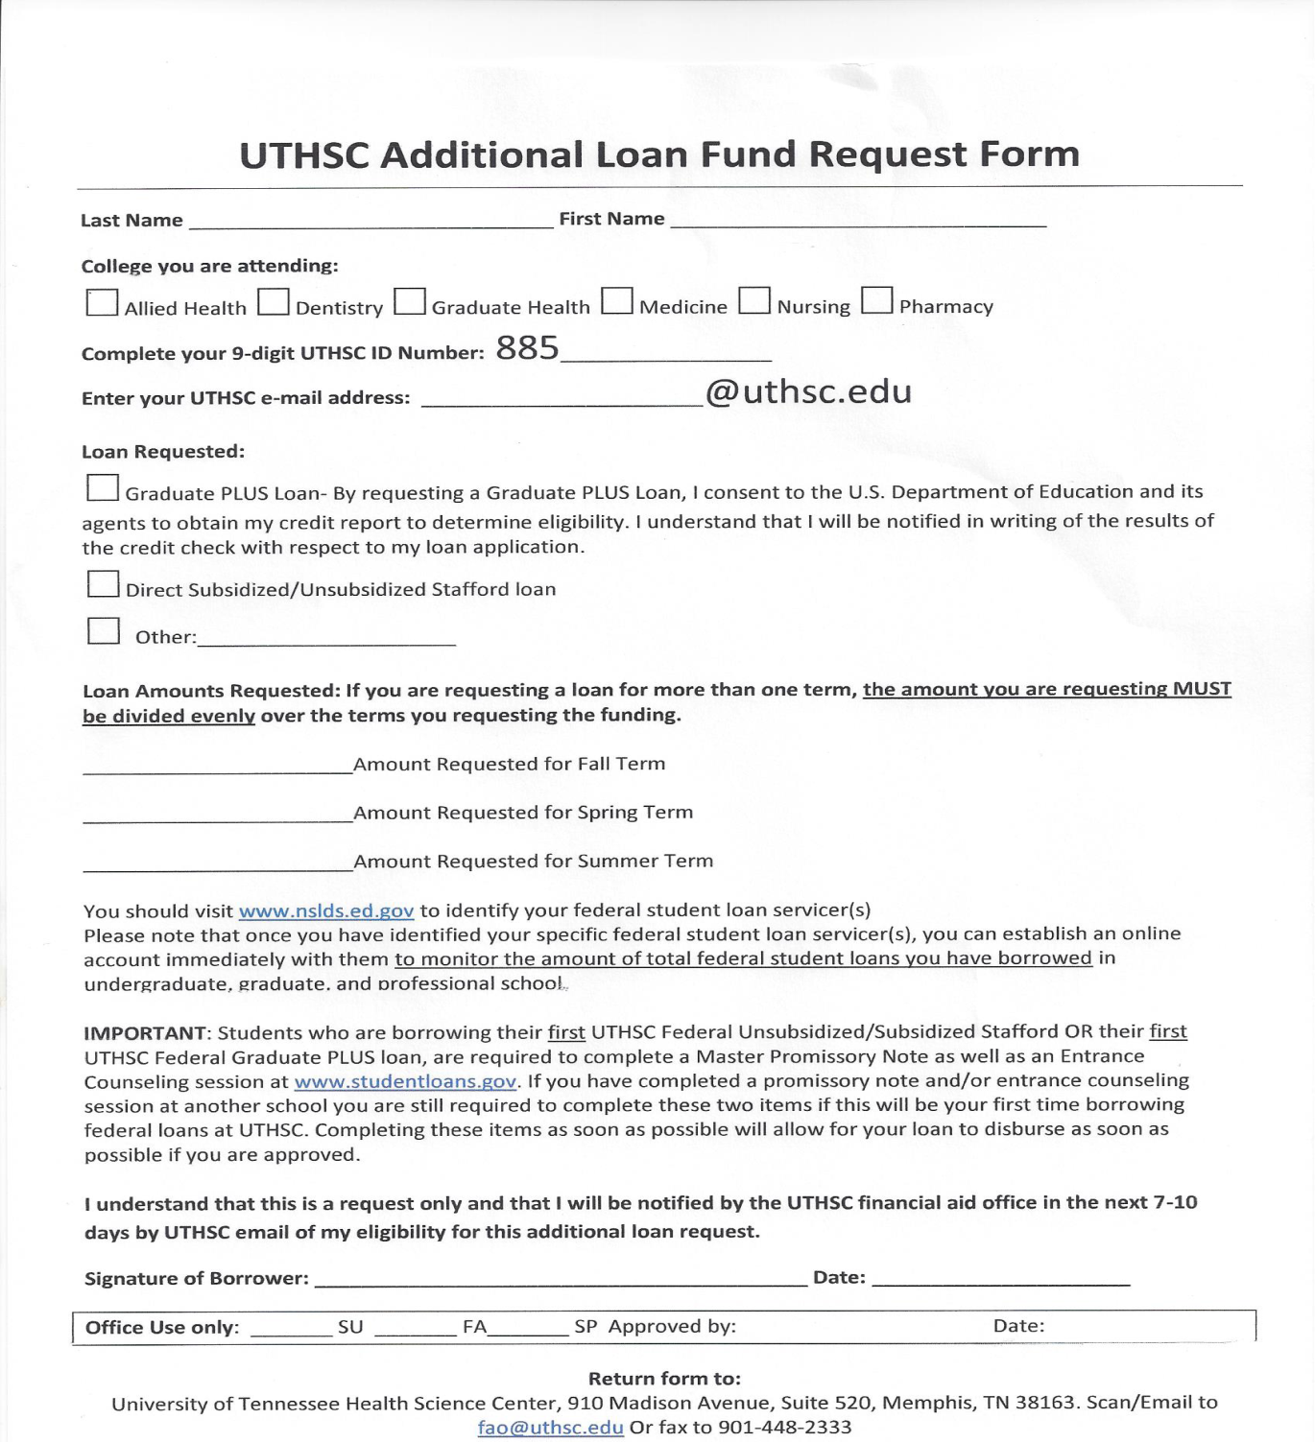
Additional
Funds Request

Slide 14
One on One Counseling
A scheduled counseling with your financial aid counselor

Slide 15
Applying for Financial Aid
PIN:
www.pin.ed.gov
FAFSA Application:
www.fafsa.ed.gov (School code: 006725)
Loan History:
www.nslds.ed.gov

Slide 16
Contact Information
Gloria Dobbs
Financial Aid Counselor
College Of Health Professions
(901) 448-1472
gdobbs1@uthsc.edu
Skype: glor.dob90

