Slide 1
Financial Aid
College of Pharmacy

Slide 2
Objective
How to apply for Financial Aid
Breakdown of Cost of Attendance
Unsubsidized Loans
Graduate Plus Loan
Mandatory Meeting

Slide 3
Applying for Financial Aid
PIN:
  www.pin.ed.gov
FAFSA Application:
  www.fafsa.ed.gov (School code: 006725)
Loan History:
  www.nslds.ed.gov
AAMC:
  www.aamc.org/stloan

Slide 4
Federal Direct Stafford Loan
1st year Pharmacy students can borrow $34,389
6.21% Interest
  No payments while in school
  Payments begin six months after graduation
Aggregate Limit = $224,000

Slide 5
Federal Direct Graduate PLUS Loan
Can be eligible for the difference between Cost of Attendance and other aid being received.
  Based on credit (co-signer)
  7.2% interest
  No payments while in school
  Payments begin six months after graduation
www.studentloans.gov

Slide 6
2014-2015
In-State (1st Yr)Cost of Attendance
ESTIMATE
Tuition $21,020
Fees $3,350
Books and Supplies $2,960
Living Expenses $19,380
Total $46,710

Slide 7
2014-2015
Out-of-State (1st yr) Cost of Attendance
ESTIMATE
Tuition $40,600
Fees $3,350
Books and Supplies $2,960
Living Expenses $19,380
Total $66,290

Slide 8
In-state packaging example
COA = $46,710
$34,389 Direct Unsubsidized Loan
$12,321 Graduate PLUS Loan
$46,710
*Scholarships will decrease loan amounts

Slide 9
Out-of-state packaging example
COA = $66,290
$34,389 Direct Unsubsidized Loan
$31,901 Graduate PLUS Loan
$66,290
*Scholarships will decrease loan amounts

Slide 10
One-Stop-Shop
Located in 910 Building on the 1st floor (across from the Sun Trust Bank)
Services available:
Financial aid
Bursar Office
Registrar Office
IT (information technology tech. ): 11:00 am – 2:00pm and 4:00 pm – 5:00pm beginning August 2 -20, 2013.

Slide 11
One-On-One
Must have a one-on-one counseling with financial aid counselor.
Skype
Telephone
Office Visit
MANDATORY!!!!!

Slide 12
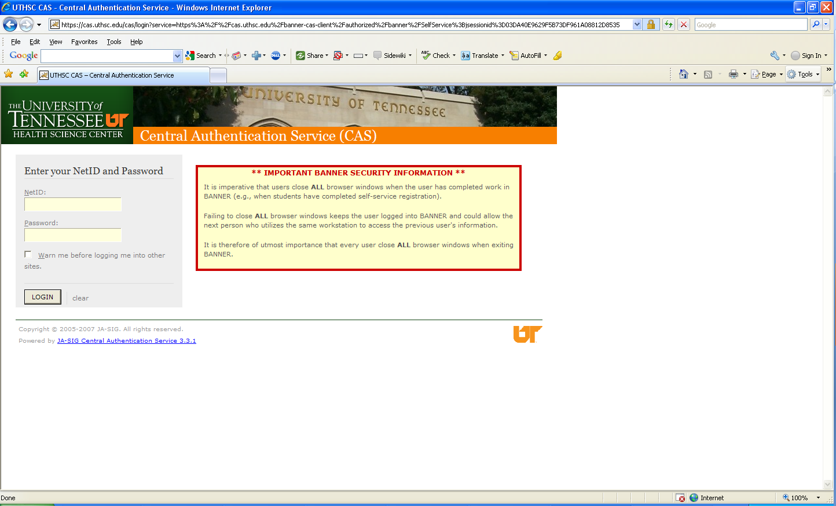
Banner Self-Service

Slide 13
Contact Information
Ms. Jacquelyn LeSueur
Financial Aid Counselor
College of Nursing
(901) 448-8324
jlesueur@uthsc.edu
Skype: jacquelyn.lesueur

Slide 14

Questions
Answers

