Slide 1
Financial Aid
College of NURSING

Slide 2
Applying for Financial Aid
FAFSA Application:
  www.fafsa.gov (UTHSC School code: 006725)
FAFSA Opens - (October 1st)
  Completed for each school year

Slide 3
Steps To Complete
FAFSA
VERIFICATION
CORRECTIONS
MASTER PROMISSORY NOTE
ENTRANCE COUNSELING
ACCEPT AWARD
TUITION/FEES PAID
REFUND DISBURSED

Slide 4
Steps To Complete
VERIFICATION- additional documents are required –verification worksheet, tax transcript
AWARD NOTICE SENT- student will receive an email notice sent to the UTHSC email account

Slide 5
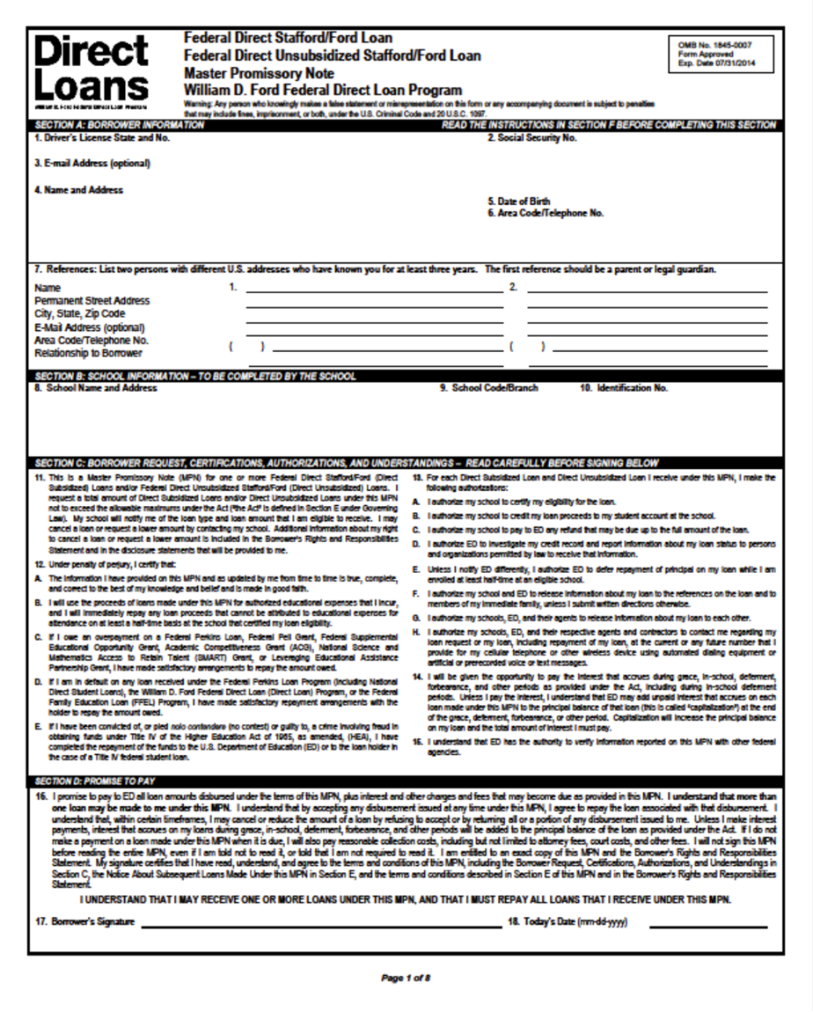
Master Promissory Note
(MPN)
Includes your rights and responsibilities as a borrower and it’s the legal document all student loan borrowers must complete promising to repay the loan.

Slide 6
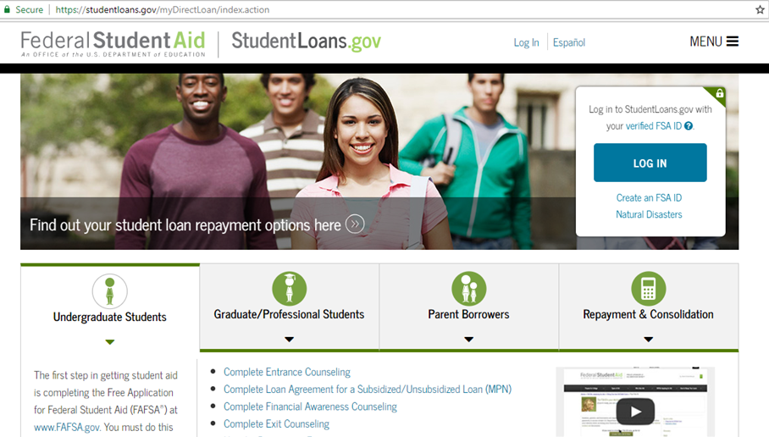
Entrance Counseling
Loan information session explaining rights & responsibilities
Sign in to StudentLoans.gov using your Federal Student Aid PIN
  Select "Entrance Counseling"

Slide 7
Accept Award
To view your awards, follow these 5 steps:
Login to Banner Self-Service
Click on Financial Aid
Next, click on Award
Award for Aid year and select year
Accept the Terms and Conditions
Lastly, you should click on Accept Award Offer
*NOTE: When accepting awards, you are accepting for the entire year and not just for the term.

Slide 8
TUITION/FEES PAID
Financial aid must first pay a student's tuition and fees each term. If excess funds remain after paying these expenses, the student is sent a financial aid refund to help them pay for their books and living expenses.

Slide 9

Refund Disbursement
All refunds are direct deposited to your checking account or mail.
The student should make sure that they are signed up for direct deposit as that ensure the quickest way for the student to receive a financial aid refund.

Slide 10
Banner Self-Service
Direct Deposit Setup
Go to: Banner Self-Service
2. Enter Your Net ID and Password.
3. At the Main Menu, click on Student.
4. On the Student menu, click on Student Account.
5. Click on Account Summary.
6. Next, click on Pay Your Fees.
7. Click on eRefunds and follow instructions to set up account.

Slide 11
FINANCIAL AID AWARDS
Loans
Scholarships
Grants
College Work-Study
Cost of Attendance Budget
Forms

Slide 12

Loan Limits

Slide 13
Types of Loans
Direct Unsubsidized Loan
Direct Graduate Plus Loan
Private/Alternative Loan

Slide 14
LOAN AMOUNTS
UNSUBSIDIZED STAFFORD
$20,500
GRADUATE PLUS
Cost of Attendance Minus Other Aid

Slide 15
Cost of Attendance

Slide 16
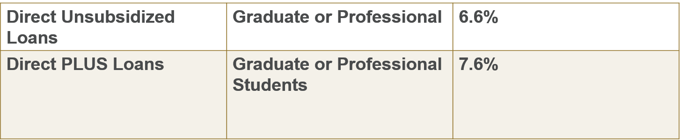
2018-19 Interest rate

Slide 17
2018-19
Out-of-State Cost of Attendance
Estimate
Tuition $39,162
Room &Board $13,896
Books and Supplies $2,915
Transportation $3,024
Miscellaneous $8,330
Total $67,327

Slide 18
Out-of-State Packaging Example
COA = $67,327
Direct Unsubsidized $ 20,500
Graduate Plus $ 46,827
Total $ 67,327
*Scholarships will decrease loan amounts

Slide 19
2018-19
In-State Cost of Attendance
Estimate
Tuition/Fees $17,150
Room & Board $13,896
Books and Supplies $2,915
Transportation $3,024
Miscellaneous $8.330
Total $45,315

Slide 20
In-State Packaging Example
COA = $43,315
Direct Unsubsidized $ 20,500
Graduate Plus $ 22,815
Total $ 43,315
*Scholarships will decrease loan amounts

Slide 21
Federal Direct Graduate PLUS Loan
Eligible for the difference between (COA) Cost of Attendance MINUS other aid received.
  Based on credit history (co-signer)
  7.6% interest
  No payments while in school
  Payments begin six months after graduation
http://www.uthsc.edu/financial-aid/forms/index.php
www.studentloans.gov (Entrance Counseling & MPN)

Slide 22
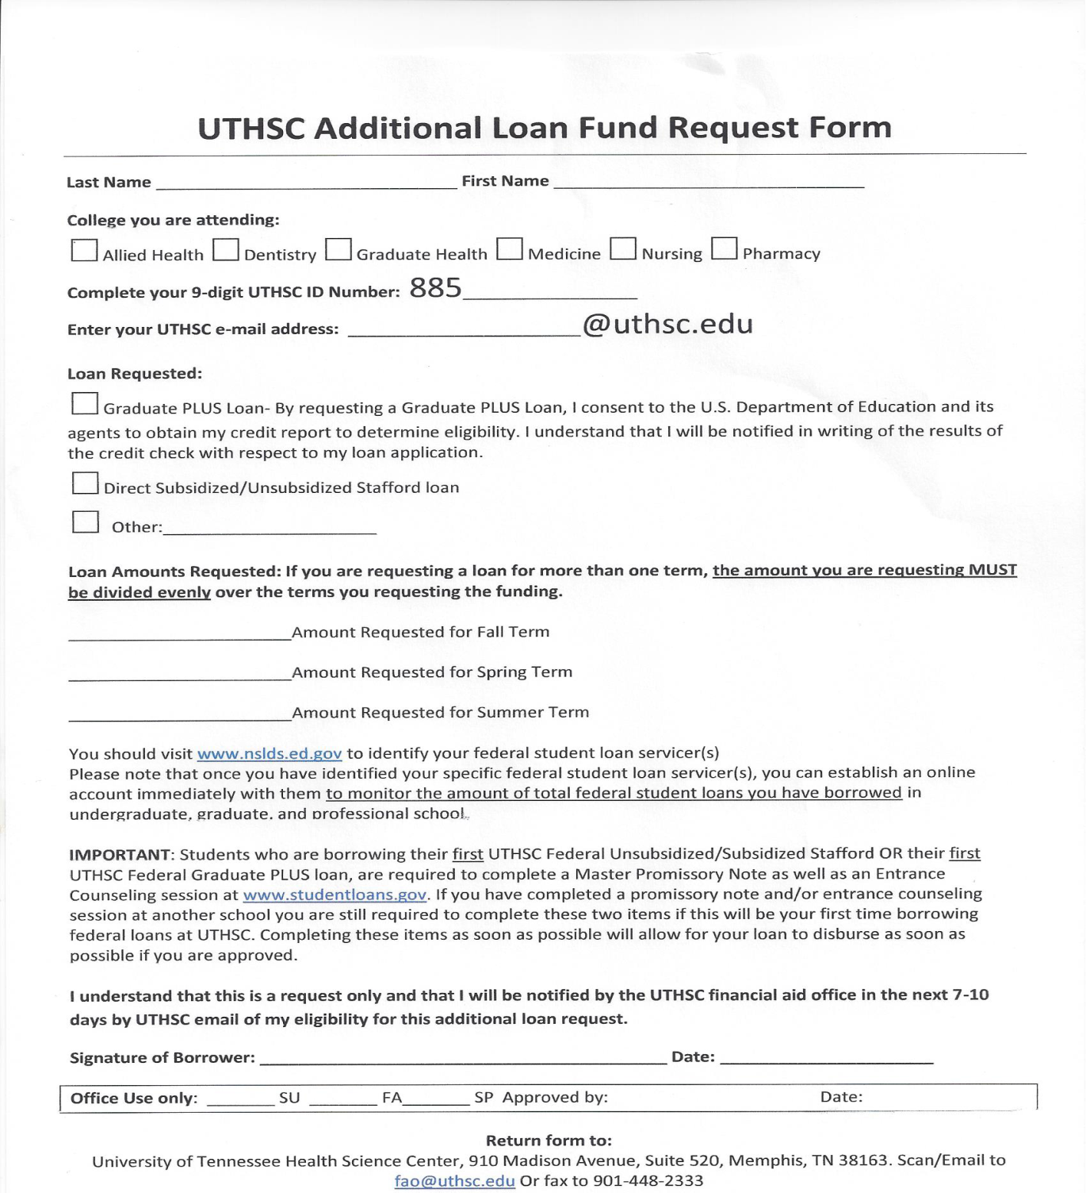
Additional
Funds Request

Slide 23
Other Loan options
Nursing Student Loan http://bhpr.hrsa.gov/dsa/sfag/nursing_programs/bk2prt1.htm
Health Resources and Services Administration (HRSA)
http://bhpr.hrsa.gov/nursing/grants/aent.html

Slide 24
One On One Counseling
ALL incoming students are required to schedule and complete a one-on-one counseling session with their Financial Aid Counselor.
Students must complete counseling – April 2019
Student will not be able to register for Fall 2019 term.
Office Visit
Phone
                MANDATORY!!!

Slide 25
Contact Information
Paulette Moore
Financial Aid Counselor
College Of Nursing
(901) 448-4859
pmoore8@uthsc.edu

Slide 26


Slide 27
Budgeting

Slide 28
Create A Budget
Budgeting is the process of creating a plan to spend your money. This spending plan is called a budget. Creating this spending plan allows you to determine in advance whether you will have enough money to do the things you need to do or would like to do.
http://uthsc.edu/financial-aid/flight/budgeting.php

Slide 29
Personal Budgeting – Get Started!
Establishing a budget and sticking to it
Distinguish between necessities and wants
Pay bills on time so that you can avoid late fees
Control or limit the use of credit cards
By working on your budgeting skills now, you will know exactly what you can afford in the future.

Slide 30
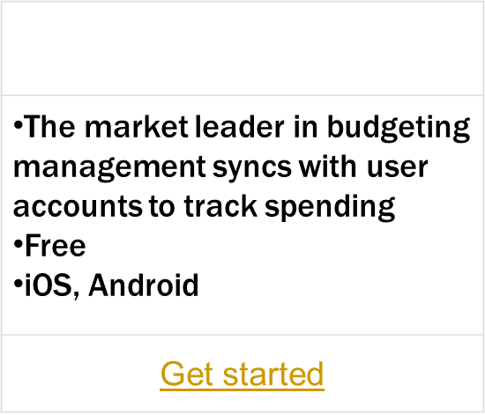


Budgeting Apps
The app automatically updates and categorizes transactions, creating a picture of spending in real time.
PocketGuard gives users a snapshot of how much they can spend at any given moment Free iOS, Android
Get started
It crunches the numbers to show how much money is available after accounting for bills, spending and savings goal contributions. All users can view how much money is left “in their pocket” for the day, week or month.

Slide 31

Why is Budgeting so Important?
Budgeting is simply balancing your expenses with your income. If they don't balance and you spend
more than you make, you will have a problem. Many people don't realize that they spend more
than they earn and slowly sink deeper into debt every year.
Following a budget or spending plan will also keep you out of debt or help you work your way out of debt if you are currently in debt.

Slide 32


Slide 33
Credit Score Range Scale
FICO Score range: 300-850.
VantageScore 3.0 range: 300–850.
Experian's PLUS Score: 330-830.
TransUnion New Account Score 2.0: 300-850.
Equifax Credit Score: 280–850.

Slide 34
What is a FICO Score?
You have a FICO Credit Score from each of the three major credit bureaus: Equifax, Experian, and Transunion. Each of these credit scores is based on different information that each of the credit bureaus has for you. And this available information may very well differ from bureau to bureau.
Because the FICO credit score can only be determined by information found in the individual’s credit file, it is essential to look over your credit reports each year to find any inaccuracies or discrepancies to ensure that everything is accurate and up to date.
The Fair Isaac Corporation is who has come up with FICO credit scores and subsequently, these scores are used by over 90% of lenders when it comes to providing you with a loan. They are also used when they grant the interest rates, monthly payments, and terms of each loan, and whether you are approved or not.

Slide 35
What Is a Good Credit Score?
Most credit scores – including the FICO score and Vantage Score 3.0 – operate within the range of 300 to 850, and a good credit score is typically one that is 700 or above.
Excellent Credit: 750+
Good Credit: 700-749
Fair Credit: 650-699
Poor Credit: 600-649
Bad Credit: below 600

Slide 36
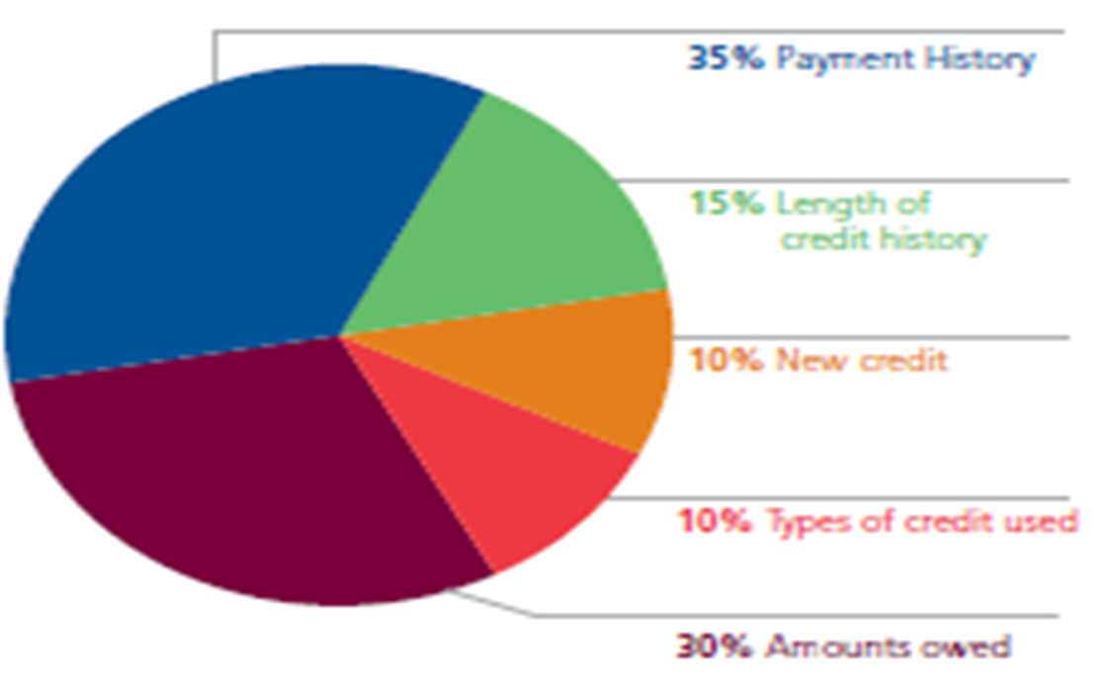
FICO Credit Scores – It Matters

Slide 37
Credit Bureaus
Equifax www.equifax.com
1-800-525-6285
Experian www.experian.com
1-888-397-3742
Transunion www.transunion.com
1-800-680-7289
**Free credit report authorized by the Federal Trade Commission: www.annualcreditreport.com
www.CreditKarma.com

Slide 38


Slide 39
What Do Thieves Do With Your Information?
Once identity thieves have your personal information, they can drain your bank account, run up charges on your credit cards, and open new accounts. An identity thief can file a tax refund in your name and get your refund.
Make sure all personal information is stored in a safe place. And all passwords can only be determined by you.
For more information: Federal Trade Commission –Consumer Information (www.consumer.ftc.gov )

Slide 40
Student Loan History

Slide 41
NSLDS – Loan History
The National Student Loan Data System (NSLDS) is the U.S. Department of Education's (ED's) central database for student aid. NSLDS receives data from schools, guaranty agencies, the Direct Loan program, and other Department of ED programs. NSLDS Student Access provides a centralized, integrated view of Title IV loans and grants so that recipients of Title IV Aid can access and inquire about their Title IV loans and/or grant data.

Slide 42
2018-19 Interest rate
Direct Unsubsidized Loans | Graduate or Professional | 6.6%
Direct PLUS Loans | Graduate or Professional Students | 7.6%
All interest rates shown in the chart above are fixed rates that will not change for the life of the loan.

Slide 43
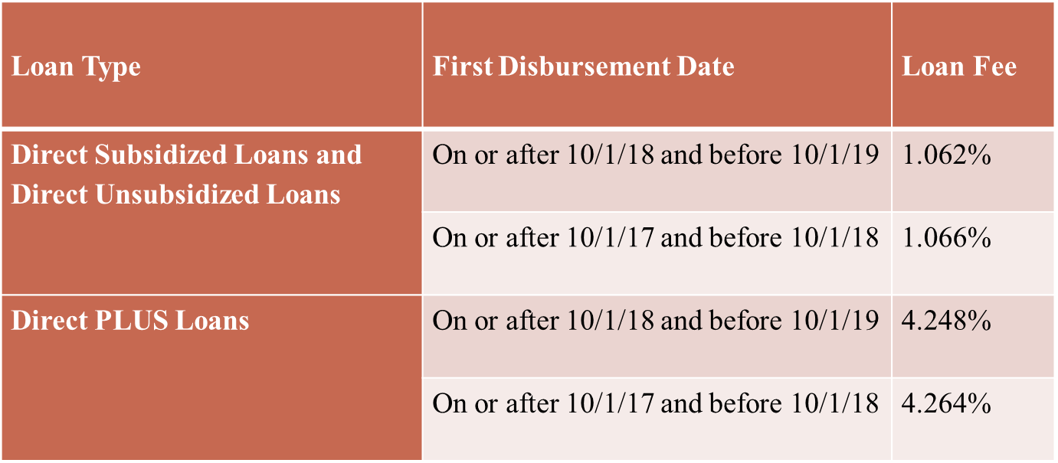
Origination Fee
Origination fee - An amount, usually calculated as a percentage of a loan, which a lender charges for processing your application.

Slide 44
Credit check with Graduate Plus Loan
Requires a credit check as part of the application process
You cannot have any adverse credit history - Obtain an endorser
Your credit is evaluated every time you request a new PLUS loan - after 120 days

Slide 45
Nslds.ed.gov
View your federal student aid history
Get your loan servicer’s contact information
Download your federal student aid history into a text file using the MyData Download function
Establish an online account with Loan Servicing to track your loan history while school…

Slide 46

Student Loan Repayment Plans

Slide 47
Accrued Interest
Accrued interest is the amount of loan interest that is accruing while you are in-school, but has not yet been paid to the lender by the borrower.
Capitalization - adding unpaid, accumulated interest to the principal balance of your loan. Capitalization increases the total cost of your loan.

Slide 48

Understanding Repayment Plans
Student borrowers may repay their student loans through one of the several repayment plans:
Standard Repayment
Graduate Repayment
Income Base Repayment (IBR)
Pay As You Earn (PAYEE)

Slide 49
Standard Repayment Plan
Standard Repayment
Graduate Repayment
Income Base Repayment (IBR)
Pay As You Earn (PAYEE)
Under this plan, the borrower will pay a fixed amount of at least $50 each month for up to 10 years. For most borrowers, this plan results in the lowest total interest paid because the repayment period is shorter than it would be under any of the other repayment plans.
(Subsidized, Unsubsidized and PLUS Loans)

Slide 50
Graduated Repayment Plan
The Graduated Repayment Plan may be beneficial if the borrower’s income is low when they leave school but is likely to steadily increase. Under this plan, payments start out low and then increases every two years.
Like the Standard Plan, the maximum repayment period is 10 years for Subsidized, Unsubsidized, and PLUS Loans.
Standard Repayment
Graduate Repayment
Income Base Repayment (IBR)
Pay As You Earn (PAYEE)

Slide 51
Income-Based Repayment
Standard Repayment
Graduate Repayment
Income-Base Repayment (IBR)
Pay As You Earn (PAYEE)
  Under IBR, monthly payment is based on the borrower’s Adjusted Gross Income (AGI), family size, and state of residence.
Monthly payments are adjusted each year according to changes in your income and family size – new application must be submitted.
An IBR fact sheet, calculator and Q&A is available on www.StudentAid.ed.gov

Slide 52
PAYE – Pay As You Earn
Standard Repayment
Graduate Repayment
Income Base Repayment (IBR)
Pay As You Earn (PAYEE)
New borrower - no outstanding balance on a Direct Loan or FFEL Program of federal loans.
All undergraduate loans must be paid in full and cannot be consolidated

Slide 53
Postpone Payment
You can receive a forbearance that allows you to temporarily postpone or reduce your federal student loan payments. Postponing or reducing your payments may help you avoid default.
With forbearance, you may be able to stop making payments or reduce your monthly payment for up to 12 months.
Interest will continue to accrue on your subsidized and unsubsidized loans (including all PLUS loans).

Slide 54
Resources:
Financial Literacy Newsletter:
FLIGHT News
Financial Literacy Website
http://www.uthsc.edu/finaid/flight/index.php
Facebook Page:
UTHSC Flight
Financial Literacy Library:
    (located in the One-Stop)

Slide 55

Questions & Answers

Slide 56
Contact Information
Ms. Janice G. Maddox, MBA
Coordinator, Financial Literacy One Stop Shop
(901) 448-1601
jmaddox9@uthsc.edu
Skype: Janice.maddox3

