Slide 1
Financial Aid
College of Graduate Health Sciences

Slide 2
Applying for Financial Aid
Free Application for Federal Student
PIN:
  www.pin.ed.gov
FAFSA Application:
  www.fafsa.ed.gov (School code: 006725)
Completed for each school year

Slide 3
Steps To Complete
MASTER PROMISSORY NOTE
ENTRANCE COUNSELING
ACCEPT AWARD
TUITION/FEES PAID
REFUND DISBURSED

Slide 4
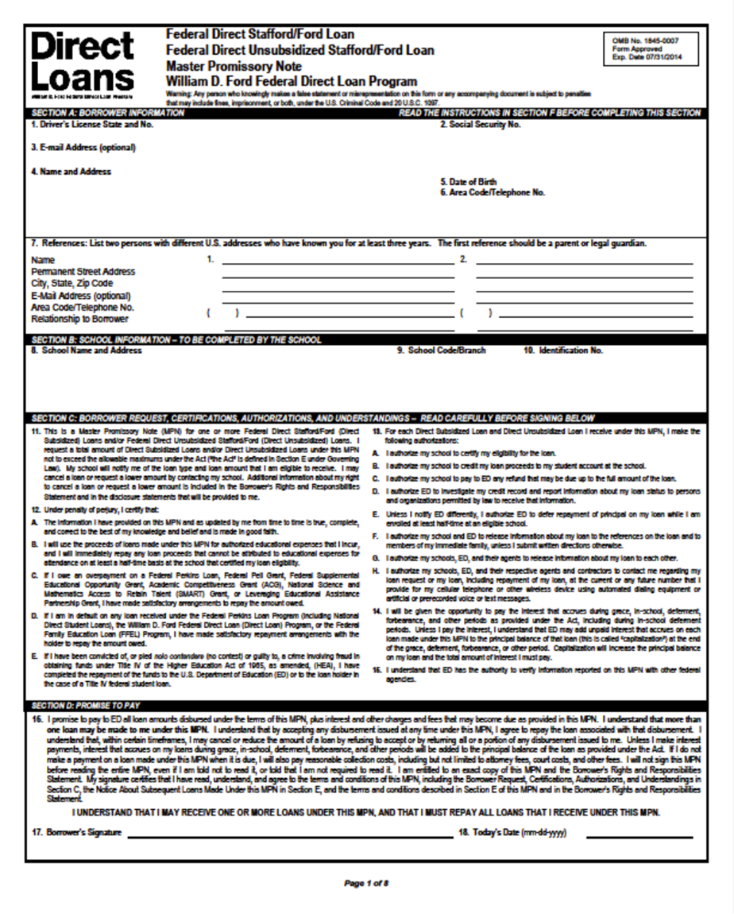
Master Promissory Note
(MPN)- includes important language about rights and responsibilities as a borrower and it’s the legal document all student loan borrowers must complete promising to repay the loan.

Slide 5
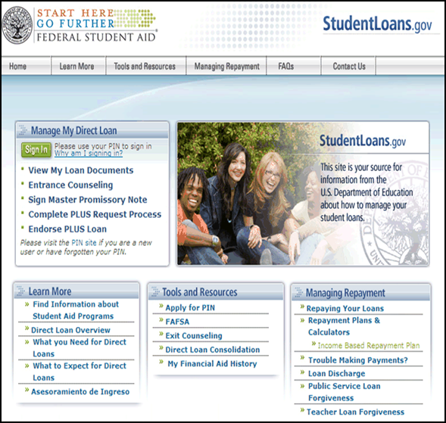
Entrance Counseling
Sign in to StudentLoans.gov using your Federal Student Aid PIN
  Select "Complete Counseling" on the left-hand navigation bar
  Select "Entrance Counseling" under "Choose Counseling Type

Slide 6
Accept Award
To view your awards, follow these 5 steps:
Login to Banner Self-Service
Click on Financial Aid
Next, click on Award
Award for Aid year and select year
Accept the Terms and Conditions
Lastly, you should click on Accept Aid Award Offer
*NOTE: When accepting awards, you are accepting for the entire year and not just for the term.

Slide 7
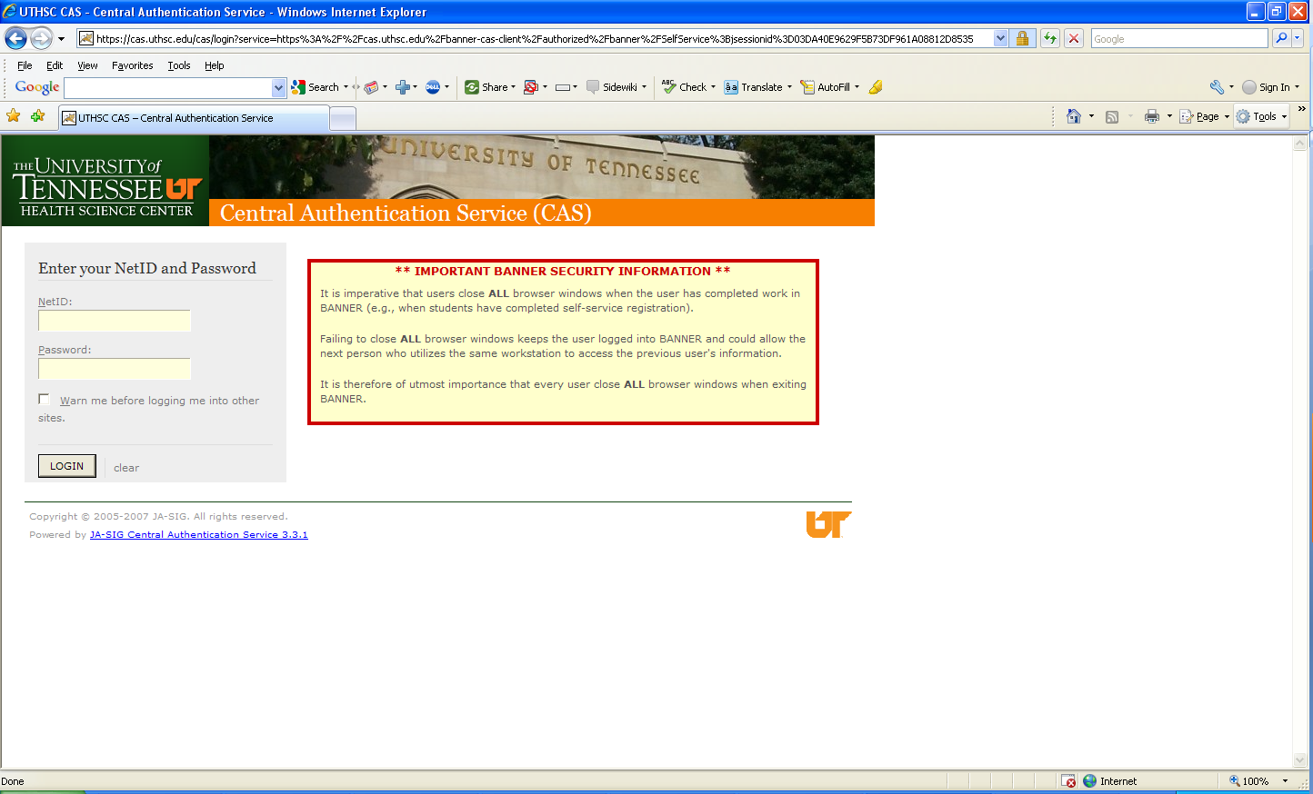
Banner Self-Service

Slide 8
Tuition/Fees Paid
Tuition and Fees Effective Fall Semester 2014
(Tuition and Fees shown are for one term only)
College of Dentistry
Graduate Health Sciences
College of Health Professions
College of Medicine
College of Nursing
College of Pharmacy
http://www.uthsc.edu/finance/bursar/colleges_fee_information.php

Slide 9

Refund Disbursement
Financial aid must first pay a student's tuition and fees each term. If excess funds remain after paying these expenses, the student is sent a financial aid refund to help them pay for their books and living expenses.
Start Date - August 1, 2014 (July 25)
Start Date - August 11, 2014 ( Aug. 4)

Slide 10

Loan Limits

Slide 11
Direct Stafford Loan
Graduate Level Students
Can borrow up to $20,500 (Unsubsidized)
  6.21% Interest (last yr. 6.8%)
  No payments while in school
  Payments begin six months after graduation
Aggregate Limit = $138,500.00

Slide 12
Perkins Loan
$4,000 per year MAY be awarded
    Limit of $8,000
  5% interest rate
  No payments while in school
  Payments begin nine months after graduation
  Based on financial need and availability of funds

Slide 13
Direct Graduate PLUS Loan
Eligibility is the difference between Cost of Attendance MINUS other aid being received
  7.21% interest rate
  No payments while in school
  Payments begin six months after graduation
www.studentloans.gov

Slide 14
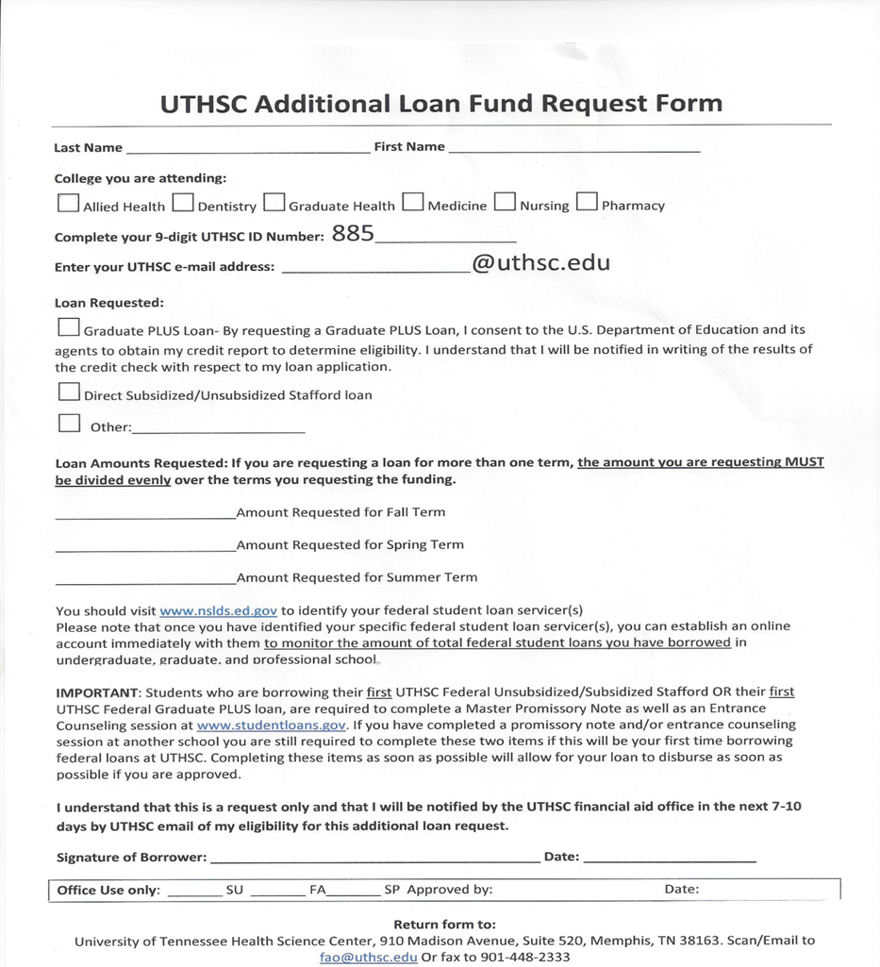
Additional Funds Request Form

Slide 15
Credit with Graduate Plus Loan
Requires a credit check as part of the application process
You cannot have any adverse credit history - Obtain an endorser
Your credit is evaluated every time you request a new PLUS loan

Slide 16
Cost of Attendance

Slide 17
2014-2015
In-State Cost of Attendance
1st Year Pharmacology
ESTIMATE
Tuition $15,000
Fees $ 3,325
Books and Supplies $ 3,000
Living Expenses $21,318
Total $42,643

Slide 18
2014-2015
Out-of-State Cost of Attendance
1st Year Pharmacology
ESTIMATE
Tuition $23,000
Fees $ 3,325
Books and Supplies $ 3,000
Living Expenses $21,318
Total $50,643

Slide 19
In-state packaging example
COA = $42,643
$20,500 Direct Unsubsidized Loan
$4,000 Perkins Loan
$18,143 Graduate PLUS Loan
$42,643
*Scholarships/Institutional waivers will decrease loan amounts

Slide 20
Out-of-state packaging example
COA = $50,643
$20,500 Direct Unsubsidized Loan
$4,000 Perkins
$26,143 Graduate PLUS Loan
$50,643
* Scholarships/Institutional waivers will decrease loan amounts

Slide 21
Estimated Refund
In-state
  $42,643 Total Aid
  -$18,325 Tuition & Fees
  $24,318 Refund
  -$3,000 Books & Supplies
  $21,318
Out-of-state
  $50,643Total Aid
  -$26,325Tuition & Fees
  $24, 318 Refund
  -$3,000 Books & Supplies
  $21,318
$10,659 per semester
$10,659 per semester

Slide 22
One on One Counseling
Must have a one-on-one counseling with financial aid counselor.
Must complete by May 2015
Skype
Office Visit
MANDATORY!!!!!

Slide 23
One-Stop-Shop
Located in 910 Building on the 1st floor
Services available:
  Financial aid
  Bursar Office
  Registrar Office

Slide 24
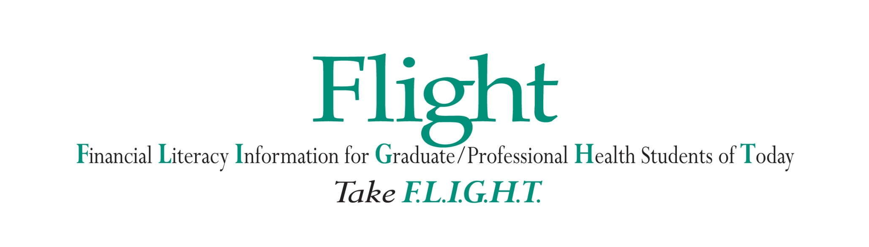
Office of Student Affairs and Enrollment Services
Financial Aid Department

Slide 25
Gold Standards
Create a personal budget/spending limitations
Creating an account with your student loan servicer
Knowing your total loan amount and estimated standard and extended monthly payments
Understanding the Federal Public Service Loan Forgiveness Program
Understanding Income Base Repayment plans
Attending at least one FLIGHT presentation each school year
Reading an article related to personal finance every week
Pulling a copy of your credit report each school year at www.annualcreditreport.com
Filing your FAFSA by March 15th each school year
Liking the FLIGHT Facebook page
Go for the Gold! Be proactive with your Personal Finance and follow the Gold Standards…

Slide 26
Student Loan History

Slide 27
Loan History – StudentAid.gov
Federal Student Aid launched a new feature on its website at StudentAid.gov.
Students, parents, and borrowers can now log in to StudentAid.gov to view their federal student loan and grant information from the National Student Loan Data System (NSLDS.ed.gov).
Please note that the NSLDS Student Access site will continue to
be available to student aid recipients at NSLDS.ed.gov.

Slide 28
StudentAid.gov
Login:
View your loan detail and grant detail
Get your loan servicer’s contact information
Download your federal student aid history into a text file using the
MyData Download function

Slide 29
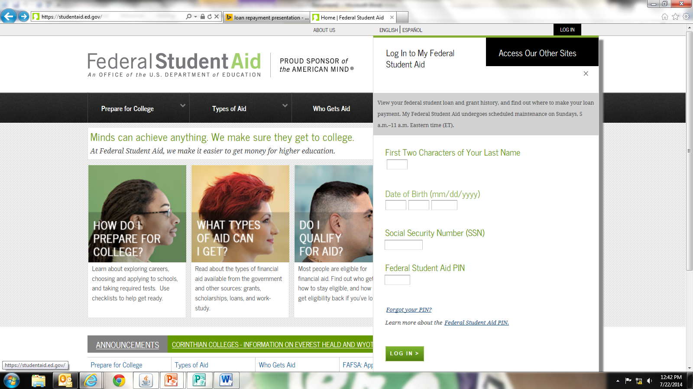
StudentAid.gov – LOGIN

Slide 30
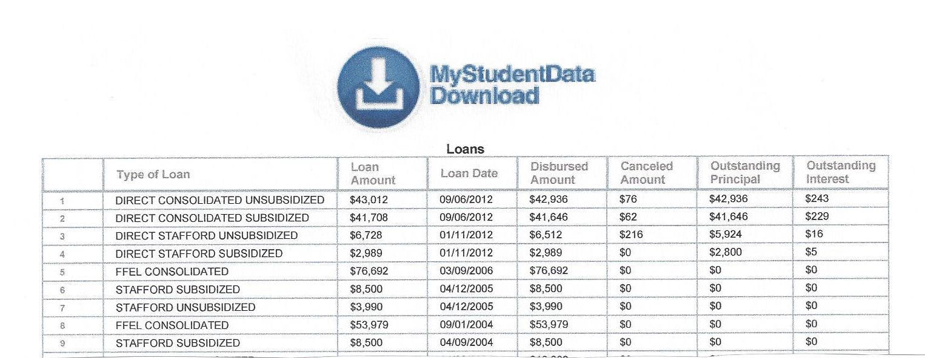
MyData Download

Slide 31
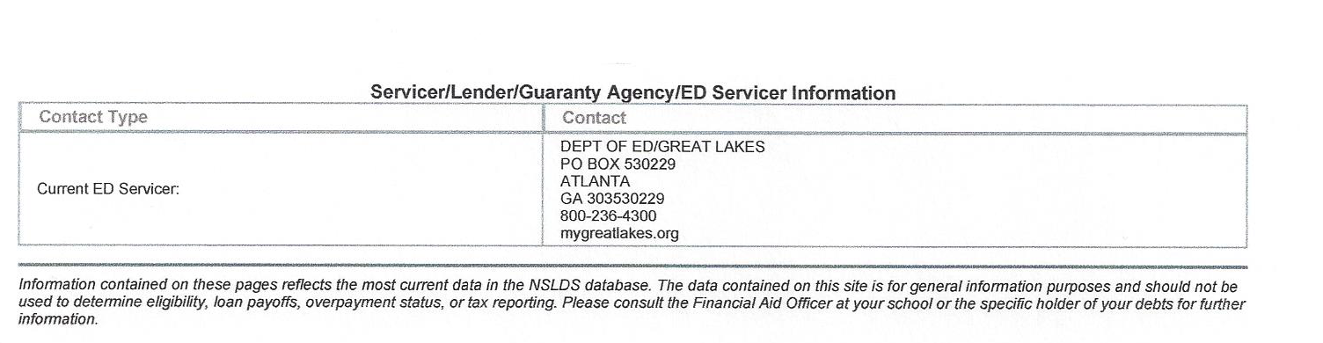
Servicer Contact Information

Slide 32
New Loan Interest Rates 2014-15
First disbursement on or after July 1, 2014 but before July 1, 2015 are as follows:
Direct Unsubsidized Loans – 6.21%
Direct Graduate PLUS Loans – 7.21%
Perkins Loan – 5.00%
The new interest rate determinations will apply “retroactively” to July 1, 2014

Slide 33


Slide 34

Understanding Repayment Plans
Student borrowers may repay their student loans through one of the several repayment plans:
Standard Repayment
Graduate Repayment
Income Base Repayment (IBR)
Pay As You Earn (PAYEE)

Slide 35
Standard Repayment Plan
Standard Repayment
Graduate Repayment
Income Base Repayment (IBR) Income-Contingent Repayment (ICR)
Pay As You Earn (PAYEE)
Under this plan, the borrower will pay a fixed amount of at least $50 each month for up to 10 years. For most borrowers, this plan results in the lowest total interest paid because the repayment period is shorter than it would be under any of the other repayment plans.
(Subsidized, Unsubsidized and PLUS Loans)
Consolidation borrowers have a repayment period of 10 - 30 years depending on their total loan indebtedness.

Slide 36
Graduated Repayment Plan
The Graduated Repayment Plan may be beneficial if the borrower’s income is low when they leave school but is likely to steadily increase. Under this plan, payments start out low and then increases every two years.
Like the Standard Plan, the maximum repayment period is 10 years for Subsidized, Unsubsidized, and PLUS Loans.
Standard Repayment
Graduate Repayment
Income Base Repayment (IBR) Income-Contingent Repayment (ICR)
Pay As You Earn (PAYEE)

Slide 37
Income-Based Repayment
Standard Repayment
Graduate Repayment
Income-Base Repayment (IBR) Income-Contingent Repayment (ICR)
Pay As You Earn (PAYEE)
  Under IBR, monthly payment is based on the borrower’s Adjusted Gross Income (AGI), family size, and state of residence.
  The minimum monthly payment may be as low as $0 or $50 depending on the calculated IBR amount.
Monthly payments are adjusted each year according to changes in your income and family size – new application must be submitted.
An IBR fact sheet, calculator and Q&A is available on www.StudentAid.ed.gov

Slide 38
Income-Based Repayment
Leaving IBR:
Borrower must repay outstanding balance under Standard Repayment plan (10-year standard or consolidation loan standard) with time in IBR counted in maximum repayment time
Any unpaid interest capitalized

Slide 39
Income-Based Repayment
Advantages of IBR
  Affordable payment (including $0)
  The government will pay the unpaid interest on subsidized loans
  for up to three consecutive years if the monthly IBR payment does
  not cover the monthly accrued interest
  Any remaining principal and interest will be cancelled after 25
  years of repayment
  IBR payments count for Public Service Loan Forgiveness
  Disadvantages of IBR
  More interest paid over the life of the loan
  To continue reduced payments under IBR, a borrower must submit
  updated information on income and family size each year

Slide 40
Income-Contingent Repayment (ICR)
A repayment plan for Direct Loans only that bases a borrower’s monthly payment on yearly income, family size, and loan amount. As their income rises or falls, so does their payments. After 25 years, any remaining balance on the loan will be forgiven, but the borrower may have to pay taxes on the amount forgiven.
Standard Repayment
Graduate Repayment
Income-Base Repayment (IBR) Income-Contingent Repayment (ICR)
Pay As You Earn (PAYEE)
High loan debt and low income could actually mean a calculated payment of $0.
What are the benefits?

Slide 41
PAYE – Pay As You Earn
New borrower - no outstanding balance on a Direct Loan or FFEL Program of federal loans on or after Oct 1, 2007 OR if you had no outstanding balance on a Direct Loan or FFEL Program loan when you received a new Direct Loan or FFEL Program loan on or after Oct. 1, 2007
Receive a disbursement of a Direct Loan (Unsubsidized, or Grad Plus) for graduate or professional students on or after Oct. 1, 2011
Standard Repayment
Graduate Repayment
Income Base Repayment (IBR)
Income-Contingent Repayment
Pay As You Earn (PAYEE)

Slide 42
PAYE – Pay As You Earn
20- Year Loan Forgiveness: If you repay under the Pay As You Earn plan, any remaining balance will be forgiven after 20 years of qualifying repayment.
10-Year Loan Forgiveness (PSLF): On-time, full monthly payments you make under Pay As You Earn (or certain other repayment plans) while employed full-time in a public service job.

Slide 43
PSLF (Public Service Loan Forgiveness)
The PSLF Program is intended to encourage individuals to enter and continue to work full-time in public service jobs. Under this program, borrowers may qualify for forgiveness of the remaining balance of their Direct Loans if the borrower:
Is not in default
Makes 120 separate, full monthly payments, under (IBR
& PAYE) repayment plans
Is employed full-time at a public service organization while making the 120 required payments, when requesting
forgiveness, and when forgiveness is granted
Complete - Employment Certification Form

Slide 44
Public Service Loan Forgiveness
Eligible public service includes:
Service in a position in AmeriCorps or the Peace Corps
Local, State, Federal or Tribal government position
A non-profit organization under 501(c)(3) of the
Internal Revenue Code that is exempt from taxation
under Section 501(a) of the Internal Revenue Code
Employment must meet the definition of “full-time”.
“Full-time” generally means the borrower is working an
average of at least 30 hours per week or the number of
hours the employer considers full-time.
An PSLF fact sheet and Q&A
is available on www.StudentAid.ed.gov

Slide 45
Postpone Payment
You can receive a deferment or forbearance that allows you to temporarily postpone or reduce your federal student loan payments. Postponing or reducing your payments may help you avoid default.
During a deferment, you do not need to make payments.
With forbearance, you may be able to stop making payments or reduce your monthly payment for up to 12 months.
Interest will continue to accrue on your subsidized and unsubsidized loans (including all PLUS loans).

Slide 46
Consolidation
A Direct Consolidation Loan allows you to consolidate (combine) multiple federal student loans into one loan. The result is a single monthly payment instead of multiple payments.
If you consolidate your loans during your grace period, you will give up the remainder of your grace period and begin repayment after your Direct Consolidation Loan is disbursed (paid out). Your first bill will be due approximately two months after the Direct Consolidation Loan is disbursed.

Slide 47
Benefits of Consolidating
  One Lender and One Monthly Payment Due
  Flexible Repayment Options
  Multiple repayment plans with various term
  selections to repay their consolidation loan(s)
  Reduced Monthly Payments
  A consolidation loan may ease the strain on a
  borrower's budget by lowering the borrower's
  overall monthly payment.

Slide 48
Federal Loan Consolidation
How Do I Apply
  Online Web Application - Apply online. www.loanconsolidation.ed.gov
  Express Phone Application - 1-800-557-7392. Apply over the phone if you have all Direct Loans.
  Paper Application
    Download a paper copy of the application and promissory note - including the complete contents of the application package.
  OR
    Request an application package be mailed to you:
    Phone at 1-800-557-7392 8AM to 8PM (EST)
    E-mail at loan_consolidation@mail.eds.com

Slide 49
Resources:
AAMC:
  www.aamc.org/stloan
Financial Literacy Website:
http://www.uthsc.edu/finaid/flight/index.php
Facebook Page:
UTHSC Flight
Financial Literacy Library:
    (located in the One-Stop-Shop)

Slide 50
Contact Information
Ms. Janice G. Maddox, MBA
Financial Literacy Coordinator
CGHS Counselor
One Stop Shop
(901) 448-1601
jmaddox9@uthsc.edu
Skype: Janice.maddox3

Slide 51

Questions
Answers

