Slide 1
FLIGHT
Financial Literacy Information for Graduate/Professional Health Students of Today

Slide 2
Take FLIGHT
• Financial Literacy is vital for an individuals’ professional and personal growth
FLIGHT helps postsecondary students use knowledge and skills to make good decisions related to budgeting, borrowing, and repayment strategies.
• FLIGHT is the ability to:
- Understand Money
- Initiate clear information financial decisions
- Save
- Manage and protect one’s finances

Slide 3
Gold Standard
- Create a personal budget/spending limitations.
- Creating an account with student loan servicer.
- Knowing your total loan amount and estimated standard and extended monthly payments.
- Understanding the Federal Public Service Loan Forgiveness Program.
- Understanding Income Base Repayment plans.
- Attend all FLIGHT presentations each school year.
- Reading an article related to personal finance every week.
- Pulling a copy of your credit report each school year at Credit Karma or Annual Credit Report.
- Filing your FAFSA by March 15th of each school year.
- Liking the FLIGHT Facebook page.

Slide 4
Personal Budgeting
• Establish a budget and stick with it
• Distinguish between necessities and wants
• Pay bills on time so that you can avoid late fees
• Control or limit the use of credit cards
By working on your budgeting skills now, you will know exactly what you can afford in the future.

Slide 5
Creating Your Budget
• Make a list of your values
• Determine your income
• Figure your available income (Refund or Net Pay)
• Determine your expenses
• Where is money really going?
• Fixed Expenses
- rent, auto, utilities, etc
• Variable Expenses
- food, clothing, entertainment, expenses that vary month to month
• Quarterly, Semi-Annually or Yearly Expenses
• Download Personal Finance Software Programs
- Mint.com or “Crash Course”
• Your expenses should be less than or equal to your total income
If your income isn’t enough to cover your expenses, adjust your budget and spending by deciding which expenses can be reduced.

Slide 6
Budgeting Resources
• practicalmoneyskills.com
• mint.com
• feedthepig.org
• budgetsimple.com
• saltmoney.org
• FLIGHT

Slide 7
STUDENT LOAN HISTORY

Slide 8
Loan History
• National Student Loan Data System (NSLDS)
- U.S Department of Education’s (ED’s) central database for student aid.
- Receives data from schools, guaranty agencies, the Direct Loan program and other Department of ED Programs.
- Centralized, integrated view of Title IV loans and grants.

Slide 9
National Student Loan Data System (NSLDS)
• View your federal student aid history
• Get your loan servicer’s contact information
• Download your federal student aid history into a text file using the
MyStudentData Download function
• Establish an online account with Loan Servicing to track your loan
history
• Visit https://studentaid.gov/ for more information

Slide 10
Accept your Financial Aid
• To view your awards, follow these 5 steps:
- Login to Banner Self-Service
- Click on Financial Aid
- Next, click on Award
- Award for Aid year and select year
- Accept the Terms and Conditions
- Lastly, click on Accept Award Offer

Slide 11
Student Loan Servicer
• Bullet Point #2 Goes Here
- Start by going to the National Student Loan Data System.
- Click on “Financial Aid Review.”
- Accept the terms and conditions.
- Login with your FSA ID.
• Once you login, you will see a summary of all your loan data.

Slide 12
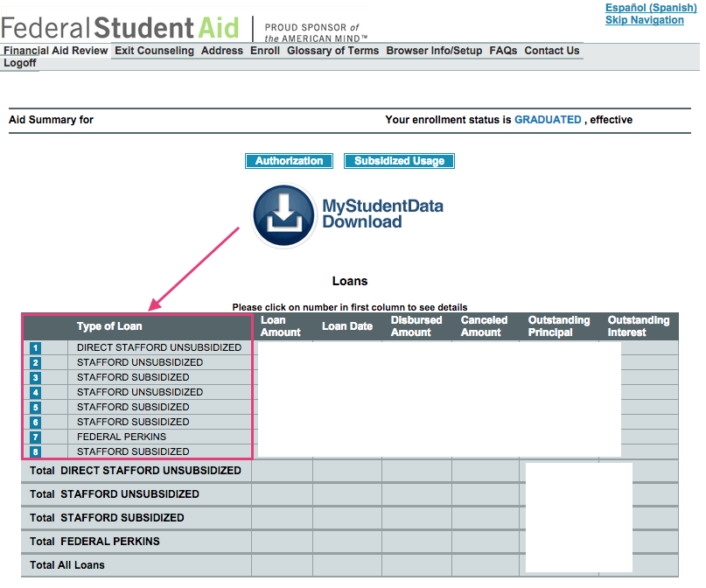
• Click on the numbers in the blue boxes to see details about each loan.
• At the bottom of page, you will see box labeled “Servicer/Lender/ Guaranty/Agency/ED Servicer Information.”
• The company to the right of the label “Current ED servicer” is your student load servicer.

Slide 13
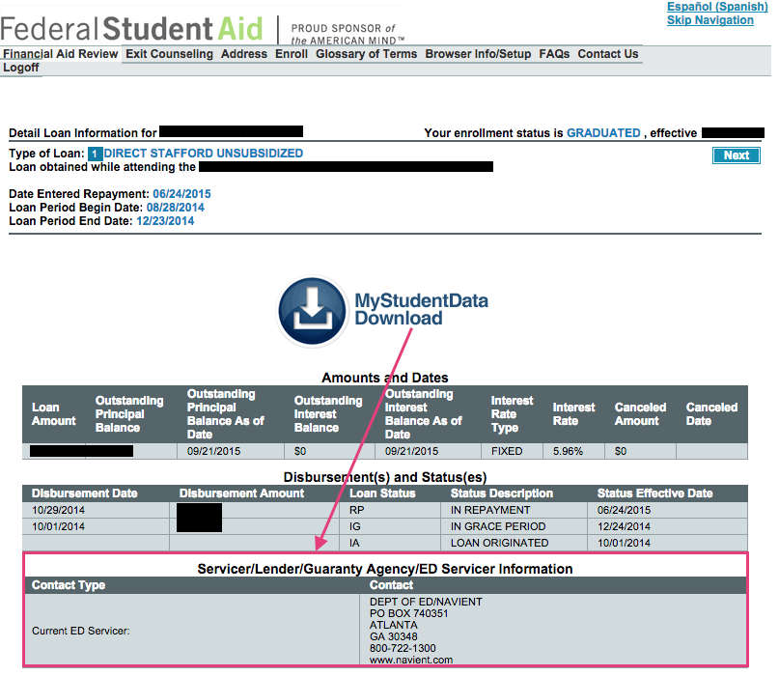

Slide 14
Origination Fee
• Definition of Origination Fee
An amount, usually calculated as a percentage of a loan, which a loan servicer charges for processing your application.
• Example:
Direct Subsidized Loans and Direct Unsubsidized Loans | On or after 10/1/20 and before 10/1/21 | 1.057%
 | On or after 10/1/19 and before 10/1/20 | 1.059%
Direct PLUS Loans | On or after 10/1/20 and before 10/1/21 | 4.228%
 | On or after 10/1/19 and before 10/1/20 | 4.236%

Slide 15
Accrued Interest
• Accrued Interest
The amount of loan interest that is accruing while you are in-school, but has not yet been paid to the lender by the borrower.
• Capitalization
Adding unpaid, accumulated interest to the principal balance of your loan. Capitalization increases the total cost of your loan.

Slide 16
REPAYMENT PLANS

Slide 17
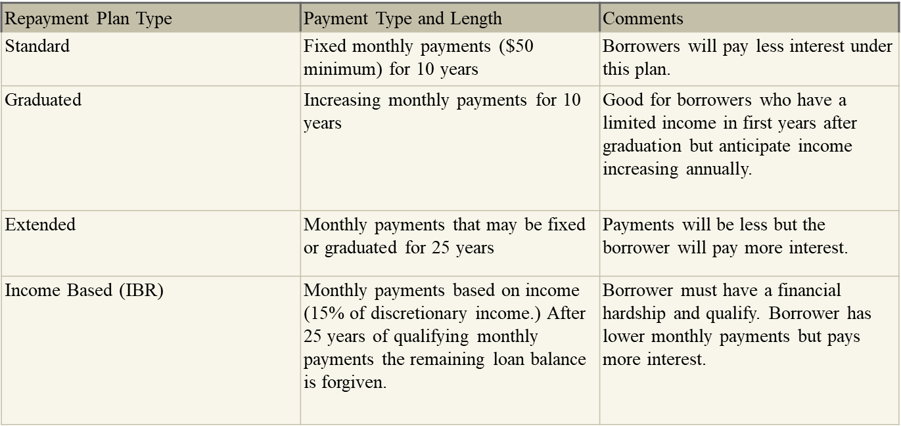
Loan Repayment Options

Slide 18
Loan Repayment Options
Income Contingent (ICR) (Direct Loans only) | Monthly payments based on income (20% of discretionary income.) After 25 years of qualifying monthly payments the remaining loan balance is forgiven. | Borrower must have a financial hardship and qualify. Borrower has lower monthly payments but pays more interest.
Pay As You Earn (Direct Loans only) | Monthly payments based on income (10% of discretionary income.) After 20 years of qualifying monthly payments the remaining loan balance is forgiven. | Borrower must have a financial hardship and qualify. Must have been new borrower as of 10/1/07 and received a disbursement after 10/1/11.

Slide 19
Estimate Payment
• The Loan Simulator
- Estimates their eligibility for all repayment plans, including income-driven plans.
- Provides a comparison of estimated monthly payment amounts for all federal student loan repayment plans.
• https://studentaid.gov/manage-loans/repayment/plans

Slide 20
PUBLIC SERVICE
LOAN FORGIVENESS

Slide 21
Public Service Loan Forgiveness
• PSLF Program
- The program encourages individuals to enter and continue to work full time in a public service jobs.
- Under this program, borrowers may qualify for forgiveness of the remaining balance of their Direct Loans if the borrower:
- Makes 120 separate, full monthly payments, under one or more specified repayment plans (IBR and PAYE).
- Is employed full time at a public service organization while making the 120 required payments, when requesting forgiveness and when forgiveness is granted.
• Complete the Employment Certification Form (Very Important)

Slide 22
Public Service Loan Forgiveness
• Eligible public service includes:
- Service in a position in AmeriCorps or the Peace Corps.
- Local, State, Federal or Tribal government position.
- Employment, in any position, by any other public service organization.
- A non profit organization under 501 (c )(3) of the Internal Revenue Code that is exempt from taxation under Section 501(a) of the Internal Revenue Code.
• Employment must meet the definition of “full-time”
“Full-time” generally means the borrower is working an average of at least 30 hours per week or the number of hours the employer considers full time.
• PSLF Help Tool and Q & A
Available at https://studentaid.gov/

Slide 23
Consolidation
• Direct Consolidation Loan
Allows you to consolidate multiple federal education loans into one loan at no cost to you.
- If you have multiple student loans you may be able to combine them into one loan with a fixed interest rate based on the average of interest rates being consolidated
- There is no application fee to complete a Direct Consolidation Loan application.
• Direct Consolidation Loan Application

Slide 24
Postpone Payment
• Deferment or Forbearance
Allows you to temporarily postpone or reduce your federal student loan payments.
- Postponing or reducing your payments may help you avoid default.
- Allows you to stop making payments or reduce your monthly payment for up to
12 months.
• Interest
Interest will continue to accrue on your subsidized and unsubsidized loans (including all PLUS loans).

Slide 25
CREDIT BUREAUS AND FICO SCORES

Slide 26
In a Nutshell
• Fair Isaac Corporation or FICO
Creates a variety of credit scores for use by lenders, credit card issuers and other creditors.
• FICO Score
- Ranges from 300 to 850.
- Affects whether your credit application gets accepted and rates you are offered.
- Ex: Graduate PLUS Loans

Slide 27
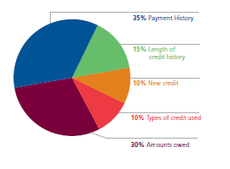
FICO Credit Scores – It Matters

Slide 28
Credit with Graduate Plus Loan
• Allows students to borrow up to their cost of attendance minus any other financial assistance (loans, scholarships and federal work study).
• Requires a credit check as part of the application process.
• A student cannot have any adverse credit history.
Obtain an endorser
• Your credit is evaluated every time you request a new PLUS Loan
120 days
• Apply at http://www.studentaid.gov/

Slide 29
Credit Bureaus
• Equifax
- http://www.equifax.com/
- 800-685-1111
• Experian
- www.experian.com
- 888-397-3742
• Transunion
- http://www.transunion.com/
- 800-888-4213

Slide 30
Financial Management Tips
• Place total disbursement (refund) in a savings account
• Transfer funds to yourself as needed (checking account)
• Pay your bills on time
• Keep balances low
• Talk to your FAO with any questions you have.
• Visit www.smartaboutmoney.org to review tips on saving money.

Slide 31
Resources
• Financial Literacy Website
http://www.uthsc.edu/finaid/flight/index.php
• Facebook Page
UTHSC Flight.
• Financial Literacy Library
Located in the One-Stop-Shop (OSS).

Slide 32
Contact Information
Ms. Janice G. Maddox, MBA
Coordinator, Financial Literacy
One Stop Shop, Suite 105
901.448.1601
jmaddox9@uthsc.edu
Skype: Janice.maddox3

Slide 33
Questions?

