Slide 1
THE FINANCIAL AID JOURNEY

Slide 2
FAFSA
Free Application for Federal Student
Completed for each school year

Slide 3
STEPS TO TAKE
FAFSA
VERIFICATION
CORRECTIONS
MASTER PROMISSORY NOTE
ENTRANCE COUNSELING
ACCEPT AWARD
TUITION/FEES PAID
REFUND DISBURSED

Slide 4
VERIFICATION- additional documents are required
CORRECTIONS- student will correct information on application and re-submit to FAFSA
AWARD NOTICE SENT- student will receive an email notice sent to the UTHSC email account

Slide 5
MASTER PROMISSORY NOTE-legal document all student loan borrowers must complete promising to repay loan
ENTRANCE COUNSELING- loan information session explaining rights &responsibilities
TUITION/FEES PAID- the date financial aid is applied to student’s account
REFUND DISBURSED- the date excess aid is processed

Slide 6
FINANCIAL AID AWARDS
Loans
Grants
Scholarships
Cost of Attendance Budgets
Forms
College Work-Study

Slide 7
Types of Loans
Subsidized Direct Loan
Unsubsidized Direct Loan
Perkins Loan
Graduate Plus Loan
Parent Plus Loan
Private/Alternative Loan

Slide 8
Types of Grants
Pell Grant
Supplemental Educational Opportunity Grant
Tennessee Student Assistance Award

Slide 9
Types of Scholarships
Hope Scholarship
Program Specific Scholarship
Private Scholarships

Slide 10
LOAN AMOUNTS
Dependent Undergraduate (3rd year and beyond)
SUBSIDIZED UNSUBSIDIZED
$5,500 $2,000

Slide 11
LOAN AMOUNTS
Independent Undergraduate & Dependent Student whose parent can’t get PLUS(3rd year and beyond)
SUBSIDIZED UNSUBSIDIZED
$5,500 $7,000

Slide 12
GRADUATE & PROFESSIONAL
UNSUBSIDIZED
$20,500

Slide 13
GRADUATE PLUS LOAN
PARENT PLUS LOAN
ALTERNATIVE/PRIVATE LOAN
Students/Parents may borrow up to their cost of attendance minus other aid awarded

Slide 14
2014-15
Out-of-State Cost of Attendance
Estimate
Tuition $30,300
Fees $ 3,350
Books and Supplies $ 1,875
Living Expenses $21,318
Total $56,843

Slide 15
Out-of-State Packaging Example
COA = $56,843
$20,500 Direct Unsubsidized Loan
$28,343 Graduate Plus
$ 4,000 Perkins Loan
$ 4,000 Work-Study
$56,843

Slide 16
2014-15
In-State Cost of Attendance
Estimate
Tuition $ 7,576
Fees $ 3,403
Books and Supplies $ 1,000
Living Expenses $19,380
Total $31,359

Slide 17
In-State Packaging Example
COA = $31359
Direct Subsidized Loan $ 5,500
Direct Unsubsidized $ 7,000
Pell Grant $ 5,730
Perkins Loan $ 4,000
SEOG $ 2,000
College Work-Study $ 4,000
Private/Alternative Loan $ 3,129
Total $31,359

Slide 18
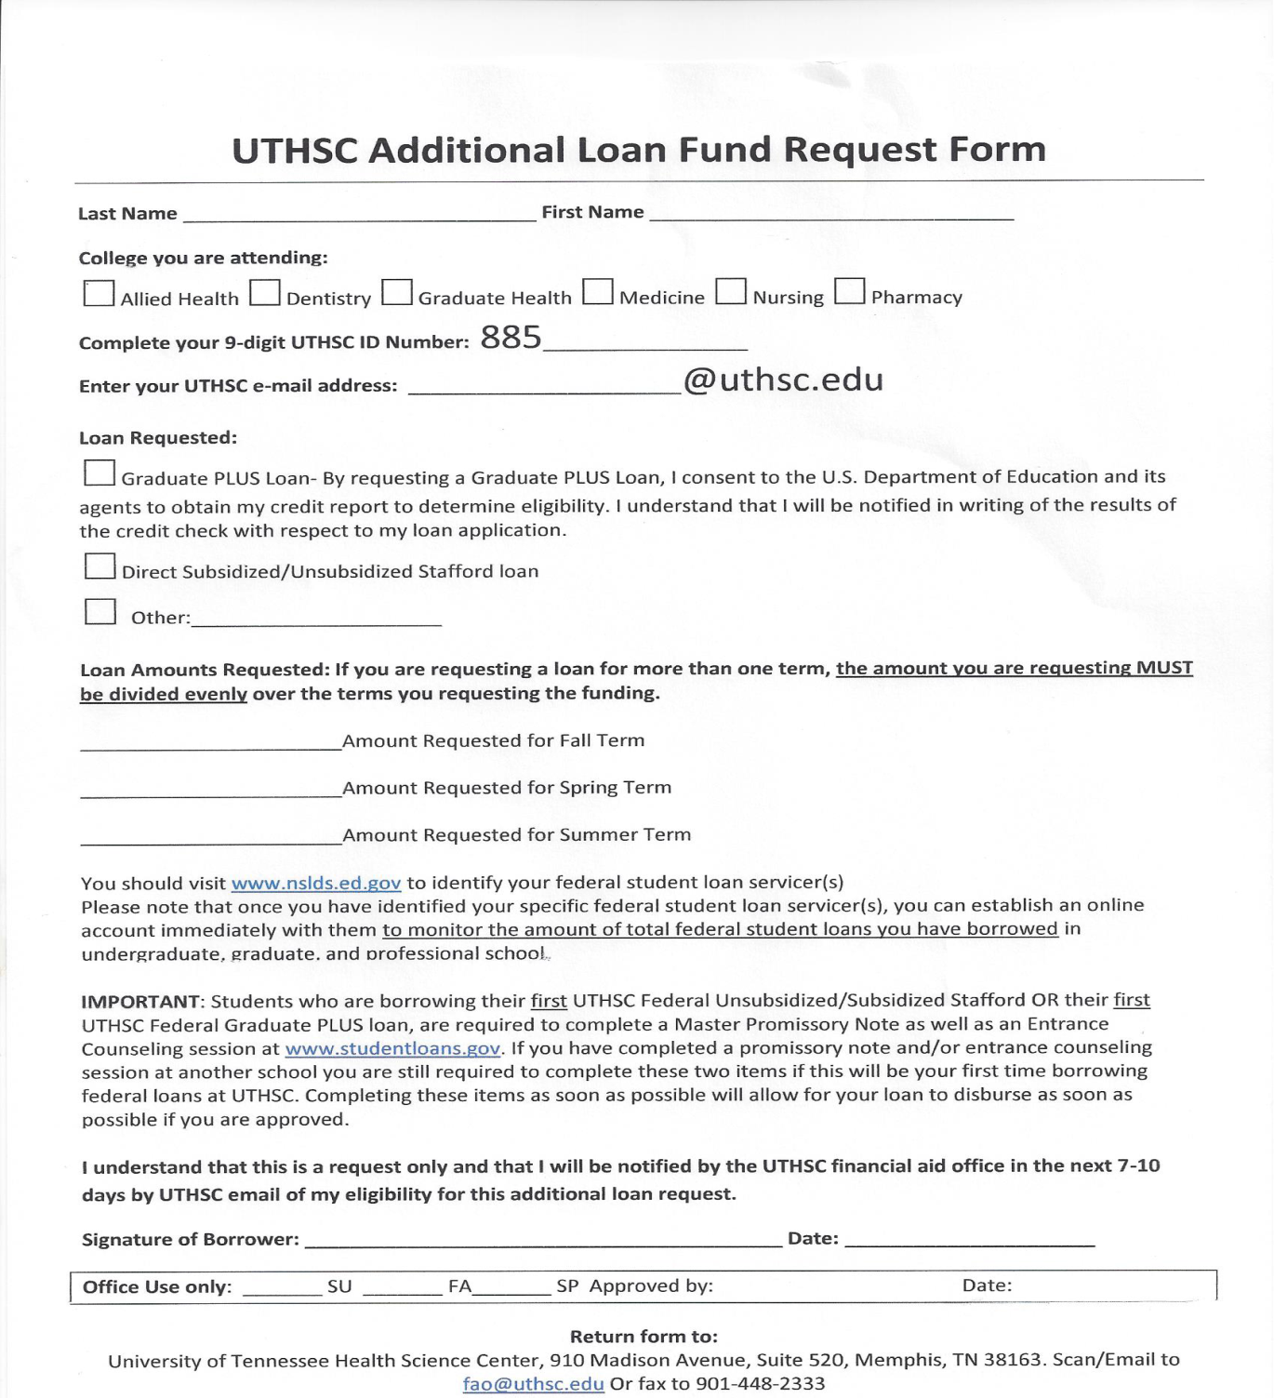
Additional
Funds Request

Slide 19
One on One Counseling
A scheduled counseling session with your financial aid counselor

Slide 20
Applying for Financial Aid
PIN:
www.pin.ed.gov
FAFSA Application:
www.fafsa.ed.gov (School code: 006725)
Loan History:
www.nslds.ed.gov

Slide 21
Contact Information
Gloria Dobbs
Financial Aid Counselor
College Of Health Professions
(901) 448-1472
gdobbs1@uthsc.edu
Skype: glor.dob90

