Slide 1
Financial Aid
College of Nursing

Slide 2
Federal Direct Stafford Loan
DNP students can borrow $20, 500
  6.8% Interest
  No payments while in school
  Payments begin six months after graduation
Aggregate Limit = $138,500

Slide 3
Perkins
$4,000 per year MAY be awarded
  5% interest
  No payments while in school
  Payments begin nine months after graduation
  Based on financial need and availability of funds

Slide 4
Federal Direct Graduate PLUS Loan
Can be eligible for the difference between Cost of Attendance and other aid being received.
  Based on credit (co-signer)
  7.9% interest
  No payments while in school
  Payments begin six months after graduation
www.studentloans.gov

Slide 5
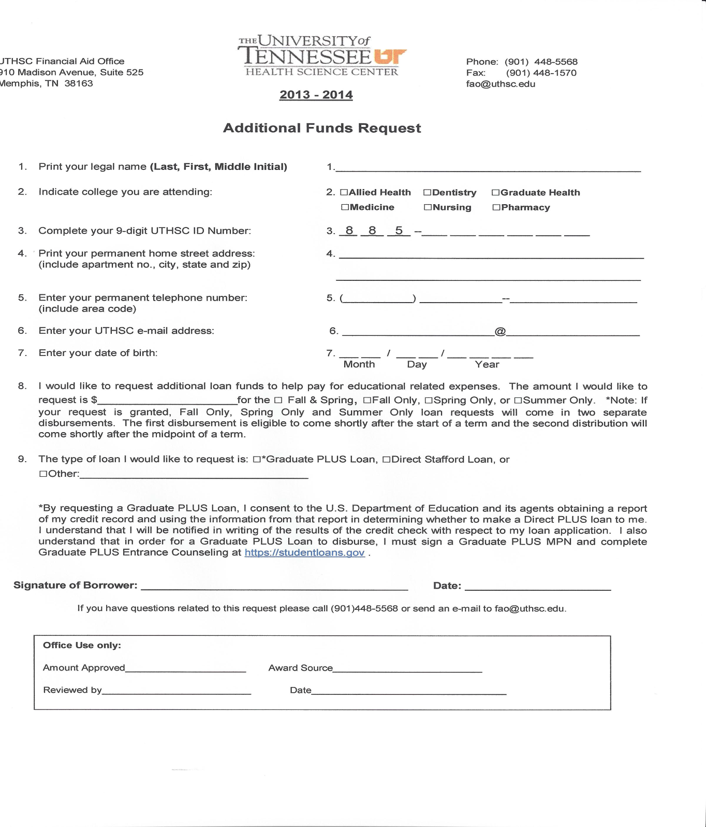
Additional Funds Request Form
http://www.uthsc.edu/finaid/documents/AdditionalFundsRequest.pdf

Slide 6
Other loan options
Nursing Student Loan
http://bhpr.hrsa.gov/dsa/sfag/nursing_programs/bk2prt1.htm.
Health Resources and Services Administration (HRSA)
http://bhpr.hrsa.gov/nursing/grants/aent.html

Slide 7
2013-2014
In-State (1st Yr)Cost of Attendance
ESTIMATE
Tuition $16,442
Fees $4,802
Books and Supplies $1,540
Living Expenses $23,256
Total $46,040

Slide 8
2013-2014
Out-of-State (1st yr) Cost of Attendance
ESTIMATE
Tuition $39,626
Fees $4,802
Books and Supplies $1,540
Living Expenses $23,256
Total $69,224

Slide 9
In-state packaging example
COA = $46,040
$20,500 Direct Unsubsidized Loan
$4,000 Perkins Loan
$21,540 Graduate PLUS Loan
$46,040
*Scholarships will decrease loan amounts

Slide 10
Out-of-state packaging example
COA = $69,224
$20,500 Direct Unsubsidized Loan
$4,000 Perkins
$44,724 Graduate PLUS Loan
$69,224
*Scholarships will decrease loan amounts

Slide 11
Estimated Refund
In-state
  $46,040 Total Aid
  -$16,442 Tuition & Fees
  $29,598 Refund
  -$1,540 Books & Supplies
Out-of-state
  $69,224 Total Aid
  -$39,626 Tuition & Fees
  $29,598 Refund
  -$1,540 Books & Supplies
$9,780 per semester$11
$9,780 per semester
$14,029 per semester

Slide 12
Applying for Financial Aid
PIN:
  www.pin.ed.gov
FAFSA Application:
  www.fafsa.ed.gov (School code: 006725)
Loan History:
  www.nslds.ed.gov
AAMC:
  www.aamc.org/stloan

Slide 13
One-Stop-Shop
Located in 910 Building on the 1st floor (across from the Sun Trust Bank)
Services available:
Financial aid
Bursar Office
Registrar Office
IT (information technology tech. ): 11:00 am – 2:00pm and 4:00 pm – 5:00pm beginning August 2 -20, 2013.

Slide 14
One-On-One
Must have a one-on-one counseling with financial aid counselor.
Skype
Telephone
Office Visit
MANDATORY!!!!!

Slide 15
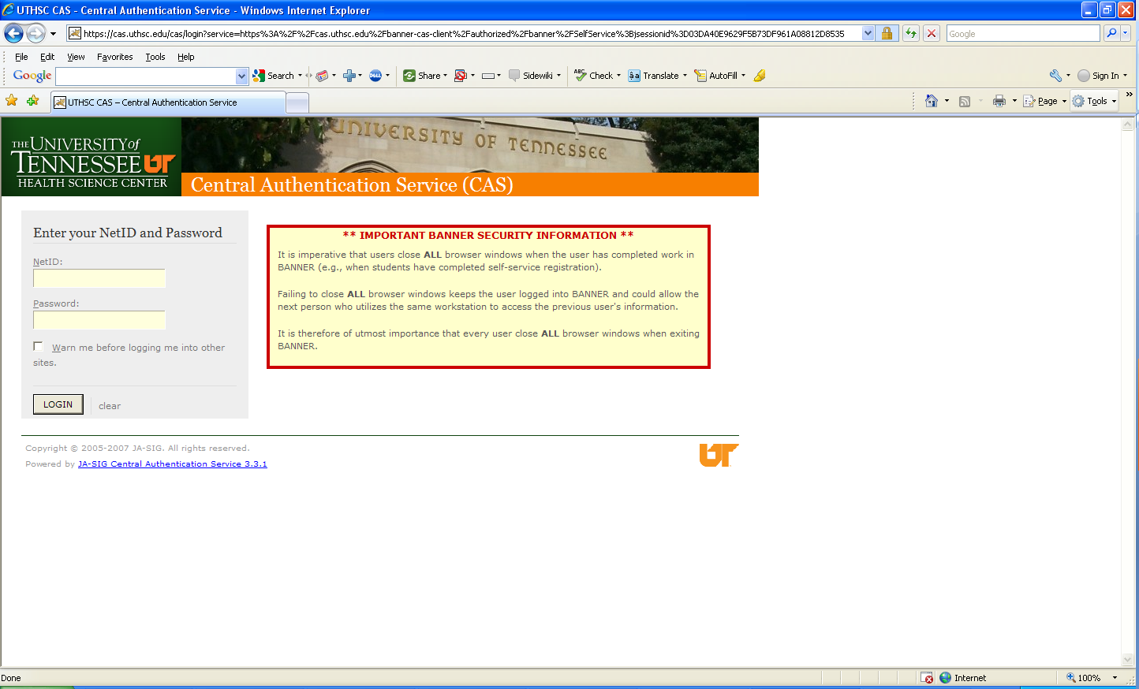
Banner Self-Service

Slide 16
Contact Information
Ms. Jacquelyn LeSueur
Financial Aid Counselor
College of Nursing
(901) 448-8324
jlesueur@uthsc.edu
Skype: jacquelyn.lesueur

Slide 17
Financial Literacy
Managing your Money
What is Financial Literacy –
It’s the ability to understand money and how to manage it so that you can make informed financial decisions – to save, manage and better protect their money. Help you prepare for the unexpected events and plan for the short or long-term goals.

Slide 18

Budgeting
Establishing a budget and sticking to it isn’t easy, but it’s the best way to be in control of your finances and make sure your money is going toward the expenses that matter most to you.
http://www.uthsc.edu/finaid/literacy/
http://www.cashcourse.org/uthsc/

Slide 19
Creating a Budget
Make a list of your values. Write down what matters to you and then put your values in order.
Set your goals.
  Write down your goals.
  Think about what you want to accomplish financially in the next three months, the next year, and the next three years.
Determine your income.
  Figure your available income (the amount of your REFUND or net pay).
Determine your expenses.
  Review your checkbook register, credit card statements, store receipts, and etc. Where is your money really going?
  "Fixed expenses," such as a rent, auto, or student loan payments, are easy to determine.
  “Variable expenses," such as food, clothing, and entertainment, vary from month to month.
  Don't forget about expenses, such as taxes or insurance, that are billed quarterly, semi-annually, or yearly.
  Look into personal finance software programs that offer a budgeting feature to help you track these expenses. “CashCourse”
Create your budget.
  Think of your budget as a “spending plan,” a way to be aware of how much money you have, where it needs to go, and how much, if any, is left over.
  Your budget should meet your "needs" first such as “fixed variables”.
  Your expenses should be less than or equal to your total income.
  If your income is not enough to cover your expenses, adjust your budget (and your spending!) by deciding which expenses can be reduced.

Slide 20
Manage Your Bank Accounts
Managing your bank accounts, whether savings or checking, by reconciling them to your bank's records is a responsibility – and one of the best money management habits you can keep.

Slide 21

Banking
Types of Accounts
Student Checking Accounts w/Debt Card
(checks needed for expenses)
Saving Accounts
Deposit student loans
**Transferring funds between accounts, you can reduce utilizing all your funds before the semester is over

Slide 22

Cutting Fees
Consolidate multiple accounts
Unlimited free ATM/debit card use
Don’t use other banks ATM’s
Avoid bouncing checks
Ask for direct deposit

Slide 23

Cutting Fees
Payment – on time
Have only one card
Interest rate - too high
No cash advances – emergencies
Debit vs. Credit Cards
Funds are utilized w/o interest
Your own personal income
Implemented as a Credit Card
Remember – Always know the correct balance in your checking account to avoid “Overdraft Fees”.

Slide 24
Keep Records….
Even if you have online banking access, you should keep your own records of account activity.
Using a checkbook register or bank book), you should keep track of all additions to your accounts (direct deposit of wages/refunds, etc.)
Log all withdrawals from your accounts (purchases on a debit card, automatic bill payment, ATM withdrawals, transfers, etc.).

Slide 25
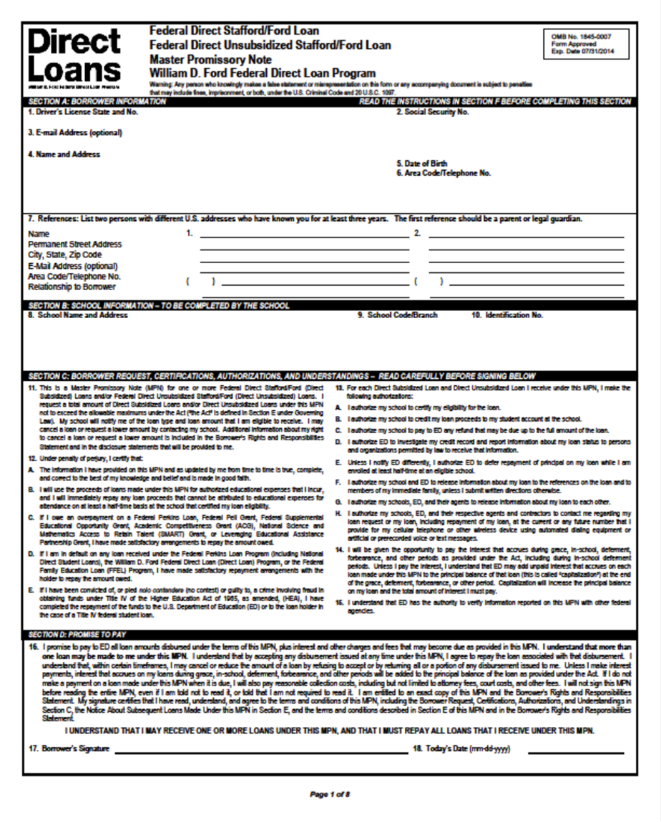
Master Promissory Note
(MPN)
The MPN includes important language about rights and responsibilities as a borrower and applies to both subsidized and unsubsidized Stafford Loans.

Slide 26
How To Complete Your Master Promissory Note
When you accept all or part of the loan offered in your financial aid award package your school will send your loan request to a state guarantee agency for approval.
Today most MPNs are digitally signed online at StudentLoans.gov. Reminder: You will need your FAFSA PIN in order to sign! To request a duplicate PIN, visit PIN.ed.gov.
In addition to signing your Master Promissory Note, first-time borrowers will be scheduled for an entrance counseling interview when starting school. Entrance counseling must be completed before loan is disbursed.

Slide 27
NSLDS – Loan History
The National Student Loan Data System (NSLDS) is the U.S. Department of Education's (ED's) central database for student aid. NSLDS receives data from schools, guaranty agencies, the Direct Loan program, and other Department of ED programs. NSLDS Student Access provides a centralized, integrated view of Title IV loans and grants so that recipients of Title IV Aid can access and inquire about their Title IV loans and/or grant data.

Slide 28
NSLDS – Loan History
What is your social security number?
  Please enter this number without the dashes. For example, 123456789.
What are the first two (2) letters of your last name?
What is your date of birth?
Please enter this date in "mmddyyyy" format. For example, 08171975 for August 17, 1975.
As you enter PIN, it will be visible on page so make sure no one else can see this screen. You will need to enter the entire PIN with each login attempt.

Slide 29
Repayment of Loans
Federal student loans are real loans, just like car loans or mortgages.
You must repay a student loan even if your financial circumstances become difficult, but you can apply for a forbearance.
Your student loans cannot be canceled because you didn’t get the education or job you expected, or because you didn’t complete your education (unless you couldn’t complete your education because your school closed).

Slide 30
Repayment Options
Income-Based Repayment (IBR) is designed to reduce monthly payments to assist with making your student loan debt manageable. If you need to make lower monthly payments, this plan may be for you. Interest rate is fixed.
The Standard Repayment plan saves you money over time because your monthly payments may be slightly higher than payments made under other plans, but you’ll pay off your loan in the shortest time. Interest rate is fixed.
The Graduate Repayment plan - your monthly payments start out low and increase every two years, for up to 10 years, interest rate is fixed.
http://studentaid.ed.gov/repay-loans/understand/plans

Slide 31
Postpone Payment
Under certain circumstances, you can receive a deferment or forbearance that allows you to temporarily postpone or reduce your federal student loan payments. Postponing or reducing your payments may help you avoid default.
During a deferment, you do not need to make payments. What’s more, depending on the type of loan you have, the federal government may pay the interest on your loan during a period of deferment.
With forbearance, you may be able to stop making payments or reduce your monthly payment for up to 12 months. Interest will continue to accrue on your subsidized and unsubsidized loans (including all PLUS loans).

Slide 32
Credit Bureaus
Equifax www.equifax.com
800-685-1111
Experian www.experian.com
888-397-3742
Transunion www.transunion.com
800-888-4213
**Free credit report authorized by the Federal Trade
Commission: www.annualcreditreport.com

Slide 33

Your Credit Scores – It Matters
Payment history – 35%
(Accounts paid on time)
Amount owed – 30 %
(# of accounts w/balances)
Length of credit history – 15%
(Larger the BETTER)
New Credit – 10%
Types of credit used – 10%
(Variety is BETTER)

Slide 34
Impact of Bad Credit
Denial of purchases such as buying a home or car
Higher interest on loans – if you do not quality with a high enough score
Possible job loss – if employer implement a credit check
Difficulty renting or entering contractual arrangements

Slide 35
Protect Against Identity Theft
Guard your Social Security Number (SS#)
Keep in a secure place
Check your credit report ANNUALLY
Verify for accounts
Password - difficult to guess
Don’t use birthdays or mother’s name
Be alert to sign of Identity Theft
Being denied or contacted by debt collectors

Slide 36
Financial Management Tips
Place total disbursement (refund) in a saving account
Keep record of all Stafford Loans in a file
Transfer funds to yourself as needed
Pay your bills on time
Keep balances low
Question - talk to your FAO
Review tips at saving money:
www.smartaboutmoney.org

Slide 37
New Additions to Financial Aid
Financial Aid Literacy & Debt Management Website:
http://www.uthsc.edu/finaid/literacy/
Banner Self-Enrollment Course (Financial Aid Literacy & Debt Management)
Facebook Page:
UTHSC Financial Aid Literacy & Debt Management

Slide 38
Contact Information
Ms. Janice G. Maddox, MBA
Financial Aid Literacy Coordinator
Financial Aid Office
(901) 448-1601
jmaddox9@uthsc.edu
Skype –janice.maddox3

Slide 39

Questions
Answers

