Slide 1
Financial Aid
College of Dentistry

Slide 2
Applying for Financial Aid
FAFSA Application:
  www.fafsa.ed.gov (UTHSC School code: 006725)
FAFSA Opens - each school year (October 1st)

Slide 3
2018-19 Interest rate
Direct Unsubsidized Loans | Graduate or Professional | 6.6%
Direct PLUS Loans | Graduate or Professional Students | 7.6%
All interest rates shown in the chart above are fixed rates that will not change for the life of the loan.

Slide 4
Steps To Complete
MASTER PROMISSORY NOTE
ENTRANCE COUNSELING
ACCEPT AWARD
TUITION/FEES PAID
REFUND DISBURSED

Slide 5
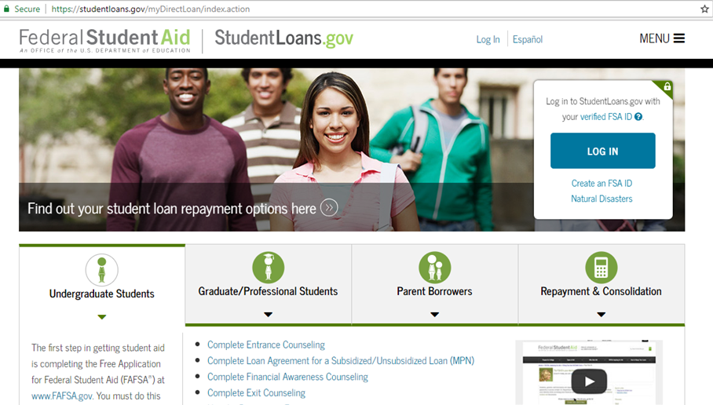
Entrance Counseling
Sign in to StudentLoans.gov using your Federal Student Aid PIN
  Select "Entrance Counseling"

Slide 6
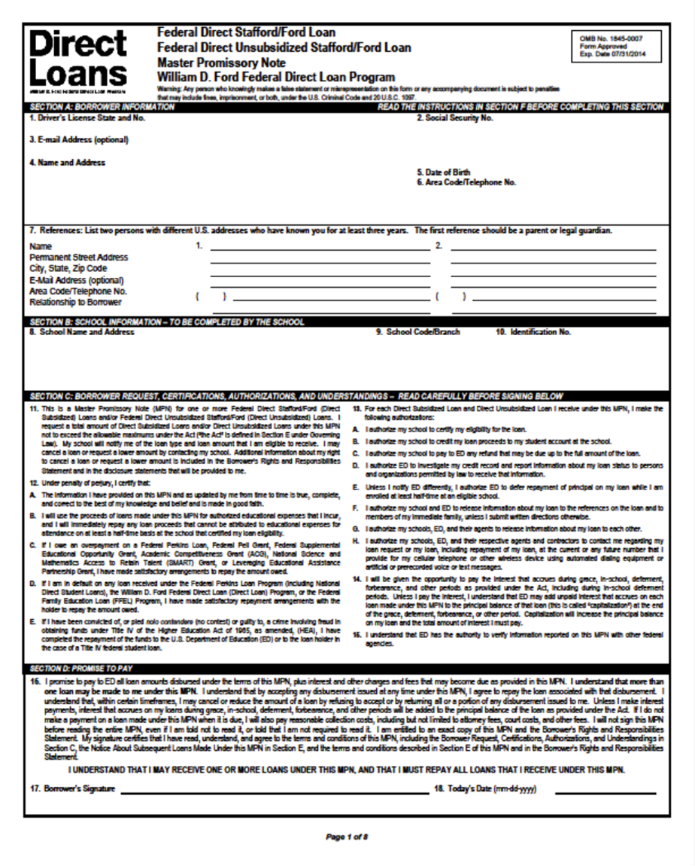
Master Promissory Note
(MPN)
Includes your rights and responsibilities as a borrower and it’s the legal document all student loan borrowers must complete promising to repay the loan.
Unsubsidized & Graduate Plus each year!

Slide 7
Accept Award
To view your awards, follow these 5 steps:
Login to Banner Self-Service
Click on Financial Aid
Next, click on Award
Award for Aid year and select year
Accept the Terms and Conditions
Lastly, you should click on Accept Award Offer
*NOTE: When accepting awards, you are accepting for the entire year and not just for the term.

Slide 8
Banner Self-Service
Direct Deposit Setup
Go to: Banner Self-Service
2. Enter Your Net ID and Password.
3. At the Main Menu, click on Student.
4. On the Student menu, click on Student Account.
5. Click on Account Summary.
6. Next, click on Pay Your Fees.
7. Click on eRefunds and follow instructions to set up account.

Slide 9

Refund Disbursement
Financial aid must first pay a student's tuition and fees each term. If excess funds remain after paying these expenses, the student is sent a financial aid refund to help them pay for their books and living expenses.
All refunds are direct deposited to your checking account or mail.

Slide 10
One On One Counseling
ALL D1 incoming students are required to schedule and complete a one-on-one counseling session with their Financial Aid Counselor.
Must complete counseling asap – Student will not be able to register for Spring 2019 term.
Office Visit
Phone
                MANDATORY!!!

Slide 11

Loan Limits

Slide 12
Types of Loans
Direct Unsubsidized Loan
Direct Graduate Plus Loan
Private/Alternative Loan

Slide 13
Direct Unsubsidized Loan
$44,944 (Unsubsidized)
  6.60% Interest rate
  No payments while in school
  Interest accrual daily after disbursement
  Payments begin six months after graduation
Aggregate Loan Limit = $224,000

Slide 14
Direct Graduate PLUS Loan
Eligibility is the difference between Cost of Attendance (COA) MINUS other aid being received
  7.60% interest rate
  No payments while in school
  Interest accrual daily after disbursement
  Payments begin six months after graduation
  Where to apply:
http://www.uthsc.edu/finaid/forms.php

Slide 15
Credit check with Graduate Plus Loan
Requires a credit check as part of the application process
You cannot have any adverse credit history - Obtain an endorser
Your credit is evaluated every time you request a new PLUS loan - after 120 days

Slide 16
Cost of Attendance

Slide 17
2018-2019
In-State Cost of Attendance
ESTIMATE
Tuition/Fees $32,184
Books and Supplies $11,555
Living Expenses $23,342
Total $67,081

Slide 18
2018-2019
Out-of-State Cost of Attendance
ESTIMATE
Tuition/Fees $71,850
Books and Supplies $11,555
Living Expenses $23,342
Total $106,747

Slide 19
In-state packaging example
COA = $67,081
$44,944 Direct Unsubsidized Loan
$23,137 Graduate PLUS Loan
$67,081
*Scholarships/Institutional waivers will decrease loan amounts

Slide 20
Out-of-state packaging example
COA = $106,747
$44,944 Direct Unsubsidized Loan
$61,803 Graduate PLUS Loan
$106,747
* Scholarships/Institutional waivers will decrease loan amounts

Slide 21
One-Stop-Shop
Located in 910 Building on the 1st floor
Services available:
Financial Aid
Registrar Office
Admissions
Residency

Slide 22
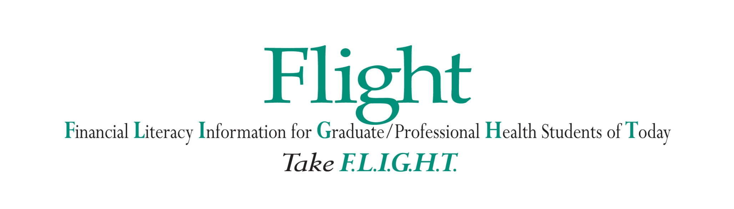

Slide 23
Student Loan History

Slide 24
NSLDS – Loan History
The National Student Loan Data System (NSLDS) is the U.S. Department of Education's (ED's) central database for student aid. NSLDS receives data from schools, guaranty agencies, the Direct Loan program, and other Department of ED programs. NSLDS Student Access provides a centralized, integrated view of Title IV loans and grants so that recipients of Title IV Aid can access and inquire about their Title IV loans and/or grant data.

Slide 25
Nslds.ed.gov
View your federal student aid history
Get your loan servicer’s contact information
Download your federal student aid history into a text file using the MyData Download function

Slide 26

Student Loan Repayment Plans

Slide 27
Accrued Interest
Accrued interest is the amount of loan interest that is accruing while you are in-school, but has not yet been paid to the lender by the borrower.

Slide 28

Understanding Repayment Plans
Student borrowers may repay their student loans through one of the several repayment plans:
Standard Repayment
Graduate Repayment
Income Base Repayment (IBR)
Pay As You Earn (PAYEE)

Slide 29
Standard Repayment Plan
Standard Repayment
Graduate Repayment
Income Base Repayment (IBR)
Pay As You Earn (PAYEE)
Under this plan, the borrower will pay a fixed amount of at least $50 each month for up to 10 years. For most borrowers, this plan results in the lowest total interest paid because the repayment period is shorter than it would be under any of the other repayment plans.
(Subsidized, Unsubsidized and PLUS Loans)

Slide 30
Graduated Repayment Plan
The Graduated Repayment Plan may be beneficial if the borrower’s income is low when they leave school but is likely to steadily increase. Under this plan, payments start out low and then increases every two years.
Like the Standard Plan, the maximum repayment period is 10 years for Subsidized, Unsubsidized, and PLUS Loans.
Standard Repayment
Graduate Repayment
Income Base Repayment (IBR)
Pay As You Earn (PAYEE)

Slide 31
Income-Based Repayment
Standard Repayment
Graduate Repayment
Income-Base Repayment (IBR)
Pay As You Earn (PAYEE)
  Under IBR, monthly payment is based on the borrower’s Adjusted Gross Income (AGI), family size, and state of residence.
Monthly payments are adjusted each year according to changes in your income and family size – new application must be submitted.
An IBR fact sheet, calculator and Q&A is available on www.StudentAid.ed.gov

Slide 32
PAYE – Pay As You Earn
Standard Repayment
Graduate Repayment
Income Base Repayment (IBR)
Pay As You Earn (PAYEE)
New borrower - no outstanding balance on a Direct Loan or FFEL Program of federal loans.
All undergraduate loans must be paid in full and cannot be consolidated

Slide 33
PAYE – Pay As You Earn
20- Year Loan Forgiveness: If you repay under the Pay As You Earn plan, any remaining balance will be forgiven after 20 years of qualifying repayment.
10-Year Loan Forgiveness (PSLF): On-time, full monthly payments you make under Pay As You Earn (or certain other repayment plans) while employed full-time in a public service job will count toward the 120 monthly payments that are required to receive loan forgiveness through the Public Service Loan Forgiveness (PSLF) Program.

Slide 34

PSLF (Public Service Loan Forgiveness)
The PSLF Program is intended to encourage individuals to enter and continue to work full-time in public service jobs. Under this program, borrowers may qualify for forgiveness of the remaining balance of their Direct Loans if the borrower:
Is not in default
Makes 120 separate, full monthly payments, after Is employed full-time
Complete - Employment Certification Form

Slide 35
Public Service Loan Forgiveness
Eligible public service includes:
Service in a position in AmeriCorps or the Peace Corps
Local, State, Federal or Tribal government position
Employment, in any position, by any other public service
organization
A non-profit organization under 501(c)(3) of the
Internal Revenue Code that is exempt from taxation
under Section 501(a) of the Internal Revenue Code
Employment must meet the definition of “full-time”.
“Full-time” generally means the borrower is working an
average of at least 30 hours per week or the number of
hours the employer considers full-time.
An PSLF fact sheet and Q&A
is available on www.StudentAid.ed.gov

Slide 36
Postpone Payment
You can receive a forbearance that allows you to temporarily postpone or reduce your federal student loan payments. Postponing or reducing your payments may help you avoid default.
With forbearance, you may be able to stop making payments or reduce your monthly payment for up to 12 months.
Interest will continue to accrue on your subsidized and unsubsidized loans (including all PLUS loans).

Slide 37
Resources:
Financial Literacy Newsletter:
FLIGHT News
Financial Literacy Website
http://www.uthsc.edu/finaid/flight/index.php
Facebook Page:
UTHSC Flight
Financial Literacy Library:
    (located in the One-Stop)

Slide 38

Questions & Answers

Slide 39
Contact Information
Ms. Janice G. Maddox, MBA
Coordinator, Financial Literacy Counselor, College of Dentistry
One Stop Shop
(901) 448-1601
jmaddox9@uthsc.edu
Skype: Janice.maddox3

