Slide 1
Financial Aid
College of Pharmacy

Slide 2
Objective
How to apply for Financial Aid
Breakdown of Cost of Attendance
Unsubsidized Loans
Graduate Plus Loan
Mandatory Meeting

Slide 3
Applying for Financial Aid
PIN:
  www.pin.ed.gov
FAFSA Application:
  www.fafsa.ed.gov (School code: 006725)
Loan History:
  www.nslds.ed.gov
AAMC:
  www.aamc.org/stloan

Slide 4
Federal Direct Stafford Loan
1st year BSN students can borrow up to $12,500 (Independent) and $7,500 (Dependent)
4.66% Interest
  No payments while in school
  Payments begin six months after graduation
Aggregate Limit = $57,500 (Independent) and $31,000 (Dependent)

Slide 5
Federal Direct Parent PLUS Loan or Alternative Loan
Can be eligible for the difference between Cost of Attendance and other aid being received.
  Based on credit (co-signer)
  7.2% interest (Parent PLUS Loan)
  No payments while in school
  Payments begin six months after graduation
  www.studentloans.gov
  Alternative Loan: Interest rate determined by issuer of loan

Slide 6
2014-2015
In-State (1st Yr)Cost of Attendance
ESTIMATE
Tuition $10,004
Fees $7,124
Books and Supplies $1,478
Living Expenses $23,256
Total $41,862

Slide 7
2014-2015
Out-of-State (1st yr) Cost of Attendance
ESTIMATE
Tuition $30,006
Fees $7,124
Books and Supplies $1,478
Living Expenses $23,256
Total $61,864

Slide 8
Federal Direct Stafford Loan
1st year MSN students can borrow up to $20,500
6.21% Interest
  No payments while in school
  Payments begin six months after graduation
Aggregate Limit = $138,500

Slide 9
Federal Direct Graduate PLUS Loan
Can be eligible for the difference between Cost of Attendance and other aid being received.
  Based on credit (co-signer)
  7.2% interest
  No payments while in school
  Payments begin six months after graduation
www.studentloans.gov

Slide 10
2014-2015
In-State (1st Yr)Cost of Attendance
ESTIMATE
Tuition $15,658
Fees $5,063
Books and Supplies $1,585
Living Expenses $23,256
Total $45,562

Slide 11
2014-2015
Out-of-State (1st yr) Cost of Attendance
ESTIMATE
Tuition $37,738
Fees $5,063
Books and Supplies $1,585
Living Expenses $23,256
Total $67,642

Slide 12
One-Stop-Shop
Located in 910 Building on the 1st floor (across from the Sun Trust Bank)
Services available:
Financial aid
Bursar Office
Registrar Office
IT (information technology tech. ): 11:00 am – 2:00pm and 4:00 pm – 5:00pm beginning August 2 -20, 2013.

Slide 13
One-On-One
Must have a one-on-one counseling with financial aid counselor.
Skype
Telephone
Office Visit
MANDATORY!!!!!

Slide 14
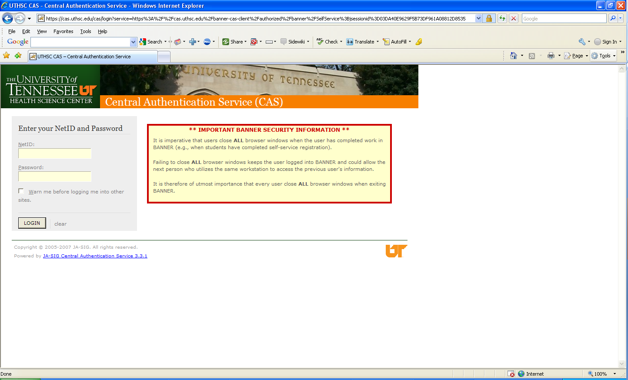
Banner Self-Service

Slide 15
Contact Information
Ms. Jacquelyn LeSueur
Financial Aid Counselor
College of Nursing
(901) 448-8324
jlesueur@uthsc.edu
Skype: jacquelyn.lesueur

Slide 16

Questions
Answers

