Slide 1


Cheat Sheets for everyday tasks

Slide 2
Table of Contents
Log in Process
Order Fulfillment Process Overview
Order Items Using the Shopping Cart
ADD a New Item to the System
UPDATE Existing Item Information
Requisitions: Filling and Delivering from General Stores
Suggested Reorder List
Receiving Items into General Stores
Receiving Items by User
Inventory Adjustments
Returns and Exchanges
Walk in Purchases
Physical Inventory
Common System Abbreviations and Terms

Slide 3
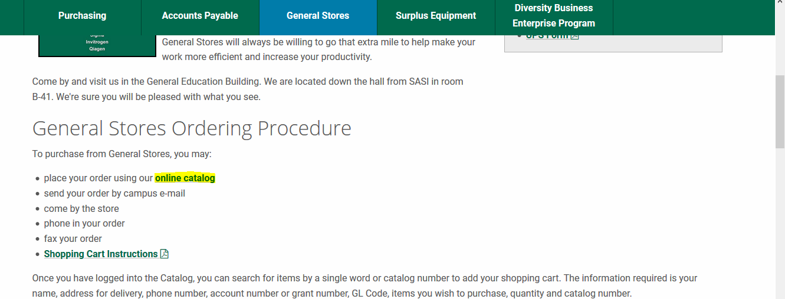
Click on the online catalog

Slide 4
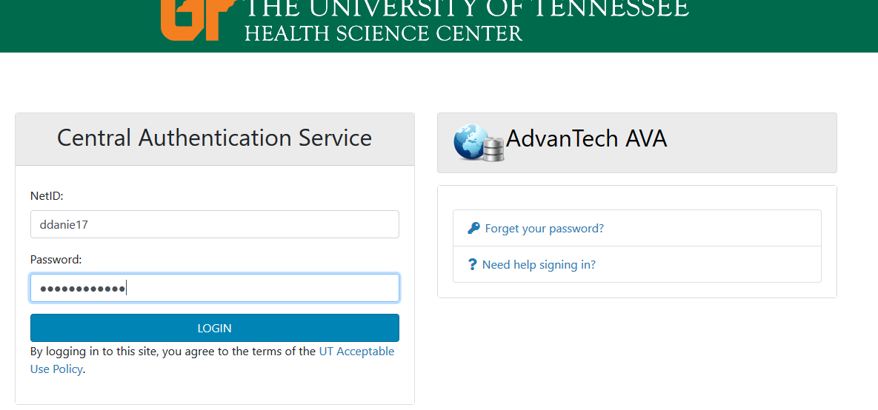
Click on the online catalog it takes you to the below log in screen. Sign in using your NetID and password and click login

Slide 5
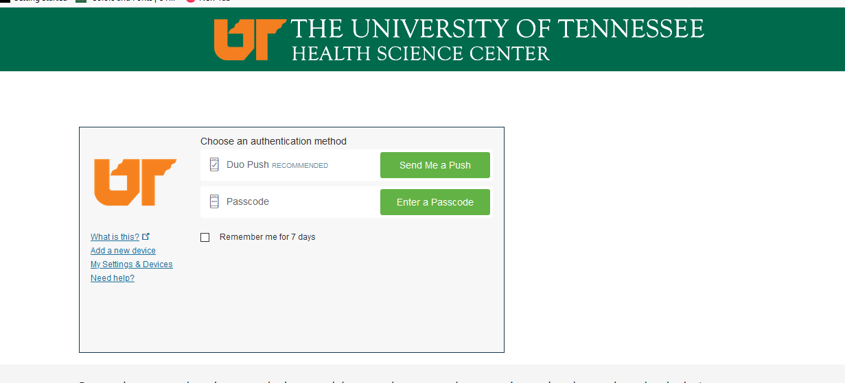
Click on LOGIN it takes you to the below where you select, "Send Me a Push".

Slide 6
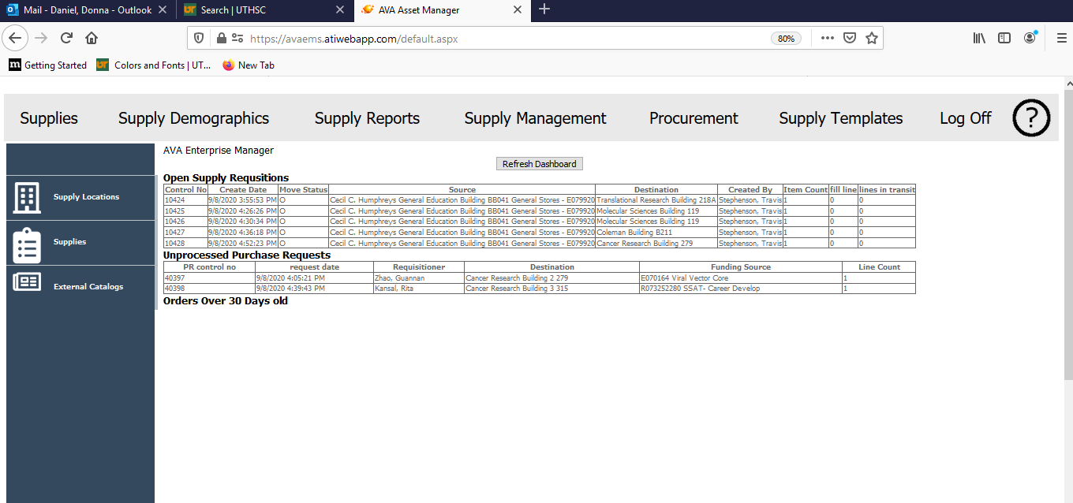
Receive the Push Notification on your phone. Accept it and it takes you to the below screen.
https://avaems.atiwebapp.com/SecureUTHSC/index.aspx

Slide 7
End User creates Shopping Cart
Stocked Item?
Open Purchase Request Created
Unprocessed Purchase Request
Appears on Suggested Order List
Order Fulfillment Process
Overview
Open Requisition Created
General Stores Review
Fillable Lines?
List downloaded and edited
Orders Placed with Vendors/UT Mktplace
View/Print from Purchase Document List
Orders Received into General Stores Inventory/ QOH Incremented
Purchase Order is Closed when all lines received
Unfillable Items on SOL
Fillable stock put In Transit
Qty Committed Incremented
QOH decremented
Items Delivered to End User
User badge is scanned to sign for receipt
Quantity Committed (in transit) is zeroed
Filled Requisition Lines are Closed
Requisition status is Closed or Partial if open lines remain

Slide 8

Order Items Using the Shopping Cart
Fill in Address::
Type 1st digit of room number,
System returns a list to select from
Top Ribbon:
Supply Management
Select UT Expense or Grant
Account Number that will pay
for purchase
SAVE Shopping Cart to Finish Later, message that cart is successfully saved will appear. If not saved and user navigated to a new screen, shopping cart items will be lost.
Blue Side Bar:
Shopping Cart
Type in product number or name, click on box with …
Catalog will load and select item to order
Tab over to quantity to order and enter quantity needed
OR
SUBMIT shopping cart and items will be ordered. Message that cart has been successfully submitted will appear.
To Order Additional Items:
Tab to next line or click in box on next line. Select the item and quantity from the catalog. Continue until order is complete for that Expense Account
NOTE:
Shopping carts that have been submitted and are
waiting to be fulfilled will appear on your
Supply Locations Dashboard under the
heading Open Supply Requisitions .
Status will be “O” for Open.
IF the item you need is not in the catalog, email Travis at:
stephe1@uthsc.edu to request a direct purchase

Slide 9
ADD a New Item to the System
Fill in Stockroom::
Type a letter or 2 of the name,
System returns a list to select from
Top Ribbon:
Procurement
Fill in other required fields.
* Starred fields are required
SAVE
System will tell you if there are required fields missing
Blue Side Bar:
Create a New Supply Item
Important For Suggested Order List -
Fill in ROP (Reorder Point – qty at which item should be ordered
and ROQ (Reorder Quantity – qty that should be ordered)
Provide the ABC Code:
A – stocked Item
X – non-stocked item
0 – direct purchase item

Slide 10
UPDATE Existing Item Information
Select the Stockroom::
Click on one from the list -- OR --
Type a few letters of the name followed by %,
System returns a list to select from
Top Ribbon:
Supplies
Search for the Item:
By number or Name
Wildcard character % can be before and/or after any part of the name
Click on the Pencil Icon to the right of the item you want to select
Blue Side Bar:
Supply Locations
SAVE
System will tell you if there are required fields missing
Update the Item information you want to change:
Current values are populated
Fields you can change have boxes
* Required fields are flagged with an asterisk
Active Item: Item is currently used and should be available to
order - checkbox
Manager Controlled Levels: Restocking levels (ROP and ROQ) are
manually set – if unchecked they are calculated based on
past usage. To start all items will be manager controlled.
Provide the Required ABC Code:
A – stocked Item
X – non-stocked item
0 – direct purchase item

Slide 11
Requisitions: Filling and Delivering from General Stores
Sort Documents by STATUS = O or P for open or partial
Search by drop down for specific information
Click on requisition containing items to pull from stock
Make note of quantity on hand to fill requisition
If no stock is on hand to fill requisition, place order with vendor or UTM
Top Ribbon:
Supply Management
Requisition becomes a Purchase Document
If QOH is enough to fill order:
Type in transfer method in Transfer Method Box
Type in tracking number IF NEEDED
Enter QTY in QTY Pulled box
Click on PLACE IN TRANSIT
Blue Side Bar:
Requisitions
Arrive at Destination:
Find Document in transit (Status T)
Enter qty received by user and click SUBMIT
Scan user’s barcode with tablet
Alternate method:
Type user’s pin from badge, hit ENTER key,
Click on SIGN button
Item is received at destination

Slide 12
Suggested Reorder List
Top Ribbon:
Supply Templates
Procurement Documents | Suggested Reorder list | Daily_SQL.xlsx
Blue Side Bar:
Download
Download Spreadsheet template
Enter Quantity to order for each item
Delete items that do not need to be ordered at this time
Save spreadsheet on your Desktop or Documents
Click CHOOSE FILE button:
Select the saved spreadsheet
Click UPLOAD FILES
Message will pop up saying file was uploaded successfully
Blue Side Bar:
Upload

Slide 13
Receiving Items into General Stores
Sort Documents by STATUS
Search by drop down for specific information
Click on PO containing items to receive
Top Ribbon:
Procurement
Enter quantity received in box
Click on Receive Button
Item is added to General Stores inventory
Blue Side Bar:
Purchase Documents
Alternate method:
Download receiving template and enter quantities for large POs
Save template spreadsheet
Upload spreadsheet in Supply Templates under Receiving Data line
If item goes onto a user instead of into General Stores stock, use Receiving Items by user sheet

Slide 14
Receiving Items by User
Top Ribbon:
Supply Management
Pull items from shelf for delivery
Log in on tablet and check battery life
Blue Side Bar:
Requisitions
Arrive at Destination:
Find Document in transit (Status T)
Enter qty received by user and click SUBMIT
Scan user’s barcode with tablet
Item is received at destination
Alternate method:
Type user’s pin from badge, hit ENTER key,
Click on SIGN button

Slide 15
Inventory Adjustments
Top Ribbon:
Supply Management
Pull items from shelf for delivery
Log in on tablet and check battery life
Blue Side Bar:
Arrive at Destination:
Find Document in transit (Status T)
Enter qty received by user and click SUBMIT
Scan user’s barcode with tablet
Alternate method:
Type user’s pin from badge, hit ENTER key,
Click on SIGN button

Slide 16
Returns and Exchanges
Top Ribbon:
Supply Management
Pull items from shelf for delivery
Log in on tablet and check battery life
Blue Side Bar:
Arrive at Destination:
Find Document in transit (Status T)
Enter qty received by user and click SUBMIT
Scan user’s barcode with tablet
Alternate method:
Type user’s pin from badge, hit ENTER key,
Click on SIGN button

Slide 17
Walk in Student Purchases
Top Ribbon:
Supply Management
Pull items from shelf for delivery
Log in on tablet and check battery life
Blue Side Bar:
Arrive at Destination:
Find Document in transit (Status T)
Enter qty received by user and click SUBMIT
Scan user’s barcode with tablet
Alternate method:
Type user’s pin from badge, hit ENTER key,
Click on SIGN button

Slide 18
Physical Inventory
Top Ribbon:
Supply Management
Pull items from shelf for delivery
Log in on tablet and check battery life
Blue Side Bar:
Arrive at Destination:
Find Document in transit (Status T)
Enter qty received by user and click SUBMIT
Scan user’s barcode with tablet
Alternate method:
Type user’s pin from badge, hit ENTER key,
Click on SIGN button

Slide 19
Physical Inventory
Top Ribbon:
Supply Management
Pull items from shelf for delivery
Log in on tablet and check battery life
Blue Side Bar:
Arrive at Destination:
Find Document in transit (Status T)
Enter qty received by user and click SUBMIT
Scan user’s barcode with tablet
Alternate method:
Type user’s pin from badge, hit ENTER key,
Click on SIGN button

Slide 20
Common System Abbreviations and Terms

