Slide 1

Business Rental Presentation
University of Tennessee
October 20th, 2016
Ericka Dombroski

Slide 2
Agenda
State of TN Program
  Rates
Emerald Club Program
  Emerald Club Benefits
How to Reserve a Vehicle
Q&A

Slide 3
State of Tennessee Agreement

Slide 4
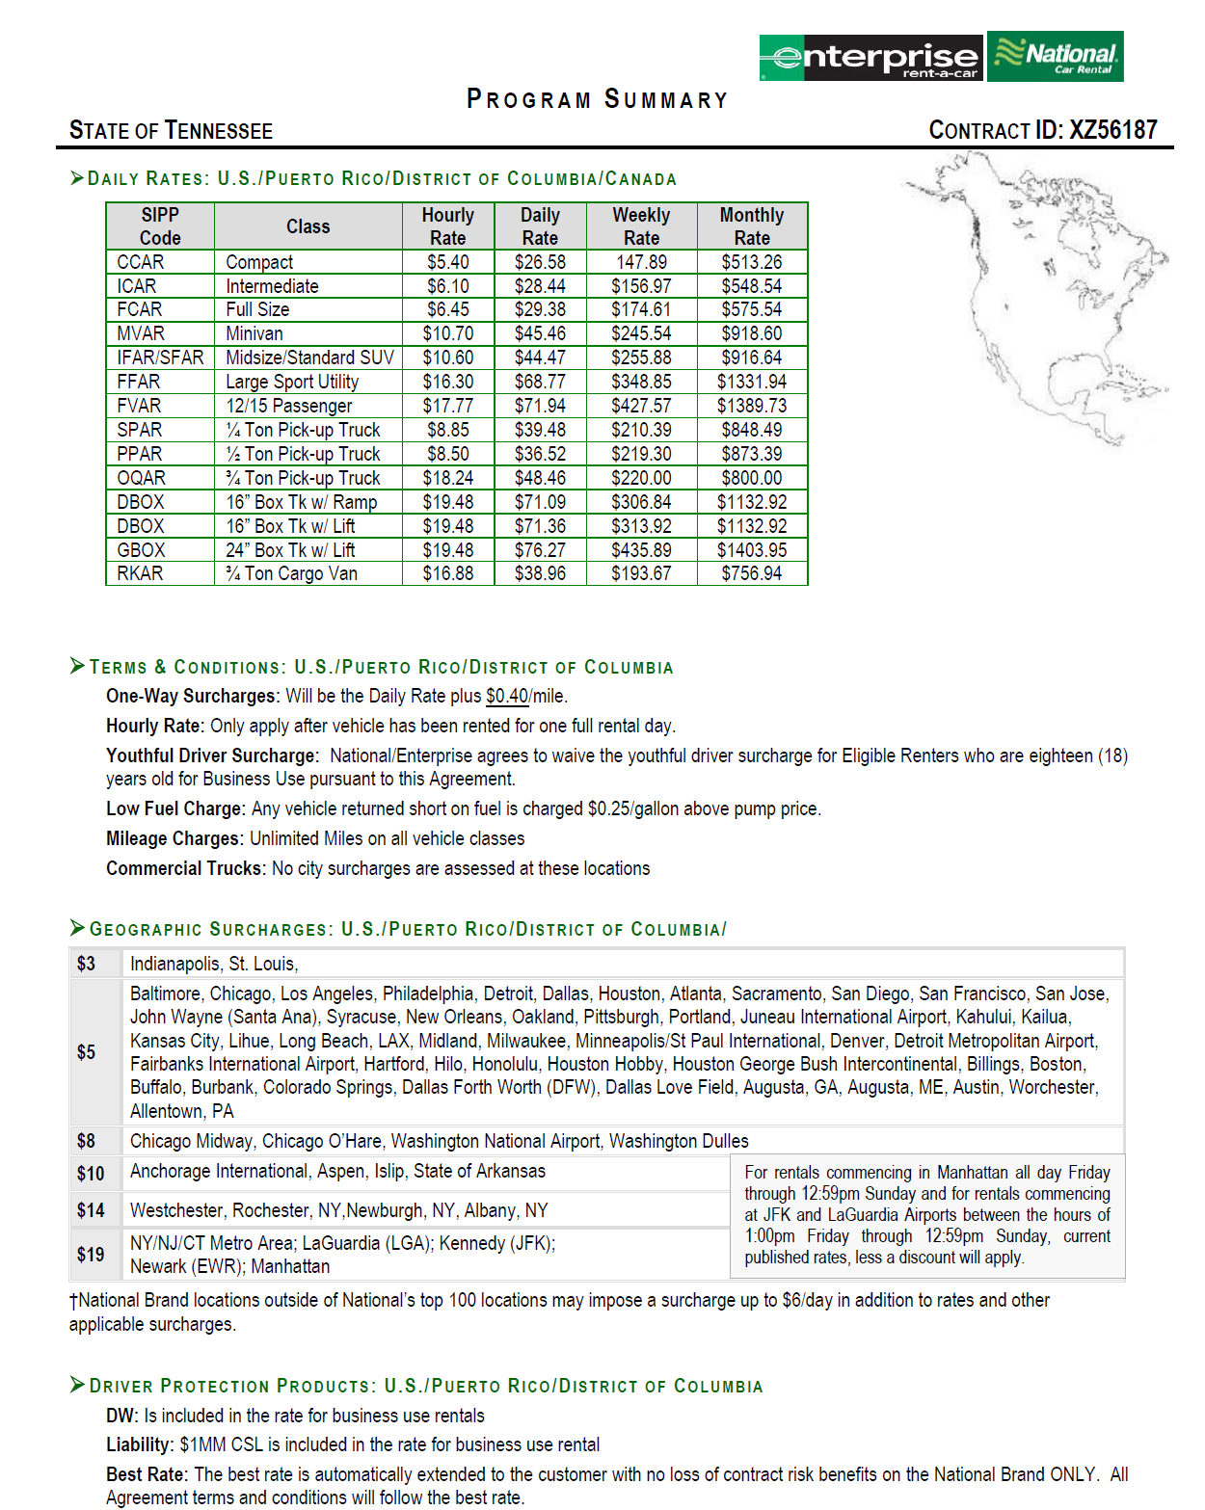
4
For rentals commencing in Manhattan all day Friday through 12:59pm Sunday and for rentals commencing at JFK and LaGuardia Airports between the hours of 1:00pm Friday through 12:59pm Sunday, current published rates, less a discount will apply.
through 12:59pm Sunday, current published rates, less a discount will apply.

Slide 5
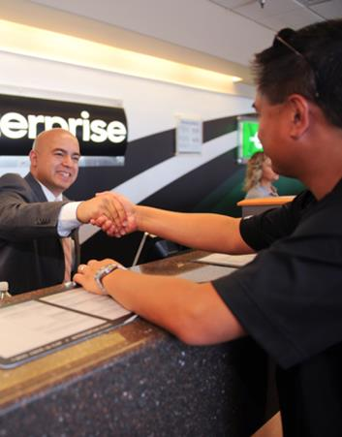
How to Reserve a Vehicle
Reservations
The State of University of Tennessee has a specialized website for all car rental needs (copy and paste this into your web browser):
http://www.enterprise.com/car_rental/deeplinkmap.do?bid=028&refId=UNITENN
5

Slide 6
Company / Industry Overview

Slide 7







About Enterprise Holdings
$17.8 billion
83,000
1.7 million
in annual revenue
employees
vehicles
8,600
more than
70
fully staffed neighborhood and airport locations
countries and territories
Only U.S.
investment-grade
car rental company
One of America’s Largest Private Companies
according to Forbes

Slide 8
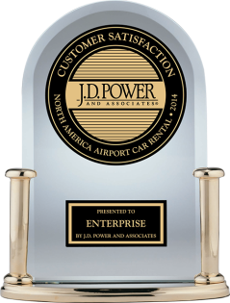
Enterprise Ranks Highest
Enterprise Rent-A-Car ranked “Highest in Rental Car Customer Satisfaction” in the J.D. Power 2015 Rental Car Satisfaction Study
Surveyed leisure and business travelers who rented vehicles at North American airports
“We know how hard our employees work every day to put customers first. We also know that listening to feedback – positive as well as negative – is the key to long-term success. So we not only are honored by this recognition, but also grateful for the continued trust and confidence of our customers, clients and partners.”
~ Pam Nicholson, CEO and president of Enterprise Holdings
Enterprise received the highest numerical score among rental car companies in the proprietary J.D. Power 2014 North American Rental Car Satisfaction StudySM. Study based on 12,308 responses measuring 8 companies and measures opinions of business and leisure travelers who rented a vehicle at an airport location. Proprietary study results are based on experiences and perceptions of surveyed in September 2013 - August 2014. Your experiences may vary. Visit jdpower.com.
Notes:
http://www.enterpriseholdings.com/press-room/enterprise-rent-a-car-ranks-highest-in-jd-power-2014-rental-car-satisfaction-study.html
ENTERPRISE RENT-A-CAR RANKS HIGHEST IN J.D. POWER 2014 RENTAL CAR SATISFACTION STUDY
Enterprise, National and Alamo Brands All Above Industry Average
ST. LOUIS, Mo. (Nov. 11, 2014) – Enterprise Rent-A-Car is the highest-ranked car rental brand in the J.D. Power 2014 North American Rental Car Satisfaction StudySM . The Enterprise brand received the highest score for the ninth time in the past eleven years, and excelled in all six factors: costs and fees; pick-up process; rental car; return process; reservation process; and shuttle bus/van.
Enterprise Rent-A-Car is owned by Enterprise Holdings, the largest car rental company in the world. Enterprise Holdings also operates the National Car Rental andAlamo Rent A Car brands. National ranked second in the annual study, followed by Alamo (tied for third) – with all three brands once again finishing above the industry average.
The annual 2014 study surveyed leisure and business travelers who rented vehicles at North American airports. “We know how hard our employees work every day to put customers first,” said Pam Nicholson, Chief Executive Officer and President of Enterprise Holdings. “We also know that listening to feedback –positive as well as negative – is the key to long-term success. So we not only are honored by today’s recognition, but also grateful for the continued trust and confidence of our customers, clients and partners.”
Both the Enterprise Rent-A-Car and National Car Rental brands were recognized earlier this year as J.D. Power Customer Champions. Five factors – people, presentation, process, product and price – were examined, with feedback, opinions and perceptions primarily gathered from J.D. Power’s syndicated research in 2013. Only 50 brands total earned this distinction, and Enterprise and National were the only two car rental brands to be recognized as Customer Champions.
“Today’s car rental marketplace is highly competitive,” Nicholson stated, “so our portfolio of brands is specifically designed to meet the diverse needs of car rental customers across the board, from cost-conscious families to road warriors to leisure travelers. Recognition like this from J.D. Power tells us that our customer-focused strategy is making a difference in the car rental and travel industries.”
In fact, when an Enterprise Holdings executive delivered this spring’s Car Rental Show keynote address, he reiterated the significance of customer relationships: “The car rental industry meets people’s very real, important and urgent needs. … Our world will continue to change: innovation will drive growth, technology will drive growth and customer preferences will drive growth. Whether we, as individual companies or an industry, succeed or fail will come down to one simple thing – how we deal with each customer.”

Slide 9





Customer Service
Best
Rental Car Overall
Best
Rental Car Company Loyalty Program
&
Best
Car Rental Company
in North America
Best
Rental Car
Company
Best
Rental Car
Company
Best
Car Rental Company
in the World
Notes:
National was selected “Best Rental Car Company Overall” and “Best Rental Car Company Loyalty Program” as part of the Executive Travel magazine’s 2013 Leading Edge Awards.
National was named the “Best Car Rental Company in North America” at the 26th Annual “Best in Business Travel” Awards by Business Traveler magazine.
Global Traveler 2013 GT Tested Awards Survey named National the “Best Car Rental Company”.
Premier Traveler named National “Best Car Rental Company in the World” for the Best of 2014.
Enterprise was named “Most Admired Car Rental Company” for 2014 in The Beat Readers’ Choice Awards. This is the 5th consecutive year for this honor.
The 2015 Travel + Leisure “World’s Best Awards” ranked National No. 1 in the “Car Rental Agencies” category, followed by Enterprise and Alamo, respectively.
9

Slide 10
Emerald Club Loyalty Program

Slide 11
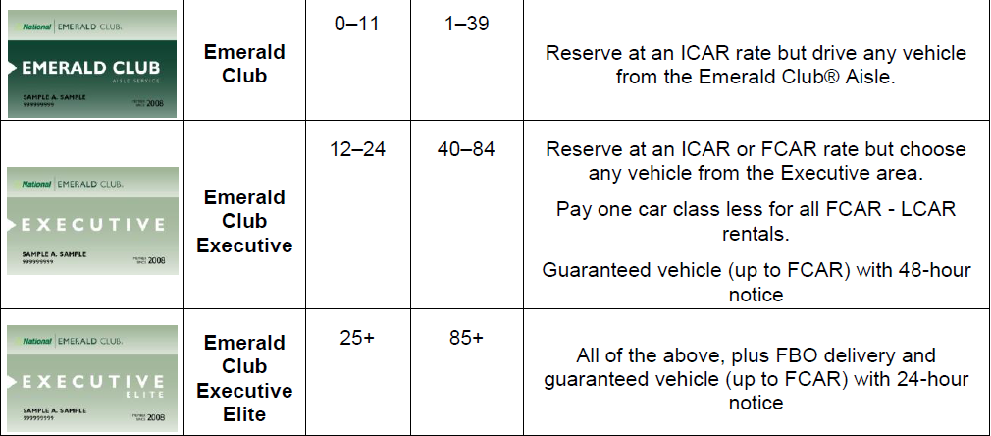
Emerald Club
Membership Annual Annual Benefits
Level Rentals Rental
Days

Slide 12
Emerald Aisle: 3 Easy Steps
1.
Reserve and Pay for a Midsize Car
2.
Bypass the Counter
3.
Choose any Car
http://www.emeraldaisle.com/main/home/iataNumber/NC002328/affiliateRes/Y
Notes:
Reserve a Midsize
Always reserve a midsize car to begin your Emerald Aisle experience
Bypass the Counter
Go straight to the Emerald Aisle; the keys are in the cars
Choose Any Car
Any size, color, make or model on the Emerald Aisle is yours at the reserved midsize rate

Slide 13
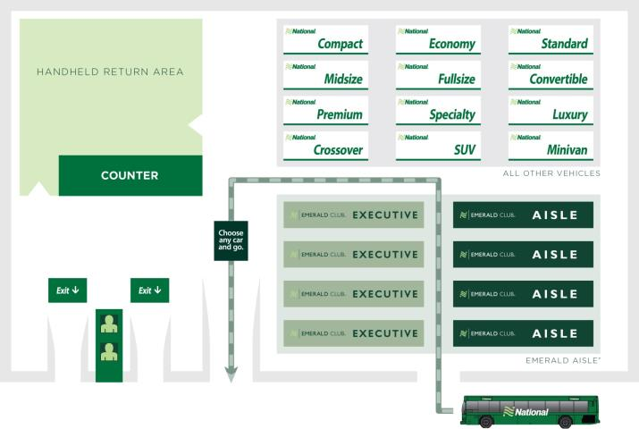
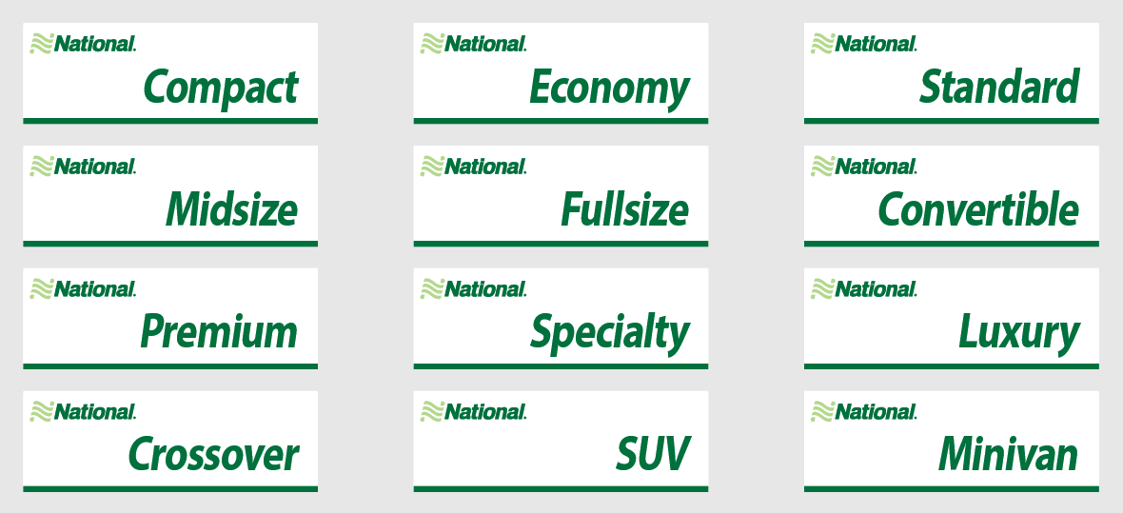





Emerald Club Lot Design
This is an example for illustration purposes; not all lots will look the same.

Slide 14
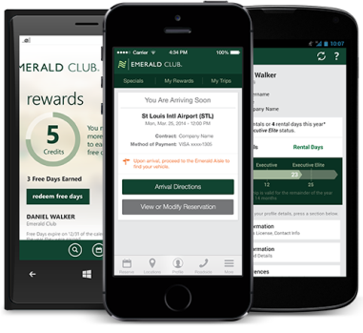
National Car Rental App
Single point of contact to manage rentals from reservation to return. Features allow you to:
  Make, modify and cancel reservations
  Track, extend itineraries
  Drop& Go Receipts
    (Sign up for this in your profile)
  Manage profile
  Map pickup and drop off locations
  View Emerald Club
  membership card
  Redeem Free Rental Days
  Access roadside assistance and
  customer service
  Take advantage of Virtual
  Aisle at select locations
Notes:
National continues to differentiate itself by carefully researching and integrating the important tools and on-the-go utility essential to today’s business travelers. Its primary goal is to focus on making business travelers more efficient when they’re on the road, offering speed, choice and control.

Slide 15





Total Transportation SolutionSM
15
Car Sharing
Truck Rental
Vanpooling (Rideshare)
Fleet Management
Car Sales

Slide 16

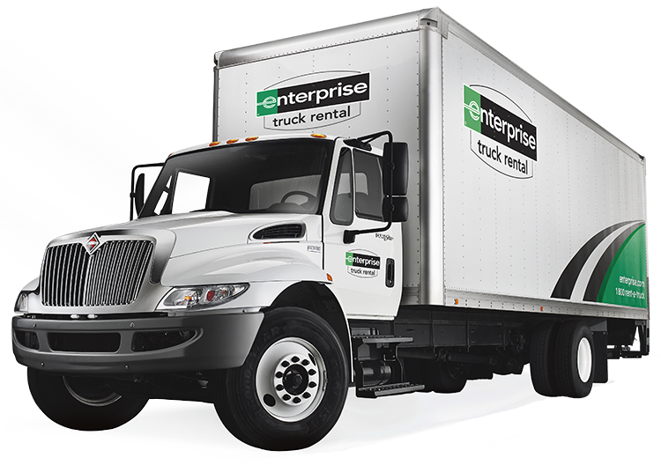
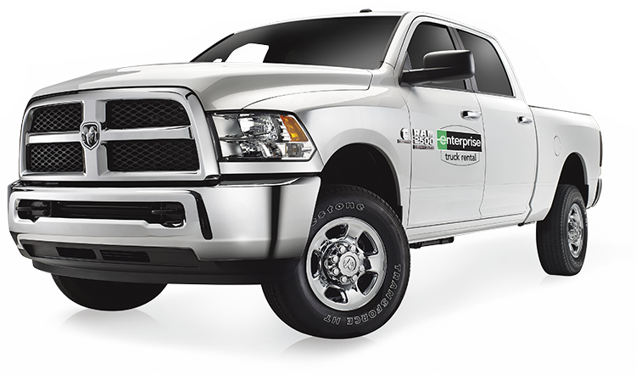
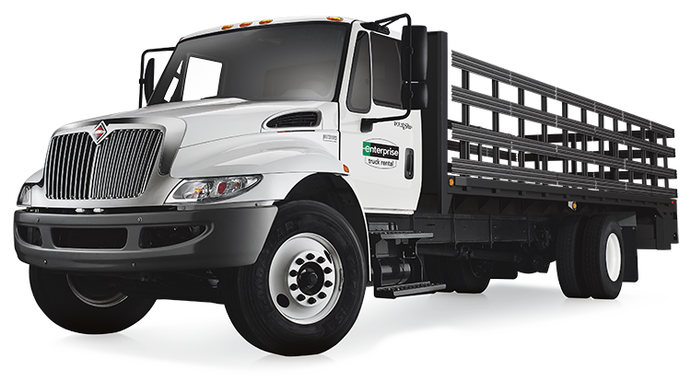
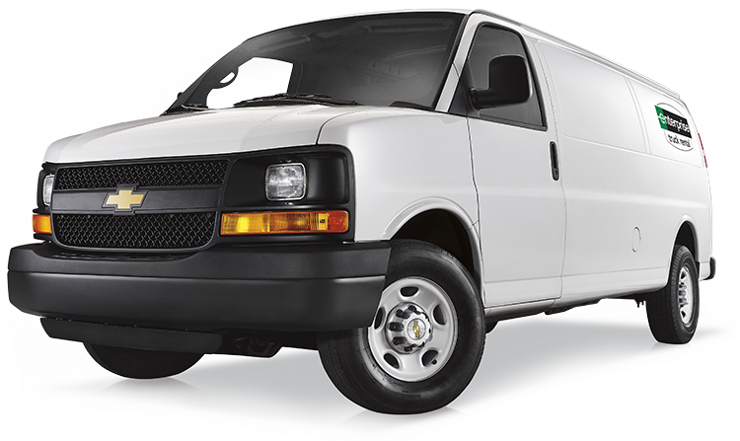
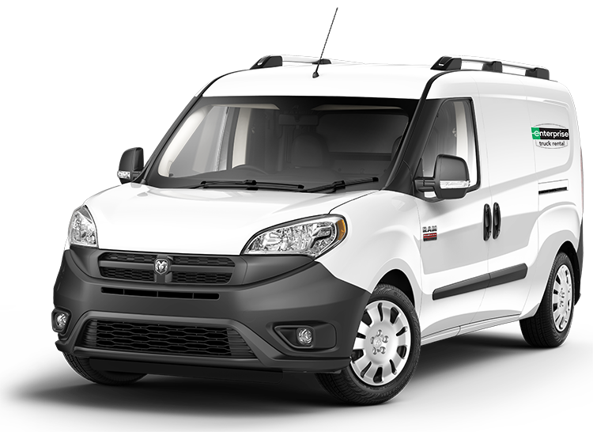
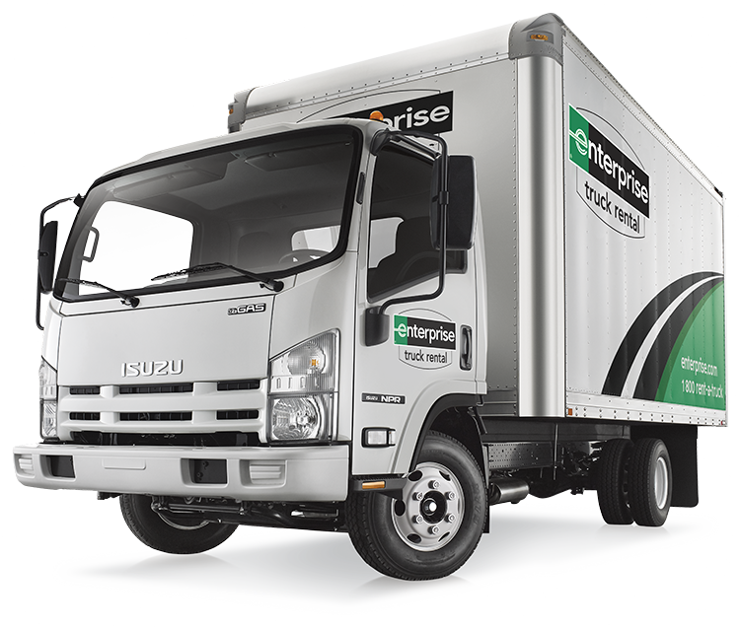
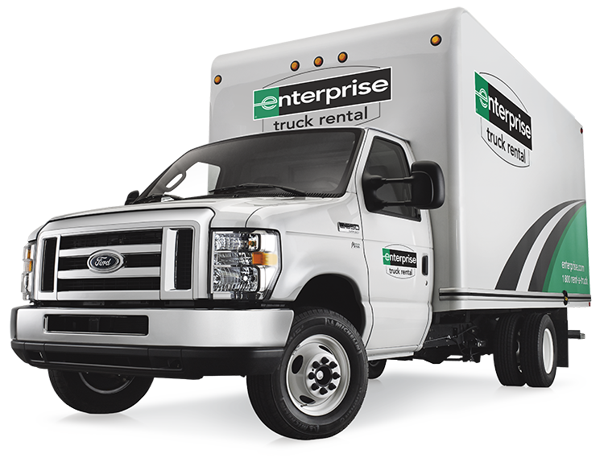
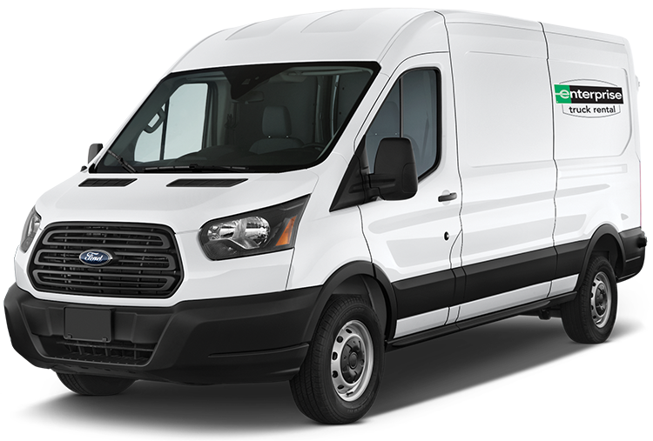
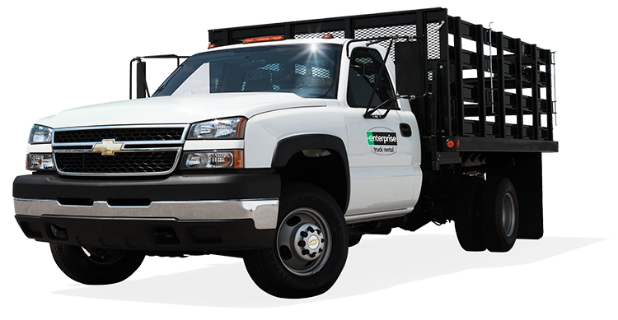

Enterprise Commercial Truck
24’ – 26’ Box Trucks
¾ Ton Pickup Trucks
20’ – 24’ Stakebeds
Cargo Vans
16’ Box Trucks
Compact Cargo Vans
Parcel Vans
High Roof Vans
12’ – 16’ Stakebeds
Rate plan is for illustration and subject to change. Final rates, terms and conditions are defined in rental agreements.
This document is proprietary and confidential.

Slide 17
Q & A

