Slide 1
Time Reports in ESS

Slide 2
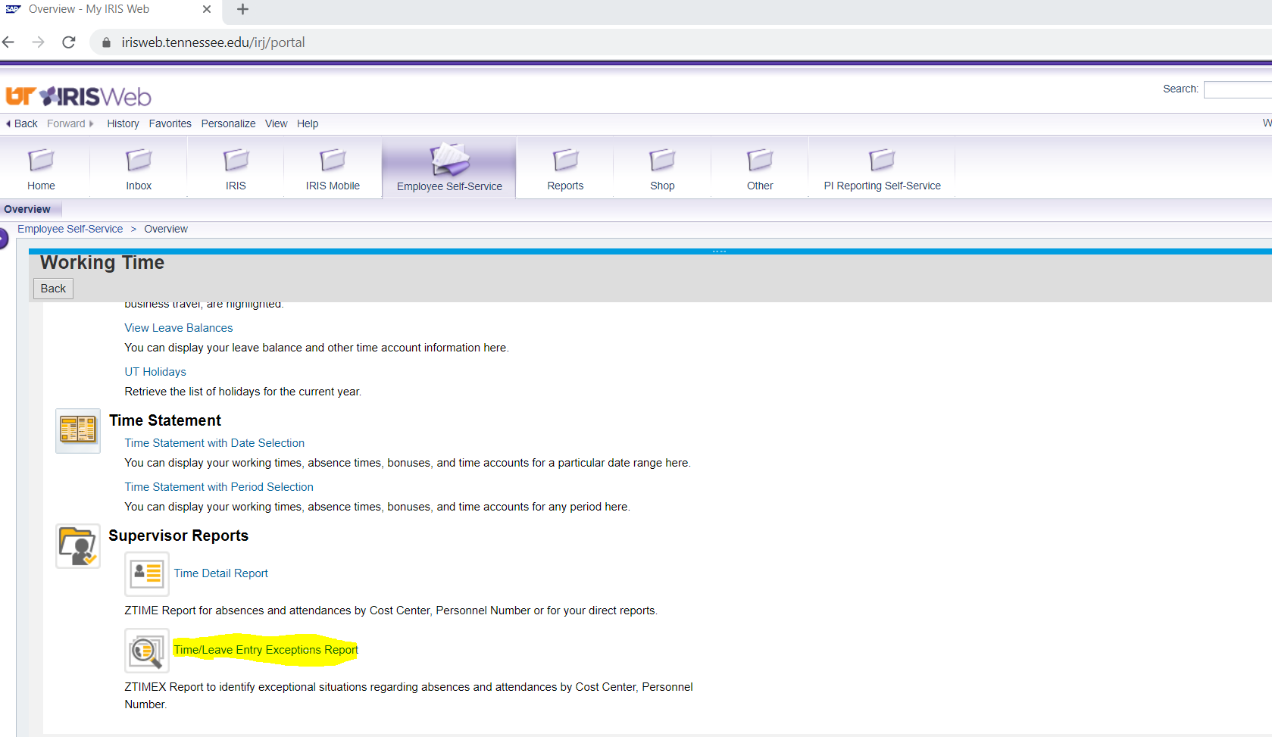
Time/Leave Entry Exception Report

Slide 3
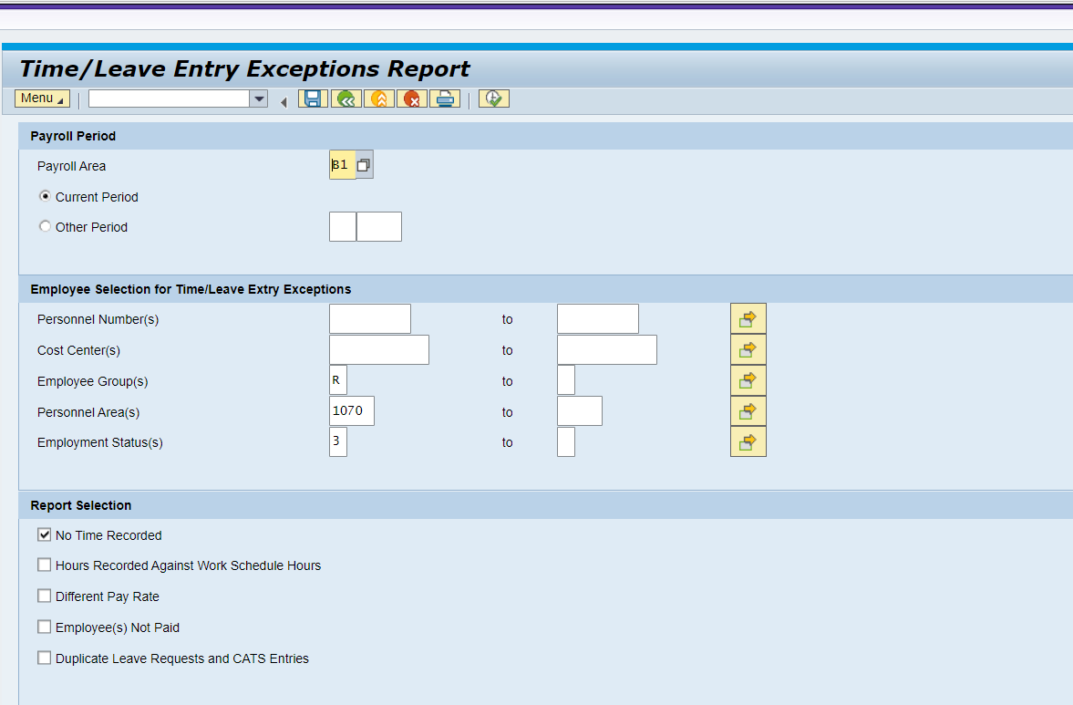
Parameters Selected for Employees with No Time Reported

Slide 4
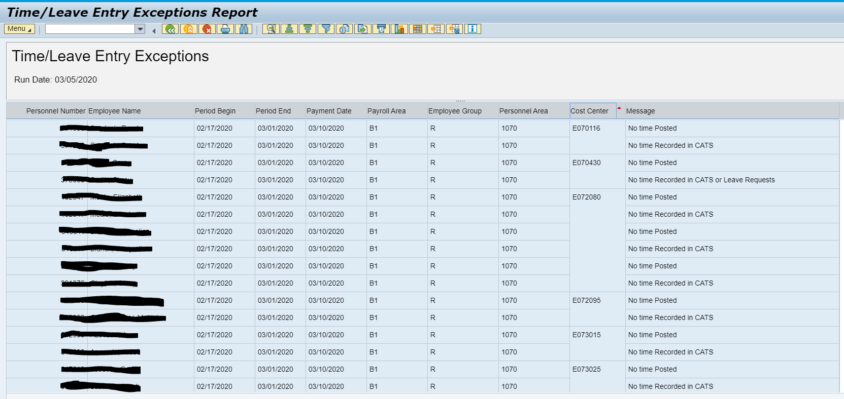
Employees with no time reported

Slide 5
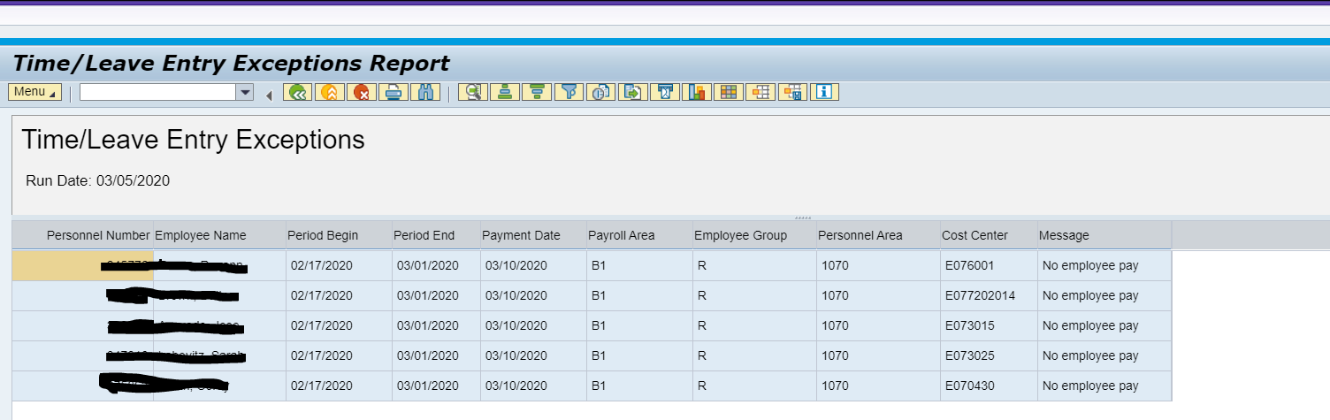
Employees Not paid

