Slide 1
Research News
New VCR
No-cost extension notices
New electronic routing and proposal development system

Slide 2
Dr. Steve Goodman
VCR for Research – starts July 27th
Contact: 901 448-7125; research@uthsc.edu

Slide 3
No-cost Extension Notices
R07XXXXXX, USPHS GRANT XX-0000050-xx, is expiring on 08/31/2015 according to the award documents in the Campus Business Office. If you are aware of an extension, please notify your Campus Business Office Grant and Contract Accountant, Murrell, Brenda [BMURRELL@TENNESSEE.EDU] to change the ending date in IRIS. If you need a time extension, please contact your campus research office for assistance.
Please let your faculty know that they should contact you, not ORA.

Slide 4
Evisions Coming Soon
Replacing PAMS
Similar look and function for routing
Adding “424” application
424 - “system-to-system” proposal submission for most federal grants
Will allow for storing institutional and individual profiles
DUNS #, EIN, tax ID, etc. will pre-fill
Salary, fringe info for individuals – can be stored
Errors show as you fill it in so you can fix them as you go

Slide 5
Evisions
Training to be provided closer to go-live
Go-live date not yet set, but possibly December

Slide 6
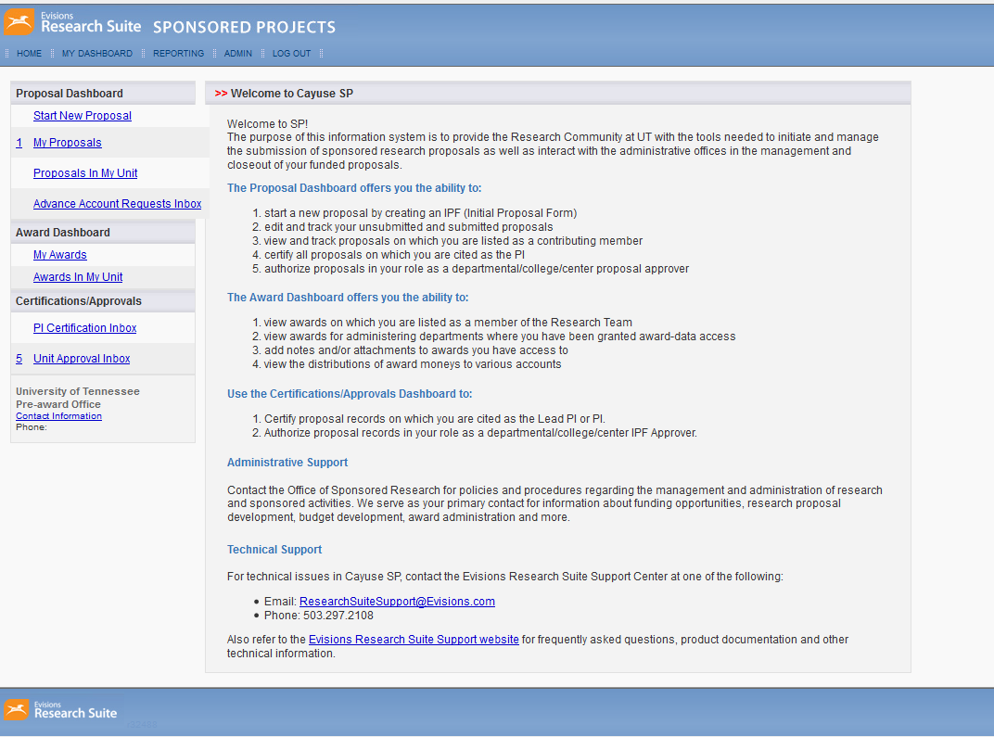

Slide 7
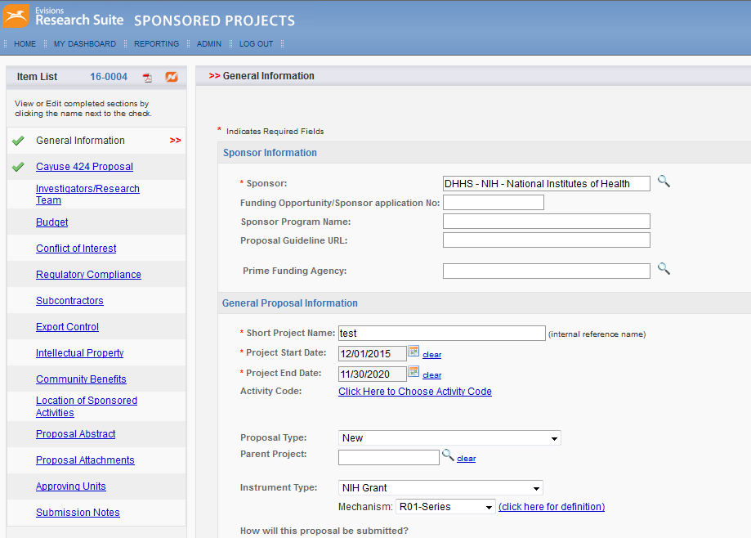

Slide 8
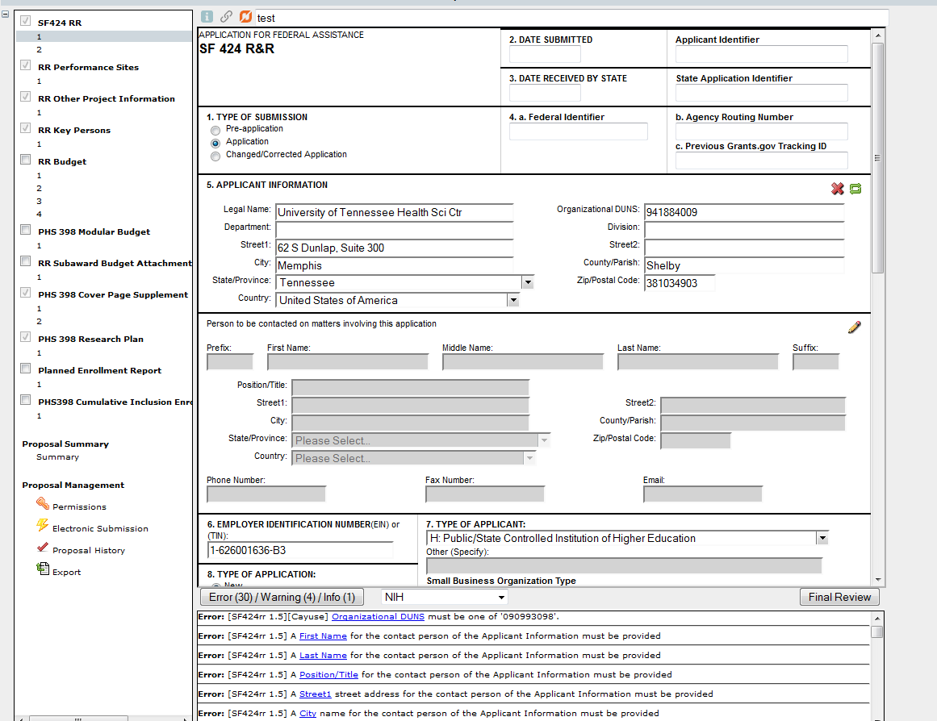

Slide 9
