Slide 1





PROCUREMENT SERVICES
Annual Inventory Verifications
Concur Travel Update
Surplus Update
Vendor Shows
Document Digitization

Slide 2
Annual Inventory Verifications
  Reminder that all Inventory Verification Reports are due on Friday, April 12th, 2019.
  Please do not wait until April 12th to complete your verifications. We are encouraging you to complete your inventory verification process early as this will provide time for the resolution of any issues that may arise.
  If there are any questions, please contact Linda Brown at ext. 8-4880.

Slide 3
Concur Travel Update
  The New Travel System SAP Concur
    Concur will give UT faculty and staff the ability to request, book, and expense travel all in one place.
    Individuals will be able to access the Concur online or by using a mobile application.
  Implementation Progress
    The design of the Request Module is being finalized.
    The Concur Implementation Team visited the HSC campus on February 19th and conducted a workshop on the Expense Module. The campus Travel Advisory Group (TAG) is currently testing the Expense Module and will provide feedback and recommendations to the Implementation Team.
    The “Go Live” and phased rollout is expected to occur this Fall (2019).

Slide 4
Surplus Update
  Surplus will soon have a new online application called, “The Exchange.”
  The Exchange will allow UTHSC Departments, Faculty and Staff with surplus property the ability to post UT assets for re-purposing to other areas/departments on campus.
  Departments in need of equipment will be able to search “The Exchange” for surplus equipment available on campus.
  Surplus equipment can be directly transferred to other departments at no cost and/or by sale.
  There will be Training Material as well as Frequently Asked Questions available on the Surplus Web Page.
  If there are any questions, please contact Jim Randolph at ext. 8-2955.

Slide 5
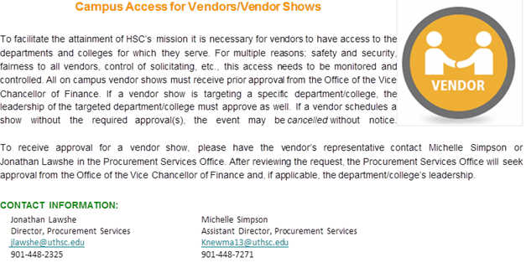
VENDOR SHOW
Friendly Reminder of recent post in The Bottom Line.
  The Office of the Vice Chancellor of Finance must preapprove any vendor shows.
  Contact Procurement Services to initiate the approval process.

Slide 6
Document Digitization
  UTHSC has issued a Framework PO, #5500007856, to Ricoh USA Inc. for document digitization services. Departments can use the PO to have files digitized. Please contact Chris Downey at one of the following sources:
      Mobile Phone 1-203-770-7036
      Office Phone: 1-704-302-1172
      E-mail: christopher.downey@ricoh-usa.com
  Once the Department receives a SOW, email the SOW to Procurement Services at purchasing@uthsc.edu . Purchasing will review and provide final approval to Ricoh.
  When the department receives an invoice, please pay the invoice against Framework PO# 5500007856. Do not pay invoices with No PO.
  Procurement Services is in negotiations with Canon for documentation digitization services as well. Procurement Services will provide an update when the Canon PO becomes available.

