Slide 1

INSTITUTIONAL COMPLIANCE UPDATES
Campus Wide Business Managers Meeting - November 19, 2020

Slide 2

OUTSIDE INTERESTS DISCLOSURE (OID) FORM
The new FY 2021 form, designed by the Office of General Counsel, collects more detailed information from employees disclosing potential conflicts of interest to help approvers/reviewers better evaluate compliance with UT’s Conflict of Interests Policy (FI0125) as well as federal rules and regulations.
For the vast majority of employees with nothing to disclose, the form and process have been streamlined to as few clicks as possible.

Slide 3
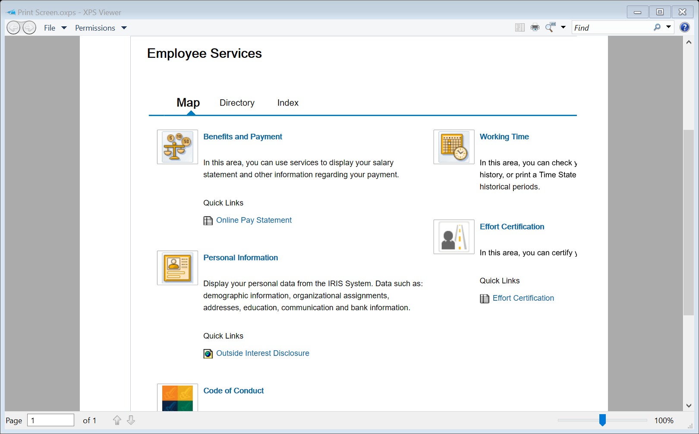
UT Homepage
https://uthsc.edu
Click on Resources
Click on MyUT & log in
Click on Employee Self-Service
Link located under Personal Information

Slide 4
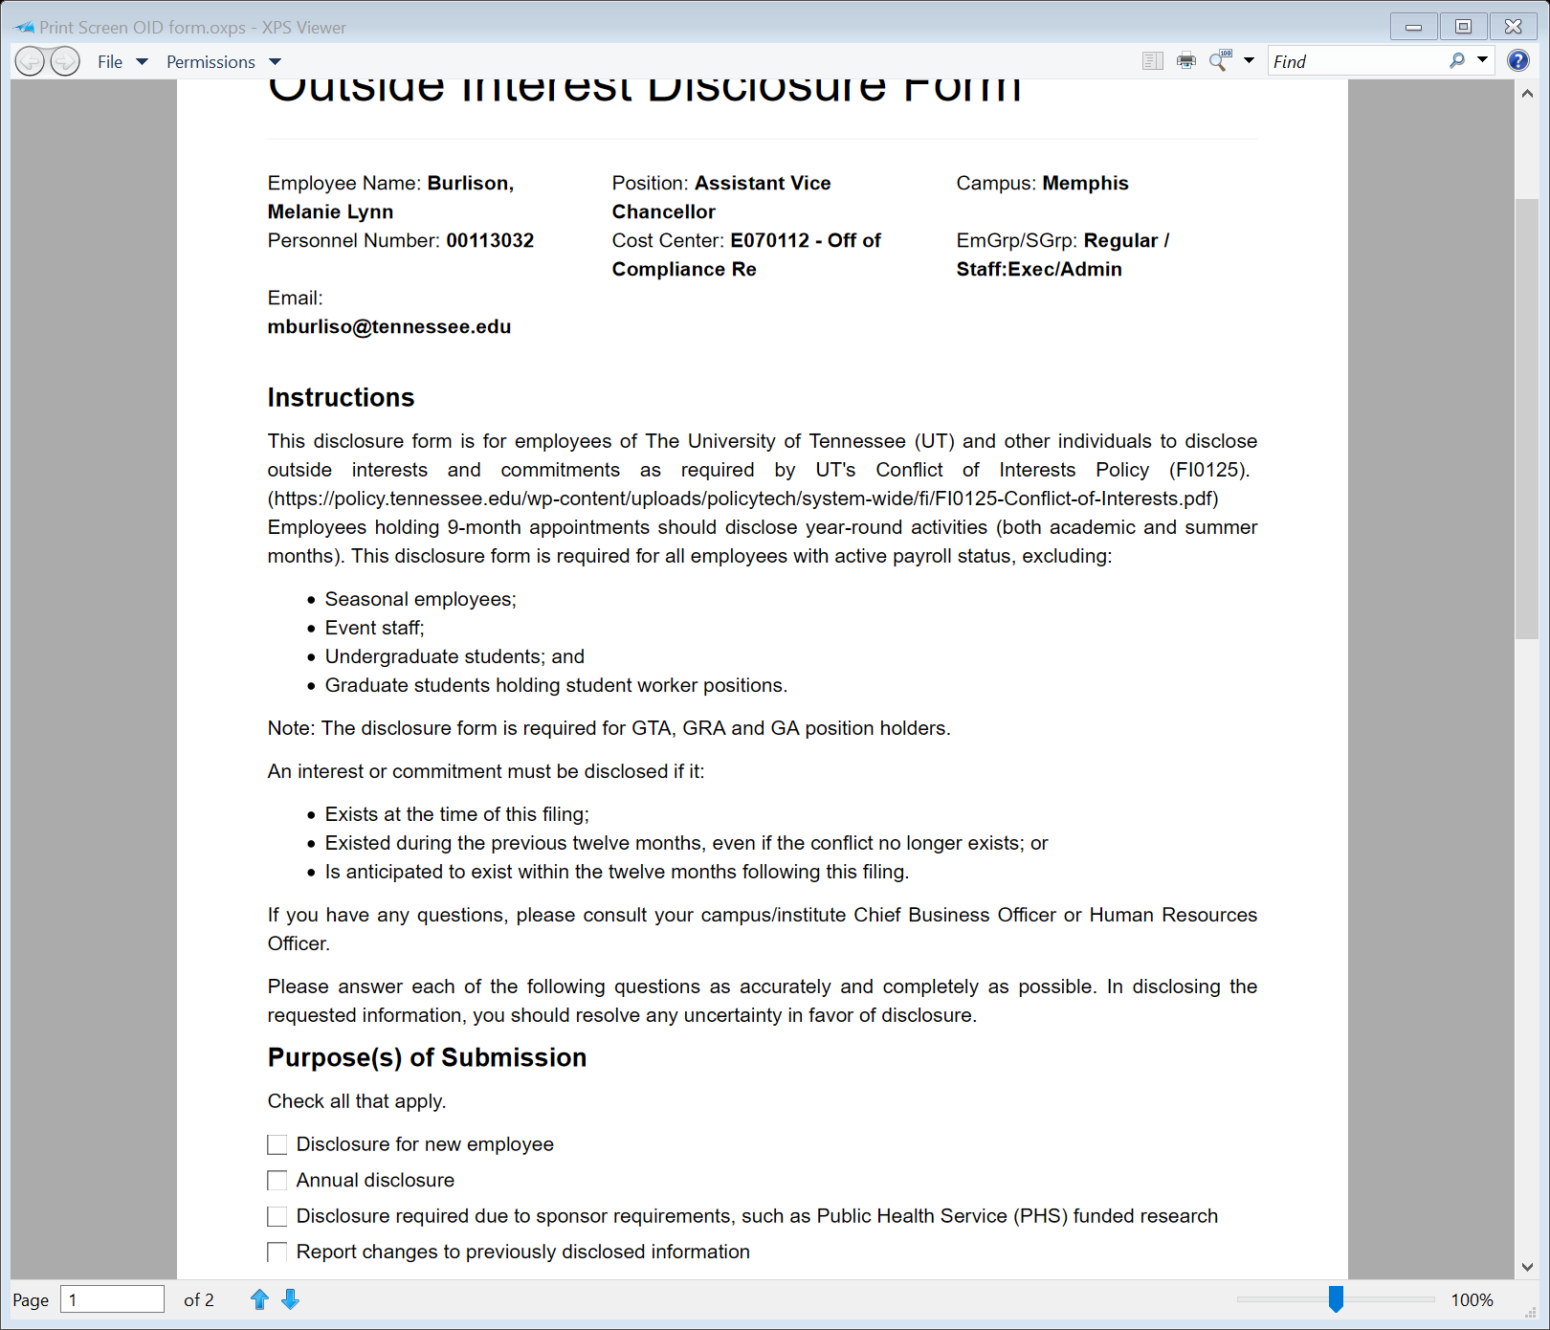

Slide 5
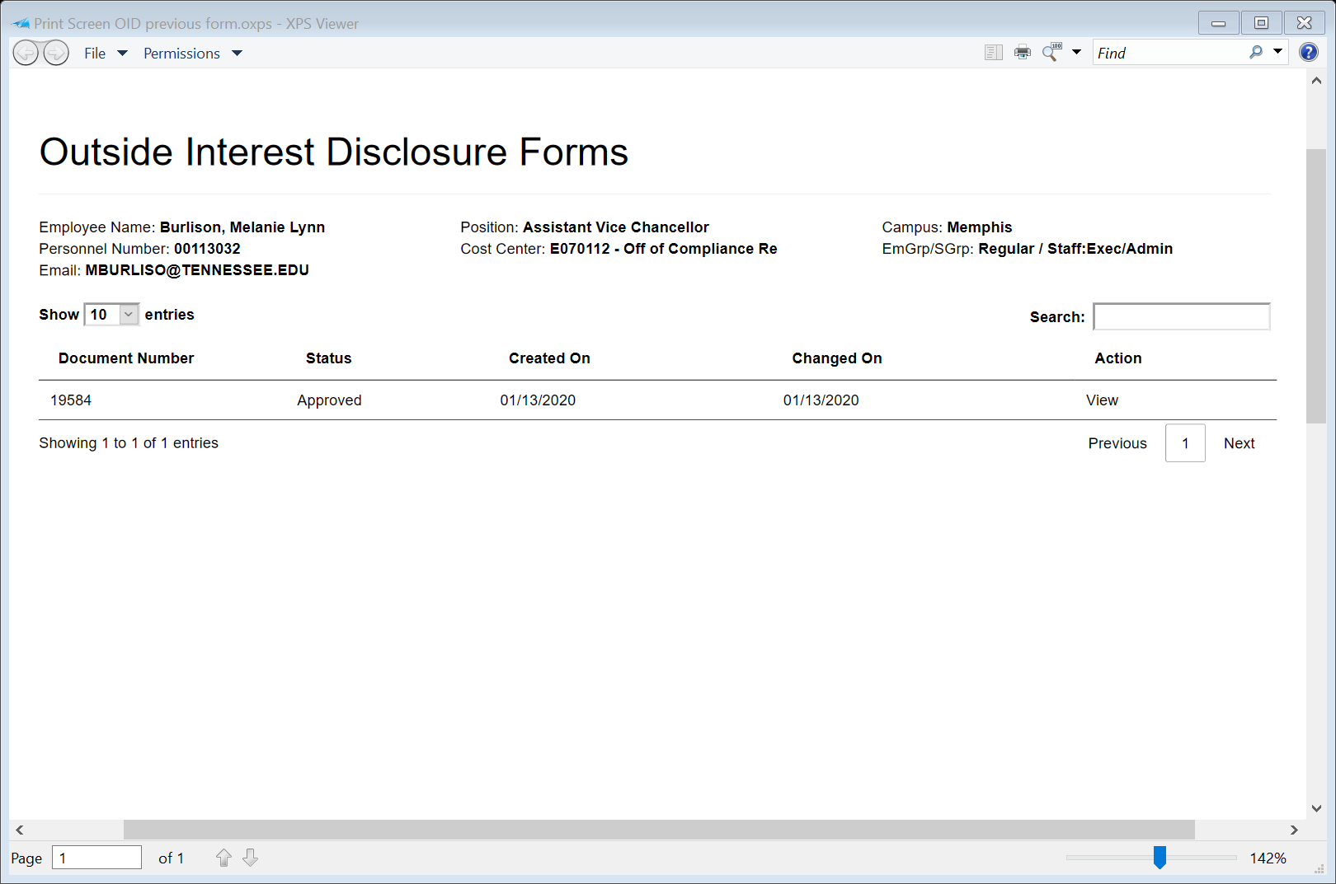

Slide 6
POSITION REPORTING RELATIONSHIPS
IT IS VERY IMPORTANT THAT THIS INFORMATION BE ACCURATE! All directors, business managers, and department heads should review each position in their respective departments and make corrections to positions.
IRIS Transaction ZHR_POS_REP_ORG
Confirm with each department head (including faculty) and the supervisor listed that the supervisor is indeed the supervisor for that employee(s).
If there is a discrepancy, please correct through the “change position” process in IRIS.
Make sure the supervisor is included for a new position, is corrected in IRIS when a change is made or a supervisor leaves that department. This should be an ongoing process.
PLEASE DO THIS REVIEW ASAP BEFORE THE NEW OID FORM IS LAUNCHED CAMPUS-WIDE!

Slide 7
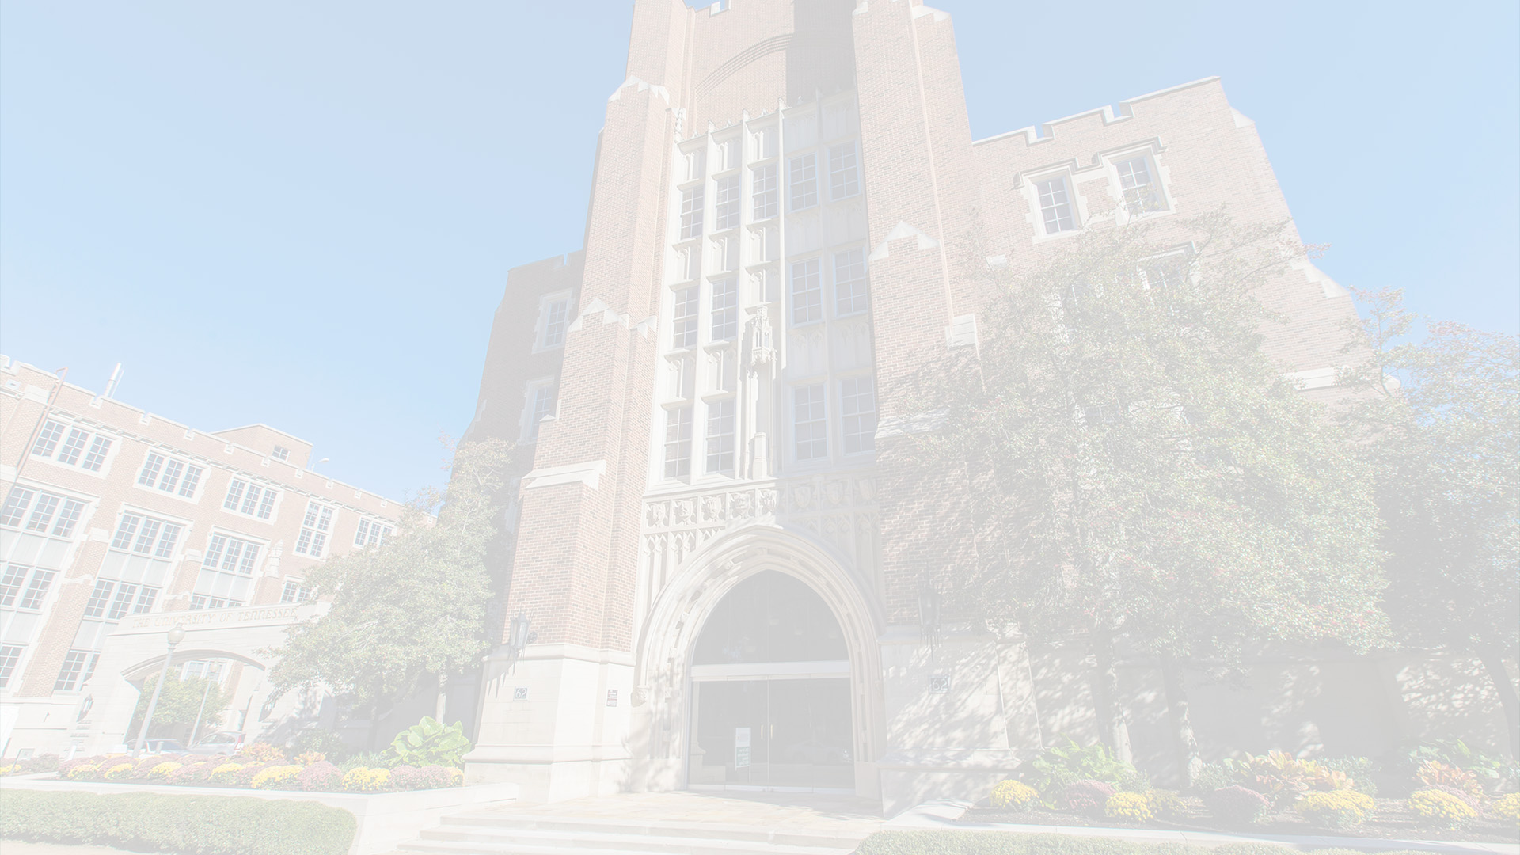
QUESTIONS?
Melanie Burlison
Assistant Vice Chancellor / UTHSC Privacy Officer
mburlison@uthsc.edu
(901) 448-8030
Jonathon Berry
Compliance Administrator
jberry21@uthsc.edu
(901) 448-5887
April Suttles
Administrative Compliance Coordinator
asuttle2@uthsc.edu
(901) 448-8680
Institutional Compliance Office
institutional.compliance@uthsc.edu
(901) 448-8469

