Slide 1

UT Incident Reporting
UTSHC Campus Safety
Novermber 11, 2020

Slide 2

Objectives
• Direct UTHSC Personnel to report incidents properly using the UT Incident Report Form.
• Locate the UT Incident Report Form on the Campus Safety website.
Notes:
Hazards fall into a variety of categories. Employees should be aware of physical hazards in their work area. This includes conditions with the potential to result in slips, trips or falls and can sometimes be addressed through good housekeeping practices.
Biological hazards, chemical hazards and radiation are also present on campus. Although they may not be located in your work area it is important that you be able to recognize the warning signs and symbols that indicate their presence.

Slide 3
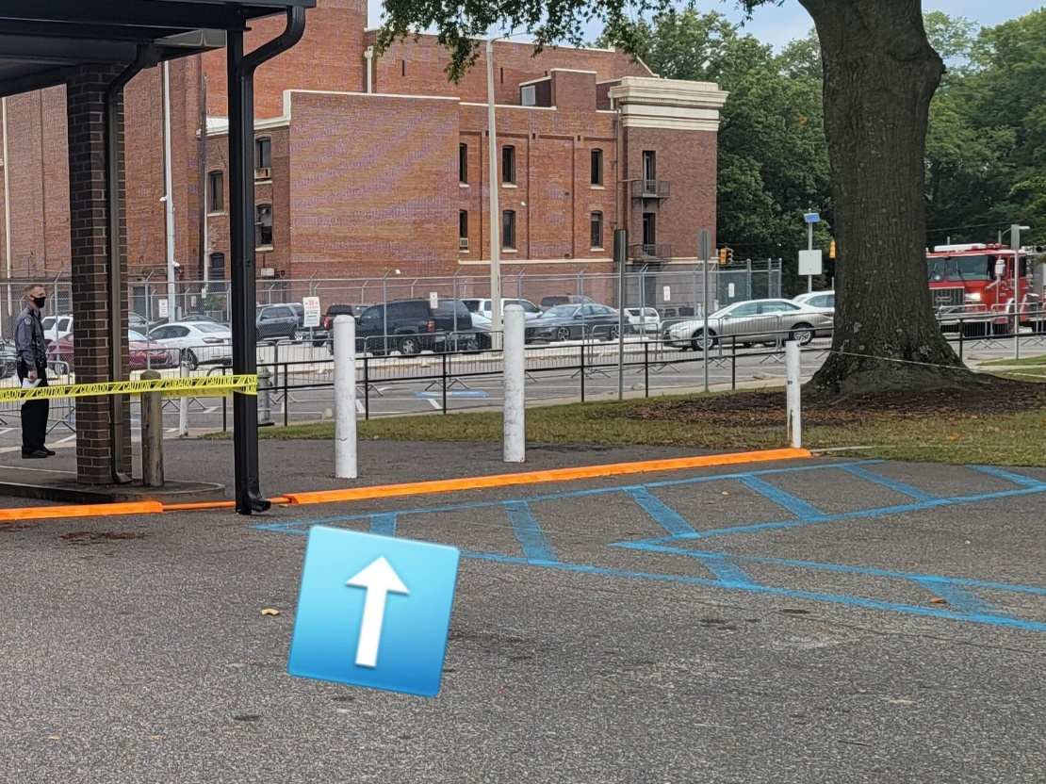
A Recent Incident
On October 19 at 3:45 in the afternoon a patient visiting the Dunn Dental school tripped on the temporary wood casing placed over cables associated with a nearby construction project.
The individual fell to her hands and knees, striking her head on the ground. University Health Services responded to the scene and provided a medical exam. Additional medical care was declined.
Notes:
Hazards fall into a variety of categories. Employees should be aware of physical hazards in their work area. This includes conditions with the potential to result in slips, trips or falls and can sometimes be addressed through good housekeeping practices.
Biological hazards, chemical hazards and radiation are also present on campus. Although they may not be located in your work area it is important that you be able to recognize the warning signs and symbols that indicate their presence.

Slide 4
Impact to UTHSC
• 31 Claims Reported in Last 5 Years
• ≥3 claims associated with pending litigation
• 53 days Average lag time before UT notified
• 4 Incidents with lag time >300 days
Notes:
Hazards fall into a variety of categories. Employees should be aware of physical hazards in their work area. This includes conditions with the potential to result in slips, trips or falls and can sometimes be addressed through good housekeeping practices.
Biological hazards, chemical hazards and radiation are also present on campus. Although they may not be located in your work area it is important that you be able to recognize the warning signs and symbols that indicate their presence.

Slide 5
UT Incident Report Form
Business Managers
please department personnel to report incidents properly:
• Student Incidents:
  Faculty must direct students to notify them of injury on campus or at affiliate sites.
  Faculty must complete UT Incident Report Form for students when informed of incidents
  Email completed form to riskmanagement@uthsc.edu
• Visitors Incidents:
  Any UTHSC staff member with knowledge of a visitor incident must complete the UT Incident Report form on their behalf. (Information required includes name, address, telephone and email)
  Email completed form to riskmanagement@uthsc.edu
• Employee Incidents:
  Employee or employee supervisor must report by calling the Corvel 24/7 nurse line (1-866-245-8588)
Notes:
Hazards fall into a variety of categories. Employees should be aware of physical hazards in their work area. This includes conditions with the potential to result in slips, trips or falls and can sometimes be addressed through good housekeeping practices.
Biological hazards, chemical hazards and radiation are also present on campus. Although they may not be located in your work area it is important that you be able to recognize the warning signs and symbols that indicate their presence.

Slide 6
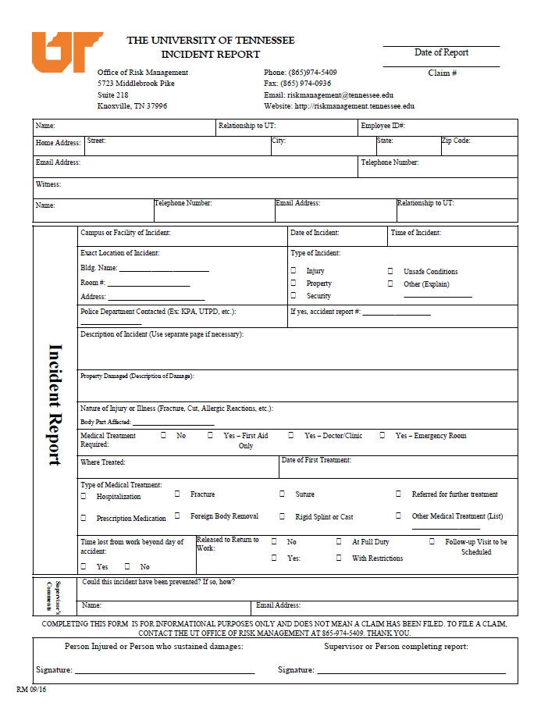
1. Complete the name, address, email address and telephone number of the individual injured or involved in the incident
2. UTHSC employee completing the form identifies themselves as the witness and provides their contact information.
3. Describe the incident to the best of your ability. UTHSC Campus Safety will follow up by investigating when notified.

Slide 7

Reporting Incidents
• UT Incident Report Form on UTHSC Campus Safety website
• Email address for submitting the form on top of the page.
Notes:
Hazards fall into a variety of categories. Employees should be aware of physical hazards in their work area. This includes conditions with the potential to result in slips, trips or falls and can sometimes be addressed through good housekeeping practices.
Biological hazards, chemical hazards and radiation are also present on campus. Although they may not be located in your work area it is important that you be able to recognize the warning signs and symbols that indicate their presence.

Slide 8

End
Contact Campus Safety at labsafety@uthsc.edu or 8-6114
with questions or concerns.
Notes:
If you have any questions about the material in this presentation or would like to report a health and safety concern please contact Campus Safety by calling 448-6114 or emailing labsafety@uthsc.edu.
You may now proceed to the quiz.

