Slide 1
CONTRACTS
Office of Finance
Business Contracts

Slide 2
Topics
1. What is a Contract?
2. Purpose of a Contract?
3. Processing a Contract?

Slide 3
What is a Contract?
Main elements –
Offer
Acceptance
Consideration
Meeting of the Minds (Mutuality)
Four (4) Corners Doctrine –
Resolves misunderstandings
Controlled by document content

Slide 4
The Purpose of a Contract
Documents the responsibilities and obligations of the involved parties. Sets expectations.
Provides a record of services – both supplied and received.

Slide 5
Submitting a Contract for Processing
Obtain an agreement with the vendor on the contract terms (services, dates, amounts)
Upload an editable version of contracts into ESM, so that we can easily red-line the contract terms – preferably WORD
Only upload necessary documents
The description of services and NCJ information should be precise

Slide 6
UT Form Contracts
Please make sure you are using the approved template. Most recent.
The approved template it is on the Business Contracts Intranet: http://uthsc.edu/finance/buscontracts

Slide 7
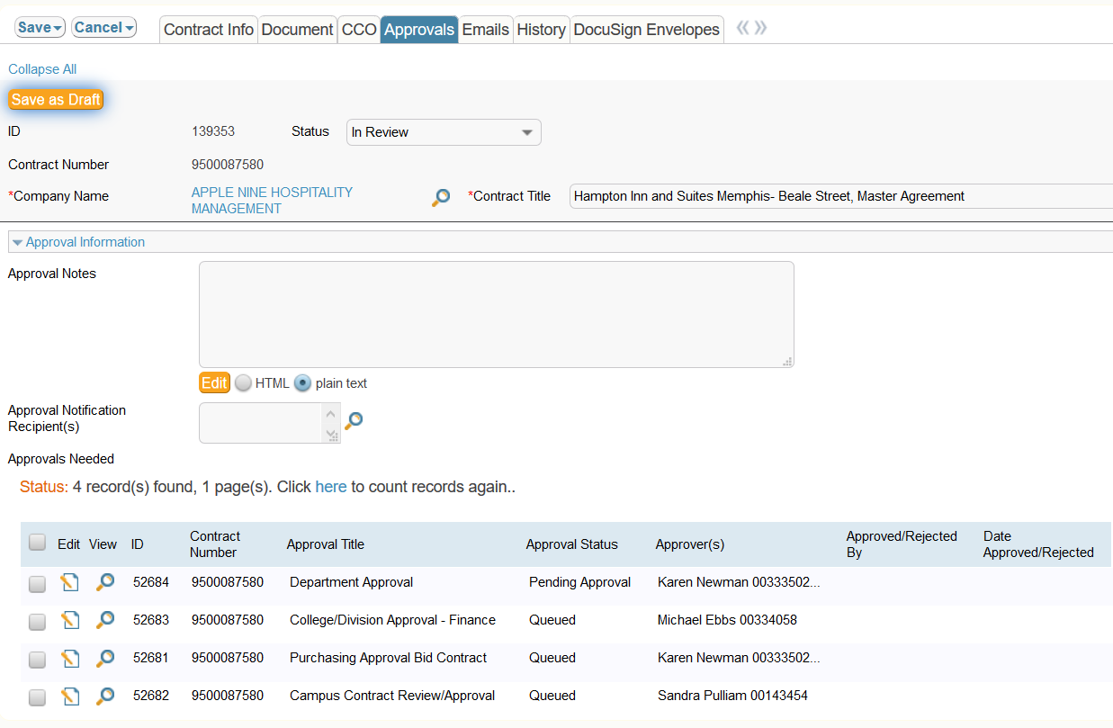
Contract Status
To see the status of a
contract, review the
“Approvals” tab

Slide 8
Who To Contact with Questions – Who owns it?

Slide 9
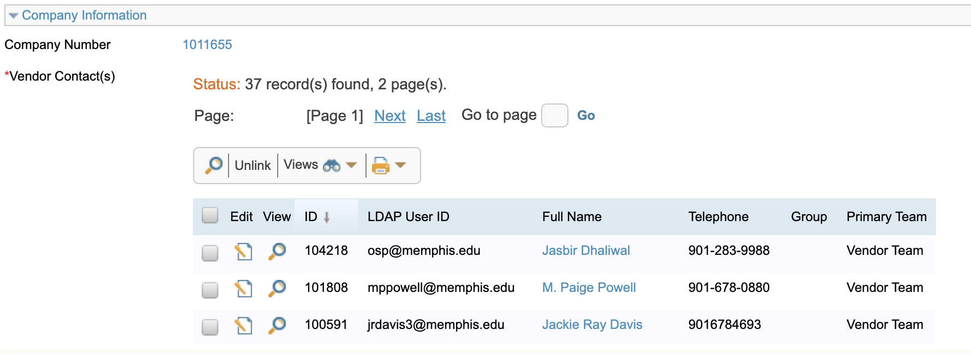
Remove Extra Vendor Contacts in ESM

Slide 10
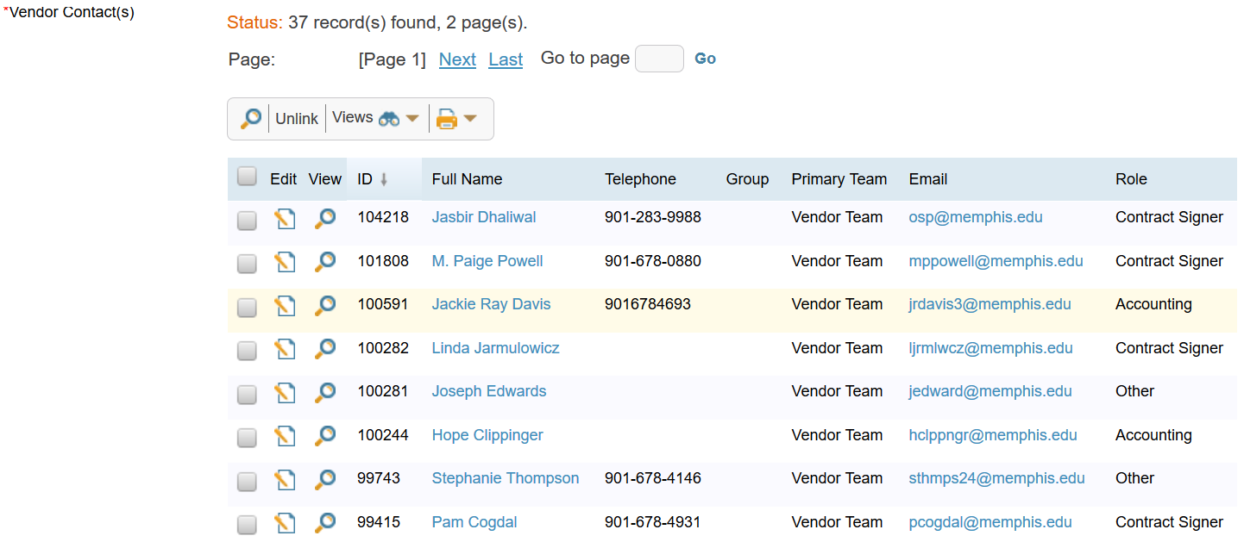
Common Errors – Vendor Contact
Leave only one person for the Business Contract Office to contact

Slide 11
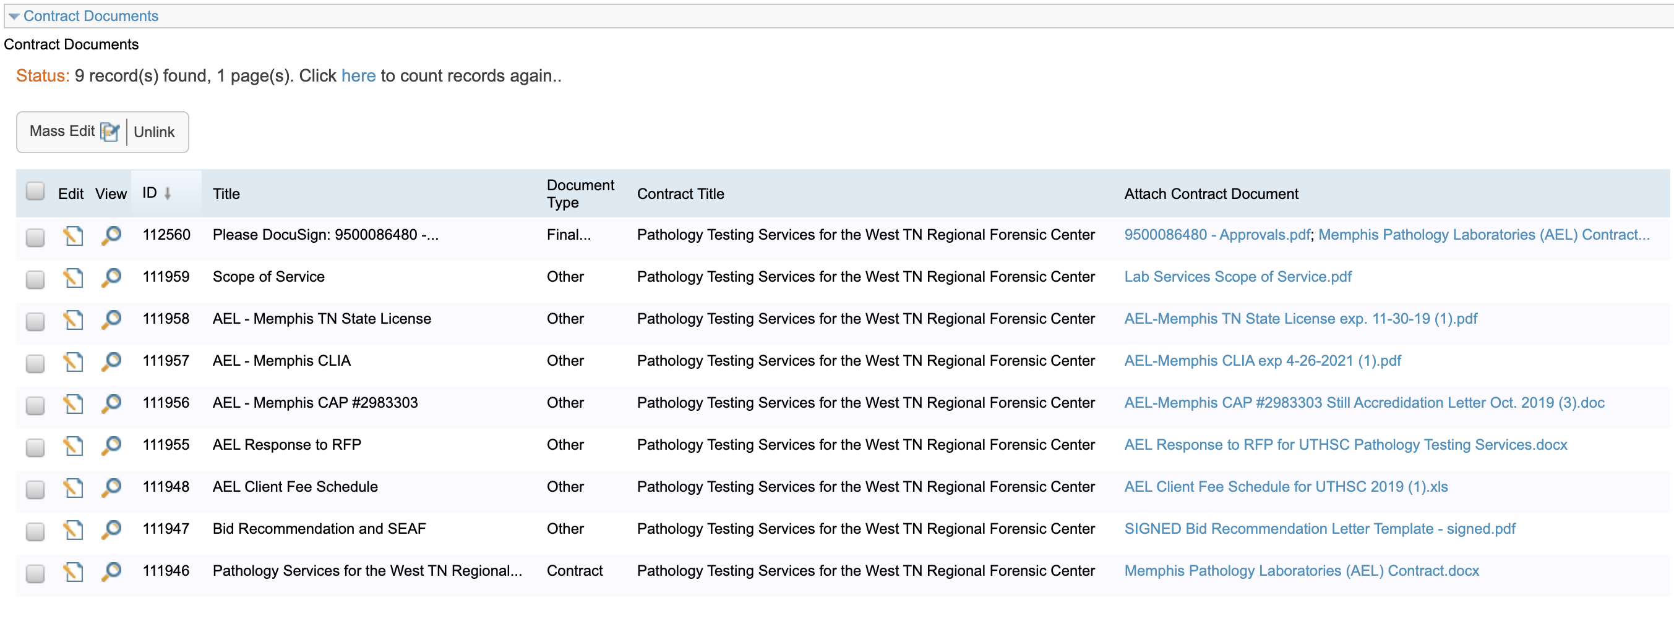
Insert Only Documents in Contract

Slide 12
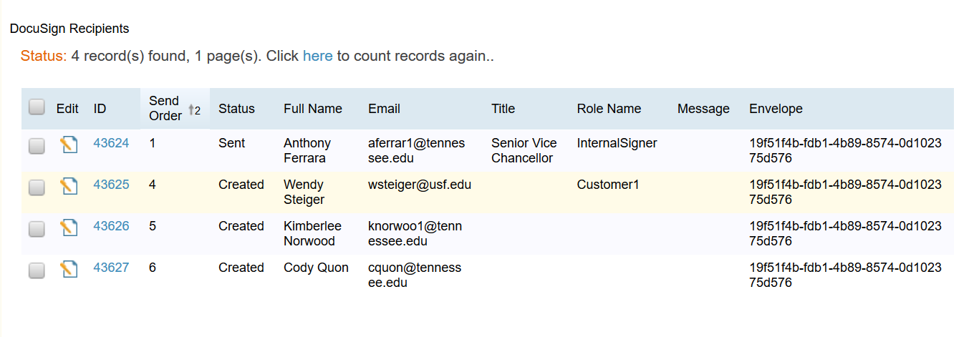
DocuSign Tab

Slide 13
Other ESM Elements
Contract should have same term and value in ESM and document
Description of contract should be precise
instead of “Hotel contract” use “Hotel contract for UTK football team for game at 2020 Gator Bowl”
“Delegated” versus “Non-Delegated”

Slide 14
RUSH AGREEMENTS
Requests to rush a contract to signature should be an occasional request, rather than a standard need.
Please email Trent Pitts(tpitts6@uthsc.edu) so that we can determine the best way to work it in with minimal disruption to other pending contracts.
“Rushing” a contract delays the process for other pending contracts.

Slide 15
QUESTIONS?

