Slide 1
The Contract Review & Approval Form
Finance & Operations
Business Contracts
January 15, 2015

Slide 2
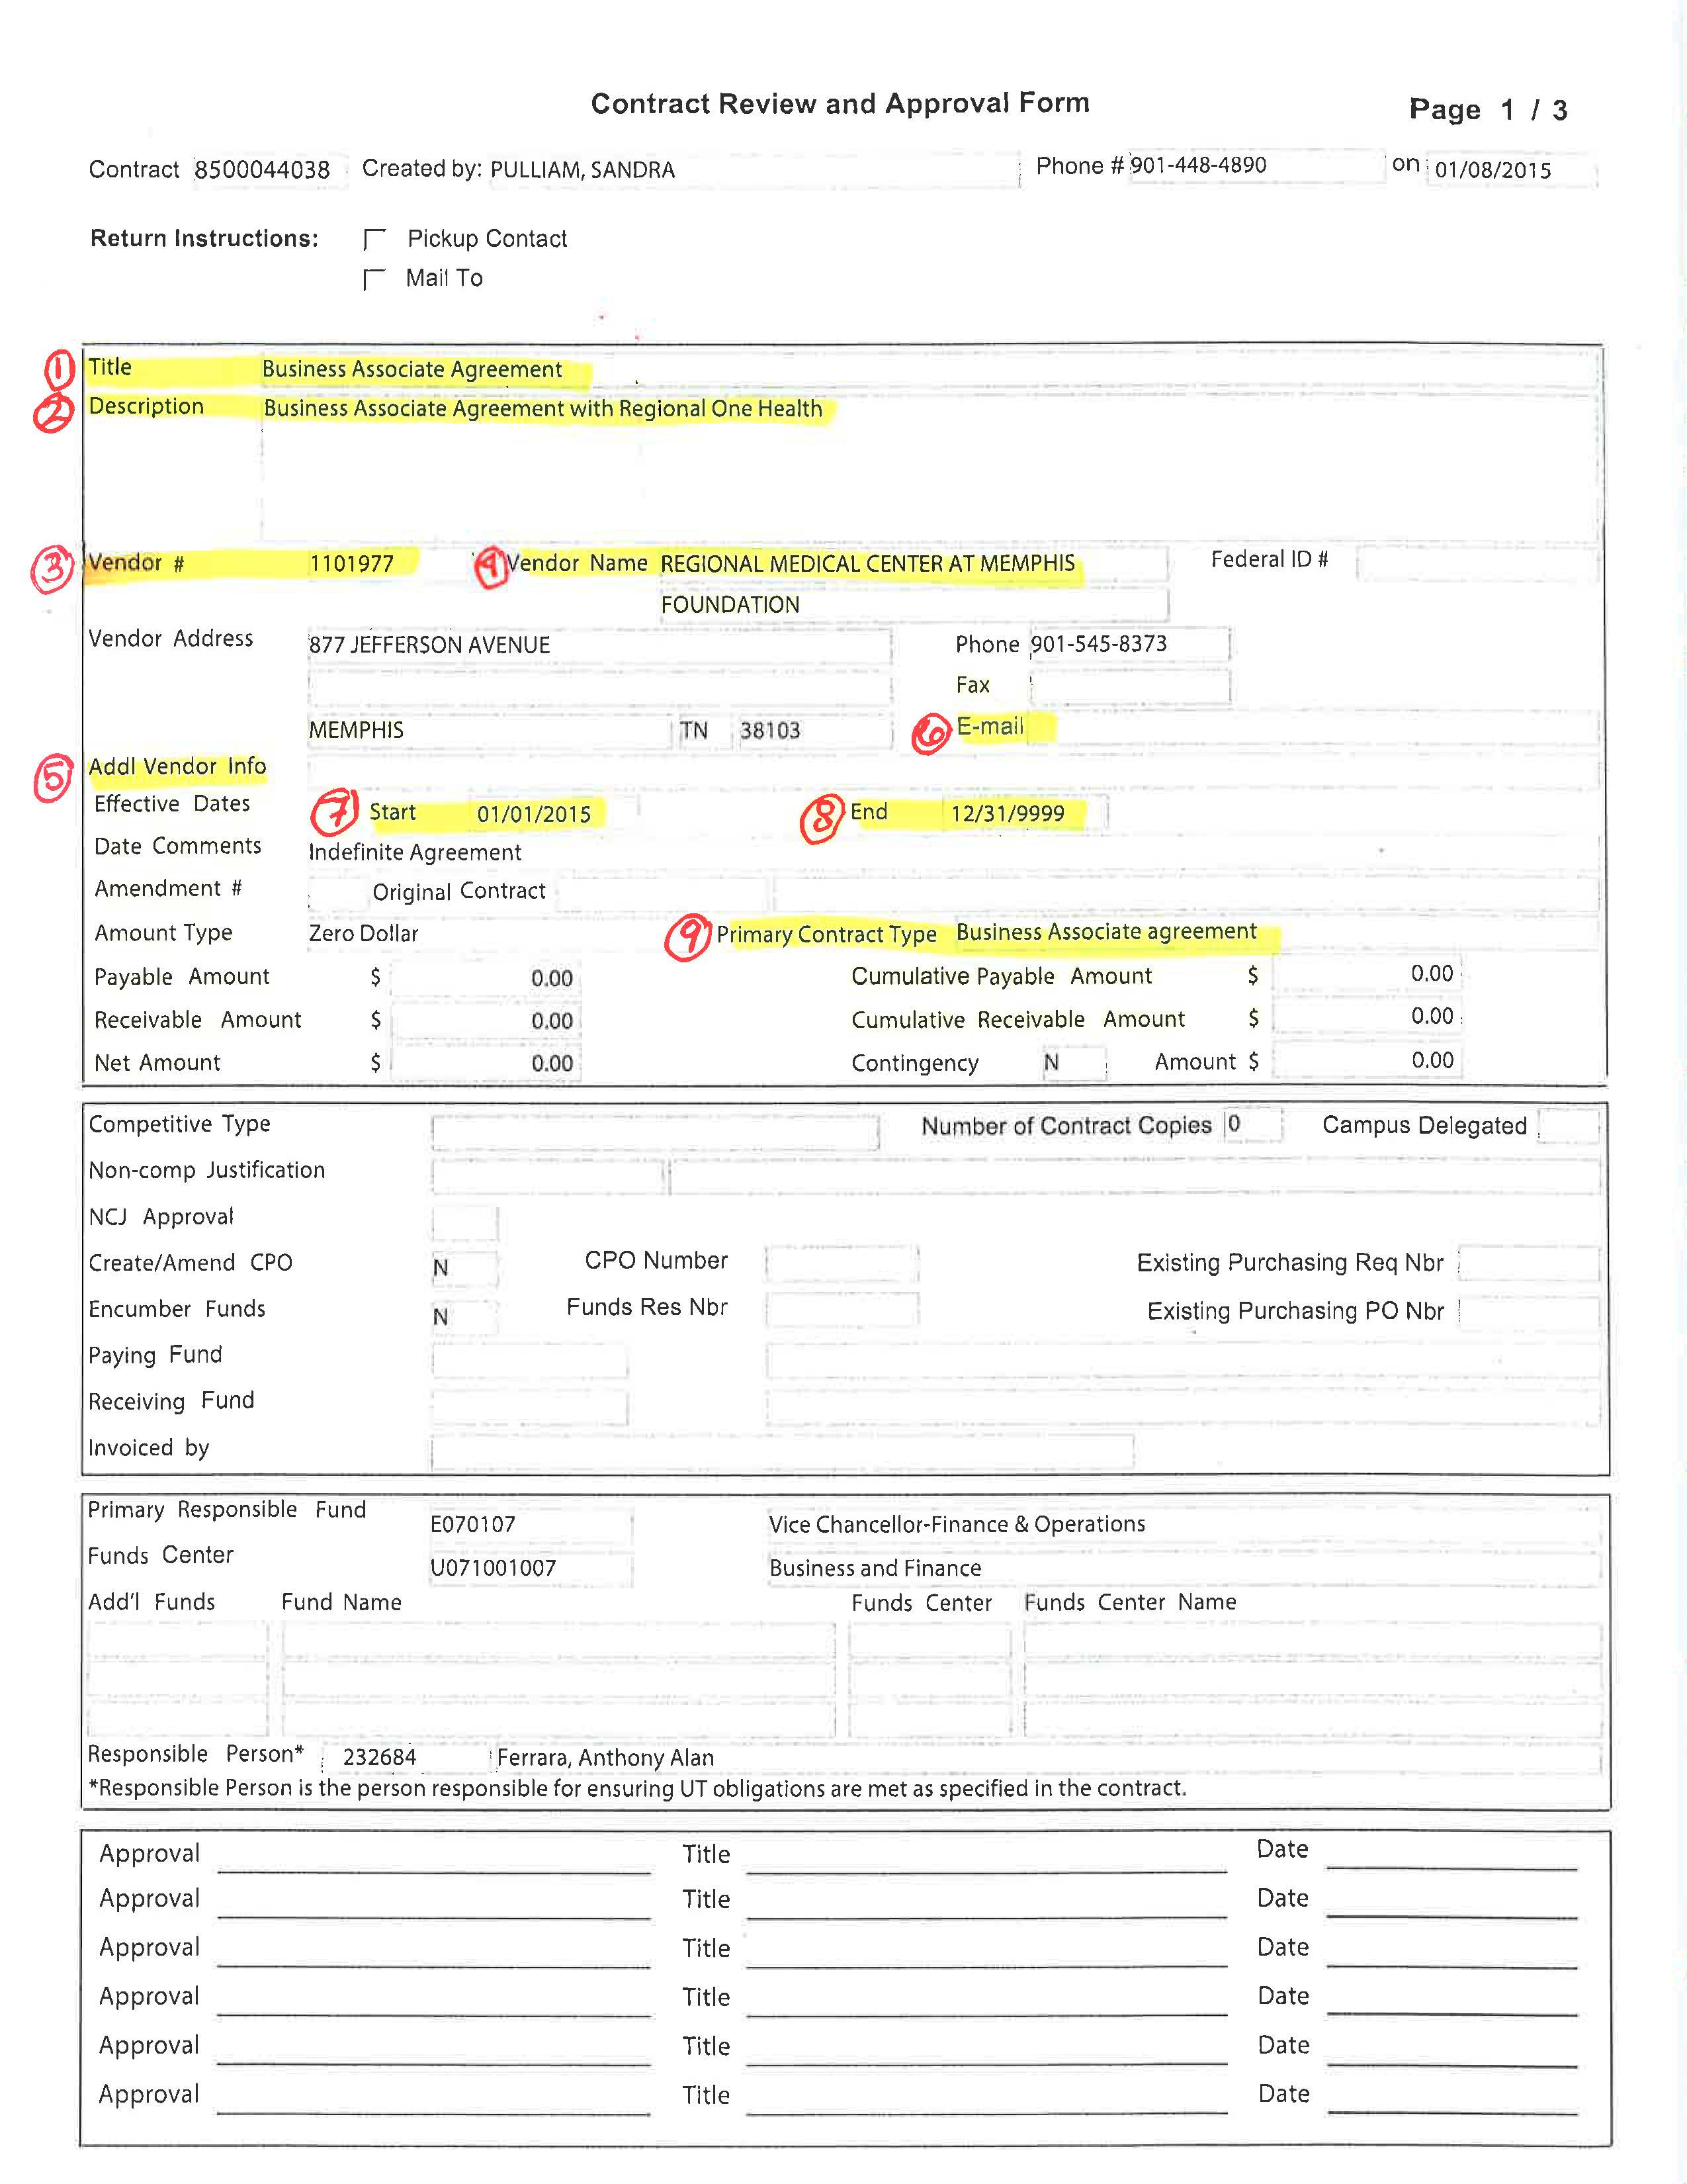
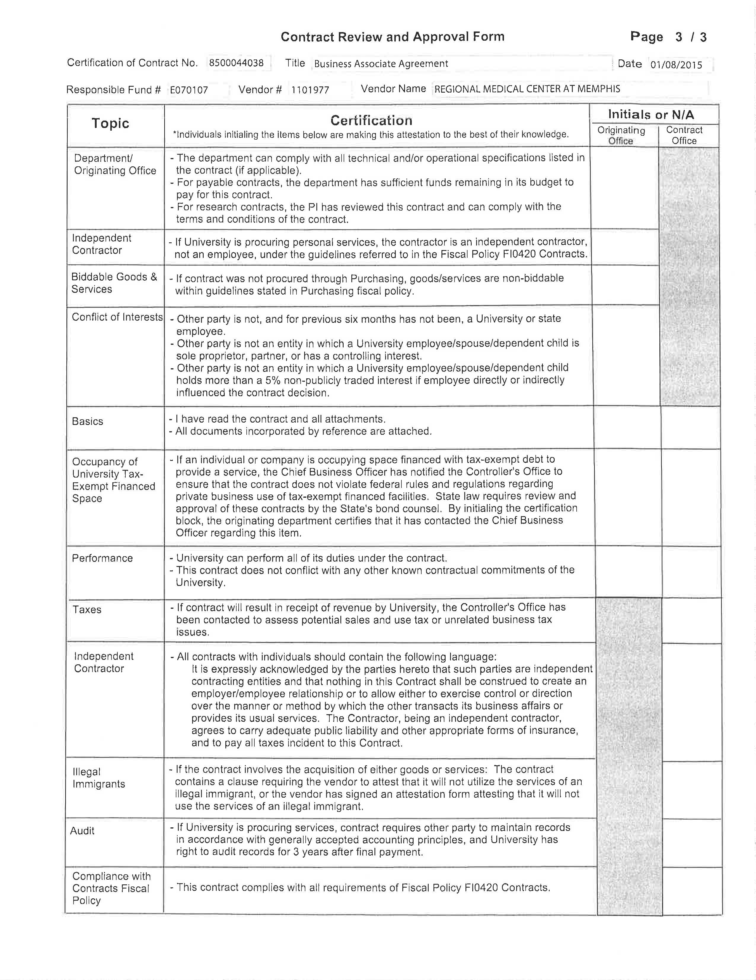
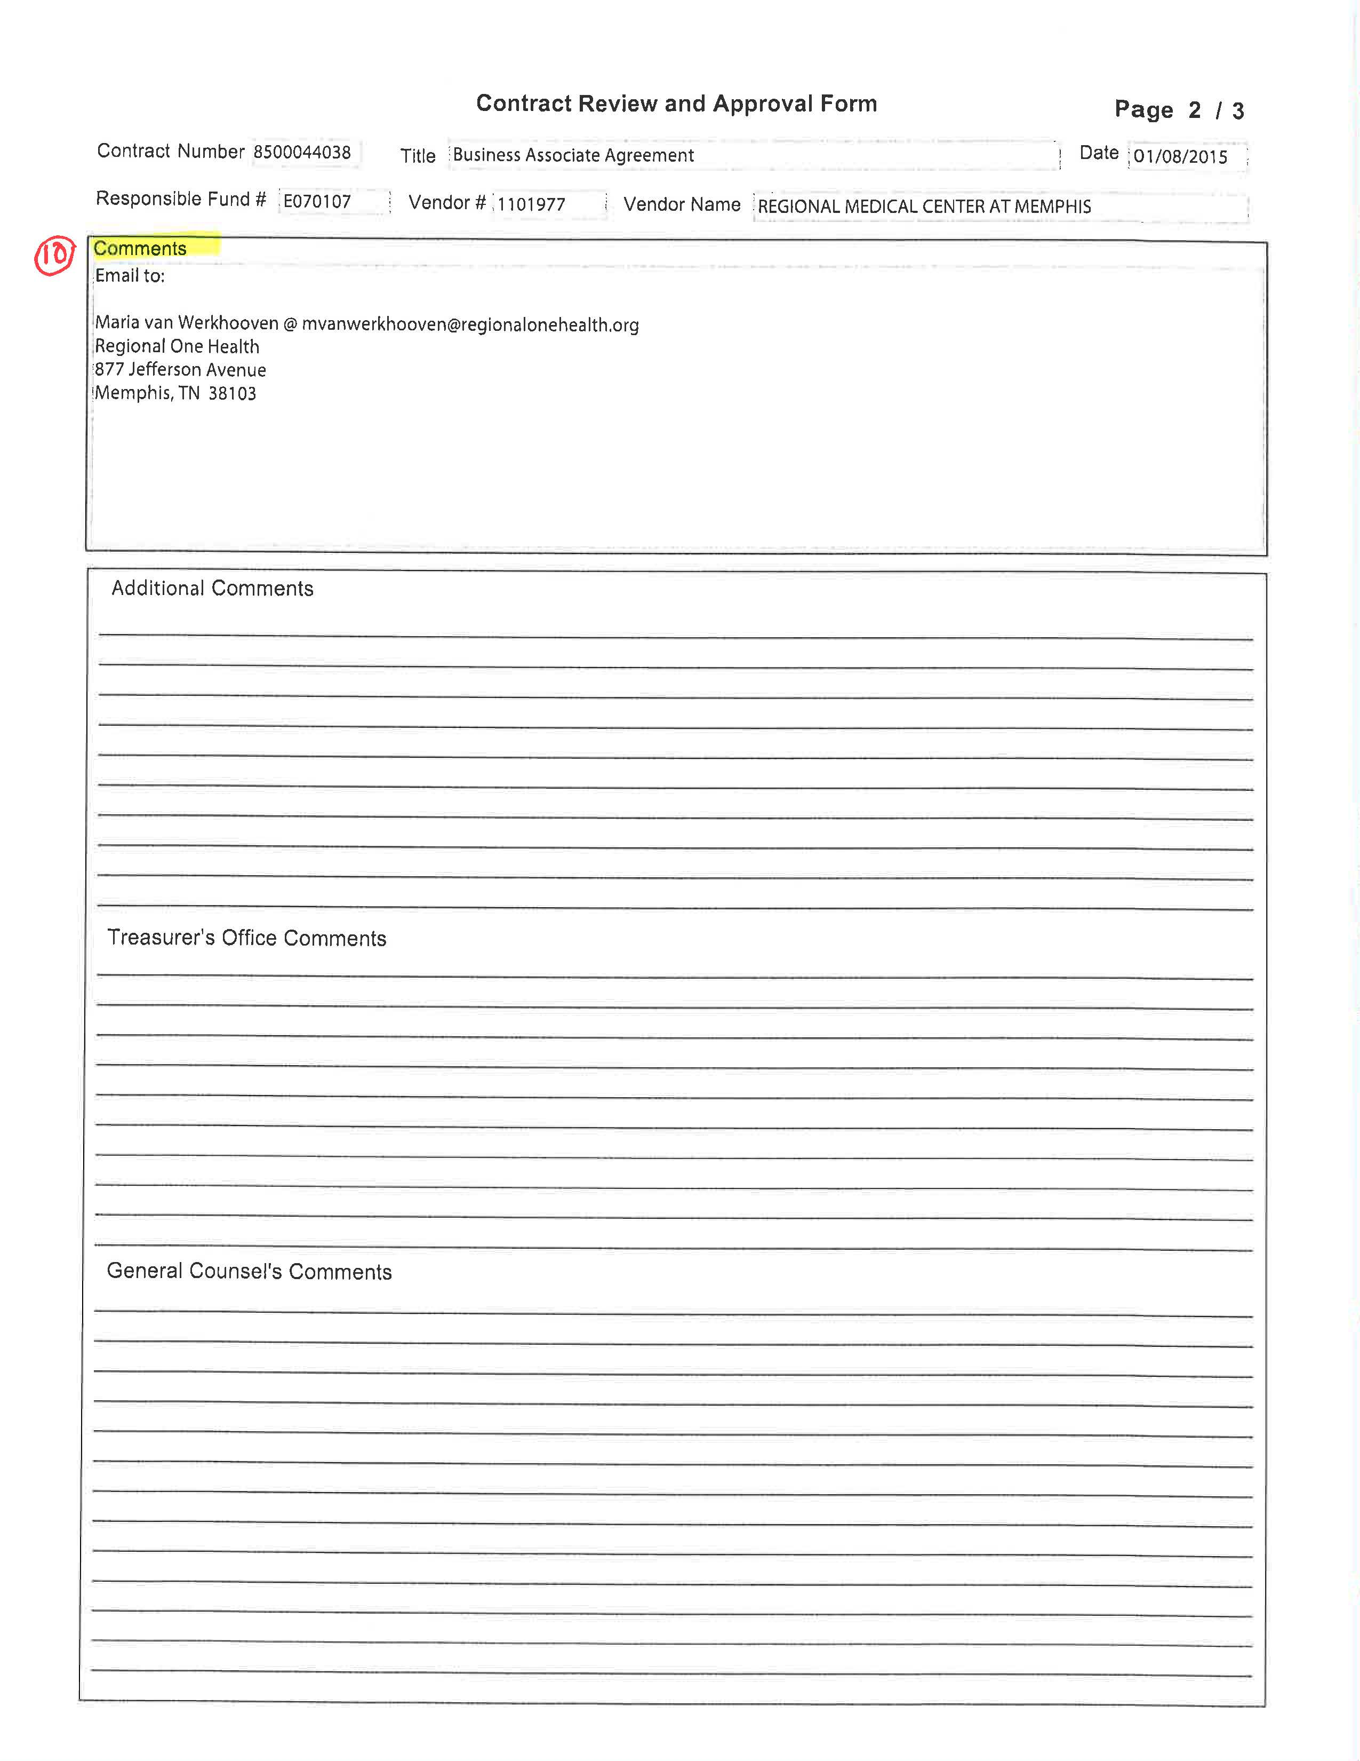
THE CONTRACT REVIEW AND APPROVAL FORM

Slide 3
Section 1 – Descriptive Information
1. Title (Required) – A short summary of the description of the services that are the subject of the contract. For instance:
  Annual software maintenance for IBL Software
  Student rotations at Grey Sloane Memorial Hospital
  2. Description (Required) –
  Provide a detailed description of the contract services. Also note if this agreement is an amendment to a current agreement.
  Please DO NOT include the agency contact information in this section. If the section is too long, the description will be cut off and all of the information will not be included on the printed copy. You should include agency contact information in the Comments section of the CRF.

Slide 4
Section 2 – Vendor Information
3. Vendor Number (Required) –
  Payable Contracts:
    Confirm that the Vendor Number is correct.
    The Vendor Number is used for invoice payment purposes. If the Vendor Number is not correct, it will cause invoice delays.
    A Vendor Number is required for ALL vendors, including individual persons
  Receivable AND Zero Dollar Contracts:
    If Vendor Number is known, you should use this number. ALWAYS use the Vendor Number when it exists.
    If there is no Vendor Number, type “Contracts” into this section and provide the name of the contracting agency in the “Additional Vendor Information” Field.
4. Vendor Name
  This is a self-populating field if you are using a pre-existing Vendor Number.
  If you not using a pre-existing Vendor Number, you will provide the FULL, LEGAL NAME of the vendor.
  Double check spelling and avoid abbreviations.
  If the vendor uses a DBA or otherwise goes by another name, include that in the “additional Vendor information” field.

Slide 5
Section 2 – Vendor Information
5. Additional Vendor Information:
  The ONLY information to include in this field is an agency name that is not otherwise included in the “Vendor Name” field or if the vendor uses a DBA or goes by another name.
  For Receivables and zero dollar agreements, where there it no vendor number, it is especially important to include the agency name here.
  For instance, for an agreement with American Lebanese Syrian Associated Charites, Inc. you might include its full name in the Vendor Name field and the name it is commonly known by, ALSAC, in the Additional Vendor Information.
6. Vendor Email:
  Include the email address of the vendor or agency.
  Whenever possible, the Business Contracts office corresponds with agencies and vendors by email, including sending partially executed agreements to the vendor for counter-signatures and sending fully executed final agreements to the agency.
  The Business Contracts office prefers to not mail agreements unless the vendor requires a wet signature.

Slide 6
Section 2 – Vendor Information
7. Start Date (Required)
  Date when services begin.
  Date must be in 00/00/0000 format.
  If the start date is uncertain, use the date 01/01/9999 and explain the reason for the uncertain date (i.e. start date is the date of the last signature) in the Date Comments field.
    Upon execution of the contract, the Business Contracts office will insert the correct date.
  If the Contract is an Amendment to an existing Contract, note that the Start Date is the date of the amendment NOT the original Contract Start Date.
8. End Date (Required)
  Date when services end.
  Date must be in 00/00/0000 format.
  If end date is indefinite or contract automatically renews until terminated, use 12/31/9999 and explain the reason for the uncertain date in the Date Comments field.
    Upon execution of the contract, the Business Contracts office will insert the correct date.

Slide 7
Section 2 – Vendor Information
      9. Primary Contract Type
        Select the correct contract type from the prepopulated list.
        This field is critical to UT’s record keeping as it is how we are able to quickly determine the volume of specific types of contracts.
        In particular, UT is required by federal law to maintain accurate information regarding its Business Associate Agreements. This field allows UT to easily provide this information upon request.
        If you have a question about how to categorize an agreement, please ask Sandra, Sherelle or Stephenie.
      10. Comments field
        This is the place to note any necessary contact information such as addresses, emails, etc. that you were not able to include earlier.
        Specifically, for Receivables contracts, be sure to provide the name and address (if it differs from the business address) of the billing contact (and an email if they prefer to have invoices emailed).
        Without a “Attention of” contact, an invoice can float around an agency for weeks (or months!) without getting to the proper person for payment.

Slide 8
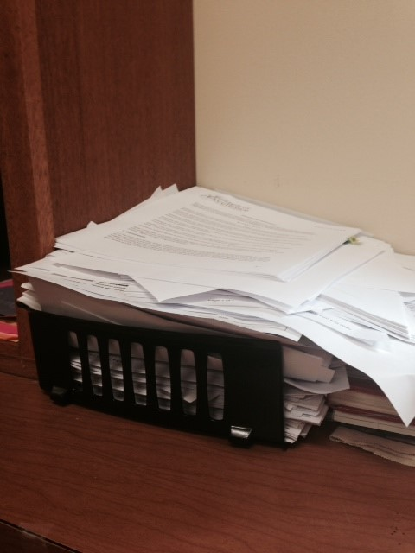
Two weeks worth of extra contract copies waiting to be shred in
Stephenie’s office
Contract Documents
  Please submit only TWO (2) hard copies of a contract with the Contract Review Form.
  Often, there are changes that must be made to the contract and the final agreement must be printed rendering the submitted documents unnecessary.
    Please provide electronic editable versions of complex agreements and agreements that originate from the other (non UT) party so that we can easily red-line changes for the vendor to review. Email to:
      Sandra Pulliam (spulliam@uthsc.edu)
      Sherelle Funderburg (sfunderburg@uthsc.edu)
      Stephenie Booher (sbooher1@uthsc.edu)
      Brenda Johnson (bjohnson@uthsc.edu) (hotels, speakers, and caterers)
  Whenever possible, we are executing contracts via email with scanned signatures, so hard copies are not used for the final executed document.

Slide 9
Other Helpful Information
UT Form Contracts
  When preparing contracts on the standard UT form, please make sure you are using the approved template.
  The approved Payables Contract includes at Terms and Conditions attachment that includes 17 terms.
  If you need a copy of the approved template, it is located on the Business Contracts Intranet. Please DO NOT use the template found on the Treasurer’s Office Intranet, it is not the approved form for the Health Science Center.
  Our office occasional makes changes to the template to fit a specific situation. The University Contracts Office is working with UT Legal to update our standard forms and when approved, they will replace the forms currently on the Intranet.
Contract Status
  It is the intention of the Business Contracts Office to maintain the most recent status of the contract, so when seeking a status update, please check IRIS first under the Selection function.
  If you do not see a recent status or think it has moved beyond what is noted in IRIS, the persons handling the contract (as identified in the IRIS Routing function) is your best source for an update.

Slide 10
RUSH AGREEMENTS
Requests to rush a contract to signature should be an occasional request, rather than a standard need.
Please keep in mind when making a Rush Request that “rushing” a contract delays the process of other pending contracts already received by the Business Contracts office.
If you have an agreement in process for approvals that you know is going to require a rush review, please email Sandra Pulliam (spulliam@uthsc.edu) and give her a heads up so that we can determine the best way to work it in with minimal disruption to other pending contracts.

Slide 11
QUESTIONS?
THANK YOU!

