Slide 1
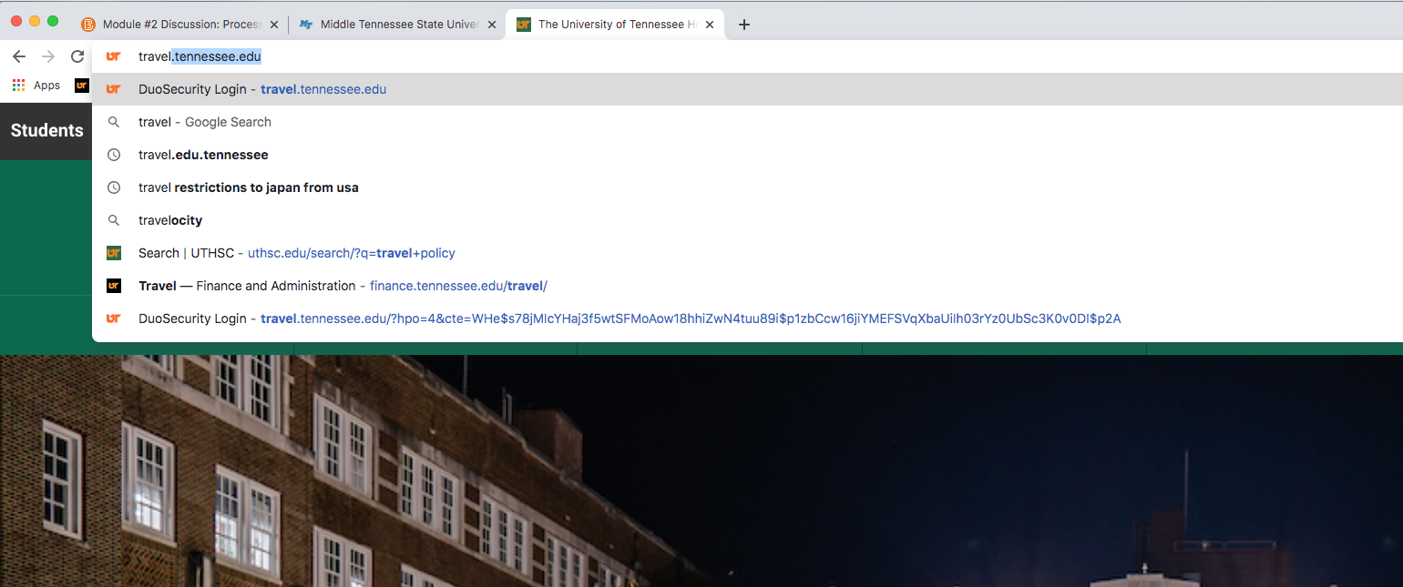
To get to the Concur system type “travel.tennessee.edu” into the address bar of your web browser.

Slide 2
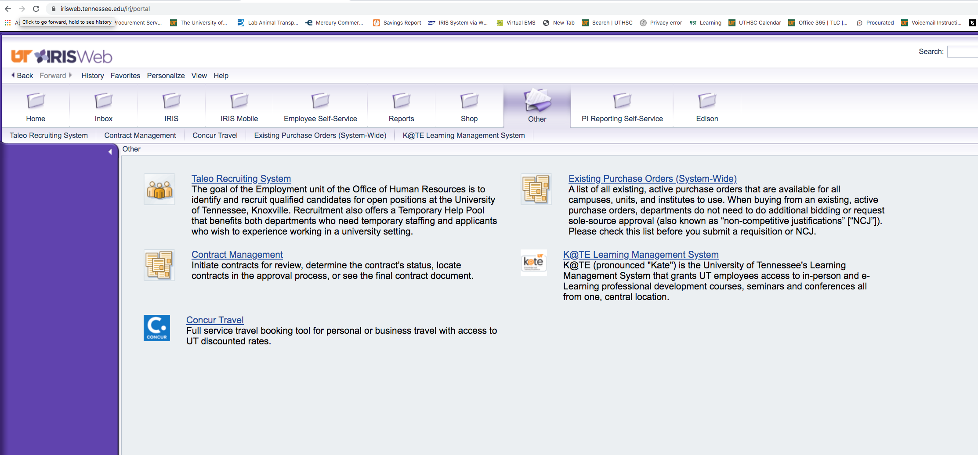
Log into IRIS Web through “My Resources” on the UT homepage and select Concur Travel.

Slide 3
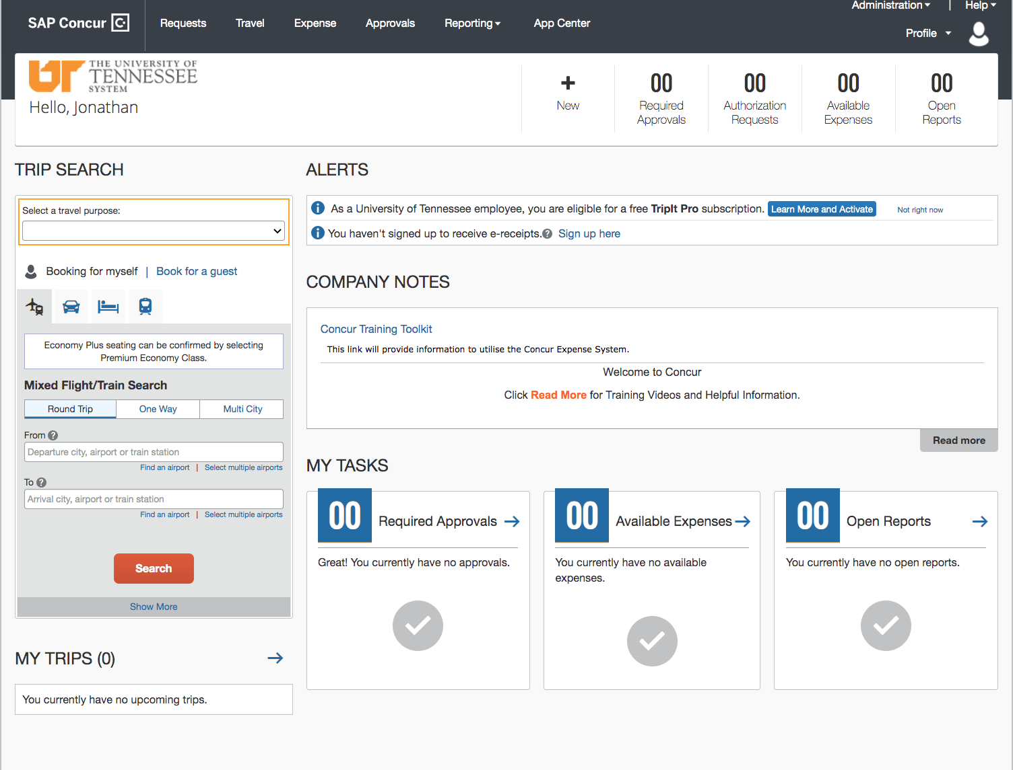
The initial log in screen will appear as below.

Slide 4
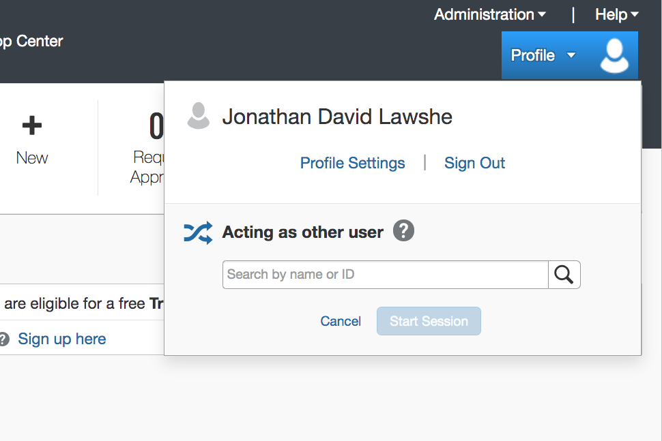

Slide 5
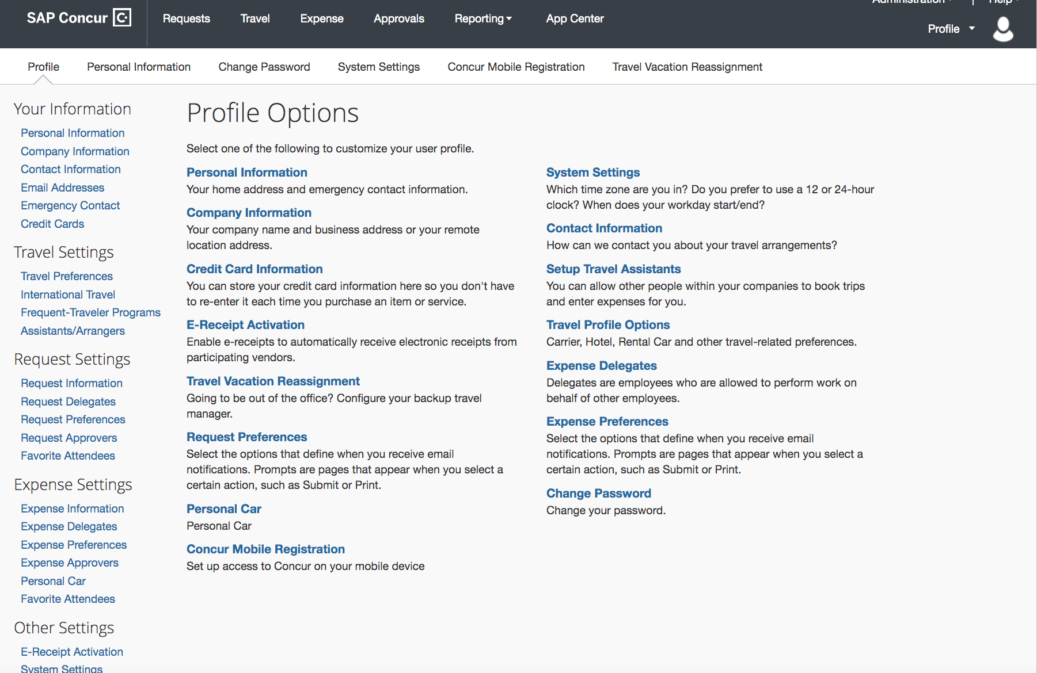

Slide 6
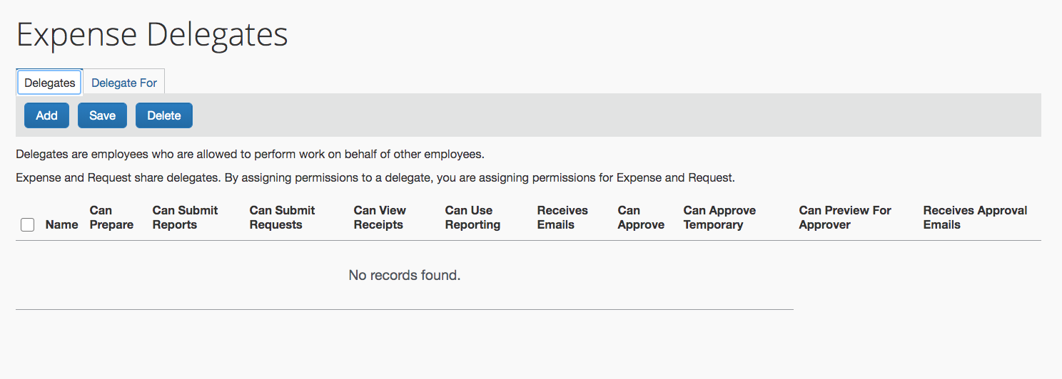
The Expense Delegates section allows you to establish what roles your delegates will play on your behalf.

Slide 7
The travel assistant allows you to give other employees the authority to book your travel.

Slide 8
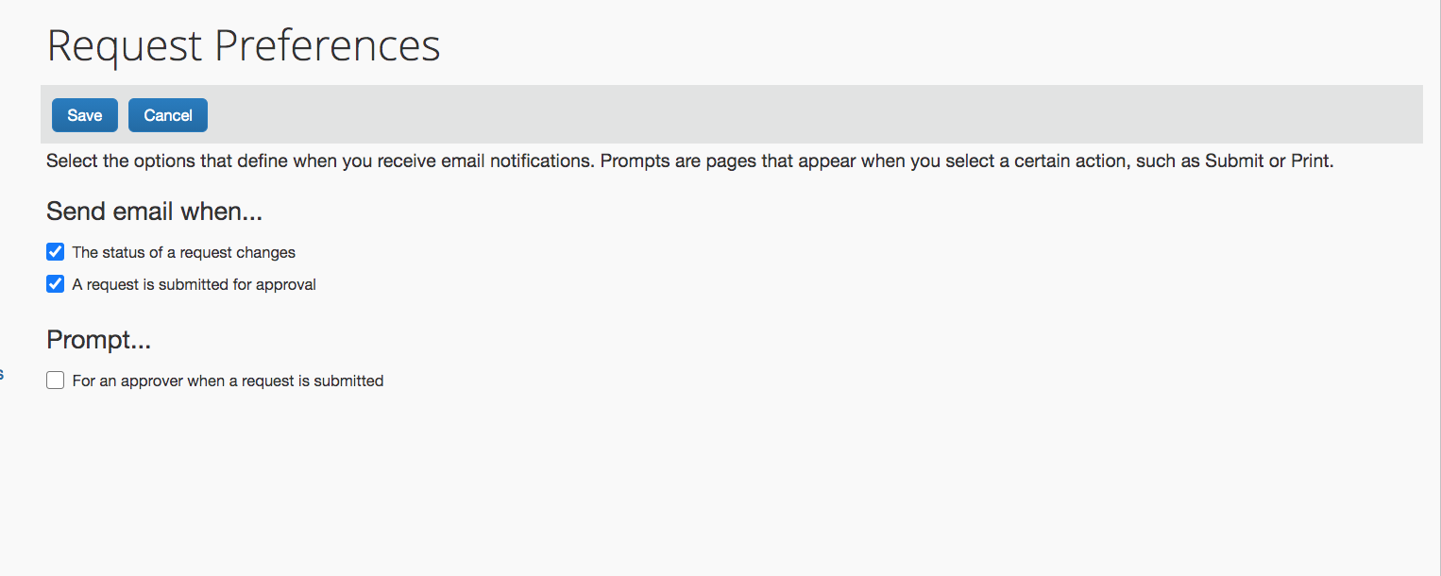
The Request References set up your email notifications.

Slide 9
To act on behalf of someone you must start a new session as that individual.

Slide 10
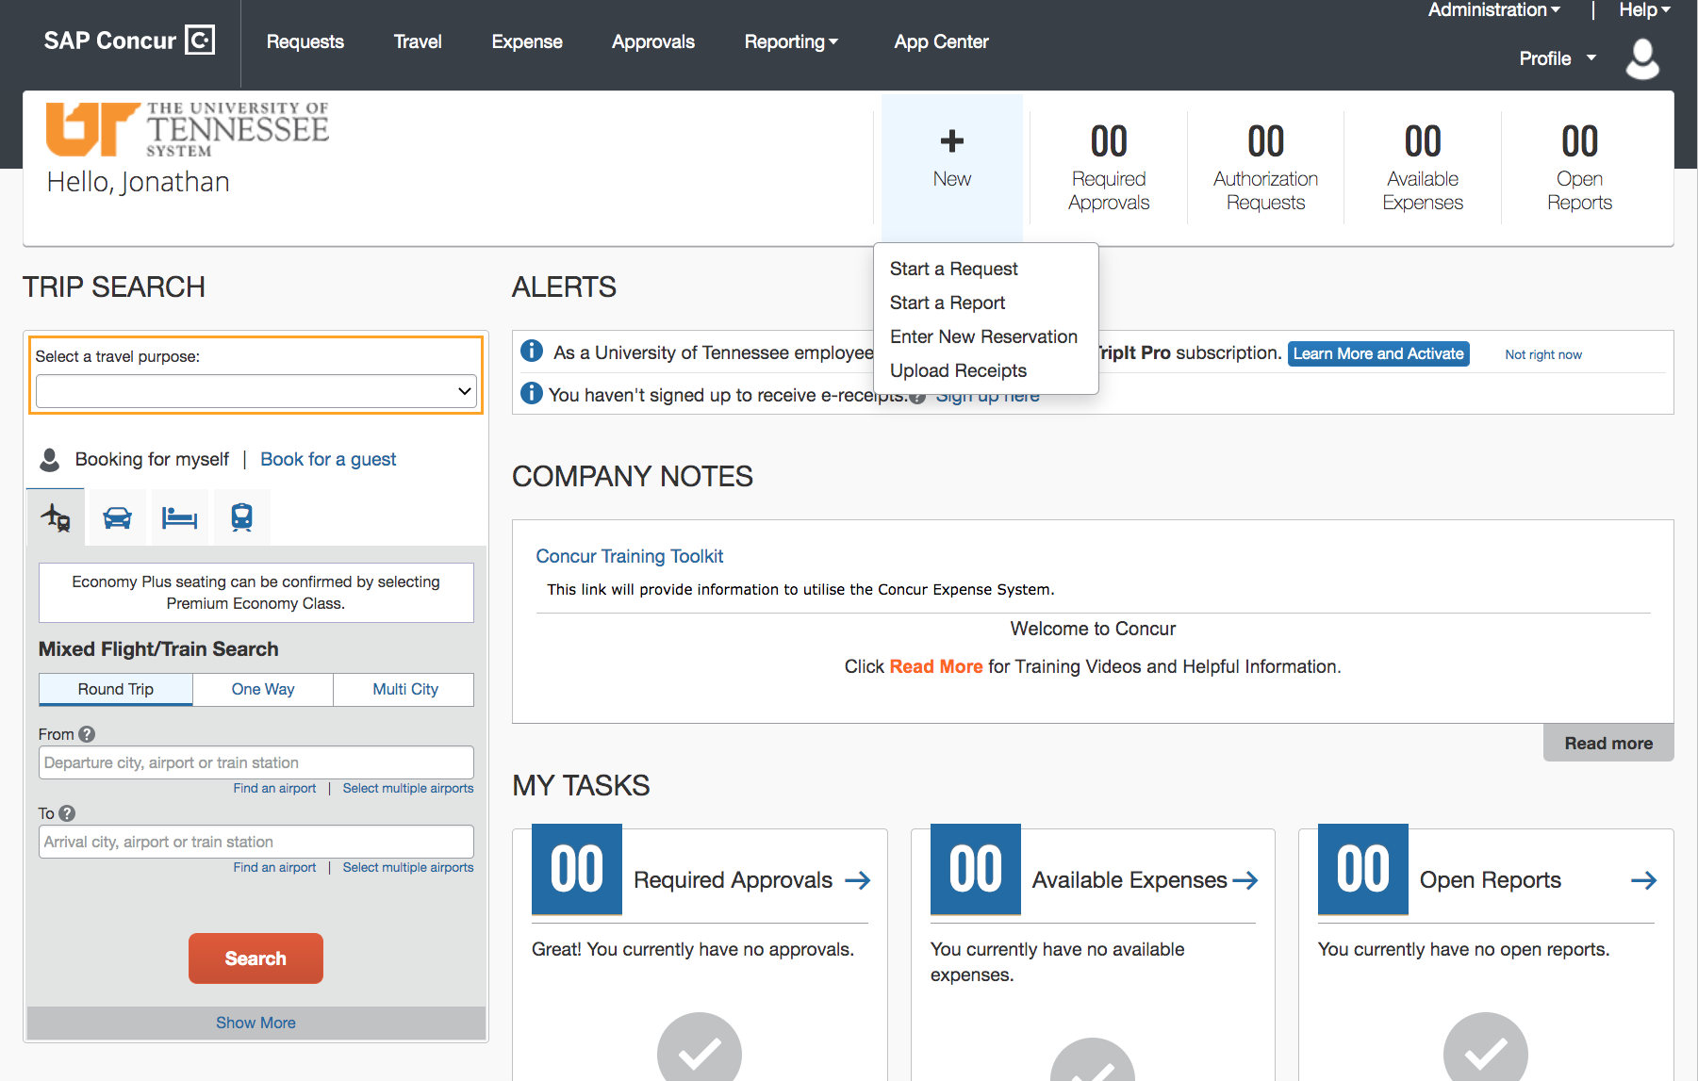
Select new to begin a new request, expense report, or reservation.

Slide 11
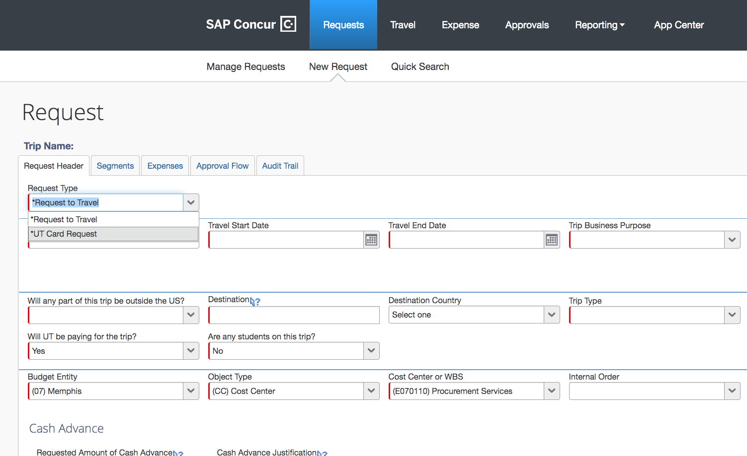
Requesting a procurement or travel card

Slide 12
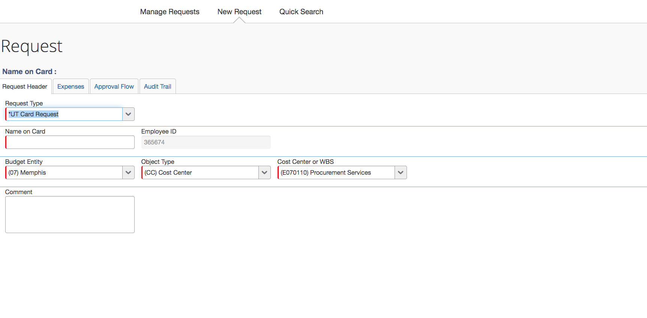
Complete the information in the request header tab and the select the expense tab.

Slide 13
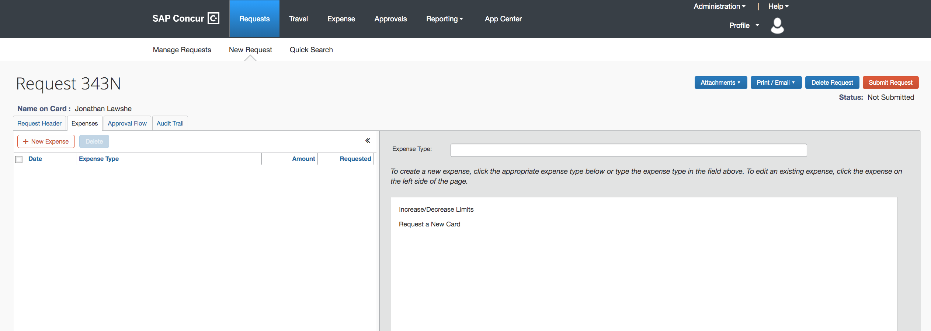
Request a new card or limit increase/decrease

Slide 14
On the next screen after selecting new card you will Select the type of card travel, group travel, or pcard.

Slide 15
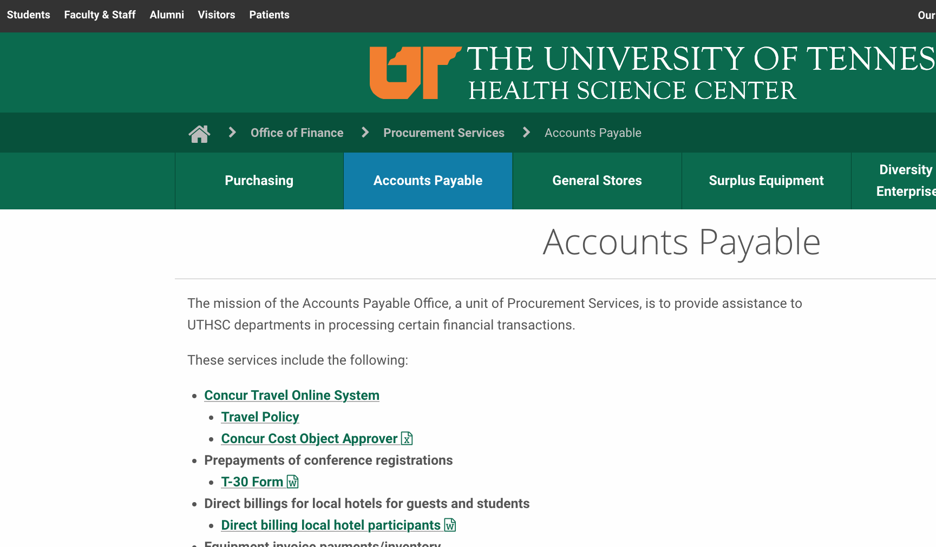
Concur only allows for one cost object approver (COA).

Slide 16
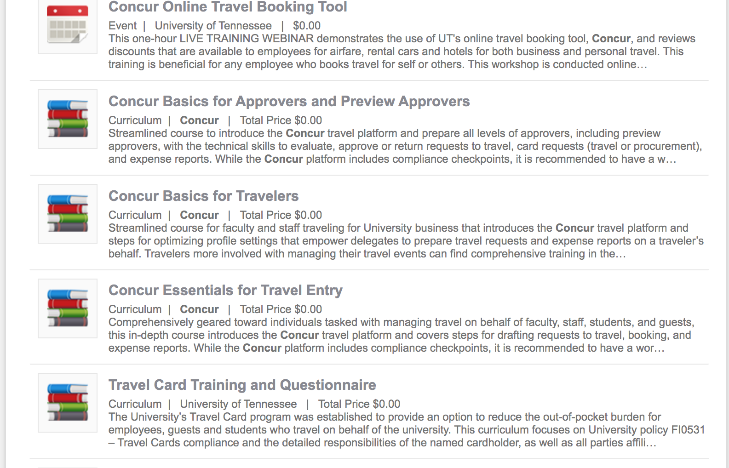
Concur training available in K@te.

