Slide 1
Research
For Campus-wide Business Meeting
October 20, 2016

Slide 2
New Research Personnel
Derrice Snipes
Research Contracts Administrator
910 Madison, Suite 823
Memphis, TN 38163
901 448-2037
dsnipes1@uthsc.edu

Slide 3
Job postings in Research
Scientific Writer - new
Research Contracts Administrator - new
Manager

Slide 4
New Research Web Pages and FAQ
New Research web page (GRA): http://www.uthsc.edu/research/gra/
New Forms and Info page: http://www.uthsc.edu/research/gra/forms-and-information/index.php
FAQ: Adding people in SP (via IRIS) http://www.uthsc.edu/research/research_administration/FAQ.php#electronicrouting

Slide 5
Evisions Upgrade Allows “View All” for Department Proposals and Awards
Next slide shows all areas where “view all” is now available.

Slide 6
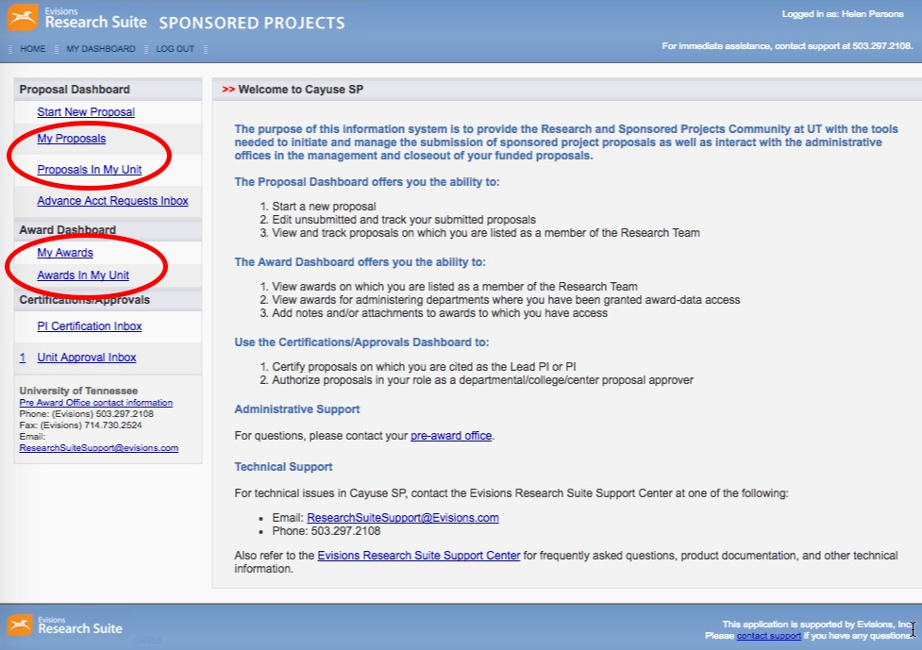

Slide 7
To view all, scroll to the bottom of the list, and click “View All”:

Slide 8
To go back to 20 per page, click “View 20 per page”

Slide 9
How to keep the list sorted
If you want to open one, but keep the sorted list intact:
Right click on the proposal to open it in a new window or tab.
REMEMBER to only keep one proposal or award tab open at a time. If you didn’t open the proposal you wanted – close the tab and choose another from the listing. IF you don’t close the tab and have two windows open, you may end up editing both proposals at one time.

Slide 10
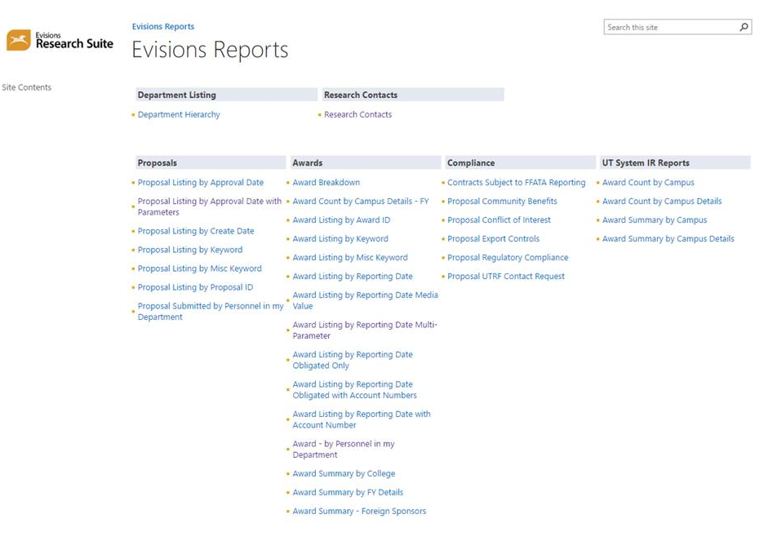
SP Reports
Link: tiny.utk.edu/researchreports
Screen shot:

