Slide 1

Campus-Wide Business Manager’s Meeting
August 18, 2016
Presentation

Slide 2
Introduction of
A Web-based application that automates all the steps of the on demand maintenance process, from requests, to approvals, to scheduling and work order issuance, to completion and feedback.
Simplifies the request by assisting the requestor with dropdown information to create the request.
Request is then dispatched to the correct work team for action.
Request is updated in real-time so that requestor is able to follow steps taken to complete work order.
Provides a seamless link to Service Level Agreements (SLAs) to enforce standards and increase efficiency.

Slide 3


Benefits to Customer
Ability to track work order
Ability to cancel work order
Ability to add pictures/documents
Real-time updates
Paper trail now Digital

Slide 4
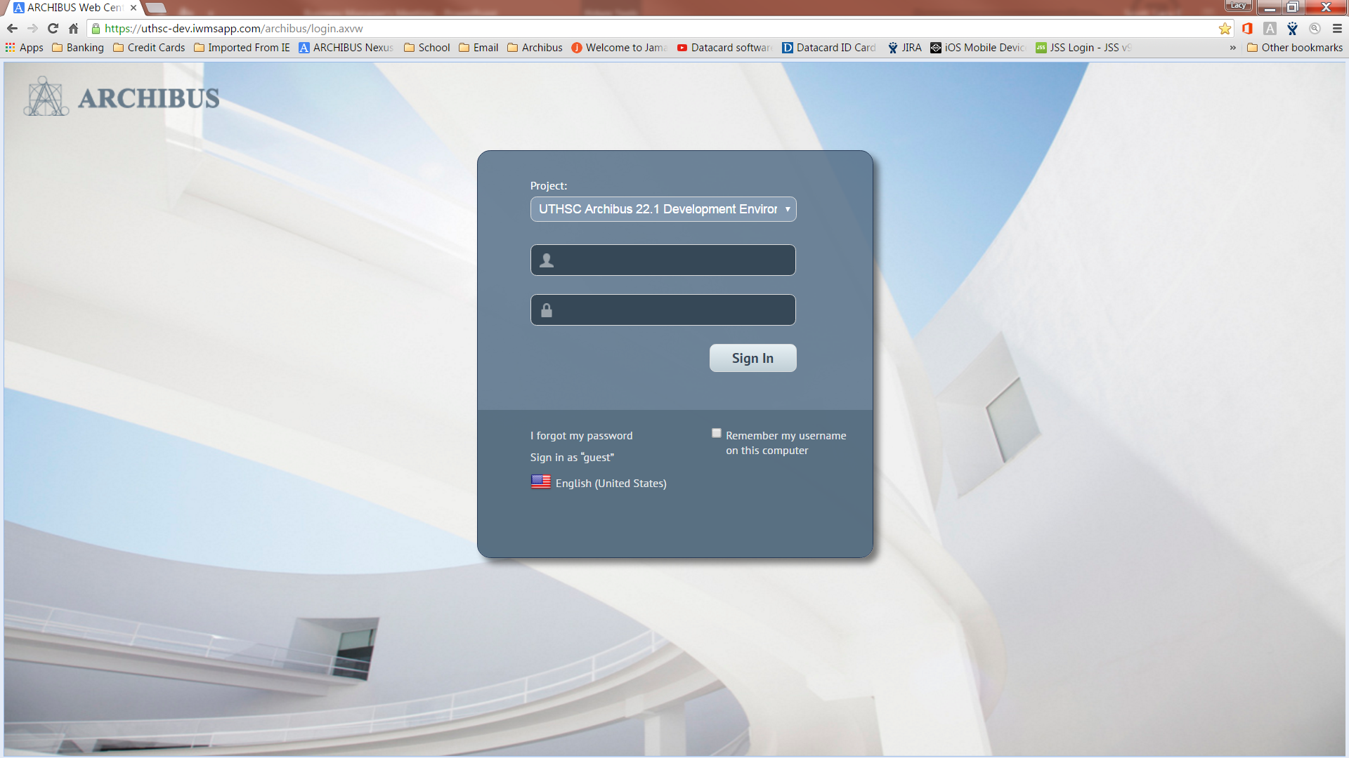
Accessing ARCHIBUS

Slide 5
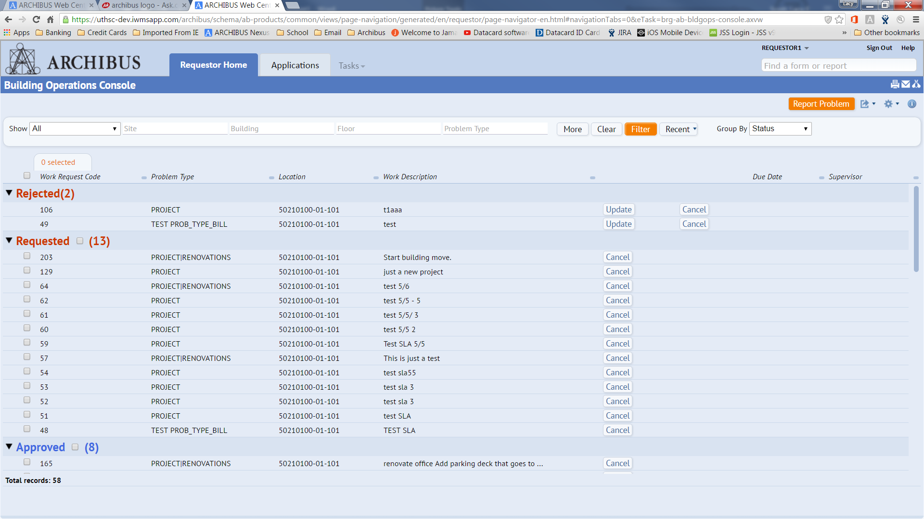
Requestor Work Screen

Slide 6
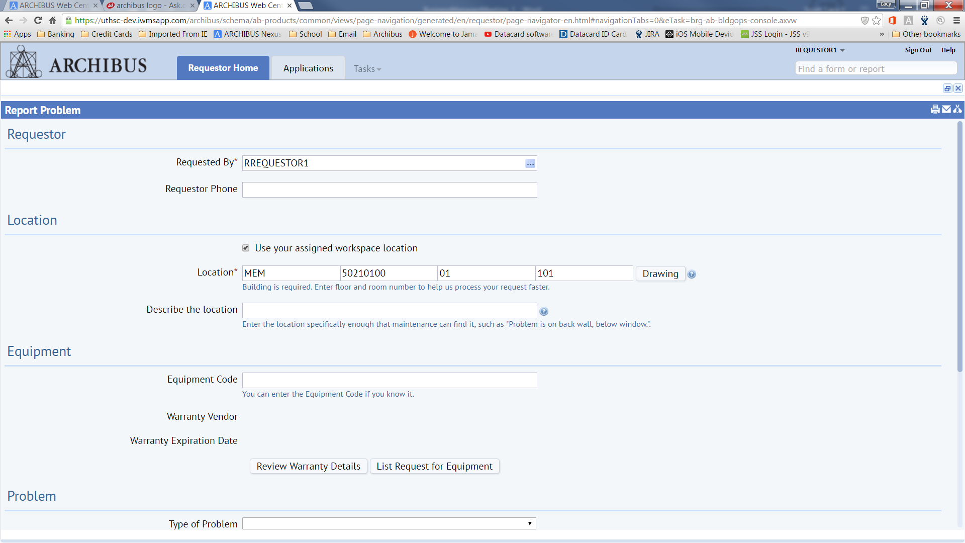
Reporting Problem

Slide 7


Benefits to Facilities
Provides a seamless link to Service Level Agreements (SLAs) to enforce standards and increase efficiency.
Better Tracking of costs associated with jobs/projects
Easier recall of past expenditures and repair procedures

Slide 8

Benefits to Customer
Ability to track work order – real-time status updates, resolutions, costs incurred
Ability to approve/deny billable work order
Ability to add pictures/documents to work order
Paper trail now Digital

Slide 9


Upcoming Training
Customer Focused Training –
                10/18; 10:00am to 12:00pm
                10/21; 2:00pm to 4:00pm
                10/25; 10:00am to 12:00pm
                10/28; 2:00pm to 4:00pm

Slide 10

Anticipated “Go Live” Date
Work order module due to “go – live” October 2016.

Slide 11

Questions and Answers

