Slide 1
WELCOME TO the
Division of Endocrinology
Diabetes and Metabolism
2018 I-CARE
PRESENTATION AND LUNCHEON

Slide 2
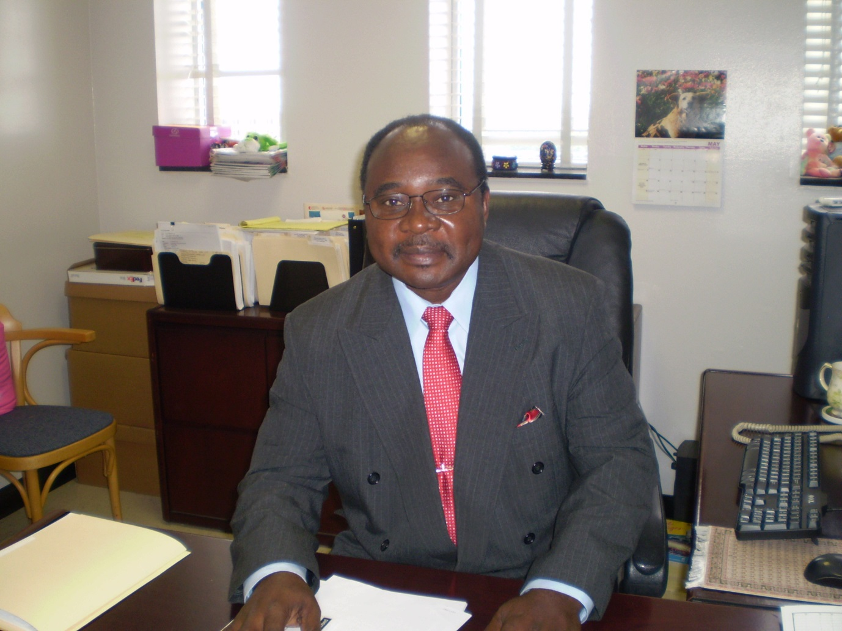
Dr. Samuel Dagogo-Jack, Division Chief

Slide 3
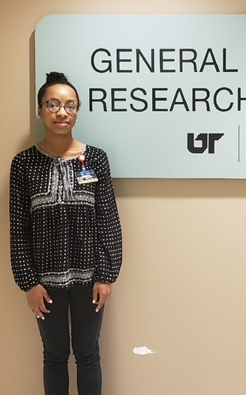
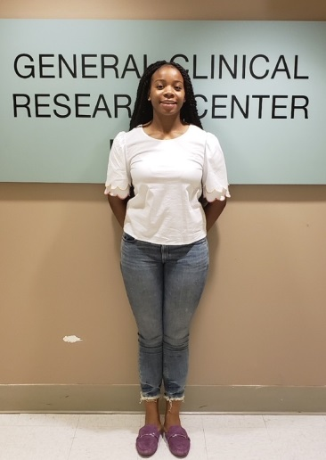
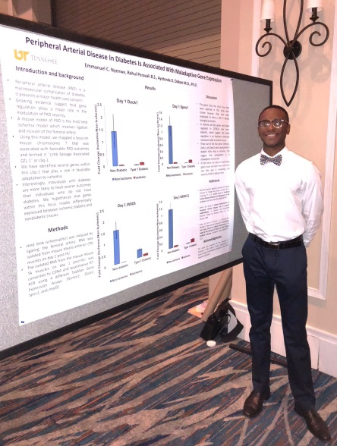
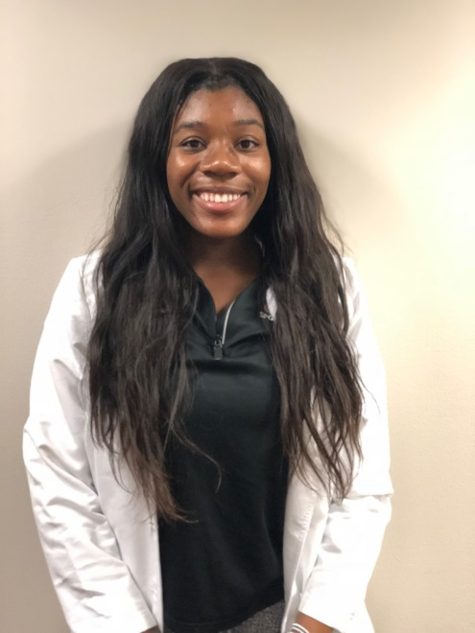
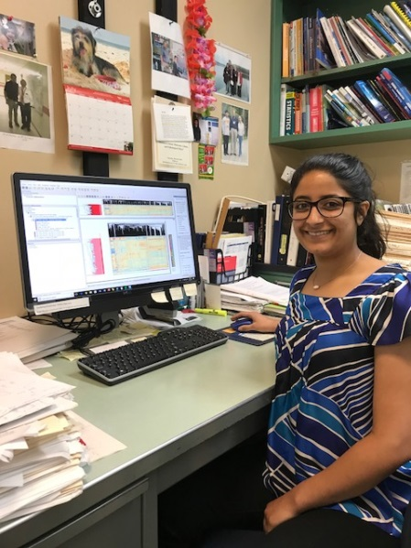
Introduction of I-CARE INTERNS

Slide 4
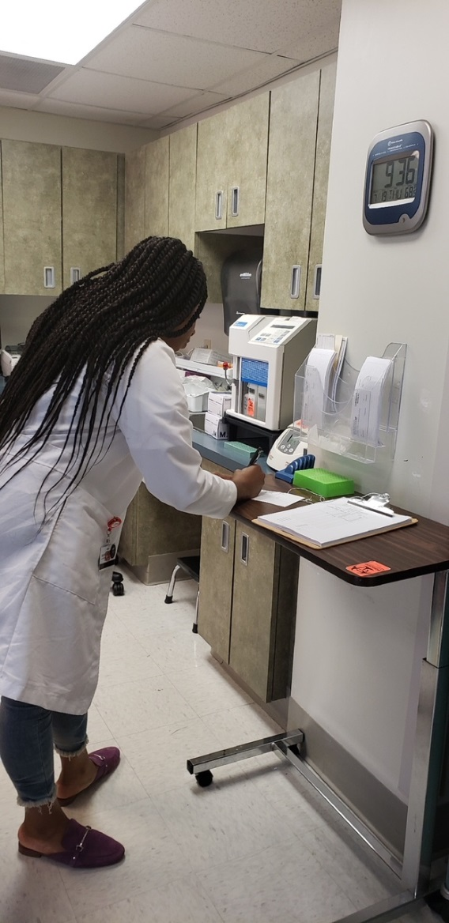
Christine Asemota
CRC Rotation
Christine
Education
Tulane University School of Medicine – Pharmacology M.S.
U of TN – Chatt Exercvise Science B.S.
Applying for Residency

Slide 5
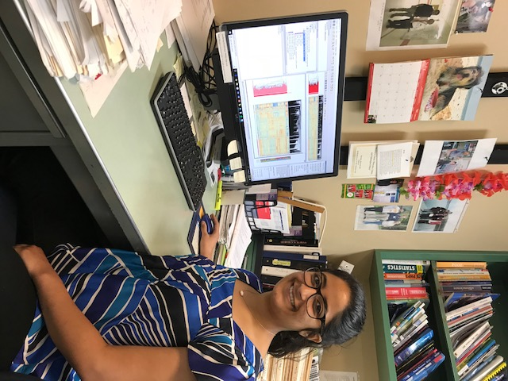
Zoya Latif
Dr. Gerling’s Lab Rotation
Attends the University of Chicago
Pursuing studies in a pre-med route Bachelor of Arts in Comparative Human Development
Very interested in research,
especially looking at pre-diabetes through the lens of race.

Slide 6
Jaelynn B. Nelson
CRC Rotation
Education:
Presently attends University of TN
Formerly attend
Howard University
Very interested in Medical Research
Plans to attend medical school and afterward possible specialize in OB/GYN .

Slide 7

Emmanuel
Nyenwe
Dr. Dokun Lab’s Rotation
Education:
Pursuing a B.S. In Neuroscience
University of Tennessee (2020)
Future plans to attend Medical School and become a physician

Slide 8

Grace Ugwueke
Rotation Dr. Stentz’s Lab
Education:
Attends the University of Miami
2016 – Present
Future plans of medical school and become a physician

