Slide 1
WELCOME TO the
Division of Endocrinology
Diabetes and Metabolism
2019 I-CARE
PRESENTATION AND LUNCHEON

Slide 2
Dr. Samuel Dagogo-Jack, Division Chief

Slide 3
Jayda Farris
2019 Honor Graduate of Central High School
Jayda presently have 19 college credit hour as she enters into her Freshman year at University of Tn-Knoxville

Slide 4
Jordan Jones
Education:
2019 Graduate of Central high School
Plans to attend Christian Brothers University

Slide 5
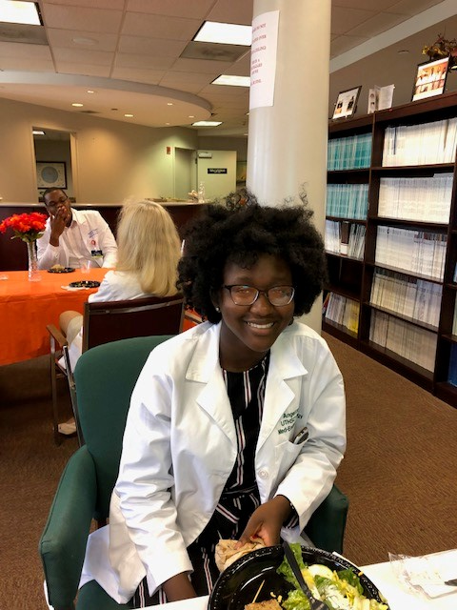
Agnel Lewis
Education:
2019 Graduate of Central high School
Will be attending the University of Tennessee Knoxville,
She is interested in becoming a pharmacist

Slide 6
Jonathan Shephard
Education:
Pursuing a B.S. In Biomedical at Southern Adventist University
Expects to graduate in May 2020(2020)
Future plans to attend Medical School

Slide 7
Tavicia Washington
Education:
Graduate of Central High School 2019
Future plans will be attending UT-Knoxville

Slide 8
Daisha Palmer
Education:
Central High School Graduate 2019
Future plans
Lane College
Wants to be a Dermatologist

