Slide 1

Connect with a Colleague, Share a Story!
“Stories matter! All our stories, those of celebrations or struggles are unique, however they have universal resonance. Share yours today!”
Mukta Panda
https://theactionalliance.org/sites/default/files/press_release_2020_public_perception_poll_for_distribution_on_9.1.2020.pdf

Slide 2
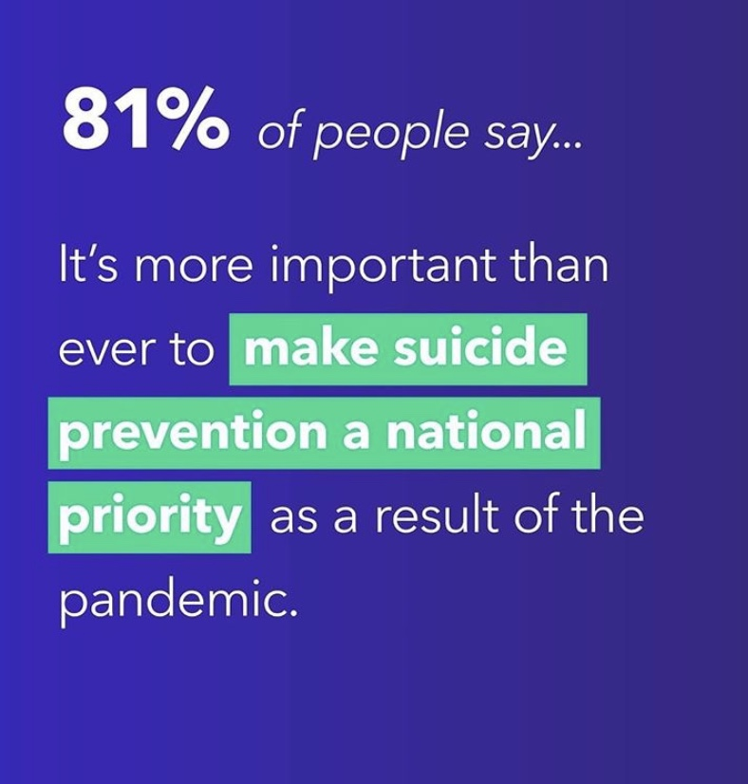

Slide 3
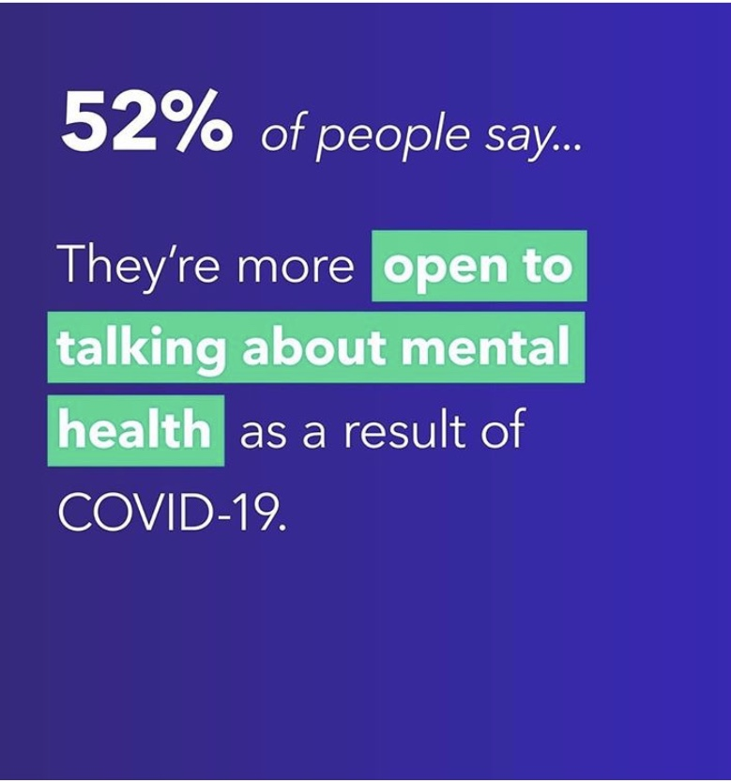

Slide 4
