Slide 2
Update to Federal and State Controlled Substance Laws and Guidelines
University of Tennessee Medical School
Capstone Course 2022
Tyler Dougherty, PharmD, BCACP
Assistant Professor of Pharmacy Practice
South College School of Pharmacy
tdougherty@south.edu

Slide 3
Disclosure and Disclaimer Information
I have no financial relationships to disclose and I will not discuss off label use or investigational use in my presentation.
This presentation should not be construed as legal advice. If in need of legal advice, please contact your lawyer.

Slide 4
Objectives
Describe the current national and state of Tennessee trends in opioid use
Compare and contrast pain guidelines and their applications
Identify monitoring and screening tools for managing patients being prescribed controlled substances
Discuss strategies for minimizing risks that are associated with opioids
Apply an algorithm to tapering a patient on opioids
Recall the requirements for prescribing buprenorphine in Tennessee
Examine new and potential federal and state legislation affecting opioid prescribing
Utilize the Tennessee Controlled Substance Monitoring Database in practice

Slide 5
Outline
Current Landscape
Best Practices
Risk Reduction
Future
Naloxone
MOUD
TN CSMD
Legislation
MOUD changes
Safe disposal
Academic detailing
National
Tennessee
COVID-19
Pain Guidelines
Monitoring
De-prescribing/tapering
Corresponding responsibility doctrine

Slide 6
Notes:
Poll Title: Do not modify the notes in this section to avoid tampering with the Poll Everywhere activity. More info at polleverywhere.com/support The famous Porter and Jick correspondence article published in NEJM addressed addiction being rare in patients treated with narcotics. What patient population was reported in this correspondence? https://www.polleverywhere.com/free_text_polls/W4n6xV0a1TQfg4JWcYEY8

Slide 7
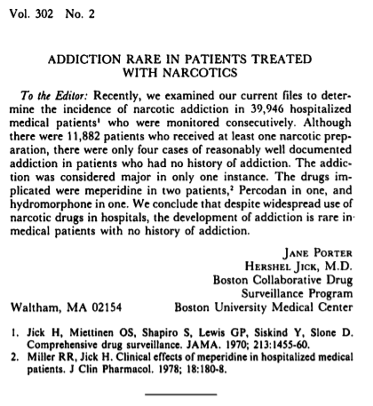
Some History…
Porter J, Jick H. Addiction rare in patients treated with narcotics. N Engl J Med 1980;302:123.

Slide 8
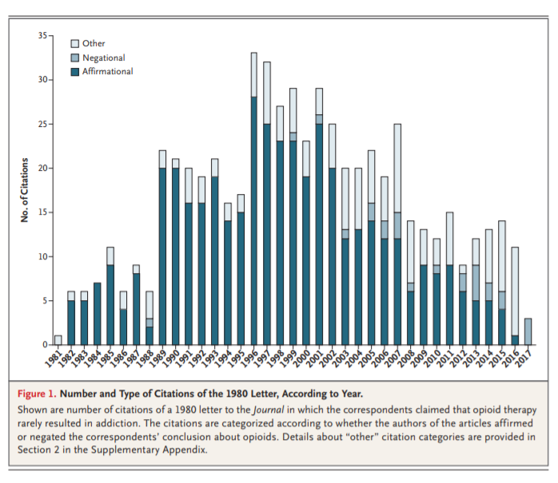
Some History…
https://www.nejm.org/doi/pdf/10.1056/NEJMc1700150?articleTools=true

Slide 9
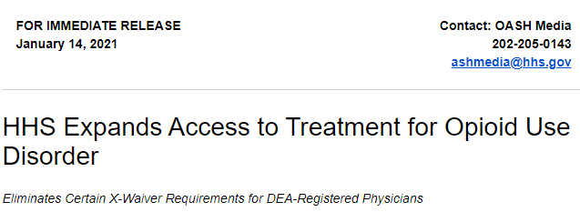
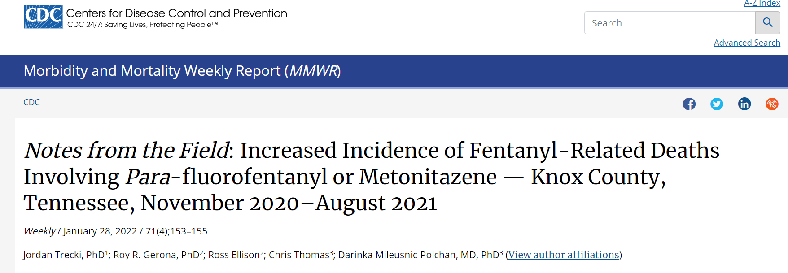
Current Landscape
Notes:
CDC report released on 10/14/20 shows a roughly 10% increase in fatalities, offer a first official snapshot of the pandemic's impact on Americans suffering addiction.
If this trend continues, the CDC estimates the U.S. will suffer more than 75,500 drug-related deaths in 2020, setting a bleak record for a second year in a row.
On 10/21/20 Purdue Pharma, the maker of Oxycontin, agreed to pay $8 Billion: $3.5 billion fines, forfeit an additional $2 billion in past profits, in addition to the $2.8 billion it agreed to pay in civil liability. The money will go towards opioid treatment and abatement programs.
Purdue will be dissolved, and its assets will be used to create a new "public benefit company" controlled by a trust or similar entity designed for the benefit of the American public. The Justice Department said it will function entirely in the public interest rather than to maximize profits. Its future earnings will go to paying the fines and penalties, which in turn will be used to combat the opioid crisis.

Slide 10
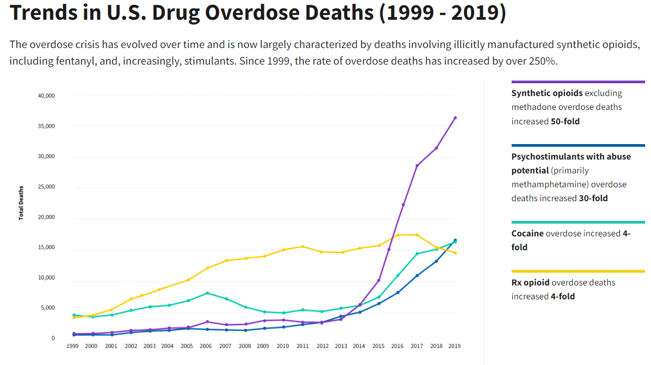
National Landscape
US Department of Health and Human Services. Overdose Prevention Strategy. https://www.hhs.gov/overdose-prevention/
Notes:
Three waves in the rise of opioid overdose deaths
Wave one: Rise in prescription opioid overdose deaths
Wave two: Rise in heroin overdose deaths
Wave three: Rise in synthetic opioid overdose deaths

Slide 11
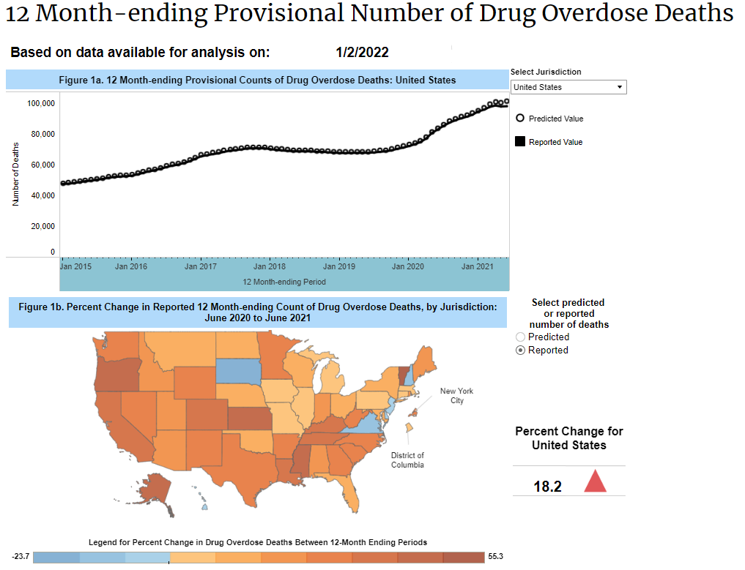
COVID-19: Increase in Overdose
Ahmad FB, Rossen LM, Sutton P. Provisional drug overdose death counts. National Center for Health Statistics. 2020. https://www.cdc.gov/nchs/nvss/vsrr/drug-overdose-data.htm

Slide 12
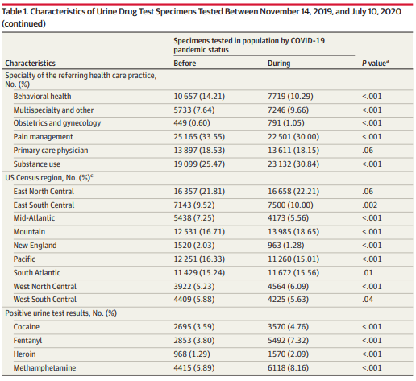
COVID-19: Increase in SUD
Wainwright JJ, et al. Analysis of drug test results before and after the US declaration of a national emergency concerning the COVID-19 outbreak. September 18, 2020. doi:10.1001/jama.2020.17694
Notes:
Cross sectional study of urine drug tests results from patients diagnosed with or at risk of substance use disorders. Patients were excluded if they were prescribed fentanyl, heroine, methamphetamine, or cocaine. Random sampling of 75,000 specimens for before COVID-19 (November 14, 2019 – March 12, 2020) versus March 13, 2020 – July 10, 2020.
Patients being tested were younger during COVID-19 testing, more often male.

Slide 13
National Landscape
100,306 drug overdose deaths (estimated, through April 2021)
75,673 opioid overdose deaths (estimated, through April 2021)
70,630 drug overdose deaths in 2019 (4.3% increase)
49,860 overdose deaths related to opioids (70.6%)
153,260,450 opioid prescriptions dispensed by retail pharmacies (down from 168,158,611 in 2018)
Approximately 15,000 people die annually from prescription opioid overdose (41/day)
Largely remained unchanged
Heroin overdose death rates have largely remained unchanged
36,659 overdose deaths involved synthetic opioids (51.5%)
1,040% rate increase from 2013-2019
Wilson N, Kariisa M, Seth P, Smith H IV, Davis NL. Drug and Opioid-Involved Overdose Deaths — United States, 2017–2018. MMWR Morb Mortal Wkly Rep 2020;69:290–297. DOI: http://dx.doi.org/10.15585/mmwr.mm6911a4external icon.
Centers for Disease Control and Prevention. Drug Overdose Deaths in the US Top 100,000 Annually. https://www.cdc.gov/nchs/pressroom/nchs_press_releases/2021/20211117.htm

Slide 14
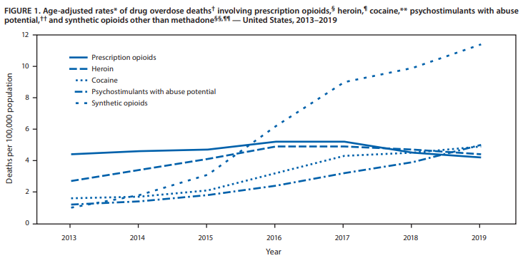
National Landscape
Mattson CL, Tanz LJ, Quinn K, Kariisa M, Patel P, Davis NL. Trends and Geographic Patterns in Drug and Synthetic Opioid Overdose Deaths — United States, 2013–2019. MMWR Morb Mortal Wkly Rep 2021;70:202–207. DOI: http://dx.doi.org/10.15585/mmwr.mm7006a4external icon

Slide 15
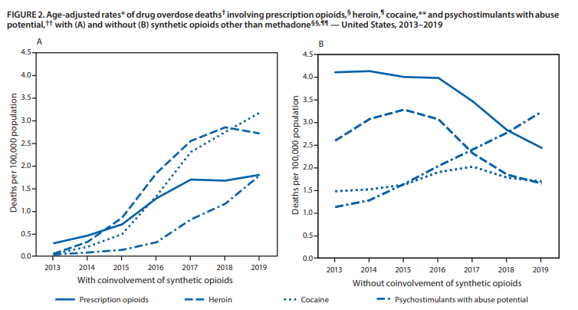
National Landscape
Mattson CL, Tanz LJ, Quinn K, Kariisa M, Patel P, Davis NL. Trends and Geographic Patterns in Drug and Synthetic Opioid Overdose Deaths — United States, 2013–2019. MMWR Morb Mortal Wkly Rep 2021;70:202–207. DOI: http://dx.doi.org/10.15585/mmwr.mm7006a4external icon

Slide 16
Notes:
Poll Title: Do not modify the notes in this section to avoid tampering with the Poll Everywhere activity. More info at polleverywhere.com/support During the past decade, which of the following have increased in Tennessee? https://www.polleverywhere.com/multiple_choice_polls/MwiJvTnijBUkESCDDeYs1?flow=Default&onscreen=persist

Slide 17
TN Overdose Deaths
Tennessee Drug Overdose Dashboard. TN Department of Health. https://www.tn.gov/health/health-program-areas/pdo/pdo/data-dashboard.html

Slide 18
TN Landscape
2,089 total overdose deaths (2019)
For every 1 overdose death, 12 nonfatal overdoses are identified in discharge records
3,032 all drug overdose deaths (2020)
1,542 deaths attributed to opioids
515 deaths attributed to prescription opioids (decrease for third year in a row)
Fentanyl involved more than half of fatal drug overdoses
24% of opioid overdoses also had benzodiazepines associated with the report
Controlled Substance Monitoring Database: 2021 Report to the 112th Tennessee General Assembly. March 1, 2021. https://www.tn.gov/content/dam/tn/health/healthprofboards/csmd/2021-CSMD-Annual-Report.pdf
Notes:
2019: 2,089 total overdose deaths
For every 1 overdose death, 12 nonfatal overdoses are identified in discharge records

Slide 19
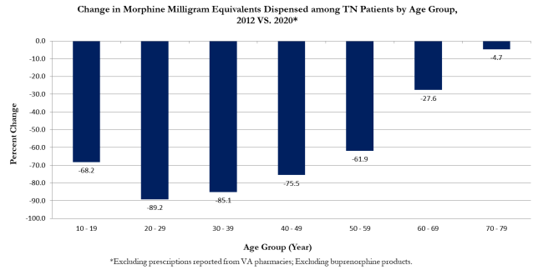
TN Landscape
Controlled Substance Monitoring Database: 2020 Report to the 112th Tennessee General Assembly. March 1, 2021. https://www.tn.gov/content/dam/tn/health/healthprofboards/csmd/2020_CSMD_Annual_Report.pdf

Slide 20
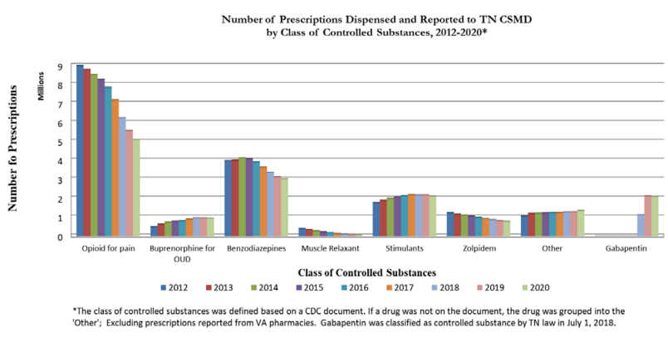
TN Landscape
Controlled Substance Monitoring Database: 2020 Report to the 112th Tennessee General Assembly. March 1, 2021. https://www.tn.gov/content/dam/tn/health/healthprofboards/csmd/2020_CSMD_Annual_Report.pdf
Notes:
Populations with increase in stimulant prescribing include:
30-39
40-49
50-59
60-69
70-79
80-89

Slide 21
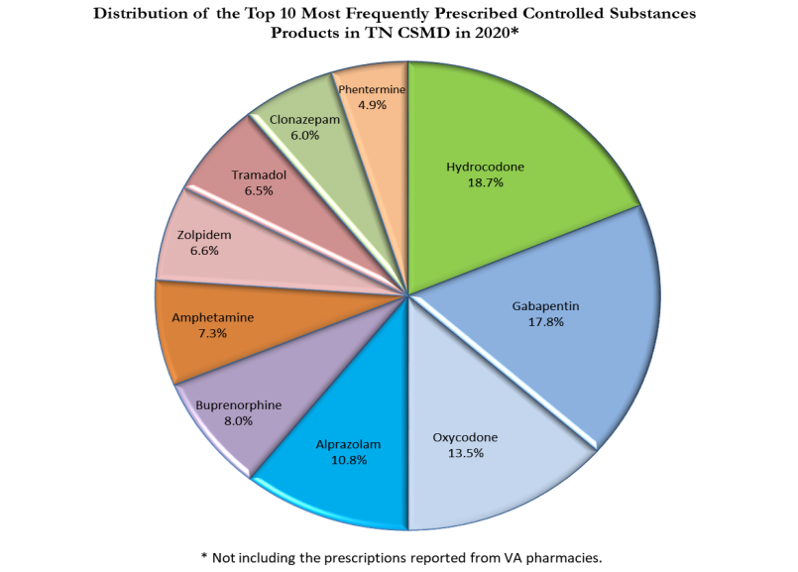
TN Landscape
Controlled Substance Monitoring Database: 2020 Report to the 112th Tennessee General Assembly. March 1, 2021. https://www.tn.gov/content/dam/tn/health/healthprofboards/csmd/2020_CSMD_Annual_Report.pdf
Notes:
Populations with increase in stimulant prescribing include:
30-39
40-49
50-59
60-69
70-79
80-89

Slide 22
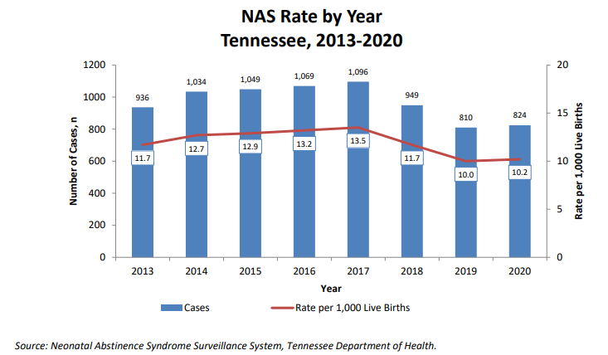
TN Landscape
Nyakeriga AM, McDonald M (2020). Neonatal Abstinence Syndrome Surveillance Annual Report 2020. Tennessee Department of Health, Nashville, TN. https://www.tn.gov/content/dam/tn/health/documents/nas/NAS-Annual-Report-2020.pdf
Notes:
65% of infants diagnosed with NAS were exposed to MAT for treatment of SUD
76.7% of infants diagnosed with NAS were exposed to at least one legally prescribed medication
94.2% of NAS infants with exposure to only prescription drugs were exposed to MAT
2nd consecutive year of a decrease
Number of cases decreased from 949 to 808
More males were diagnosed with NAS than females

Slide 23
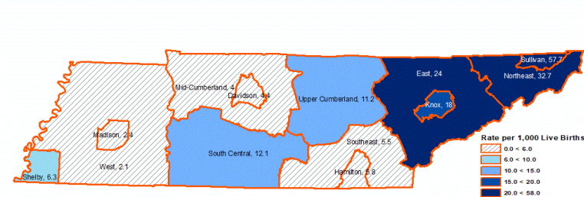
TN Landscape
Nyakeriga AM, McDonald M (2020). Neonatal Abstinence Syndrome Surveillance Annual Report 2020. Tennessee Department of Health, Nashville, TN. https://www.tn.gov/content/dam/tn/health/documents/nas/NAS-Annual-Report-2020.pdf
Notes:
Exposure to prescription medications increased as you look West to East Tennessee.
Elicit substance exposure is more common in West TN (Shelby County), whereas prescribed medication is more common in East TN (opioids, buprenorphine)

Slide 24
TN Landscape
5,029,476 opioid prescriptions dispensed in 2020
Number of MME dispensed has decreased 57% (2012-2020)
Number of opioid prescriptions for pain have decreased by 43% (2012-2020)
Number of patients receiving long-acting opioids has decreased by 20% (2019-2020)
Stimulant prescribing continues to increase as compared to 2012 (20% higher)
Controlled Substance Monitoring Database: 2020 Report to the 112th Tennessee General Assembly. March 1, 2021. https://www.tn.gov/content/dam/tn/health/healthprofboards/csmd/2020_CSMD_Annual_Report.pdf
TN Department of Health Overdose Dashboard. Accessed February 3, 2022. https://www.tn.gov/health/health-program-areas/pdo/pdo/data-dashboard.html
Notes:
Increase in stimulant prescribing has been seen in previous epidemics of opioid abuse and highlights the urgent need for timely identification and treatment of substance use disorder

Slide 25
BEST PRACTICES
Pain Guidelines
Monitoring
TN Together
De-prescribing/tapering
Corresponding responsibility doctrine

Slide 26
Notes:
Poll Title: Do not modify the notes in this section to avoid tampering with the Poll Everywhere activity. More info at polleverywhere.com/support Which of the following best describe your practice of opioid prescribing? https://www.polleverywhere.com/multiple_choice_polls/QP3t9XVOIz3FfSkGDurUE?flow=Default&onscreen=persist

Slide 27
CDC Chronic Pain Guidelines
Chronic pain: >90 days
Estimated 116 million U.S. adults
Previous treatments
Co-morbidities
History (overdose, SUD)
CSMD
Can use a therapeutic trial of opioids
Requires informed consent and treatment agreement
Use the lowest effective dose
50 MME/day
90 MME/day
CDC Checklist: https://www.cdc.gov/drugoverdose/pdf/pdo_checklist-a.pdf
Notes:
Estimated that 116 million US adults suffer from chronic pain (more than heart disease, diabetes, and cancer combined)
If prescribing >50 MME/day, increase follow and consider offering naloxone. Increased risk of overdose
Attempt to avoid >90 MME/day, and consult a specialist

Slide 28
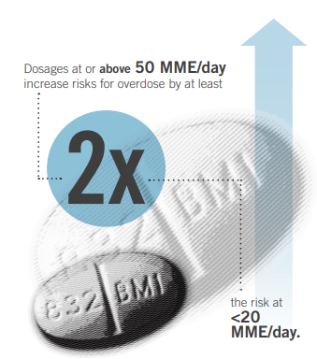
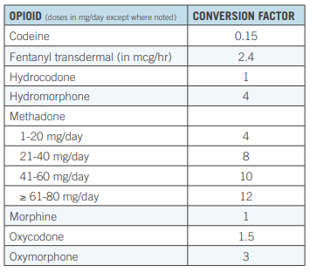
CDC Chronic Pain Guidelines
CDC Calculating Total Daily Dose of Opioids for Safer Dosage. https://www.cdc.gov/drugoverdose/pdf/calculating_total_daily_dose-a.pdf
Notes:
Estimated that 116 million US adults suffer from chronic pain (more than heart disease, diabetes, and cancer combined)
If prescribing >50 MME/day, increase follow and consider offering naloxone. Increased risk of overdose
Attempt to avoid >90 MME/day, and consult a specialist

Slide 29
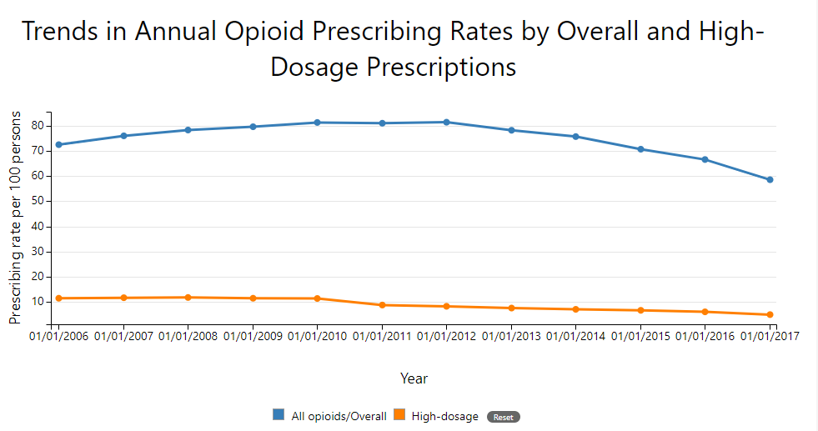
Centers for Disease Control and Prevention. Vital Signs: Changes in Opioid Prescribing in the United States, 2006–2015. MMWR 2017; 66(26):697-704.
Notes:
In 2017, however, there were still almost 58 opioid prescriptions written for every 100 Americans.
More than 17% of Americans had at least one opioid prescription filled, with an average of 3.4 opioid prescriptions dispensed per patient.
Per prescription, the average daily amount was more than 45.3 MME.
The average number of days per prescription continues to increase, with an average of 18 days in 2017.²

Slide 30
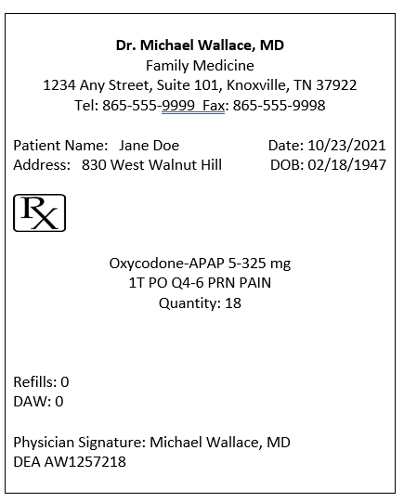
What is the maximum number of MME’s/day this patient is receiving?

Slide 31
Notes:
Poll Title: Do not modify the notes in this section to avoid tampering with the Poll Everywhere activity. More info at polleverywhere.com/support What is the maximum number of MME's/day this patient is receiving? https://www.polleverywhere.com/multiple_choice_polls/OHaHZkRUFHNr1Iary8ho2?flow=Default&onscreen=persist

Slide 32
CDC Chronic Pain Guidelines
Avoid benzodiazepines with opioid
Must use UDT at onset and at least annually
Check PDMP at onset and every three months
Follow up with patient:
Change of dose: 1-4 weeks
Stable dose: every 3 months
Acute pain: 3 days sufficient, 7 days rarely
CDC Checklist: https://www.cdc.gov/drugoverdose/pdf/pdo_checklist-a.pdf

Slide 33
Benzodiazepine Risk
https://www.fda.gov/drugs/drug-safety-and-availability/fda-requiring-boxed-warning-updated-improve-safe-use-benzodiazepine-drug-class

Slide 34
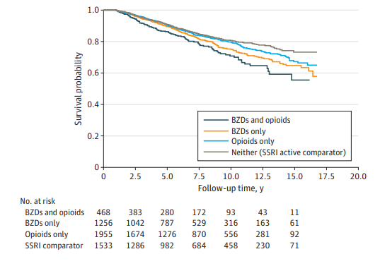
Risk of Benzodiazepine on All-Cause Mortality
Xu KY, Hartz SM, Borodovsky JT, Bierut LJ, Grucza RA. Association Between Benzodiazepine Use With or Without Opioid Use and All-Cause Mortality in the United States, 1999-2015. JAMA Netw Open. 2020;3(12):e2028557. doi:10.1001/jamanetworkopen.2020.28557

Slide 35
Benzodiazepine/Z-Drugs
Minimize benzodiazepine and opioid combinations
Not recommended to use beyond two weeks
Lowest effective dose, shortest time
Create an exist strategy/alternative options
One provider, one pharmacy
20% increase in risk of overdose if managed by multiple providers for benzo + opioid
If using in 65 or older, consider lorazepam, oxazepam, temazepam (LOT)
Benzodiazepine and Z-Drug Safety Guideline. Kaiser Permanente. 2019. https://wa.kaiserpermanente.org/static/pdf/public/guidelines/benzo-zdrug.pdf
Chua K, Brummett CM, Ng S, Bohnert ASB. Association Between Receipt of Overlapping Opioid and Benzodiazepine Prescriptions From Multiple Prescribers and Overdose Risk. JAMA Netw Open. 2021;4(8):e2120353. doi:10.1001/jamanetworkopen.2021.20353
Notes:
Based on 2015-2016 survey data, estimated that 30.6 million americans reported past-year use of benzo’s, with 17% reporting misuse.
Maust DT, Lin LA, Blow FC. Benzodiazepine use and misuse among adults in the United States. Psychiatr Serv. 2019;70(2):97-106. doi: 10.1176/appi.ps.201800321

Slide 36
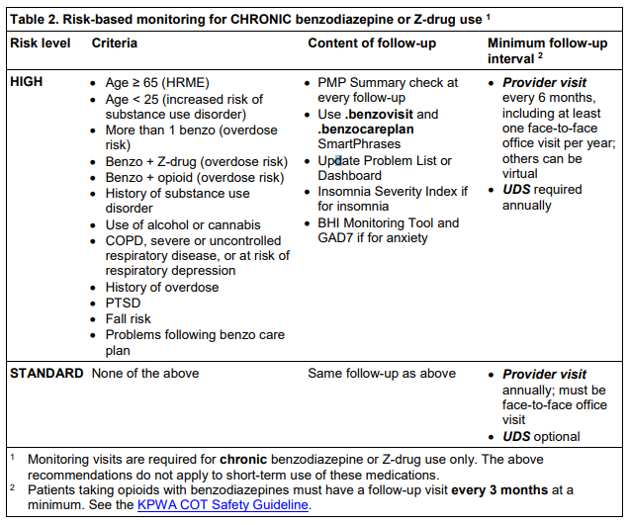
Benzodiazepine Risk
Benzodiazepine and Z-Drug Safety Guideline. Kaiser Permanente. 2019. https://wa.kaiserpermanente.org/static/pdf/public/guidelines/benzo-zdrug.pdf

Slide 37
Chronic Back/Hip/Knee Pain
The SPACE Trial
12-month, randomized trial of VA participants
Moderate – severe chronic back pain or hip/knee osteoarthritis despite analgesic use
Opioid vs nonopioid therapies aiming to improve pain and function
Pain intensity significantly better in nonopioid group
Opioids did not result in better pain-related function
Krebs EE, Gravely A, et al. Effect of opioid vs nonopioid medications on pain-related function in patients with chronic back pain or hip or knee osteoarthritis pain: the SPACE randomized clinical trial. JAMA. 2018;319(9):872-882. doi:10.1001/jama.2018.0899
Notes:
Opioid group: started with IR morphine, oxycodone, or hydrocodone/APAP
Nonopioid group: started with APAP or NSAID
Pain/Function was assessed using Brief Pain Inventory (BPI) scale over 12 months
240 patients were randomized, 58.3 years of age, mostly male
Demonstrates the lack of support for initiation of opioid therapy for moderate/severe chronic back pain or hip/knee osteoarthritis pain.

Slide 38
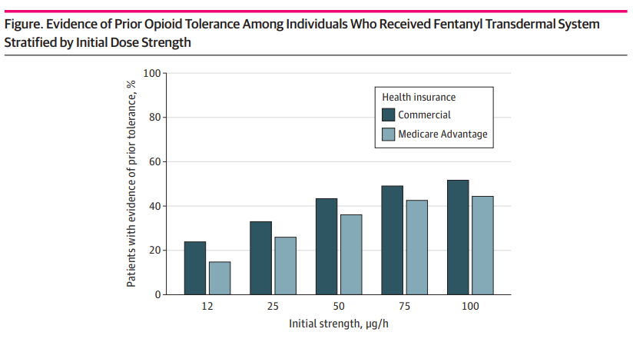
Is your patient opioid tolerant?
Jeffery M, et al. Assessment of potentially inappropriate prescribing of opioid analgesics requiring prior opioid tolerance. JAMA Network Open. 2020;3(4). https://jamanetwork.com/journals/jamanetworkopen/fullarticle/2764402
Notes:
Question: what proportion of patients are opioid-tolerant when starting opioids that require tolerance for safe use?
Type of study: retrospective cohort study using a national database of medical, pharmacy, and her data. Included commercial and Medicare Advantage patients with at least 183 days of continuous enrollment. Time frame was 2007-2016
Finding: 153385 use episodes of opioid analgesics labeled only for use in people who are opioid-tolerant, more than half of patients who received these medications showed no evidence of prior opioid tolerance in health insurance or EHR data
Meanings: many patients may be at risk of potentially serious adverse events owing to widespread use of certain ER opioids without prior tolerance

Slide 39
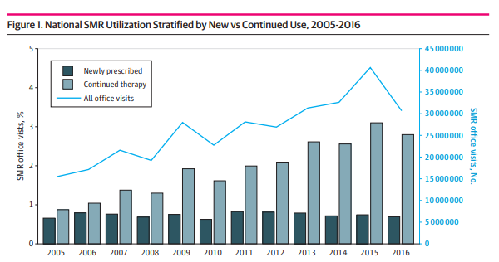
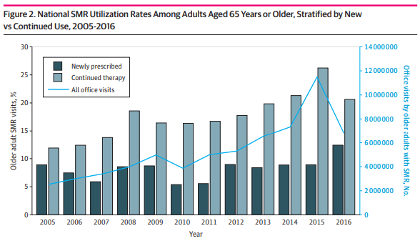
Muscle Relaxant Overprescribing
Soprano SE, Hennessy S, Bilker WB, et al. Assessment of physician prescribing of muscle relaxants in the United States, 2005 – 2016. Jama Network Open. 2020; 3(6): e207664. file:///C:/Users/tdougherty/Downloads/soprano_2020_oi_200329%20(1).pdf
Notes:
Cross sectional study using data from the National Ambulatory Medical Care Survey from 2005-2016.
Visits were from encounters within non-federally funded, office-based physicians in the US
Outcomes/Measures: number of visits for newly prescribed versus continued prescribing of skeletal muscle relaxants.
Results: 314,970,308 off visits
Mean age: 53.5 years, 61.8% men
Office visits with a prescribed SMR nearly doubled from 15.5 million in 2005 to 30.7 million in 2016.
Visits for NEW SMR prescriptions remained stable (see graph), but office visits for continued SMR therapy tripled from 8.5 million in 2005 to 24.7 million in 2016.
Older adults accounted for 22.2% of visits for SMR prescriptions (this group is only 14.5% of the population)
The number of prescriptions for SMR’s in older adults considered potentially inappropriate in this population (carisoprodol, chlorzoxazone, cyclobenzaprine, metaxalone, methocarbamol) doubled.
Concomitant use of an opioid was recorded 67.2% of the continued SMR prescribing visits.

Slide 40
Limitations to CDC Guidelines
Inflexible application of recommended ceiling doses/durations as hard limits
Abrupt opioid taper or cessation
Limited coverage and access to multi-modal, comprehensive care
OUD diagnosis difficulty and access barriers
Payors applying dosage limits
Kurt Kroenke, Daniel P Alford, Charles Argoff, Bernard Canlas, Edward Covington, Joseph W Frank, Karl J Haake, Steven Hanling, W Michael Hooten, Stefan G Kertesz, Richard L Kravitz, Erin E Krebs, Steven P Stanos, Mark Sullivan, Challenges with Implementing the Centers for Disease Control and Prevention Opioid Guideline: A Consensus Panel Report, Pain Medicine, Volume 20, Issue 4, April 2019, Pages 724–735, https://doi.org/10.1093/pm/pny307

Slide 41
Nonopioid Treatments for Chronic Pain
Low back pain
Exercise, CBT, PT
APAP, NSAIDs, SNRIs
Osteoarthritis
Exercise, weight loss
APAP, oral/topical NSAIDs
Migraine
Prevention vs Treatment
Neuropathic pain
SNRIs, gabapentin/pregabalin, topical lidocaine
Nonopioid treatments for chronic pain. Centers for Disease Control and Prevention. 27 April 2016. https://www.cdc.gov/drugoverdose/pdf/nonopioid_treatments-a.pdf
Notes:
Preventive treatments • Beta-blockers • TCAs • Antiseizure medications • Calcium channel blockers • Non-pharmacological treatments (Cognitive behavioral therapy, relaxation, biofeedback, exercise therapy) • Avoid migraine triggers
Acute treatments • Aspirin, acetaminophen, NSAIDs (may be combined with caffeine) • Antinausea medication • Triptans-migraine-specific

Slide 42
Acute Pain
Randomized trial comparing efficacy of 4 oral analgesics
400 mg ibuprofen + 1000 mg acetaminophen
5 mg oxycodone + 325 mg acetaminophen
5 mg hydrocodone + 300 mg acetaminophen
30 mg codeine + 300 mg acetaminophen
Primary endpoint: between-group difference in decline in pain 2 hours after ingestion using 11-point numerical rating scale
Chang AK, Bijur PE, et al. Effect of a single dose of oral opioid and nonopioid analgesics on acute extremity pain in the emergency department: A randomized clinical trial. JAMA. 2017;318(17):1661-1667. doi:10.1001/jama.2017.16190
Notes:
Randomized clinical trial conducted at 2 urban Eds in Bronx, NY
Included 416 patients aged 21-64 with moderate – severe acute extremity pain

Slide 43
Opioid Sparing
Retrospective study from 2007-2017, 18 and older, undergoing major surgery
Exposure: Opioid ONLY or Gabapentinoid and Opioid together on day of surgery
Primary Outcome: Overdose
5,547,667 hospital admissions
Low clinical risk, but still a risk
Bykov K, Bateman BT, Franklin JM, Vine SM, Patorno E. Association of Gabapentinoids With the Risk of Opioid-Related Adverse Events in Surgical Patients in the United States. JAMA Netw Open. 2020;3(12):e2031647. doi:10.1001/jamanetworkopen.2020.31647

Slide 44
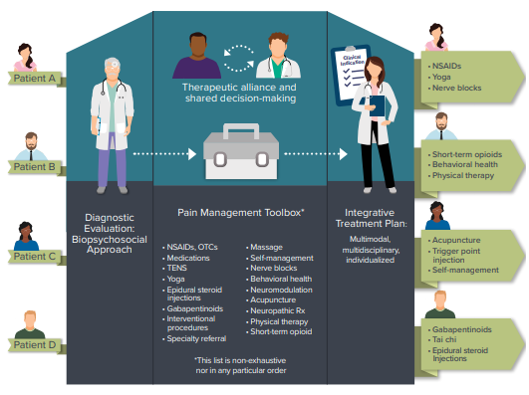
Individualized, Integrative Treatment
U.S. Department of Health and Human Services (2019, May). Pain Management Best Practices Inter-Agency Task Force Report: Updates, Gaps, Inconsistencies, and Recommendations. Retrieved from U. S. Department of Health and Human Services website: https://www.hhs.gov/ash/advisory-committees/pain/reports/index.html
Notes:
Structural procedures/injections
CBT, massage, exercise
Psychosocial therapy
Other meds to treat co-morbid conditions (depression, anxiety, almost 30% of chronic pain patients have this)
Discuss the ECHO model
Also discuss the use of genetic testing?

Slide 45
TN Chronic Pain Guidelines
Can use a therapeutic trial of opioids
Requires informed consent and treatment agreement
Discuss birth control plan to prevent unintended pregnancy
Use the lowest effective dose, immediate release products
Discuss and document the 5 A’s (analgesia, activities of daily living, adverse side effects, aberrant drug-taking behaviors and affects) at each visit
Tennessee Chronic Pain Guidelines. https://www.tn.gov/content/dam/tn/health/healthprofboards/pain-management-clinic/ChronicPainGuidelines.pdf
Notes:
TN Data suggests risk of overdose begins at 81 MME/day

Slide 46
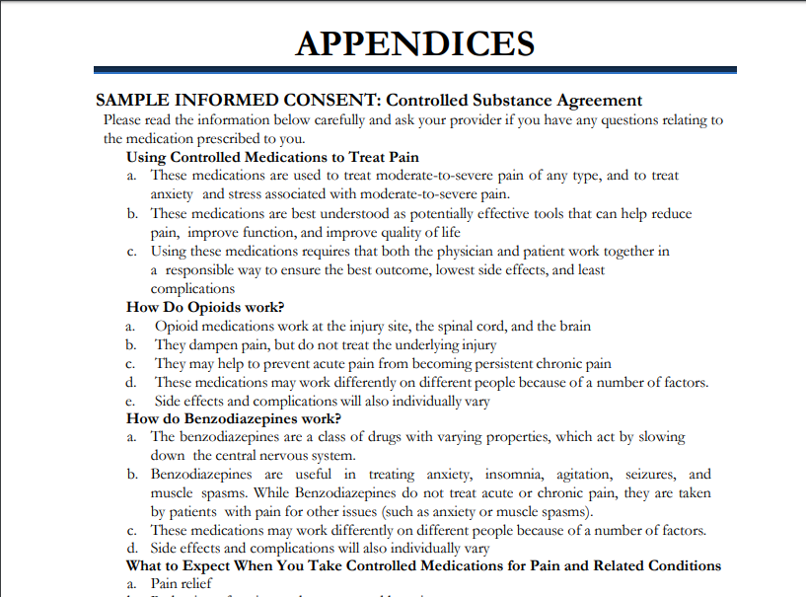
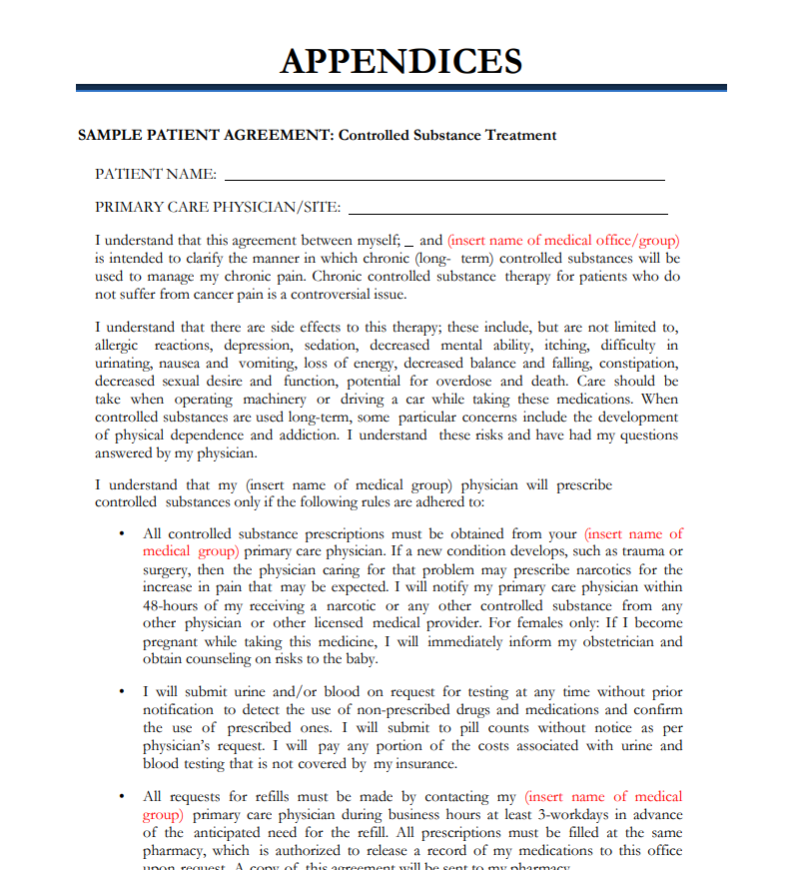
Informed Consent/Agreements
Tennessee Chronic Pain Guidelines. https://www.tn.gov/content/dam/tn/health/healthprofboards/pain-management-clinic/ChronicPainGuidelines.pdf
Notes:
“Informed consent”… at a minimum:
(i) Adequate information to allow the patient or the patient's legal representative to understand:
(a) The risks, effects, and characteristics of opioids, including the risks of physical dependency and addiction, misuse, and diversion;
(b) What to expect when taking an opioid and how opioids should be used; and
(c) Reasonable alternatives to opioids for treating or managing the patient's condition or symptoms and the benefits and risks of the alternative treatments;
TCA §63-1-164
A healthcare practitioner may treat a patient with more than a three-day supply of an opioid if the healthcare practitioner treats the patient with no more than one (1) prescription for an opioid per encounter and:(i) Personally conducts a thorough evaluation of the patient;
(ii) Documents consideration of non-opioid and non-pharmacologic pain management strategies and why the strategies failed or were not attempted;
(iii) Includes the ICD-10 code for the primary disease in the patient's chart, and on the prescription when a prescription is issued; and
(iv) Obtains informed consent and documents the reason for treating with an opioid in the chart.

Slide 47
TN Chronic Pain Guidelines
Primary Care Providers are encouraged to treat patients requiring <120 MME/day
If patient requires >120 MME/day, must consult with pain medicine specialist
If patient requires >120 MME/day for more than 6 months, must consult with a pain medicine specialist annually
Risk of overdose starts at 81 MME
Tennessee Chronic Pain Guidelines. https://www.tn.gov/content/dam/tn/health/healthprofboards/pain-management-clinic/ChronicPainGuidelines.pdf

Slide 48
TN Chronic Pain Guidelines
Assess risk for abuse
Establish treatment goals
Avoid benzodiazepines with opioid
Must use UDT at onset and at least twice yearly
Check CSMD at least twice yearly per law
Cannot use telemedicine
Co-prescribing Naloxone
https://apps.health.tn.gov/naloxone/savealife/
Recent evidence of decreased naloxone filling post-pandemic
Tennessee Chronic Pain Guidelines. https://www.tn.gov/content/dam/tn/health/healthprofboards/pain-management-clinic/ChronicPainGuidelines.pdf
O’Donoghue AL et al. Trends in Filled Naloxone Prescriptions Before and During the COVID-19 Pandemic in the United States. JAMA. 2021
Notes:
All three of these are free.
BRI = Brief Risk Interview, short clinical interview that includes topics on past misuse, presence of mental health disorders, history of SUD, UDT and CSMD information. Categorizes into Low, Low Medium, Medium, Medium High, High, and Very High risk.
ORT= Opioid Risk Tool, 10 item patient completed questionnaire, most widely used . Personal and family history of substance used disorder and psychiatric issues, Low, Medium, High risk
SOAPP-R= Screener and Opioid Assessment for Patients with Pain-Revised. 5 point rating scale, impulsivity, legal problems, past substance use disorder, past sexual abuse, Low or High Risk
PEG
Pain average
Interference with Enjoyment of life
Interference with General Activity

Slide 49
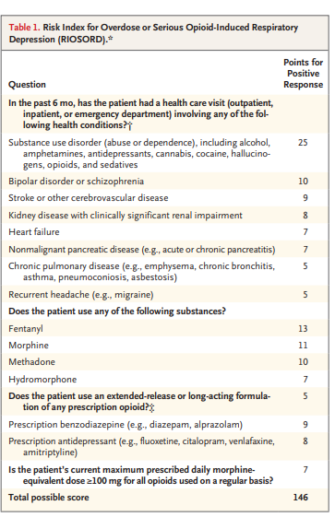
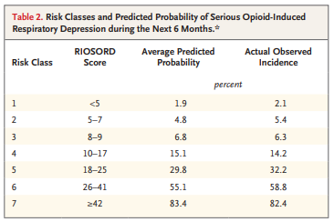
Risk Assessment Tools
Brief Risk Interview
Opioid Risk Tool
Screener and Opioid Assessment for Patients with Pain-Revised
Babu KM, et al. Prevention of Opioid Overdose. N Engl J Med. 380;23: 2246-2255
Notes:
Risk Index for Overdose or Severe Opioid-Induced Respiratory Depression (RIOSORD): validated instrument used to estimate the risk of overdose in opioid-treated patients.

Slide 50
Treatment Goals
Primary goal: clinically significant improvement in PAIN and FUNCTION
3-item PEG Assessment Scale
Pain Average
Interference with Enjoyment of life
Interference with General activity
Most likely will not result in the elimination of pain
Tennessee Chronic Pain Guidelines. https://www.tn.gov/content/dam/tn/health/healthprofboards/pain-management-clinic/ChronicPainGuidelines.pdf
Notes:
TN Chronic Pain Guidelines say that these SHALL be included in the medical record.

Slide 51
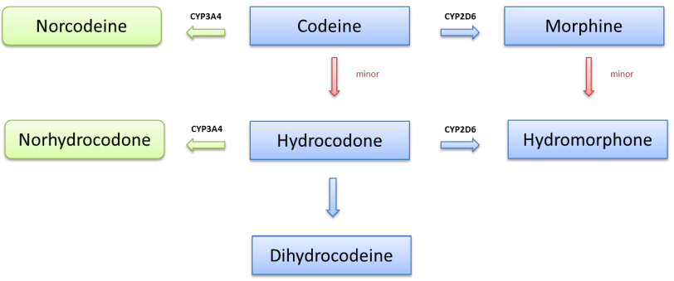
Drug Screening Considerations
Tennessee Chronic Pain Guidelines. https://www.tn.gov/content/dam/tn/health/healthprofboards/pain-management-clinic/ChronicPainGuidelines.pdf
Notes:
Immunoassays are the most common form of urine drug testing and can be performed at POC. They are typically used as a screening method, not a confirmation method.
Immunoassays are qualitative
Immunoassays can result in false positives (high rates of false positives). Therefore, when choosing a test, make sure to consider cross-reactivities for use.
Confirmation is typically performed using GC/MS and LC/MS.
Urine drug screens would result in metabolism of the ingested drug.
Saliva testing is also becoming more prominent for its ease of use. However, the ingested drug would be most likely found from this test.
This raises considerations of drug metabolism and screening methods. Read diagram.

Slide 52
TN Chronic Pain Guidelines – Acute Pain
Pain present for <90 days
Can be spontaneous, surgical, or injury-related
Use multi-modal care:
Nonpharmacologic therapies
NSAIDs for 2-4 weeks
Education
If pain persists, can try three days or less of opioids (tramadol, if not contraindicated)
Avoid extended-release formulations in acute setting
Evaluate for MOUD and check CSMD
Tennessee Chronic Pain Guidelines. https://www.tn.gov/content/dam/tn/health/healthprofboards/pain-management-clinic/ChronicPainGuidelines.pdf
Notes:
Heat, rest, massage, acupuncture, PT,
US Preventative Task Force now recommends to screen for unhealthy drug use in adults 18 and older.

Slide 53
CARA 2016 – Partial Fills
Allows for partial filling of C-II’s
Requested by the patient or practitioner
Total quantity dispensed in all partial fills cannot exceed total quantity prescribed
Once a partial fill occurs, the remaining portion may be filled within 30 days of the date on the Rx
If not, the prescriber should be notified
No further quantity can be dispensed after 30 days without a new Rx
Comprehensive Addiction and Recovery Act 2016. 21 USC 829; 21 CFR 1306.13

Slide 54
Public Chapter 124 Amended: effective 4/9/2019

Slide 55
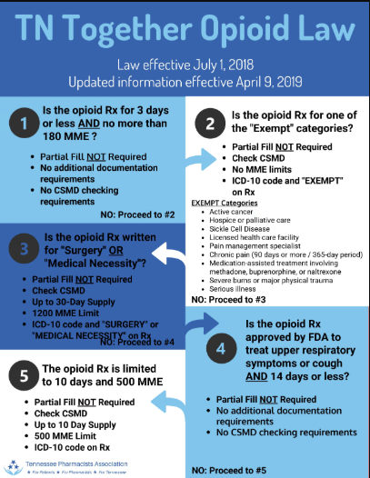
Notes:
2019 Flow Diagram

Slide 56
Discrepancies Across Corporations
Business | Day Supply Limitation | MME/Day Limitation
Walmart | 7-day supply for acute pain | Up to 50 MME/day for acute pain
CVS/Caremark | 7-day supply for acute pain *require PA for DS/MME increase or ER therapy | Up to 90 MME/day limit for acute pain
Express Scripts | 7-day supply for acute pain for first 4 fills, requiring PA if exceed 28 day supply/60 day period | Up to 90 MME/day for acute pain
Tenncare | Up to 15 days/180 day period, first script is 5 days or less, and additional 10 days requires PA | Up to 60 MME/day for acute pain
https://lab.express-scripts.com/lab/insights/drug-safety-and-abuse/our-focus-opioid-recovery-and-abuse-prevention
https://oig.hhs.gov/oas/reports/region4/41800124_Factsheet.pdf
https://www.caremark.com/portal/asset/Opioid_Reference_Guide.pdf
https://corporate.walmart.com/newsroom/2018/05/07/walmart-introduces-additional-measures-to-help-curb-opioid-abuse-and-misuse

Slide 57
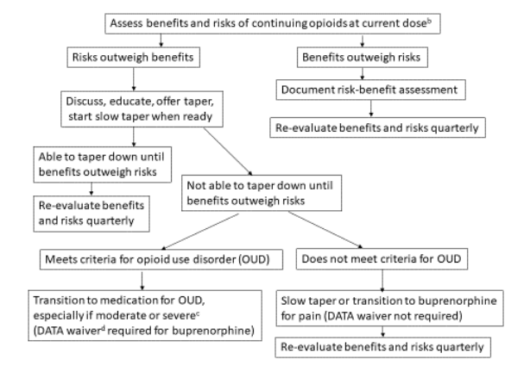
Tapering: Benefits vs Risk
Dowell D, Compton WM, Giroir BP. Patient-Centered Reduction or Discontinuation of Long-term Opioid Analgesics: The HHS Guide for Clinicians. JAMA. Published online October 10, 2019. doi:10.1001/jama.2019.16409.
Notes:
Belbuca and Butrans can be used for pain

Slide 58
Dose Reduction/Tapering
When starting an opioid trial, discuss “exit” strategy
Consider many types of patients who would benefit
Consider pain score at initiation and current
Recent systematic review found:
Improvement in Pain: 8/8 studies
Improvement in Function: 5/5 studies
Improvement in Quality of Life: 3/3 studies
Initial daily dose reductions of 5-10% every 2-4 weeks
Once at 1/3 of original dose, smaller dose reductions less often may be required (ie 5% q 4-8 weeks)
Frank J, et al. Patient outcomes in dose reduction or discontinuation of long-term opioid therapy: A systematic review. Ann Intern Med. 2017;167: 181-191. https://cha.com/wp-content/uploads/2019/03/Annals-IM-Frank-2017-tapering-opiates.pdf
Notes:
Patients who would benefit from opioid taper/dose reduction:
Patient has requested, is having significant adverse events (sedation, constipation, falls)
Patient has not met goals of therapy (no improvement in function/problematic pain)
Patient is ambivalent or resistant to taper: discuss opioid-induced hyperalgesia
Patient shows signs/characteristics of OUD or concomitant medications that increase risk

Slide 59
Why does the Pharmacist call?
“Red Flags”
Checking CSMD
Distance between doctor, pharmacy, and residence
Multiple pharmacies being used
“Cocktails”
Pre-printed/stamped pads
OBRA’ 90 Requirements
Duplicate therapies
Drug-disease contraindications
Counseling requirements
Insurance
Notes:
Many pharmacies are not filling for patients who live outside of specific city or zip code areas

Slide 60
Corresponding Responsibility Doctrine
“A prescription for a controlled substance to be effective must be issued for a legitimate medical purpose by an individual practitioner acting in the usual course of his professional practice. The responsibility for the proper prescribing and dispensing of controlled substances is upon the prescribing practitioner, but a corresponding responsibility rests with the pharmacist who fills the prescription. An order purporting to be a prescription issued not in the usual course of professional treatment or in legitimate and authorized research is not a prescription within the meaning and intent of Section 309 of the Act (21 U.S.C. §829) and the person knowingly filling such a purported prescription, as well as the person issuing it, shall be subject to the penalties provided for violations of the provisions of law relating to controlled substances (21 C.F.R. §1306.04(a)).”
Food and Drugs, 21 C.F.R. § 1306.04. https://www.deadiversion.usdoj.gov/21cfr/cfr/1306/1306_04.htm

Slide 61
RISK REDUCTION
Naloxone
MOUD
TN CSMD

Slide 62
Notes:
Poll Title: Do not modify the notes in this section to avoid tampering with the Poll Everywhere activity. More info at polleverywhere.com/support When do you consider co-prescribing naloxone? https://www.polleverywhere.com/multiple_choice_polls/POBQNNomU4fFjHWEGJ6EI?flow=Default&onscreen=persist

Slide 63
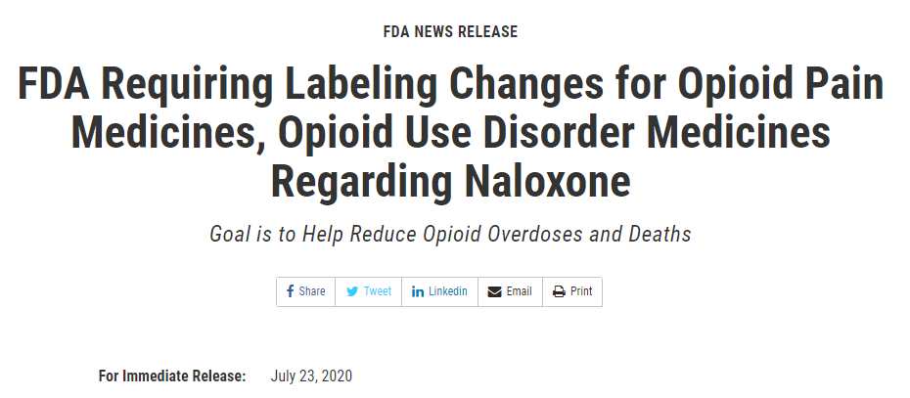
Co-Prescribing Naloxone
Notes:
The required labeling changes announced in a Drug Safety Communication recommend that health care professionals consider prescribing naloxone when they prescribe medicines to treat OUD. Additionally, the labeling changes recommend that health care professionals consider prescribing naloxone to patients being prescribed opioid pain medicines who are at increased risk of opioid overdose, including those who are also taking benzodiazepines or other medicines that depress the central nervous system; those who have a history of OUD; and those who have experienced a prior opioid overdose. A naloxone prescription should also be considered for patients prescribed opioids who have household members, including children, or other close contacts at risk for accidental ingestion or opioid overdose.
The FDA is requiring that these recommendations be added to the prescribing information for opioid pain medicines and medicines to treat OUD, including buprenorphine, methadone and naltrexone.

Slide 64
Naloxone
http://ijhs2.deonandan.com/wordpress/wp-content/uploads/2015/09/Untitled.png
Notes:
Naloxone comes as an

Slide 65
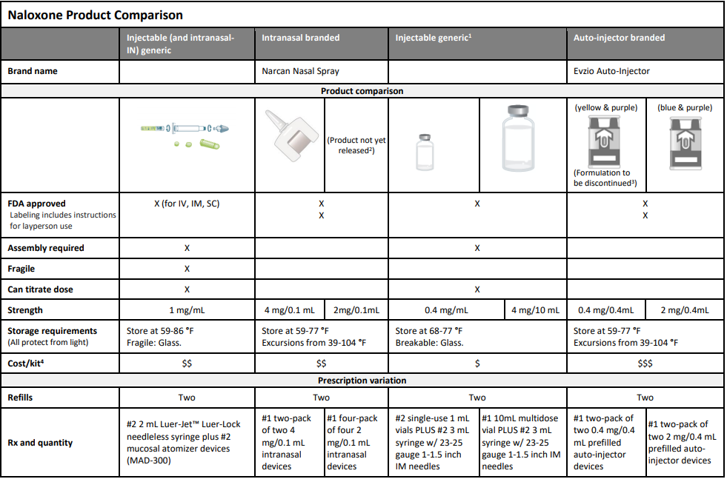
Naloxone
Naloxone product comparison. Prescribe To Prevent. https://prescribetoprevent.org/wp2015/wp-content/uploads/Naloxone-product-chart.17_04_14.pdf

Slide 66
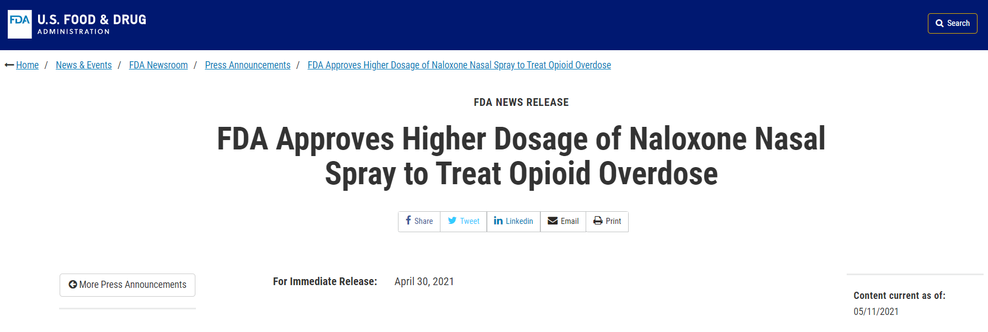
Co-Prescribing Naloxone
https://www.fda.gov/news-events/press-announcements/fda-approves-higher-dosage-naloxone-nasal-spray-treat-opioid-overdose
Notes:
8 mg intranasal spray authorized via KLOXXADO to Hikma Pharmaceuticals

Slide 67
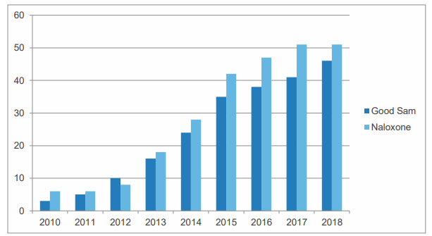
Current State Naloxone Access
Davis C. Legal interventions to reduce overdose mortality: naloxone access and overdose good Samaritan laws. The Network for Public Health Law. December 2018. https://www.networkforphl.org/_asset/qz5pvn/legal-interventions-to-reduce-overdose.pdf
Notes:
https://www.networkforphl.org/_asset/qz5pvn/legal-interventions-to-reduce-overdose.pdf
Network for Public Health Law
Naloxone laws/good Samaritan laws over time
There is some evidence that direct authority for pharmacists to provide naloxone can decrease the rate of overdose deaths. (Abouk R, Pacula RL, Powell D. Association Between State Laws Facilitating Pharmacy Distribution of Naloxone and Risk of Fatal Overdose. JAMA Intern Med. 2019; 179: 805-11)
Direct authority: pharmacists have explicit permission to dispense naloxone by having prescriptive authority or by not requiring a prescription.
Indirect authority: pharmacists are able to dispense through standing orders or statewide protocols.
Weak laws: any other naloxone laws providing protections other than those in the first two categories.
Data pulled from 2005-2016 National Vital Statistics System
Three year rates, post-adoption of law (allows for time implementation)
Medicaid claims data only for naloxone dispensing, 40% of nonelderly adults with opioid addiction
The rate is reported per 100,000 people
Opioid related ER visits with direct authority increased 15% relative to states without direct authority

Slide 68
Co-Prescribing Naloxone
Vermont mandated when opioids prescribed >90 MEE/day OR with a concomitant benzodiazepine
Virginia mandated when opioids prescribed >120 MME/day or concomitant benzodiazepine
Tennessee currently has a statewide pharmacy practice agreement
Naloxone can be dispensed to patients at risk of overdose, to a family member or friend
Pharmacist is required to complete training course
Good Samaritan Law
Vermont Department of Health. Rule governing the prescribing of opioids for pain. http://www.healthvermont.gov/sites/default/files/documents/pdf/REG_ opioids-prescribing-for-pain.pdf. Published March 2019. Accessed April 28, 2019
Virginia Department of Health Professions, Board of Medicine. Board of Medicine regulations on opioid prescribing and buprenorphine. https://www.dhp.virginia.gov/medicine/newsletters/ OpioidPrescribingBuprenorphine03142017.pdf. Published 2017. Accessed April 28, 2019.
Notes:
Vermont Department of Health. Rule governing the prescribing of opioids for pain. http://www.healthvermont.gov/sites/default/files/documents/pdf/REG_ opioids-prescribing-for-pain.pdf. Published March 2019. Accessed April 28, 2019
Virginia Department of Health Professions, Board of Medicine. Board of Medicine regulations on opioid prescribing and buprenorphine. https://www.dhp.virginia.gov/medicine/newsletters/ OpioidPrescribingBuprenorphine03142017.pdf. Published 2017. Accessed April 28, 2019.

Slide 69
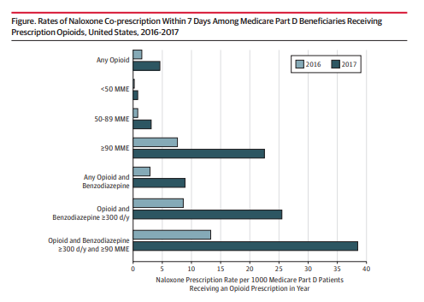
Notes:
Medicare part D patients: excluded hospice
Co-prescribing defined as naloxone claim within 7 days of opioid Rx
NO STANDARD DEFINITION OF NALOXONE CO-PRESCRIPTION
7 Days allows for insurance issues (PA’s)
2016 = 12.7 M beneficiaries received at least 1 opioid rx, 19,758 patients received naloxone
2017 = 12.5 M beneficiaries received at least 1 opioid rx, 58092 patients received naloxone
Rates of naloxone co-prescribing increased from 1.5 to 4.6/1000 beneficiaries

Slide 70
Co-Prescribing Naloxone
Consider in patients who:
>50 MME opioid dose with:
Co-morbidities making the patient more susceptible to overdose
Concomitant benzodiazepine use
History of SUD, overdose, or MOUD
Polypharmacy
Good Samaritan or family member
How do you know the patient picks up naloxone when prescribed?
Notes:
Breathing issues, mental health disorders, abuse alcohol,
Have children in the home or dependents who could access the opioid

Slide 71
Notes:
Poll Title: Do not modify the notes in this section to avoid tampering with the Poll Everywhere activity. More info at polleverywhere.com/support True or False: A healthcare provider can designate a delegate to check the controlled substance monitoring database on behalf of the healthcare provider. https://www.polleverywhere.com/multiple_choice_polls/Sr19Enj9nXu3tgGxin6Hq?display_state=chart&activity_state=opened&state=opened&flow=Default&onscreen=persist

Slide 72
Notes:
Poll Title: How often do you check the TN CSMD when prescribing controlled substances? https://www.polleverywhere.com/multiple_choice_polls/WezRAhQqkhFq5CL1LeLRN?flow=Default&onscreen=persist

Slide 73
Tennessee CSMD Requirements
Must check CSMD before prescribing opioid or benzodiazepine as a new episode of treatment
Do not have to check when prescribing 3 days or less
Must check every 6 months when controlled substance remains apart of treatment plan
Best practice is to check regularly with each prescription
Can authorize up to two delegates (“extenders”) to check for you
Include access to your collaborating practitioners
Controlled Substance Monitoring Database (CSMD) and Prescription Safety Act: Frequently Asked Questions. https://www.tn.gov/health/health-program-areas/health-professional-boards/csmd-board/csmd-board/faq.html
Notes:
New episode of treatment = a prescription for a controlled substance that has not been prescribed by that healthcare practitioner within the past 6 months

Slide 74
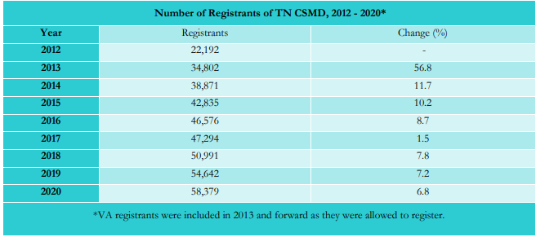
Number of CSMD Registrants
Controlled Substance Monitoring Database: 2020 Report to the 112th Tennessee General Assembly. March 1, 2021. https://www.tn.gov/content/dam/tn/health/healthprofboards/csmd/2020_CSMD_Annual_Report.pdf

Slide 75
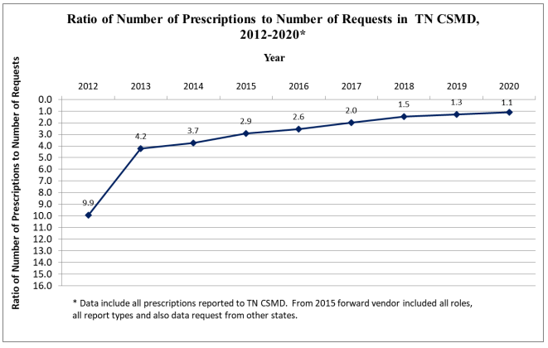
Tennessee CSMD
Controlled Substance Monitoring Database: 2020 Report to the 112th Tennessee General Assembly. March 1, 2021. https://www.tn.gov/content/dam/tn/health/healthprofboards/csmd/2020_CSMD_Annual_Report.pdf
Notes:
Gateway Electronic Health Record (HER)/Pharmacy Management System integration will most likely increase the number of uses and rate of checking

Slide 76
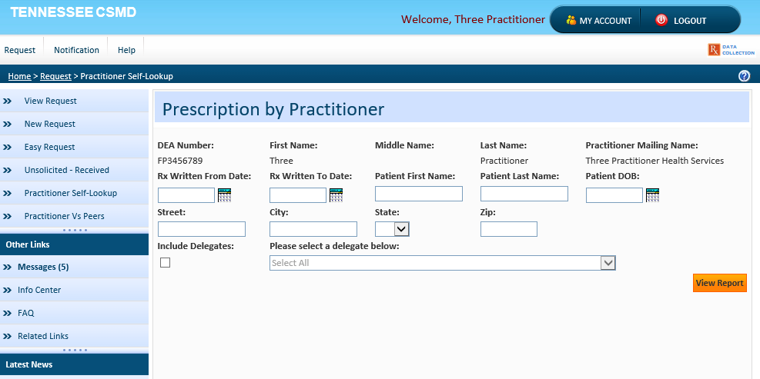
Practitioner Self Lookup
Slide courtesy of Dr. Todd Bess, Tennessee Controlled Substance Monitoring Database.

Slide 77
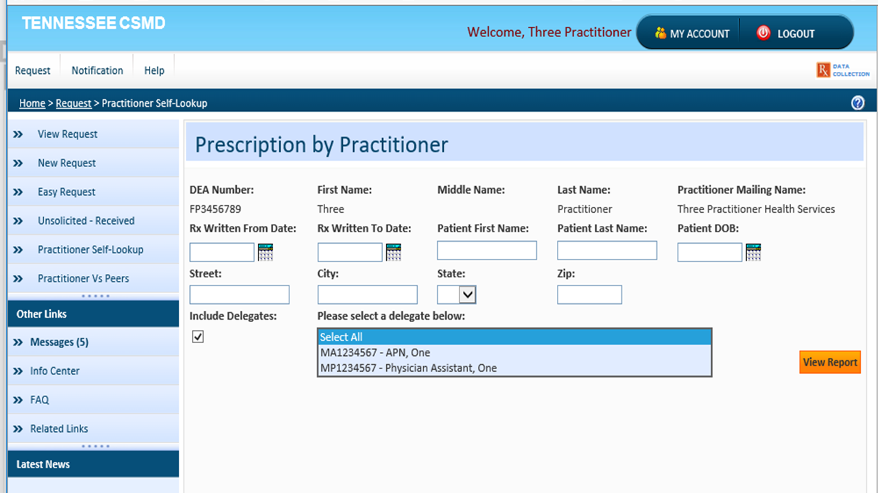
Practitioner Self Lookup with Option for APRN/PA
Slide courtesy of Dr. Todd Bess, Tennessee Controlled Substance Monitoring Database.

Slide 78
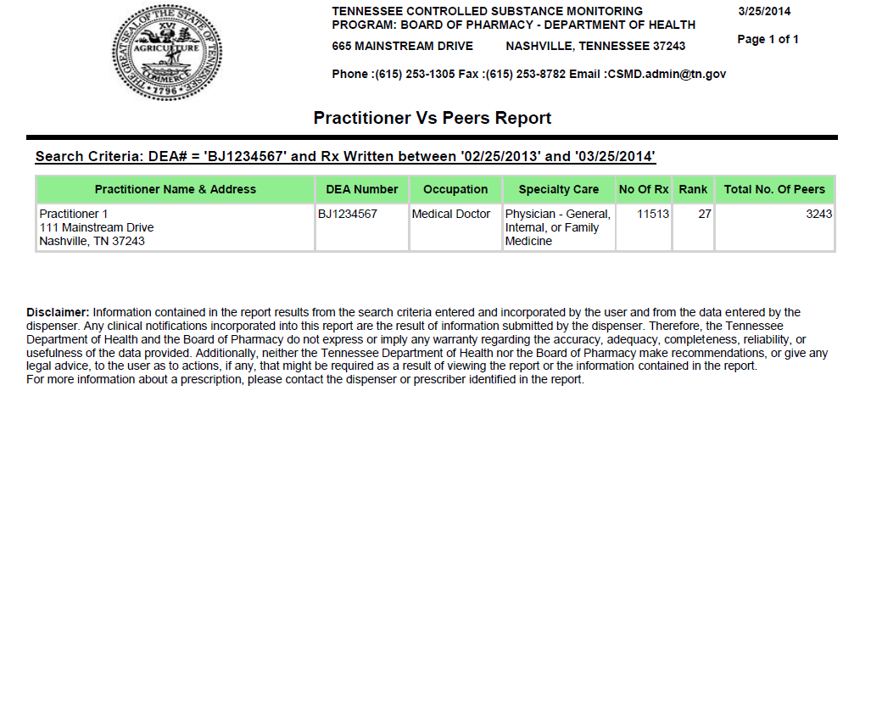
Practitioner vs. Peer Report
Slide courtesy of Dr. Todd Bess, Tennessee Controlled Substance Monitoring Database.
Notes:
Important for the user so they can see where they rank among their peers when prescribing controlled substances. They can run as often as they want. If they are trying to improve this gives them a tool. NOTE: This is based on total number of CII-V prescriptions.

Slide 79
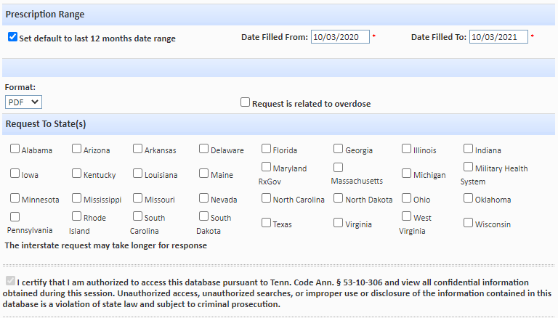
CSMD Multi-State Lookup
Slide courtesy of Dr. Todd Bess, Tennessee Controlled Substance Monitoring Database.

Slide 80
Medication for Opioid Use Disorder
Previously known as Medication Assisted Treatment (MAT)
SAMHSA now recommends to replace MAT with MOUD
Buprenorphine (+/- naloxone), methadone, naltrexone
MOUD
Notes:
The term “MAT” implies that medication plays a secondary role to other approaches while the term “MOUD” reinforces the idea that medication is its own treatment form. https://plymouthcountyoutreach.org/portfolio/moud/

Slide 81
Notes:
Poll Title: Do not modify the notes in this section to avoid tampering with the Poll Everywhere activity. More info at polleverywhere.com/support True or False: In Tennessee, physicians are the only licensed healthcare providers who can prescribe buprenorphine for OUD. https://www.polleverywhere.com/multiple_choice_polls/5OgVW6RGxZVHeQox4yeIc?flow=Default&onscreen=persist

Slide 82
Drug Addiction Treatment Act (DATA)
Enacted in 2000 with intent of allowing addicts to be treated for addiction in office-based settings (outside of OTPs)
Only permitted drugs are buprenorphine SL and buprenorphine-naloxone tablets/films
Treatment must be by a “qualifying physician”
Qualifying physician may not treat more than 100 patients and must obtain special DEA number
CARA 2016 increased the number of patients
Special DEA Identification number (DATA 2000 Waiver ID or “X” number)
DEA Requirements for DATA Waived Physicians. https://www.deadiversion.usdoj.gov/pubs/docs/dwp_buprenorphine.htm
Notes:
Estimated 19.3 M people have SUD, with 2.1 M of those people having OUD (https://www.samhsa.gov/data/sites/default/files/cbhsq-reports/Assistant-Secretary-nsduh2018_presentation.pdf) only 20% of OUD patients receive treatment!!!
Law resulted as a concern that OTPs were not accessible to many addicts (rural areas, fear of stigma)
Qualified physician: board certified in addiction psychiatry or addiction medicine, or who has at least 8 hours of authorized training in the treatment/management of opioid dependent patients
X-number is not in lieu of DEA number, it is in addition to. Therefore, pharmacists need both numbers when dispensing
In order to qualify for a waiver under DATA 2000, physicians must hold a current State medical license, a valid DEA registration number, and must meet one or more of the following conditions: The physician holds a subspecialty board certification in addiction psychiatry from the American Board of Medical Specialties.
The physician holds an addiction certification from the American Society of Addiction Medicine.
The physician holds a subspecialty board certification in addiction medicine from the American Osteopathic Association.
The physician has completed not less than eight hours of training with respect to the treatment and management of opioid-addicted patients. This training can be provided through classroom situations, seminars at professional society meetings, electronic communications, or otherwise. The training must be sponsored by one of five organizations authorized in the DATA 2000 legislation to sponsor such training, or by any other organization that the Secretary of the Department of Health and Human Services (the Secretary) determines to be appropriate.
The physician has participated as an investigator in one or more clinical trials leading to the approval of a narcotic drug in Schedule III, IV, or V for maintenance or detoxification treatment, as demonstrated by a statement submitted to the Secretary by the sponsor of such approved drug.
The physician has other training or experience, considered by the State medical licensing board (of the State in which the physician will provide maintenance or detoxification treatment) to demonstrate the ability of the physician to treat and manage opioid-addicted patients
The physician has other training or experience the Secretary considers demonstrates the ability of the physician to treat and manage opioid-addicted patients.

Slide 83
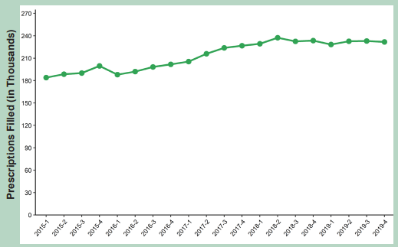
Number of Prescriptions TN: Buprenorphine
2020 Buprenorphine Report. Office of Informatics and Analytics. Tennessee Department of Health, Nashville, TN. November, 2020.
Notes:
While opioids for pain and benzodiazepine prescriptions have decreased from 2015 to 2019 by 37.3% and 37.5% respectively15, buprenorphine prescriptions for MAT have steadily increased. In Q1 2015, only 184,004 buprenorphine prescriptions were filled (28 per 1,000 residents). By Q4 2019, however, 231,848 buprenorphine prescriptions were filled (34 per 1,000 residents), a 26.0% increase.

Slide 84
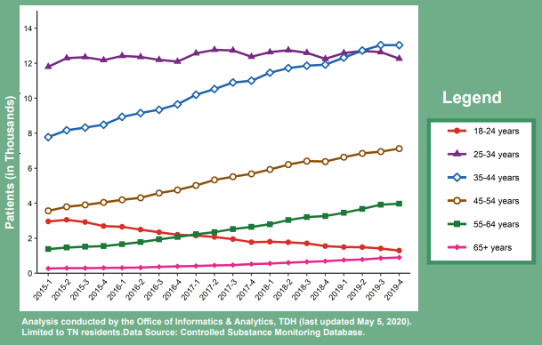
Number of Prescriptions TN: Buprenorphine
2020 Buprenorphine Report. Office of Informatics and Analytics. Tennessee Department of Health, Nashville, TN. November, 2020.

Slide 85
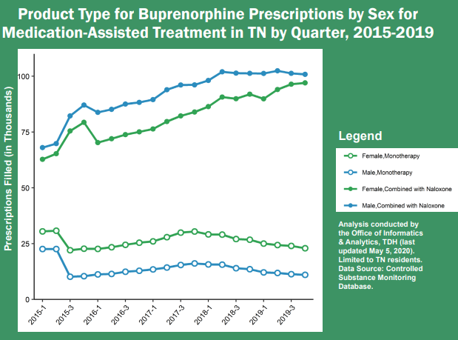
Number of Prescriptions TN: Buprenorphine
2020 Buprenorphine Report. Office of Informatics and Analytics. Tennessee Department of Health, Nashville, TN. November, 2020.

Slide 86
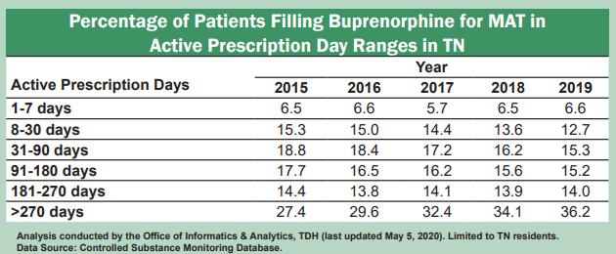
Number of Prescriptions TN: Buprenorphine
2020 Buprenorphine Report. Office of Informatics and Analytics. Tennessee Department of Health, Nashville, TN. November, 2020.

Slide 87
TN Buprenorphine Guidelines
Buprenorphine products may only be prescribed for a use recognized by the FDA
Buprenorphine without naloxone shall only be prescribed for patients who are:
Pregnant
Nursing*
Documented allergy to naloxone (< 5%)
TN was the last remaining state to restrict the prescribing of buprenorphine as MOUD to physicians only
Tennessee Nonresidential Buprenorphine Treatment Guidelines. TN Department of Mental Health and Substance Abuse Services. 2018. https://www.tn.gov/content/dam/tn/health/documents/2018%20Buprenorphine%20Tx%20Guidelines.PDF
Notes:
Consensus of the Buprenorphine Treatment Guidelines Committee is that the risks associated with buprenorphine, either with or without naloxone, are similar in nursing mothers and the prescriber should provide clear documentation for justifying the use of buprenorphine without naloxone to a nursing mother for more than 3 months
Buprenorphine “mono” is intended for beginning treatment and likely will be administered by prescriber
NP’s and PA’s can participate in assessment and management

Slide 88
NP/PA Prescribing Buprenorphine
PC 761 signed into law June 30, 2020
Authorizes NP/PA who practices as a family, adult, or psychiatric practitioner
No limitations of license for previous three years
Employed by community mental health center or FQHC and has adopted clinical protocols for MAT
Cannot write for >16 mg buprenorphine
Cannot dispense or write for buprenorphine “mono”
Must have a DATA waiver
Collaborating physician must review 100% of patient charts
NP/PA can only manage up to 50 patients at any given time
Public Chapter No. 761. State of Tennessee. https://trackbill.com/bill/tennessee-house-bill-656-drugs-prescription-as-enacted-authorizes-nonphysician-healthcare-providers-who-are-otherwise-permitted-to-prescribe-schedule-ii-or-iii-drugs-to-also-prescribe-a-buprenorphine-product-for-the-treatment-of-opioid-use-disorder-if-certain-requirements-met-amends-tca-title-33-title-53-title-63-and-title-68/1672600/#/details=true

Slide 89
Need For MOUD Providers in TN?
2020 Buprenorphine Report. Office of Informatics and Analytics. Tennessee Department of Health, Nashville, TN. November, 2020.
Notes:
Office-based opioid treatment (OBOT) Clinic: • “Nonresidential office-based opiate treatment facility” includes, but is not limited to, stand-alone clinics, treatment resources, individual physical locations occupied as the professional practice of a prescriber or prescribers licensed pursuant to title 63, or other entities prescribing products containing buprenorphine, or products containing any other controlled substance designed to treat opiate addiction by preventing symptoms of withdrawal to twenty-five percent (25%) or more of its patients or to one hundred fifty (150) or more patients

Slide 90
Discontinuing/Tapering Buprenorphine
No clear recommendation on treatment duration
Payor caps
Must compare the risk:benefit when tapering/discontinuing
Discontinuing too early can increase risk of relapse
Tennessee Nonresidential Buprenorphine Treatment Guidelines. TN Department of Mental Health and Substance Abuse Services. 2018. https://www.tn.gov/content/dam/tn/health/documents/2018%20Buprenorphine%20Tx%20Guidelines.PDF

Slide 91
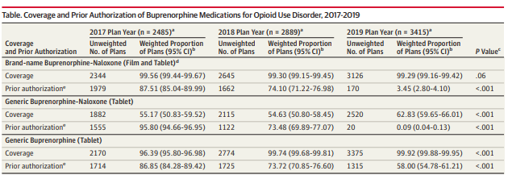
Payment Reform for MOUD
Mark TL et al. Association between Medicare and FDA policies and prior authorization requirements for buprenorphine products in Medicare Part D Plans. JAMA. 9 July, 2019. file:///C:/Users/tdougherty/Downloads/jama_mark_2019_ld_190024%20(1).pdf

Slide 92
Buprenorphine Approved for MOUD
Name | Dosage Form | Strength (mg) | Manufacturer
Zubsolv | SL Tablet | 0.7/0.18, 1.4/0.36, 2.9/0.71, 5.7/1.4, 8.6/2.1, 11.4/2.9 mg | Orexo
Bunavail (Buprenorphine/Naloxone | Buccal Film | 2.1/0.3, 4.2/0.7, 6.3/1.0 mg | BioDelivery Sciences International
Suboxone (Buprenorphine/Naloxone | SL Film | 2.0/0.5, 4.0/1.0, 8.0/2.0, 12.0/3.0 mg | Indivior, Sandoz, Mylan, Dr. Reddy’s
Suboxone (Buprenorphine/Naloxone) | SL Tablet | 2.0/0.5, 8.0/2.0 mg | Actavis, Amneal, Ethypharm, TEVA
Subutex (Buprenorphine/Naloxone) | SL Tablet | 2, 8 mg | Actavis, Barr, Mylan, Sun, Rhodes
Sublocade | SQ Injection (monthly) | 100 mg/0.5ml, 300 mg/1.5ml | Indivior
Probuphine | Implant (6 months) | 74.2 mg (4 implants) | Braeburn
Notes:
Belbuca and Butrans approved for PAIN

Slide 93
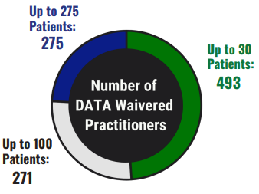
Challenges with MOUD
Insurance coverage
SUPPORT ACT
Accessible providers
83,000 MDs nation wide with DATA waiver
Access to affordable treatment
Pregnant females
Continuity of care
ER discharge
Confidentiality: HHS 42 CFR Part 2
Diversion: brand street value
Patrick S, et al. Association of Pregnancy and Insurance Status with Treatment Access for Opioid Use Disorder. JAMA Network Open. 2020;3(8).
2020 Buprenorphine Report. Office of Informatics and Analytics. Tennessee Department of Health, Nashville, TN. November, 2020.
Notes:
How many patients are estimated to have SUD??
Nation wide: 80% of DATA waivered MD’s can only see up to 30 patients
TN: 58% of DATA waivered Md’s can only see up to 30 patients
Recent publication in JAMA looked at the association of pregnancy and insurance status to treatment access for OUD. The researchers used a “secret shopper” format simulated as “patient callers” to determine if outpatient clinics would take these patients. Patients were randomized as pregnant vs non-pregnant, and insured vs non-insured. Pregnant females were more often turned away for buprenorphine providers, and approximately 30% of clinics contacted did not accept insurance, only accepting appointments if the patient agreed to pay cash at approx. $250/initial appointment for buprenorphine providers.
Continuity of care:
Pharmacy access to records, including receiving counseling, potential discussion of decreasing dose
Hospital discharge

Slide 94
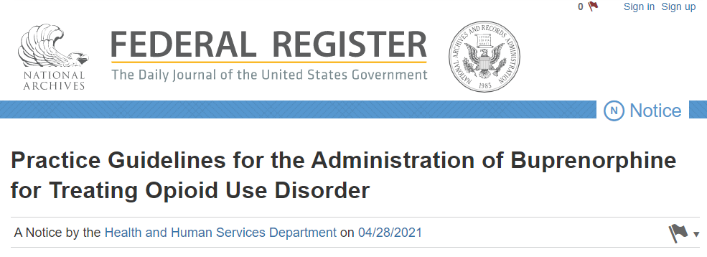
Changes with MOUD
https://www.federalregister.gov/documents/2021/04/28/2021-08961/practice-guidelines-for-the-administration-of-buprenorphine-for-treating-opioid-use-disorder
Notes:
The exemption applies to physicians, NP’s, PA’s, Clinical Nurse Specialists, Certified Registered Nurse Anesthetist, and Certified Nurse-Midwifes who may only treat patients who are located in the states in which they are authorized to practice medicine.
Practitioners utilizing this exemption will be limited to treating no more than 30 patients with buprenorphine for opioid use disorder at any one time (note: the 30 patient cap does not apply to hospital-based physicians, such as Emergency Department physicians).
They must still give SAMHSA notice that they intend to prescribe buprenorphine
The exemption applies only to the prescription of drugs or formulations covered under the X-waiver of the CSA, such as buprenorphine, and does not apply to the prescription, dispensation, or use of methadone for the treatment of OUD.
Physicians utilizing this exemption shall place an "X" on the prescription and clearly identify that the prescription is being written for opioid use disorders (along with the separate maintaining of charts for patients being treated for OUD).
An interagency working group will be established to monitor the implementation and results of these practice guidelines, as well as the impact on diversion.

Slide 95
How to Obtain a DATA Waiver
Must have a valid DEA number
Take 8-hour MOUD waiver course
Complete Notice of Intent Form online and submit to SAMSHA
Forward Certificate of Completion of 8-hour training to SAMSHA
Steps to Obtain Your MAT Waiver. PCSS. http://www.narcad.org/uploads/5/7/9/5/57955981/physicians_mat_waiver_how_to_1_pager.pdf

Slide 96
Future Directions
Legislation
MOUD changes
Safe disposal
Academic detailing

Slide 97
Notes:
Poll Title: Do not modify the notes in this section to avoid tampering with the Poll Everywhere activity. More info at polleverywhere.com/support True or False: Prescribers can request a waiver for the purpose of electronic prescribing of controlled substances. https://www.polleverywhere.com/multiple_choice_polls/85ASGw2k5pqn1fbrEwsLq?flow=Default&onscreen=persist

Slide 98
Future Directions
Federal SUPPORT Act: C-II-V controlled substances must be e-prescribed for Medicare patients (January 1, 2021)
Prior to 2019, state of Tennessee planned to require C-II prescriptions to be electronically prescribed by January 1, 2020.
In 2019, TN General Assembly enacted Public Chapter 124
Brought TN into alignment with SUPPORT Act
Included C-III-V controlled substances
Provides for some exemptions
The SUPPORT for Patients and Communities Act (H.R. 6). American Society of Addiction Medicine. https://www.asam.org/advocacy/the-support-for-patients-and-communities-act-(h.r.-6)

Slide 99
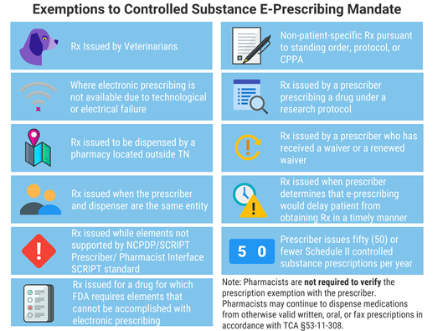
Future Directions
Exemptions to controlled substance e-prescribing mandate. Tennessee Pharmacist Association
WAIVER LINK: https://tennessee.na1.echosign.com/public/esignWidget?wid=CBFCIBAA3AAABLblqZhCupjadFM1Fh2AmAc-RFlR2N2LS-yKQ5TJcIx80T5K5BzcXigkPNmPxDhKRkFCbTeQ* .

Slide 100
Risk Reduction Strategies
Antifentanyl vaccine
Coupled to antigenic carrier
Encouraging use of fentanyl strip distribution
Decreasing use of contaminated drug
Increasing referral to treatment upon overdose
Kosten TR, Petrakis IL. The Hidden Epidemic of Opioid Overdoses During the Coronavirus Disease 2019 Pandemic. JAMA Psychiatry. 2021;78(6):585–586. doi:10.1001/jamapsychiatry.2020.4148.
Notes:
Vaccine: chemically coupling heroin or fentanyl derivatives to antigenic carriers such as tetanus or diptheria toxoids to produce antibodies against fentanyl within about 6 weeks
Fentanyl strips can reduce use of fentanyl contaminated use or solitary drug use

Slide 101
Minimum Disciplinary Action: Opioid Prescribing
PC 978 established a task force to define minimum disciplinary action by TN licensing boards for prescribers who treat patients with opioids
If the licensing board/agency finds “that the healthcare practitioner engaged in a significant deviation or pattern of deviation from sound medical judgement”, then:
Minimum disciplinary action must be imposed on the practitioner
The minimum disciplinary action is binding on each board/agency
Notes:
The minimum discipline that the board or committee assesses shall include the following:
Reprimand
Successful completion of a board/committee approved intensive CE course on opioid
Restriction against prescribing opioids for at least six months, and until completion of CE
One or more Type A civil penalties
Must notify all collaborative practitioners (PA, NP, etc)
Restricted from collaborating with NP’s or PA’s during restriction
Minimum discipline the board assesses shall include the following:
Probation
Successful completion of practice monitoring program including: quarterly reports of non-opioid prescribing practices, medical record keeping, pain management, opioid practices, additional CE
Restriction against opioid prescribing for 2x the amount that was assessed originally (not less than 1 year)
One or more Type A civil penalties
Notification to collaborating providers
0880-02-.25. General Rules and Regulations Governing the Practice of Medicine. Minimum Discipline for Opioid Prescribing. https://publications.tnsosfiles.com/rules_filings/05-17-19.pdf
The prescribing boards and committee recognize that a higher level of minimum discipline is required for those licensees who have been disciplined for opioid-related prescribing violations but continue to violate the standard of care. As set out in paragraph (1) of this rule, the following findings are synonymous, though the boards or committee may have used one or more sets of language to describe a violation. If a licensee commits an order violation in which the prior order contains one or more of the following findings, the licensee has committed an opioid-related order violation for purposes of paragraph (5) of this rule:
That the licensee had prescribed, dispensed, or administered opioids in a manner that constituted gross healthcare liability or a pattern of continued or repeated health care liability, ignorance, negligence or incompetence;
(b) That the licensee engaged in a significant deviation or pattern of deviation from sound medical judgement related to the issuance of opioids;
(c) That the standard of care related to the issuance of opioids was violated ;
(d) That the licensee had dispensed, prescribed or administered opioids not in the course of professional practice, or not in good faith to relieve pain and suffering or not to cure an ailment, physical infirmity or disease; SS-7039 (October 2018) 3 RDA 1693
(e) That the licensee was unfit or incompetent by reason of negligence, habits or other cause related to the licensee's prescribing or issuance of opioids; or
(f) That the licensee violated the rules of the licensing entity with regard to prescribing or issuance of opioids.
(4) If within one (1) year from the date a licensee's opioid-prescribing privileges are reinstated, having been restricted by an opioid-related order, that licensee's board or committee finds that, during that year the licensee had prescribed, dispensed, or administered opioids in a manner that violates the board's or committee's statutes or rules (for example, by prescribing in a manner that constitutes gross healthcare liability or a pattern of continued or repeated health care liability, ignorance, negligence or incompetence), the board or committee shall make a finding that the licensee re-engaged in a significant deviation or pattern of deviation from sound medical judgement such that they are a repeat offender. For purposes of such a finding, sound medical judgment is the equivalent to the standard of care as defined in T.C.A. § 63-1-122.

Slide 102
MOUD Expansion
Expansion of MOUD
Increase # Providers
Quality Therapeutics
Eliminate PA Requirements
Buprenorphine Rx in ER
MOUD in Criminal Justice Centers
Increase Coverage
Carroll J, et al. Evidence-based strategies for preventing opioid overdose: What’s working in the United States. CDC. 2018.

Slide 103
Safe Disposal
Syringe exchanges or disposals
http://safeneedledisposal.org/state-search/?state=TN#showTable
Safehouse Philadelphia: https://www.safehousephilly.org/frequently-asked-questions#faqgeneral-beginoperating
Increase access to collection boxes: http://tdeconline.tn.gov/rxtakeback/
Increase access to at-home medication disposal kits
Carroll J, et al. Evidence-based strategies for preventing opioid overdose: What’s working in the United States. CDC. 2018.

Slide 104
Academic Detailing
Blend the communication approach of pharma with evidence-based information of academics
Demonstrated to improve physician practices in:
Opioid prescribing
High-risk pregnancy screening
MOUD implementation
Naloxone distribution
National Resource Center for Academic Detailing (NaRCAD)
Carroll J, et al. Evidence-based strategies for preventing opioid overdose: What’s working in the United States. CDC. 2018.
Notes:
Academic detailing is an outreach education technique that combines the direct social marketing traditionally used by pharmaceutical representatives with unbiased content summarizing the best evidence for a given clinical issue. Academic detailing is conducted with clinicians to encourage evidence-based practice in order to improve the quality of care and patient outcomes.
Often performed by physicians, pharmacists, nurses.

Slide 105
Summary
Number of overdose deaths continue to rise, yet the number of opioid prescriptions are decreasing
Continue to follow best practices using the CDC and TN Pain Guidelines for managing chronic pain patients
Naloxone should be discussed and co-prescribed for patients at high-risk of overdose
MOUD access is a concern, but NP/PA’s can now prescribe with limitations in TN
The TN CSMD has clinical utility for patient management but also for comparing own prescribing history
All controlled substance prescriptions should be e-prescribed as of January 1, 2021, with some exceptions
Innovations in safety disposal and education outreach will expand

Slide 106
Notes:
Poll Title: Do not modify the notes in this section to avoid tampering with the Poll Everywhere activity. More info at polleverywhere.com/support Based on published data, which of the following is driving the majority of overdose deaths? https://www.polleverywhere.com/multiple_choice_polls/cWRgP3frpdxb4BLLT7udx?flow=Default&onscreen=persist

Slide 107
Notes:
Poll Title: Do not modify the notes in this section to avoid tampering with the Poll Everywhere activity. More info at polleverywhere.com/support True or False: Prescribers can authorize up to two "extenders" to check the TN CSMD on their behalf. https://www.polleverywhere.com/multiple_choice_polls/67smeU5Ok3yXkg3HdsKSf?flow=Default&onscreen=persist

Slide 108
Notes:
Poll Title: Do not modify the notes in this section to avoid tampering with the Poll Everywhere activity. More info at polleverywhere.com/support HHS guidelines now allow for the prescribing of buprenorphine for up to how many patients without obtaining a DATA waiver? https://www.polleverywhere.com/multiple_choice_polls/lf5YJfWJyWzxqOymprSvs?flow=Default&onscreen=persist

Slide 109
Questions?
Tyler Dougherty, PharmD, BCACP
Assistant Professor of Pharmacy Practice
South College School of Pharmacy
tdougherty@south.edu

