Slide 1
Medical professionalism: navigating conflict and promoting interprofessionalism
Amanda Linz, MD
Kristen bettin, md, Med
Capstone course
2021-2022

Slide 2
objectives
Describe the challenges to developing a professional identity and maintaining professional behavior.
Identify positive experiences that shape professional identity.
Discuss tools for conflict resolution and how they help maintain healthy interprofessional relationships.
Define how professional identity development during medical school will impact the care provided to patients during subsequent residency training.
Set at least 3 goals to maintain professional identity.

Slide 3
Case 1
Rafael was uncomfortable. His fellow intern, Delilah, was one of the smartest people in their residency group and he had been looking forward to working with her this month at the county hospital. They had a huge service of very sick patients, and overall they were providing very good care to them. But almost every day, Delilah made sarcastic or demeaning comments about patients: the hopeless guy with alcoholism, the woman who likes to turn tricks, and so on. Instead of anyone saying something about the importance of treating patients with respect, the rest of the team just laughed or ignored the comments. Rafael wasn’t sure what he should do; perhaps he was overly sensitive. After all, what was important was what happened in the patient's room, not in the hallway, wasn’t it?

Slide 4
Small group discussion
Describe your perception of this scenario.
Have there been any breeches of professionalism?
If you were the medical student on this team, how would you handle this?
If you were Rafael, how would you handle this?

Slide 5
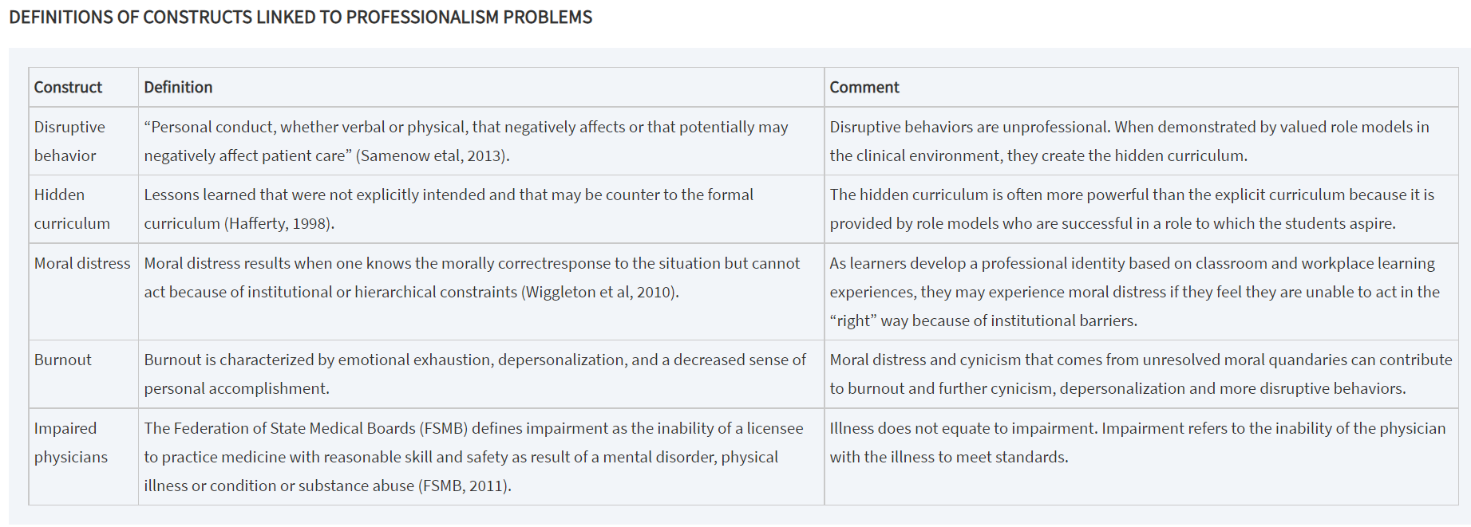
Definitions of constructs linked to professionalism problems
Levinson W, Ginsburg S, Hafferty FW, Lucey CR. eds. Understanding Medical Professionalism. McGraw Hill; 2014. Accessed October 07, 2021. https://accessmedicine-mhmedical-com.ezproxy.uthsc.edu/content.aspx?bookid=1058&sectionid=59867807

Slide 6
Large group share
Have someone from your group share the take home points from your discussion.
Are any of the previously mentioned constructs present in the first case?
Notes:
Have someone from your group share the take home points from your discussion.
Are any of the previously mentioned constructs present in the first case?

Slide 7
Reflecting on positive role models
Consider the following prompts and write down your thoughts about one of these to share with the group.
Think of a physician you consider an exemplar of professionalism. Describe why you chose this person, illustrating with an incident or pattern of decisions or actions that supports your choice.
Reflect on your experiences in medical school or in the community that have been critical in fostering change in your understanding of what it means to be a professional – to be a physician.

Slide 8
Case 2
Jeanette Smith-Johnson, a hospital pharmacist, was really upset. She had just received an order for an antibiotic dose that was too high, given the patient's age and renal function. When she went to the floor to talk with the prescribing resident, Dr. Estania chewed her out in the middle of the patient care unit, within earshot of multiple doctors, nurses, and patient families. Then Dr. Estania turned to his team and said, “All pharmacists are people who failed to get into medical school.” Jeanette felt that it was too risky to say anything about the incident, but it made her feel like the talk about interprofessional teamwork in the institution was just “lip service.”

Slide 9
Conflict resolution and interprofessionalism
Get Ready
Create Space
Do the work
Close and affirm
Raise your words not voice
Notes:
Get Ready – don’t rehearse your anger, check your biases, commit to respectful and curious attitude, clarify your goals for the conversation- immediate/ priority goal, consider settling for dialogue
Create Space- offer neutral start (I know how busy you are- is this a good time), suggest a mutual goal, psychological safety (both, if colleague tearing- check in and pause)
Do the work- elicit the story (like elevator, listen actively – don’t prepare eloquent answer while listening- look for new info and what is confirmed- which helps reprioritize), apologize) sharing my story (ground it- use words to express emotions- I and not you)
Close and affirm – negotiate next steps, affirm working relationship

Slide 10
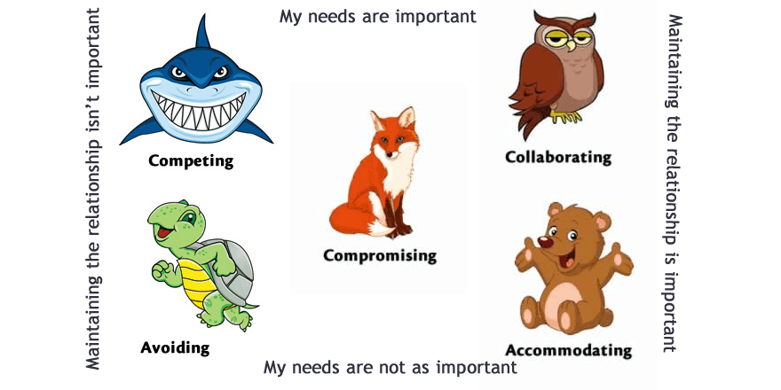
Conflict management styles
https://www.mediationinstitute.edu.au/whats-your-conflict-management-style/

Slide 11
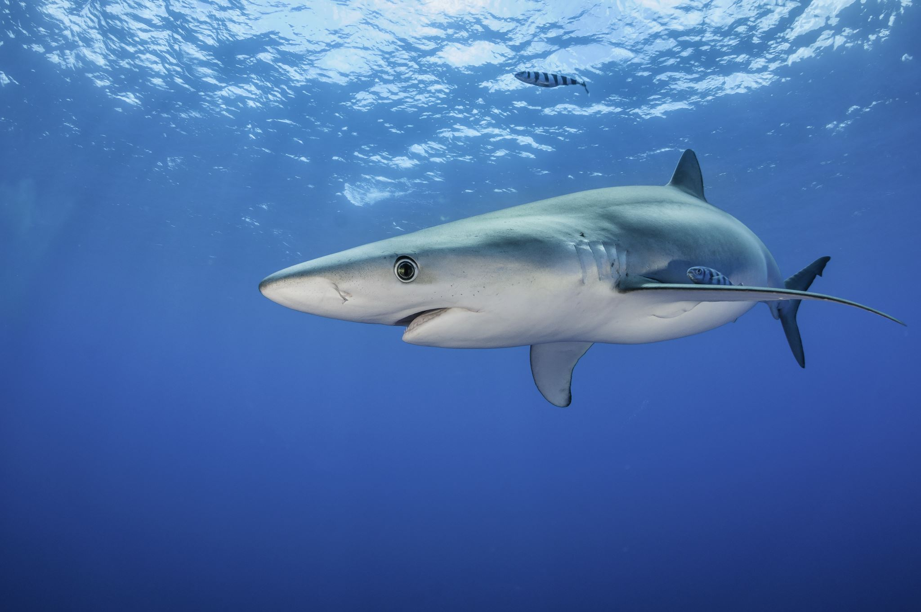
The Competitive Shark
Do it my way or not at all!
Need to win.
Pursue their own concerns at the other person’s expense.
Can be uncooperative, threatening, and intimidating.
Strongly defend a position they believe is correct.
May result in hostility and resentment toward the shark, or damaged relationships.
When to use: emergencies where quick, decisive action is needed; when unpopular decisions need to be implemented.
Notes:
Do it my way or not at all!
This is the typical attitude of the shark. Sharks use a forcing or competing style to achieve their goals. They have a need to win – therefore, others must lose. When competing, an individual pursues his or her own concerns at the other person’s expense, using whatever power seems appropriate to win their position – even if it means being uncooperative, threatening, and intimidating. They strongly defend a position they believe is correct or simply try to win.
If the shark’s decision is truly correct, a better decision can result. However, it may result in hostility and resentment toward the shark, or damaged relationships.
This style may be appropriate for emergencies when you need quick, decisive action, and people are aware of and support the approach, or when unpopular decisions need to be implemented.

Slide 12
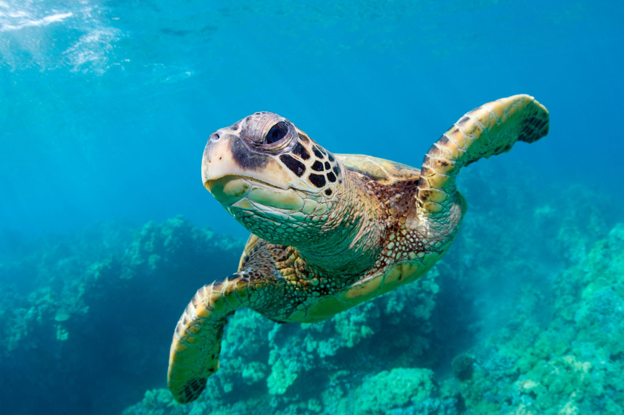
The Avoidant Turtle
Conflict? What conflict?
Turtles avoid, withdraw, deny, or delay conflicts.
Would rather hide and ignore conflict than resolve it
Uncooperative and unassertive.
May give up personal goals
May help to maintain relationships, but conflicts and negative feelings may linger
When to use: issue is trivial, the relationship is insignificant, emotionally-charged atmosphere
Notes:
Conflict? What conflict?
Turtles avoid, withdraw, deny, or delay conflicts. They would rather hide and ignore conflict than resolve it – this leads them to be uncooperative and unassertive. Turtles even tend to give up personal goals.
This may help to maintain relationships that would be hurt by conflict resolution, but conflicts and negative feelings may linger, too.
This is often appropriate when the issue is trivial, or the relationship is insignificant. Sometimes it can be effective when the atmosphere is emotionally charged, and you need to create some space.

Slide 13
The Accommodating Teddy Bear
Whatever you say.
Soothing or accommodating conflict-management style
Agree with and flatter because they need to please everyone
Self-sacrifice
May help maintain relationships, but the bear may be taken advantage of
When to use: if you really don’t care about the issue or when you realize you are wrong
Notes:
Whatever you say.
Teddy bears use a soothing or accommodating conflict-management style with emphasis on human relationships. They agree and flatter because they have a need to please everyone involved. Therefore, teddy bears often neglect their own desired outcomes to satisfy those of the others. There is an element of self-sacrifice.
Sometimes accommodating maintains relationships, but the bear may be taken advantage of.
However, it’s good to use this when you really don’t care about the issue or when you realize you are wrong (and the other party has a better solution).

Slide 14
The Compromising Fox
I’ll give you this if you give me that.
Concerned about goals and relationships.
Look for mutually acceptable solutions that partially satisfy everyone; willing to give up some of their goals but also persuade others to give up some of their goals too
Compromise is assertive and cooperative.
Can maintain relationships and find solutions, but compromise is not always ideal.
When to use: for complex issues that have no clear solutions or when people in conflict have equally important solutions
Notes:
I’ll give you this if you give me that.
Foxes use a compromising conflict-management style. Individuals who use this approach are concerned about goals and relationships. They have a strategy of a little something for everyone – they tend to find mutually acceptable solutions that partially satisfy both parties.
Foxes are willing to sacrifice some of their goals while persuading others to give up part of theirs. Compromise is assertive and cooperative.
This way it is possible to maintain relationships and find solutions, but compromise is not always ideal.
Compromising is suitable to use in situations when complex issues have no clear solutions or when people in conflict have equally important solutions.

Slide 15
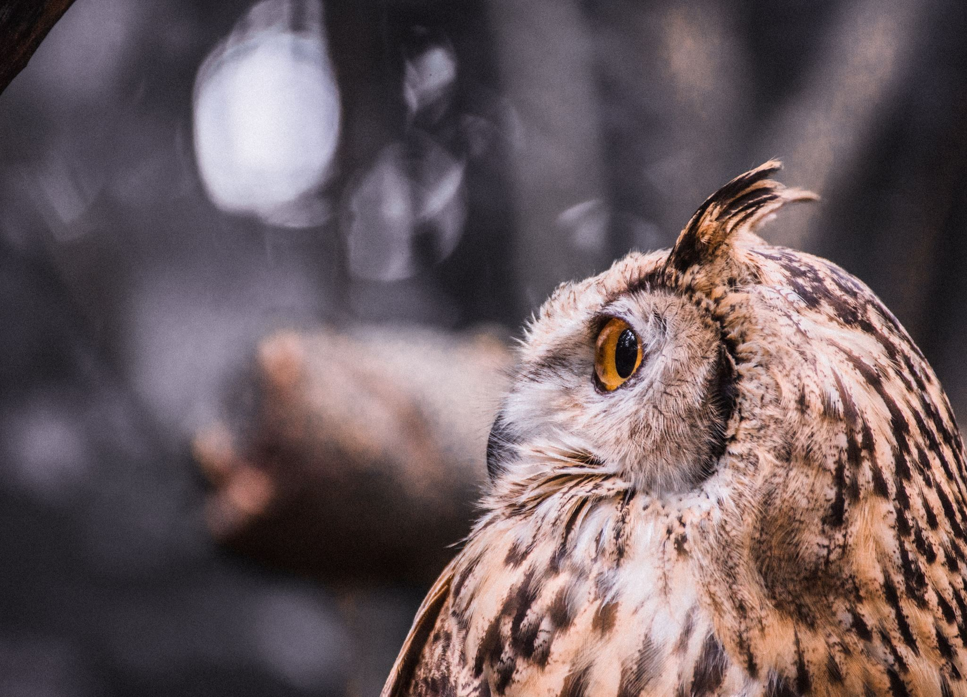
The Collaborative Owl
My preference is … What’s your choice?
Collaborative or problem-confronting conflict management
Value goals and relationships
Gather information, look for alternatives, dialogue openly, and welcome disagreement
View conflicts as problems to be solved and work to find solutions agreeable to all
Relationships are maintained (because both sides get what they want) and negative feelings are eliminated
Takes a lot of time and effort to synthesize listen to everyone
When to use: both issues and relationship are important
Notes:
My preference is … What’s your choice?
Owls use a collaborative or problem-confronting conflict management style. Owls value their goals and relationships. They gather information, look for alternatives, dialogue openly, and welcome disagreement. Owls view conflicts as problems to be solved and work to find solutions agreeable to all sides.
The advantage of this strategy is that relationships are maintained (because both sides get what they want) and negative feelings are eliminated. On the other hand, this takes a great deal of time and effort to synthesize everybody’s ideas.
The appropriate time to use an Owl style is when the issues and relationship are both important.

Slide 16
So, which one are you? Consider the following case…

Slide 17
Case 2
Jeanette Smith-Johnson, a hospital pharmacist, was really upset. She had just received an order for an antibiotic dose that was too high, given the patient's age and renal function. When she went to the floor to talk with the prescribing resident, Dr. Estania chewed her out in the middle of the patient care unit, within earshot of multiple doctors, nurses, and patient families. Then Dr. Estania turned to his team and said, “All pharmacists are people who failed to get into medical school.” Jeanette felt that it was too risky to say anything about the incident, but it made her feel like the talk about interprofessional teamwork in the institution was just “lip service.”

Slide 18
Large group discussion
What would you do if you were the pharmacist in this situation?
What would you do if you were another resident on the team?
Which strategies would you use to address this conflict?
https://www.mediationinstitute.edu.au/whats-your-conflict-management-style/

Slide 19
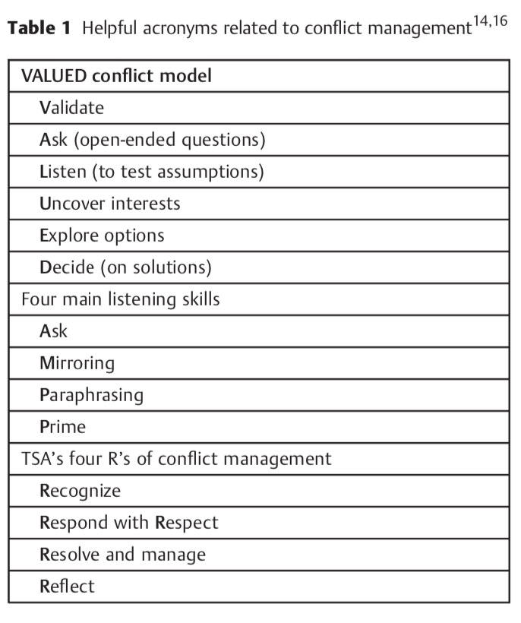
Clin Colon Rectal Surg 2013;26:259–264.

Slide 20
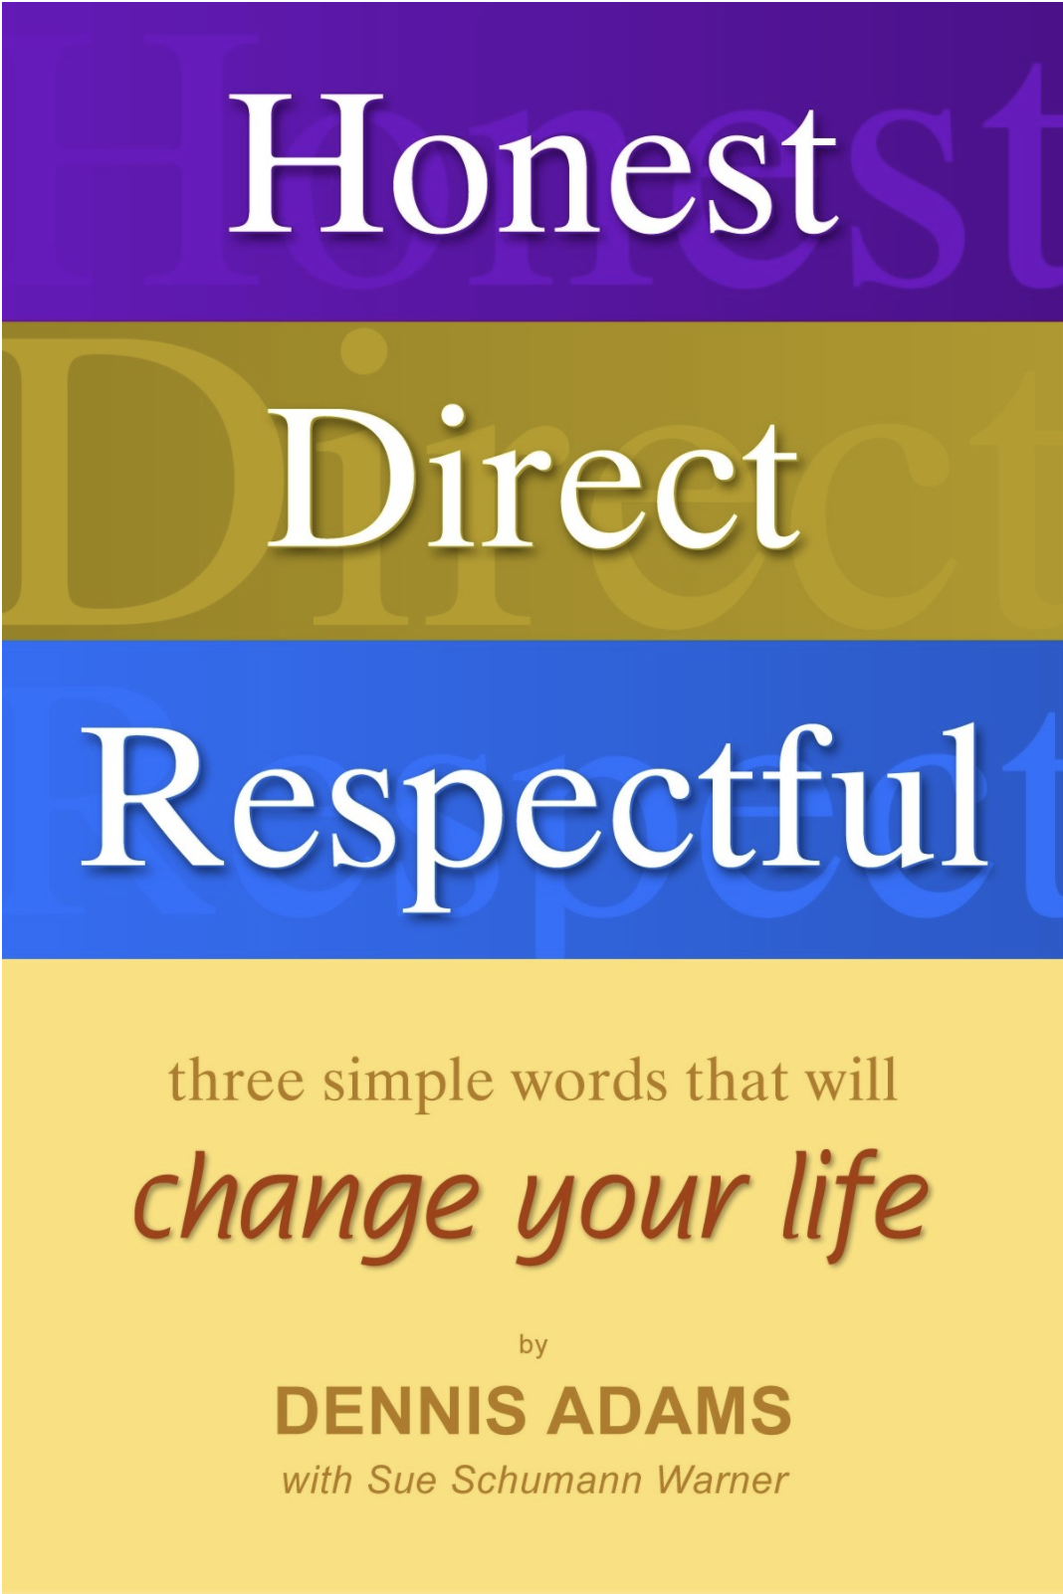
Honest Direct respectful communication
Use a “Focus Message” to start the conversation:
When you _____________ (name the behavior but do not try to interpret it)
I feel ____________ (state your feeling, don’t say “like”)
And I want/wish/wonder ______________.
THEN STOP!!

Slide 21
Why does this matter?
You will encounter conflict in medicine whether it is within or discipline or between disciplines
Professionalism and maintaining professional behavior is a key milestone during residency
Breaches of professionalism can contribute to unsafe work environments, sub-standard patient care, and medical errors

Slide 22
Reflection questions
Define how professional identity development during medical school will impact the care you provide to patients during your residency training.
Set at least 3 goals to help you maintain professional identity.
Prepare a 1-2 paragraph written reflection on the following prompts. Due by Monday, January 10th at 5pm.
If your last name begins with A-L – email your reflection to Dr. Linz (amandalinz@uthsc.edu)
If your last name is M-Z – email your reflection to Dr. Bettin (kbettin@uthsc.edu)

