Slide 1
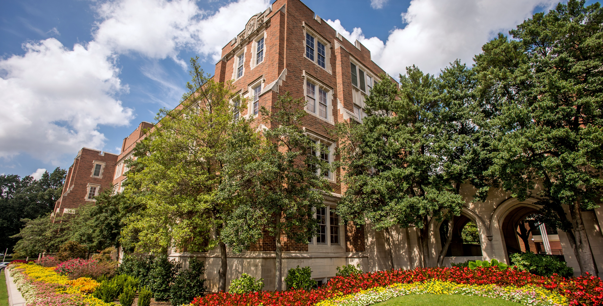
2020
Campus Master Plan Update
Open House
February 4, 2020

Slide 2
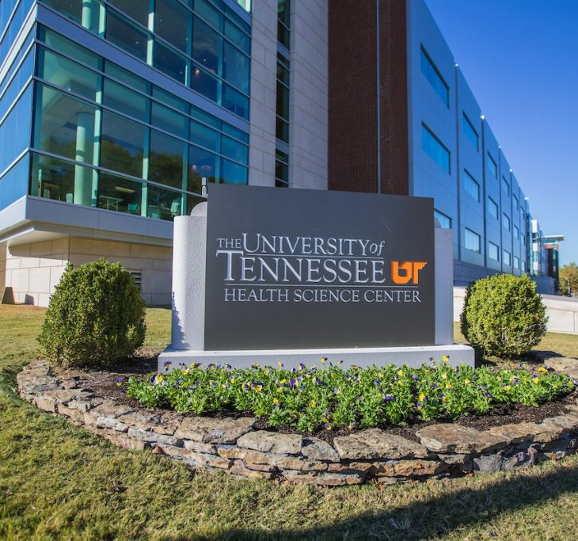
AGENDA
Schedule and Process
Goals and Objectives
Master Plan Implementation
Diagrams and Engagement Stations

Slide 3
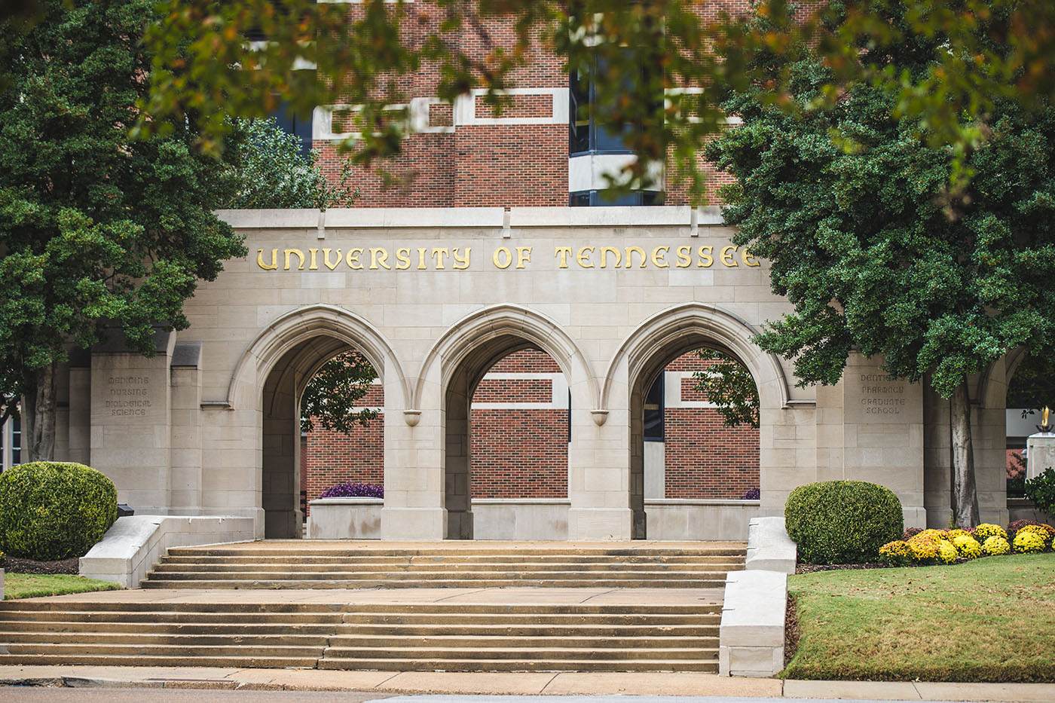
SCHEDULE and PROCESS

Slide 4
project schedule
PHASE I: Analysis & Assessment
PHASE II:
Big Ideas & Concepts
PHASE III: Implementation
PHASE IV: Documentation & Approvals
OPEN HOUSE
FEBRUARY
THEC
MARCH
WORKSHOP 02
APRIL
WORKSHOP 03
MAY
WORKSHOP 04
JULY
WORKSHOP 05
AUGUST
UT BOARD
FEBRUARY
TN SBC
JUNE
WORKSHOP 01
FEBRUARY
WORKSHOP 06
OCTOBER
WORKSHOP 07
NOVEMBER
PHASE I MEETINGS:
February/March Targeted Interviews
April (SWOT)
Campus and Community Open House
PHASE II MEETINGS:
May (Big Ideas)
Committee Review
July (Review Concepts)
Committee Review
PHASE III MEETINGS:
August
THEC Review
October (Phasing)
November (Final Plan)
PHASE IV MEETINGS:
Jan - June
Final Presentations and Approvals
Campus and Community Open House

Slide 5
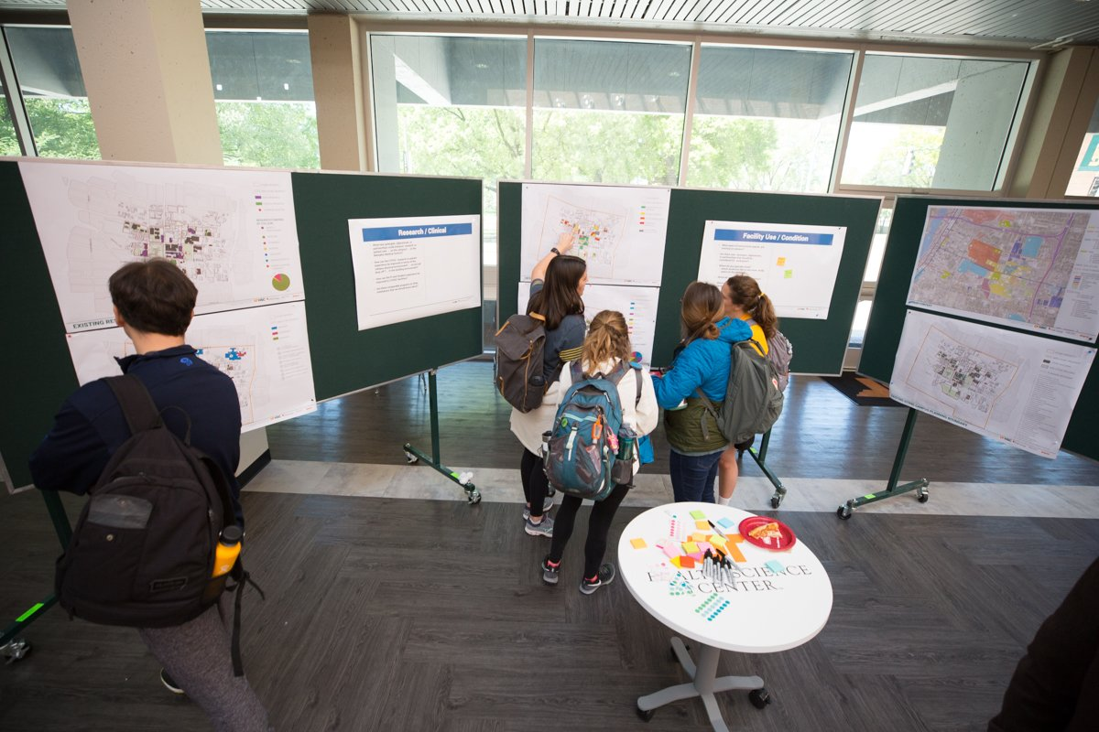
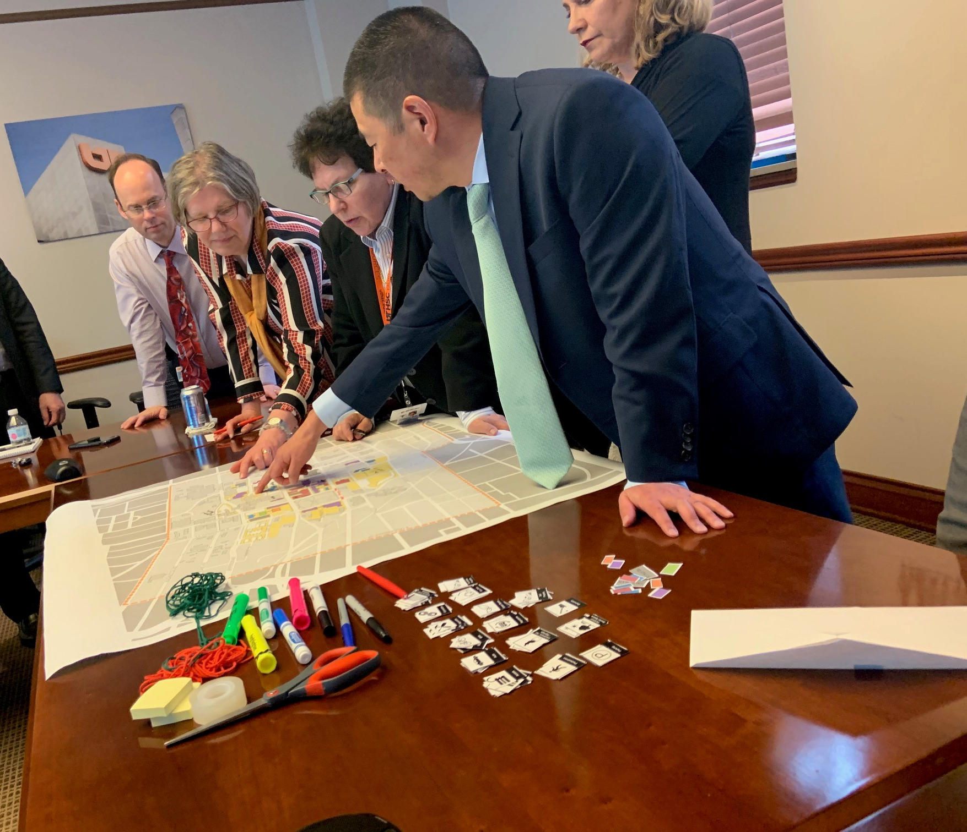
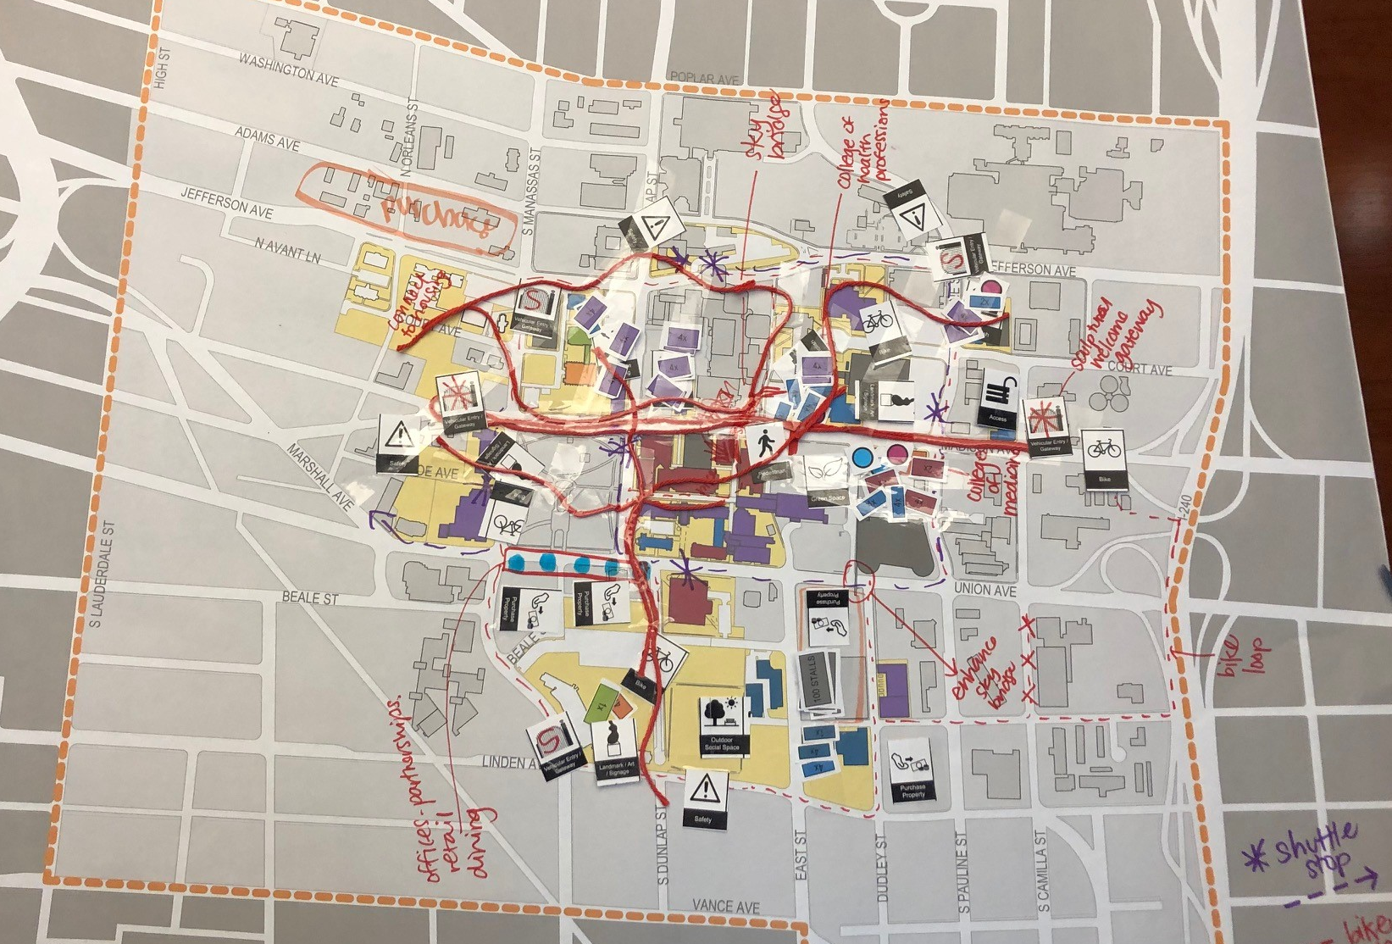
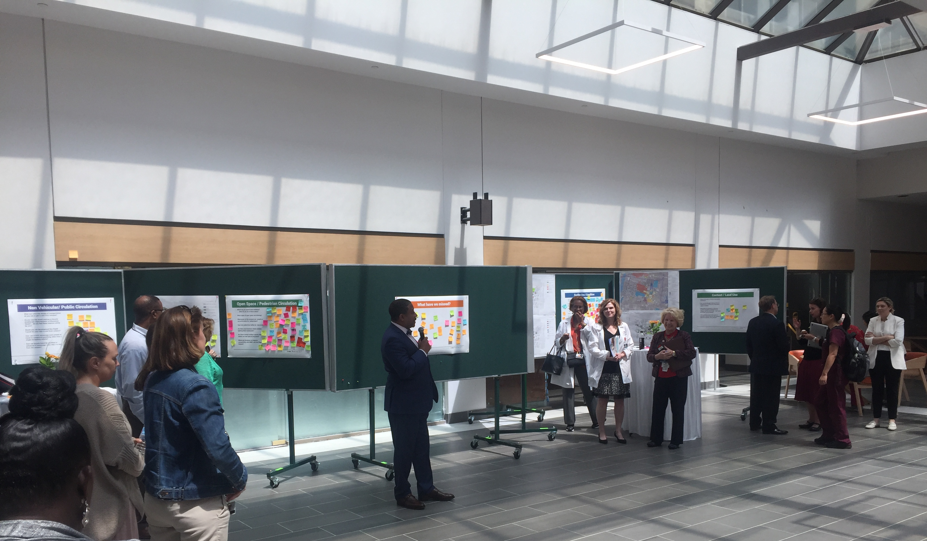
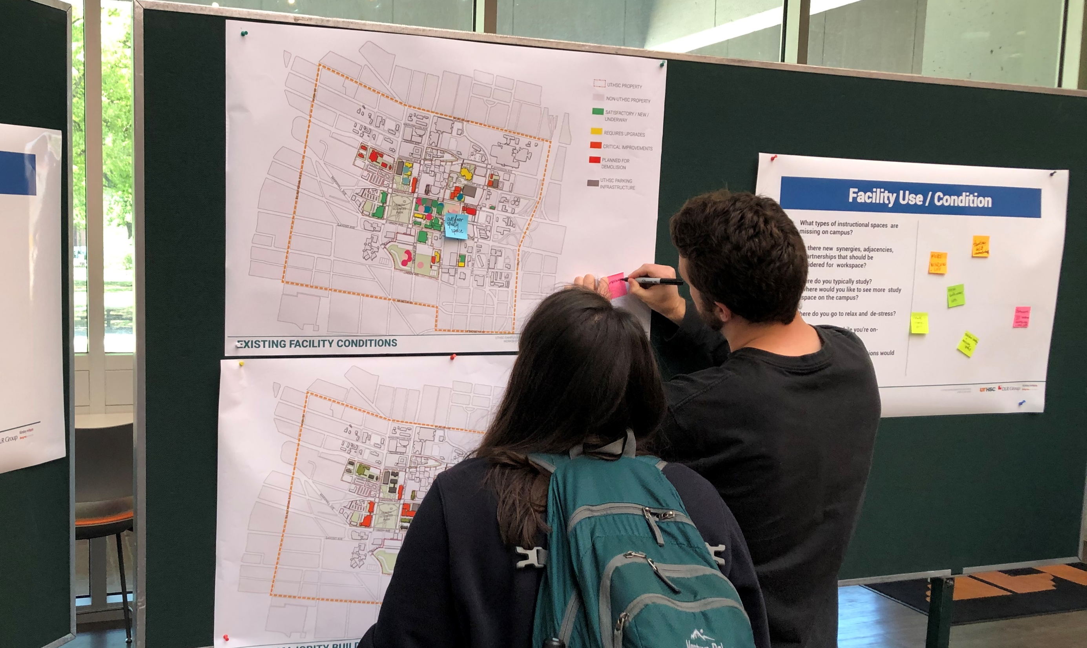
planning process

Slide 6
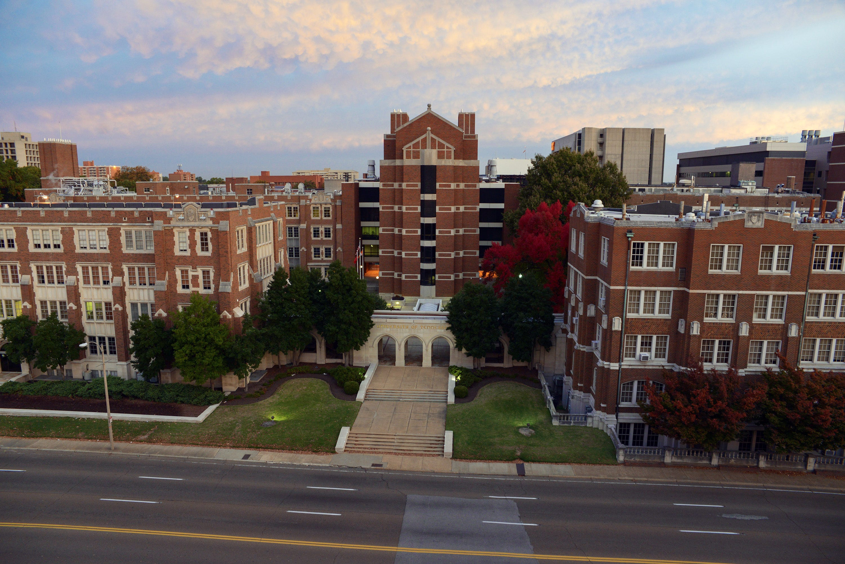
GOALS And OBJECTIVES

Slide 7
main campus 10-Year Plan
3.4K
FROM INCIDENTAL…
TO INTENTIONAL.

Slide 8
Overarching campus goals
SAFETY
WAYFINDING
PROVIDE A SAFE ENVIRONMENT FOR STUDENTS, FACULTY, AND STAFF TO WORK AND LEARN.
SIMPLIFY NAVIGATION AND WAYFINDING FROM PARKING AREAS TO CAMPUS BUILDINGS.
ACCESS
ENTRIES
EXPAND SAFE AND SECURE PEDESTRIAN ACCESS BETWEEN CAMPUS FACILITIES.
PROVIDE CLEAR POINTS OF ENTRY TO CAMPUS BUILDINGS.
WELLNESS
PARKING
PROVIDE A HEALTHY WORKPLACE THAT PROMOTES PHYSICAL AND MENTAL WELLNESS.
PROVIDE ADEQUATE AND CONVENIENT PARKING.

Slide 9
Academic goals
EQUAL FACILITIES
COLLABORATION
USE RECENT WORK
ENSURE THE EQUAL QUALITY OF ALL ACADEMIC FACILITIES
POSITION SHARED ENVIRONMENTS FOR COLLABORATION
USE SPACE METRICS THAT ARE BASED ON TECHNOLOGY RICH AND PROBLEM-, CASE-, AND TEAM-BASED LEARNING
CROSS-DISCIPLINARY
USE RECENT WORK
LOCATE CORE COLLEGE FACILITIES IN CLOSE PROXIMITY FOR CROSS-DISCIPLINARY INTERACTION
CAPITALIZE ON THE IMPACT OF RECENT RENOVATIONS AND NEW BUILDINGS
SUPPORT SPACE
IMPROVE ACCESS TO INDOOR AND OUTDOOR STUDENT SUPPORT SPACE
EXPANSION
OUT WITH THE OLD
PROVIDE FLEXIBLE, ADJACENT EXPANSION SITES
CONNECTIVITY
ELIMINATE OUTDATED SPACE OVER TIME
EXPAND COLLEGE CONNECTIVITY

Slide 10
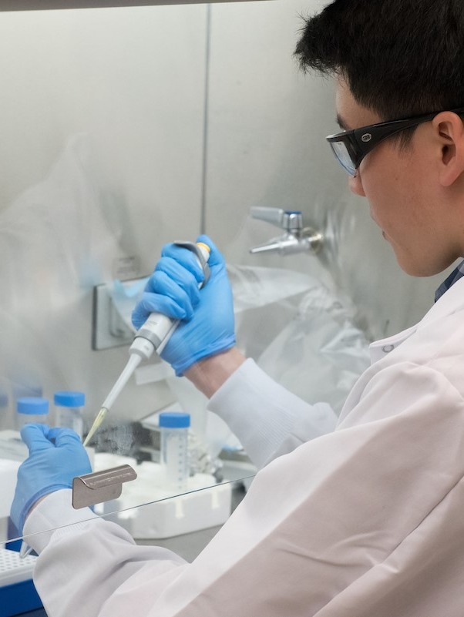
RESEARCH goals
OPTIMIZE
INNOVATION
OPTIMIZE RESEARCH SPACE RENOVATION AND COMMERCIALIZATION CAPABILITIES
DEVELOP AN INNOVATION DISTRICT AROUND THE CAMPUS RESEARCH CORE
RECRUIT
LEASE SPACE
POSITION RESEARCH AND SUPPORT SPACE TO LEVERAGE, RECRUIT, AND ENGAGE CORPORATE, CLINICAL, AND ACADEMIC PARTNERS
PROVIDE LEASE SPACE FOR BIOTECHNOLOGY AND PHARMACEUTICAL START-UP OPPORTUNITIES
METRICS
USE SPACE METRICS THAT ACCOMMODATE EVOLVING RESEARCH PRACTICES

Slide 11
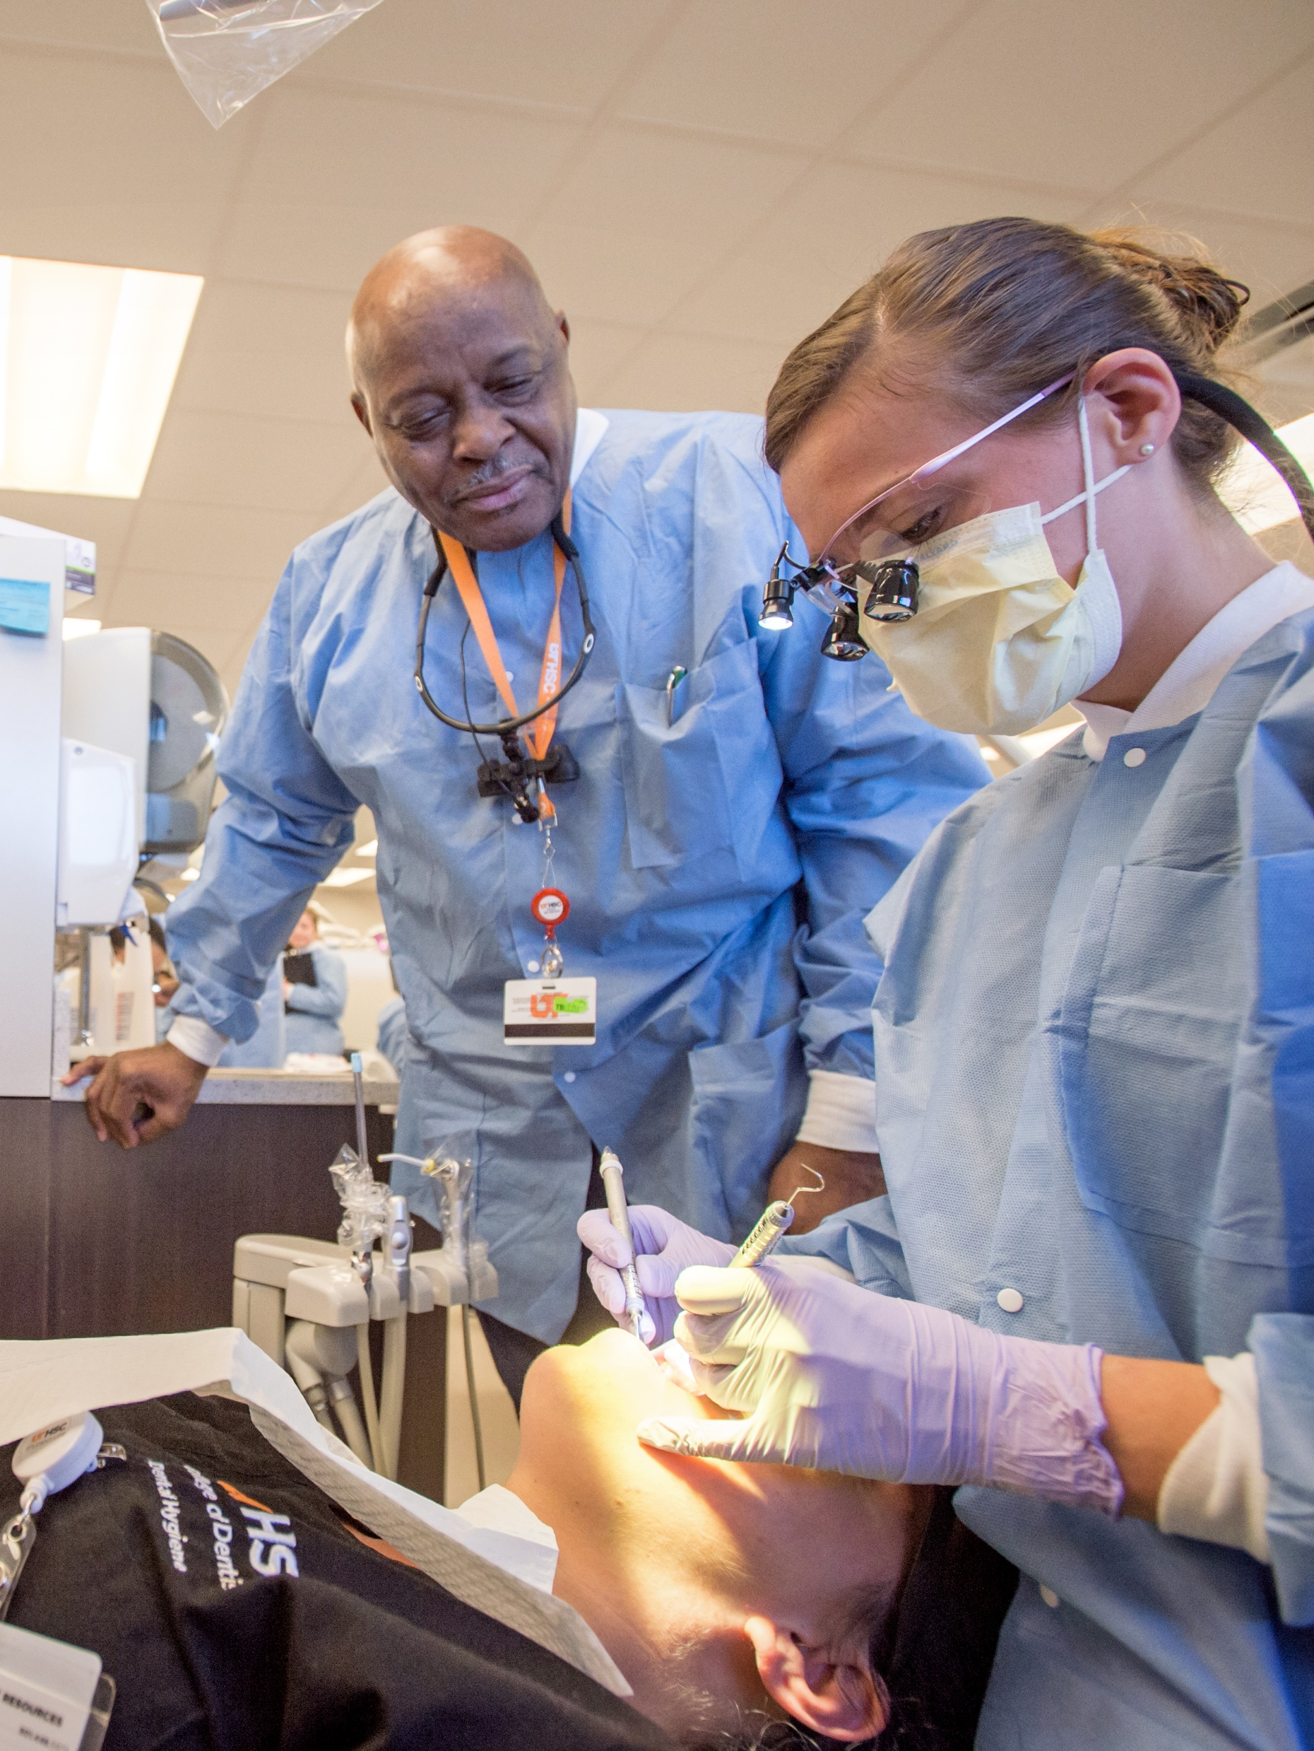
CLINICAL goals
AMBULATORY
ADJACENCIES
CONSOLIDATE AND EXPOUND UPON AMBULATORY SERVICES
STRENGTHEN ADJACENCIES BETWEEN CLINICAL FACILITIES, RESEARCH CENTERS, AND COLLEGES
CLINICAL
URBAN
PROVIDE A LOGICAL, CONNECTED SERIES OF CLINICAL SERVICES AND SPACES
SUPPORT A HOLISTIC AND HEALING URBAN ENVIRONMENT
IN-PATIENT
ESTABLISH AND IDENTIFY SITES FOR NEW IN-PATIENT CLINICAL PARTNERS AND PROGRAMS

Slide 12
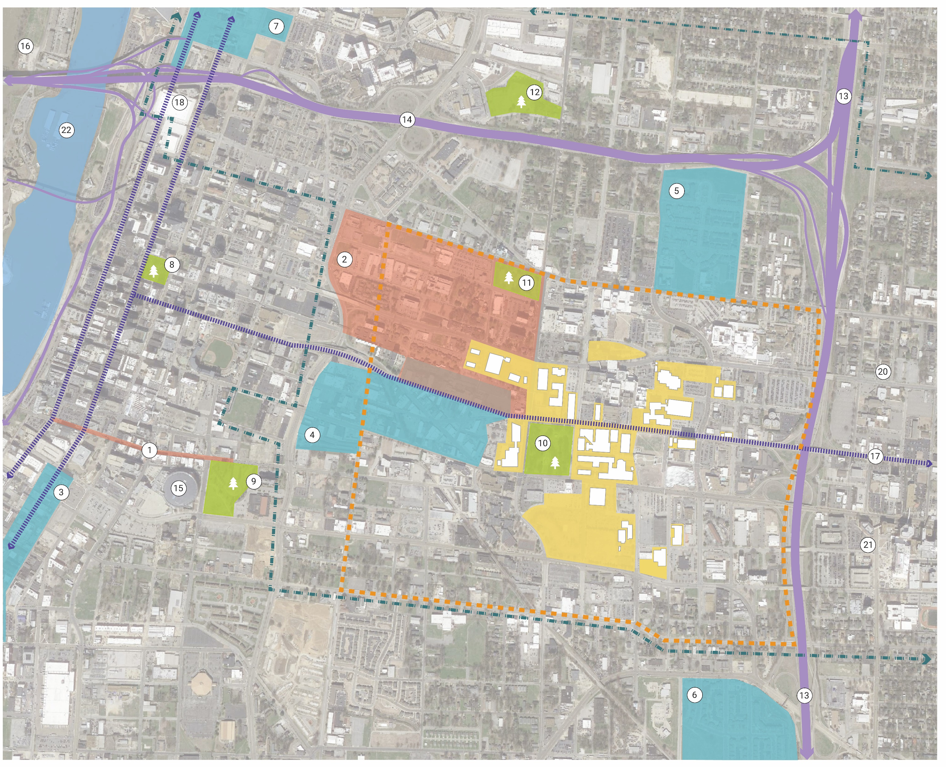
Context & Partners
UTHSC Planning Boundary
Memphis Medical District
UTHSC
Historic District
1 - Beale Street
2 - Victorian Village
Private Redevelopment Area
3 - South Main
4 - Edge District
5 - Legends Park
6 - University Place
7 - Pinch District
Park
8 - Court Square
9 - Robert R. Church Park
10 - Health Sciences Park
11 - Morris Park
12 - Winchester Park
Trolley Line
Road
13 - Highway 240
14 - Highway 40
Key Features
15 - Fedex Forum
16 - Mud Island
17 - Madison Ave
18 - Convention Center
19 - Downtown Memphis
20 - Midtown
21 - Cross town
22 - Mississippi River
##

Slide 13
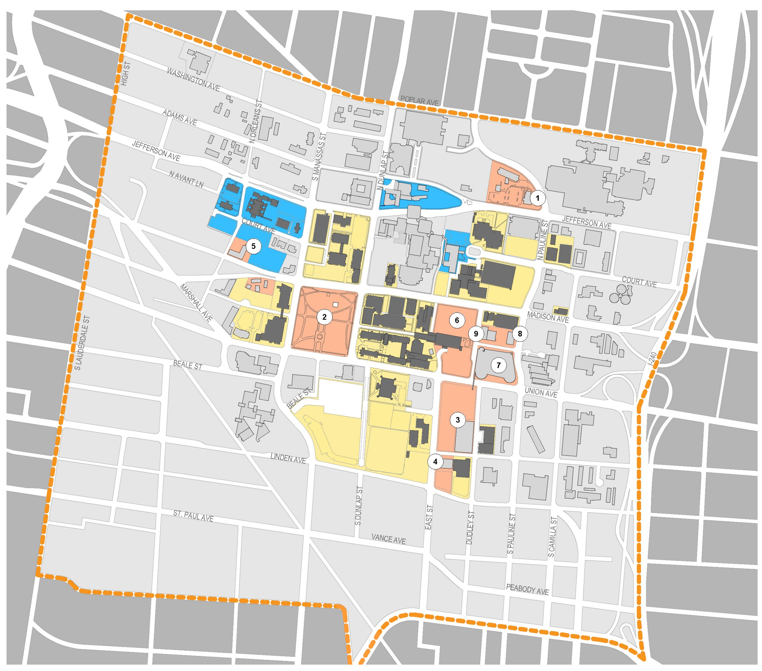
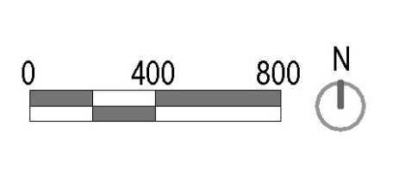
Planning Boundary & Ownership
UTHSC Property
UTHSC Lessor
Strategic Acquisition
Non-UTHSC Property
UTHSC Planning Boundary
ACQUISITIONS
Regional One + Hotel Parcel
Health Sciences Park
Baptist Parking Lot
Pappy’s Coffee Lot
Trolley Stop Restaurant
Innova Memphis Lot
Baptist Parking Garage
Medical Center Apartments
Innova Memphis Office Building

Slide 14
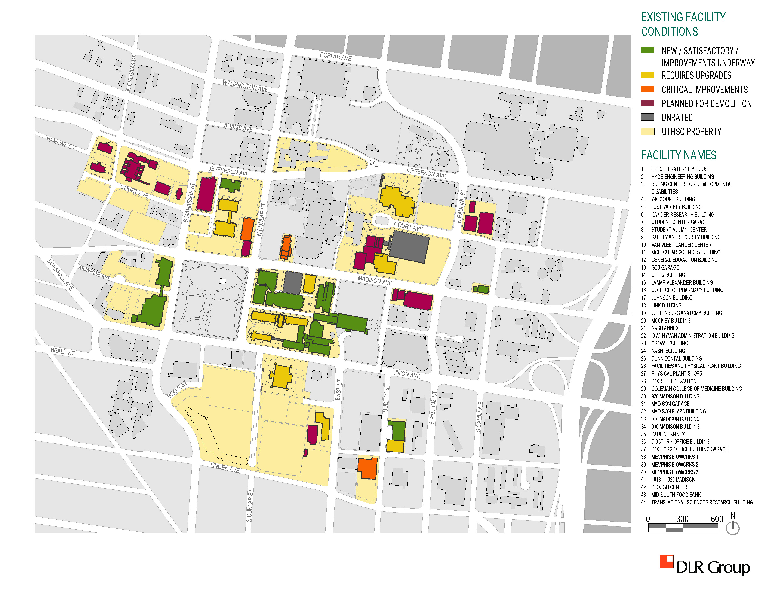
Existing
Facility
Conditions
New/Satisfactory/ Improvements Underway
Requires Upgrades
Critical Improvements
Planned for Demolition
Unrated
UTHSC Property

Slide 15
FUTURE SPACE NEEDS
Long-term Deficit
629,891 ASF
Short-term Deficit
17,144 ASF
Surplus Today
66,503 ASF
1,436,540
1,370,037
1,608,949
1,625,638
1,339,360
1,969,251
Space in good condition
Indicates impact of space in critical condition and proposed demolition

Slide 16
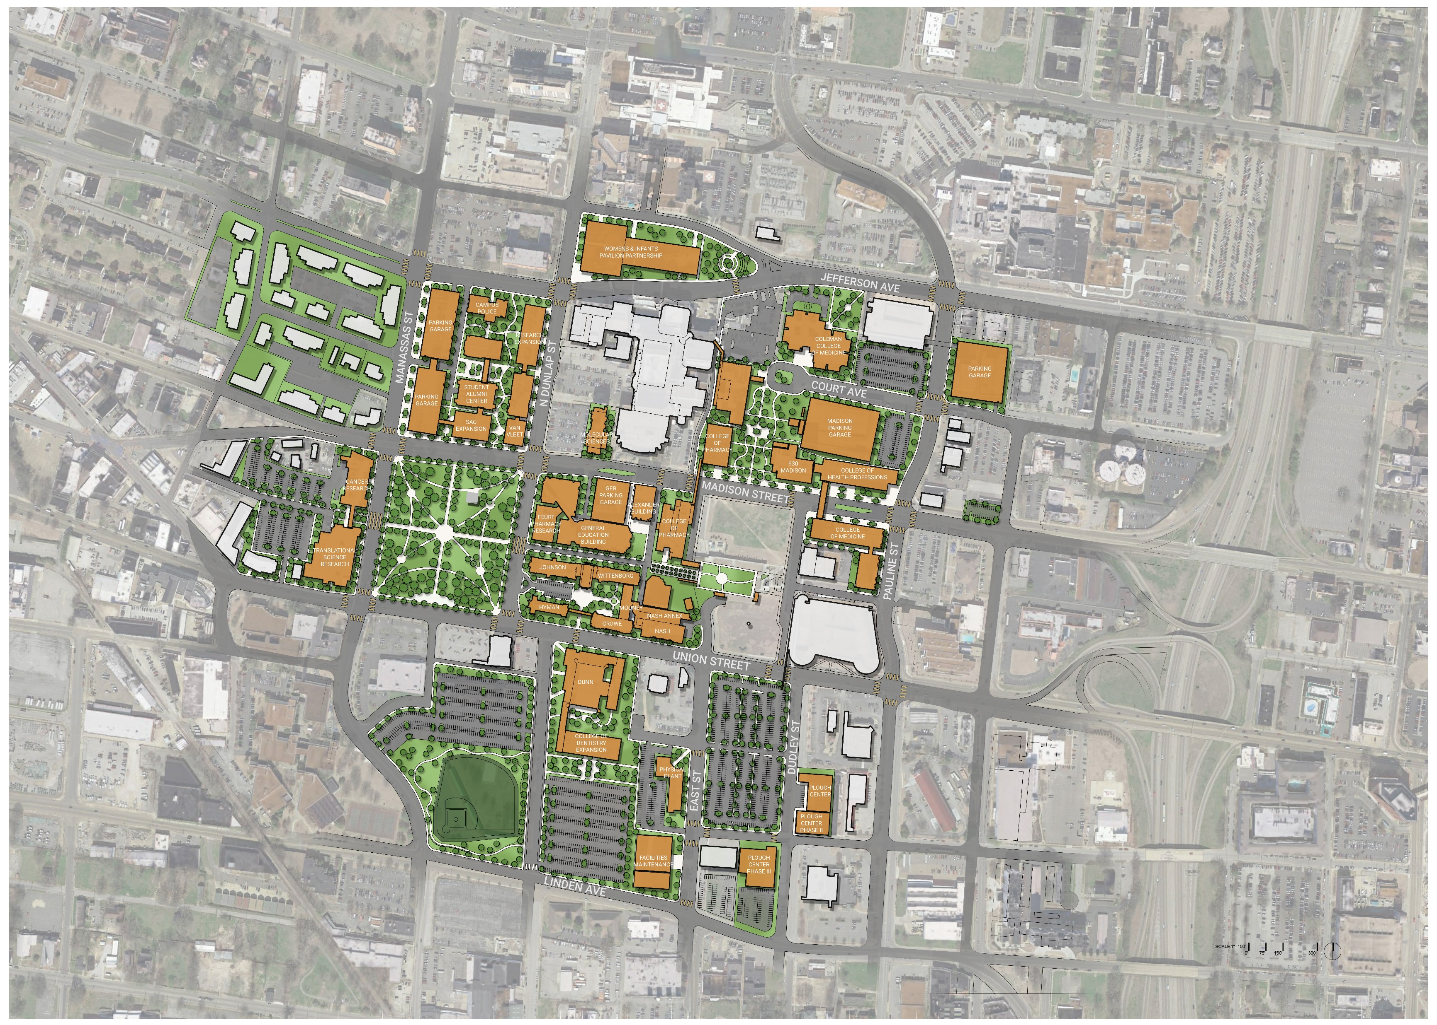
Master Plan Framework
Improve Campus Corridors and Embrace the Urban Context
Foster easy connections with Clinical Partners and Education Providers
Define Limits of the UTHSC Campus Environment
Designate a branded campus perimeter with landmarks
Define Pedestrian Corridors to Create Safe Connections Throughout Campus
Enhance indoor and outdoor campus circulation
Create a Network of Campus Green Spaces
Connect cross-disciplinary centers with beautiful, comfortable, and useable open space
Showcase and Connect Centers of Excellence
Locate along major street corridors and link to a research spine

Slide 17
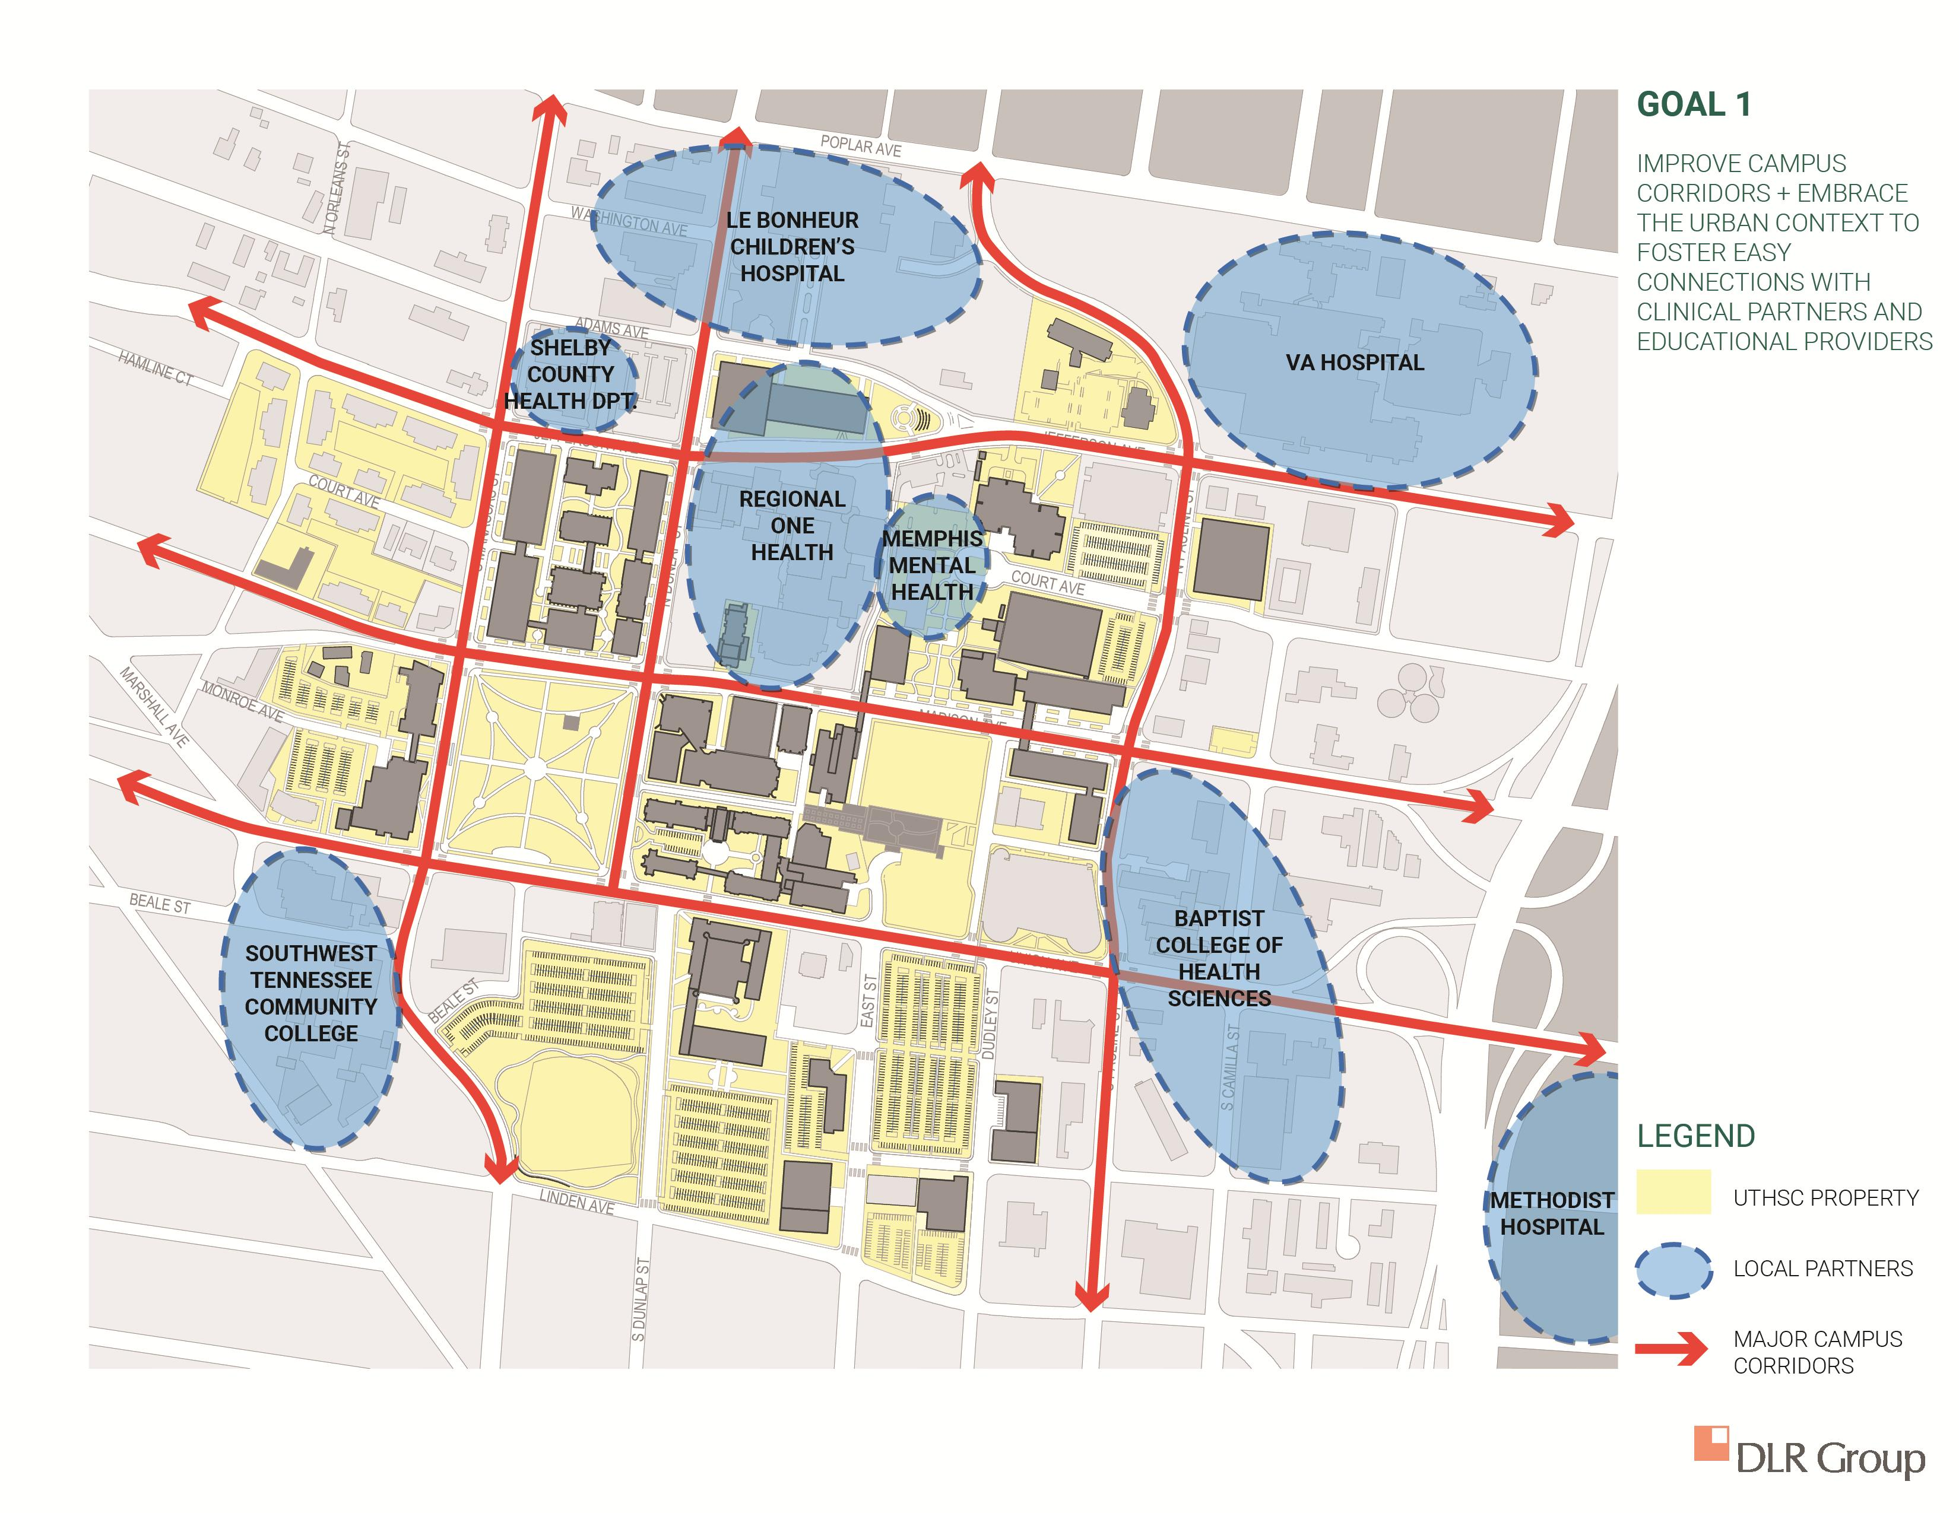
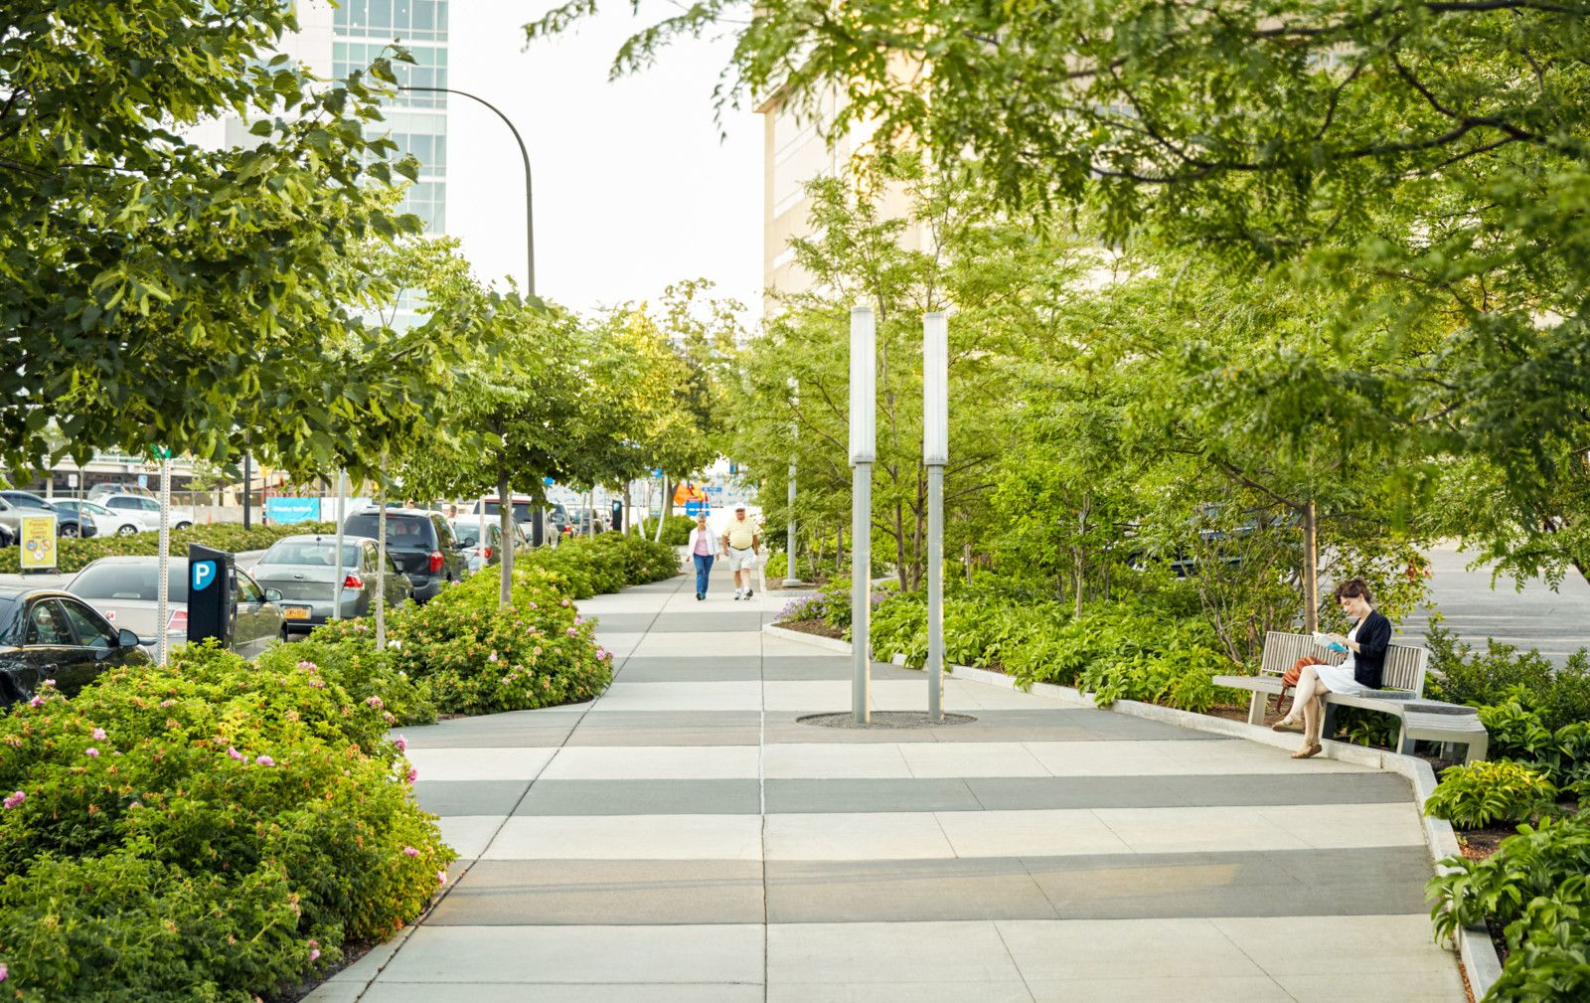
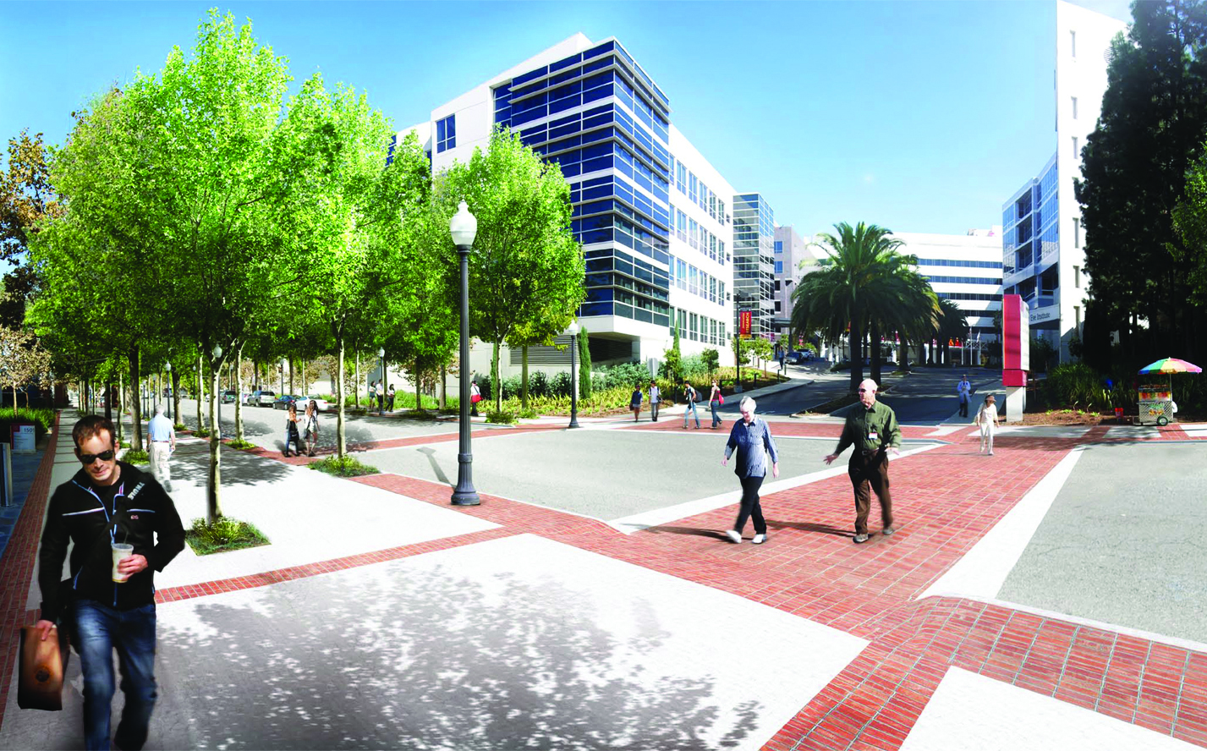
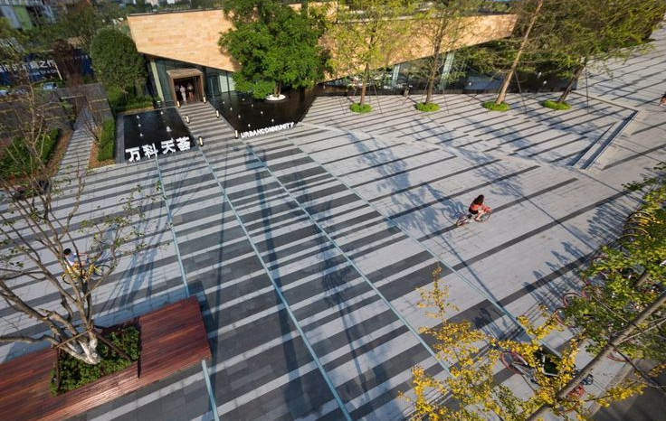
Principle 01: Improve campus corridors and embrace the urban context to foster easy connections with clinical partners and educational providers
Buffalo-Niagara Medical Campus, Pedestrian Corridors
USC HSC, Pedestrian Improvements
UTHSC Property
Local Partners
Major Campus Corridors
Plaza and Pedestrian Corridor

Slide 18
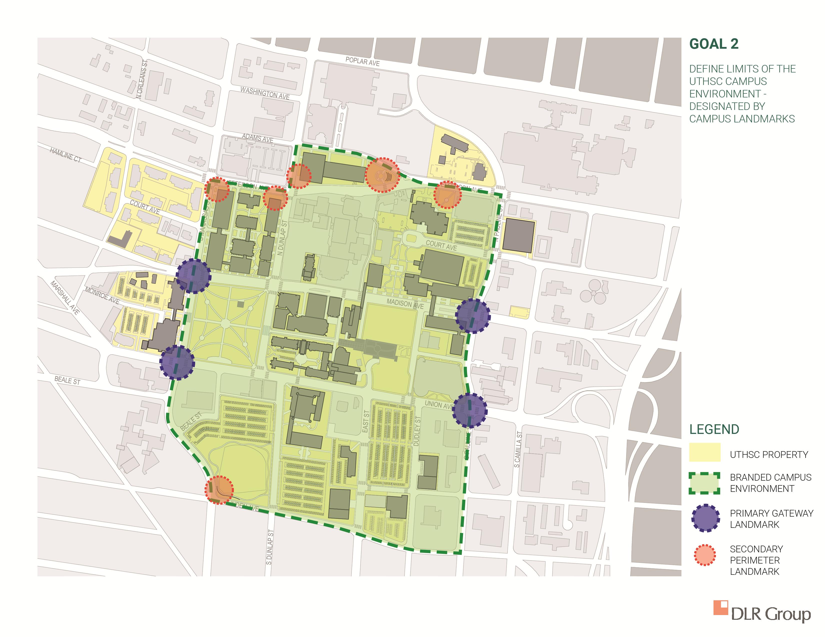
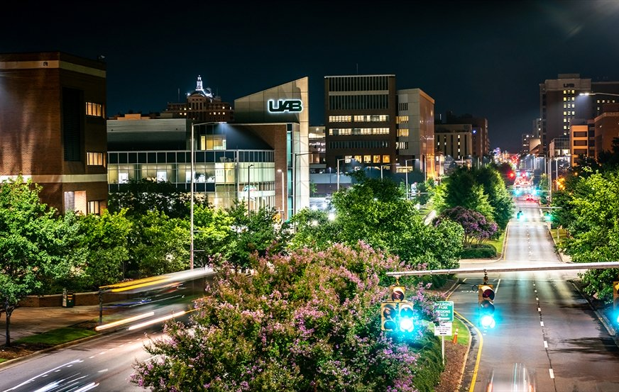
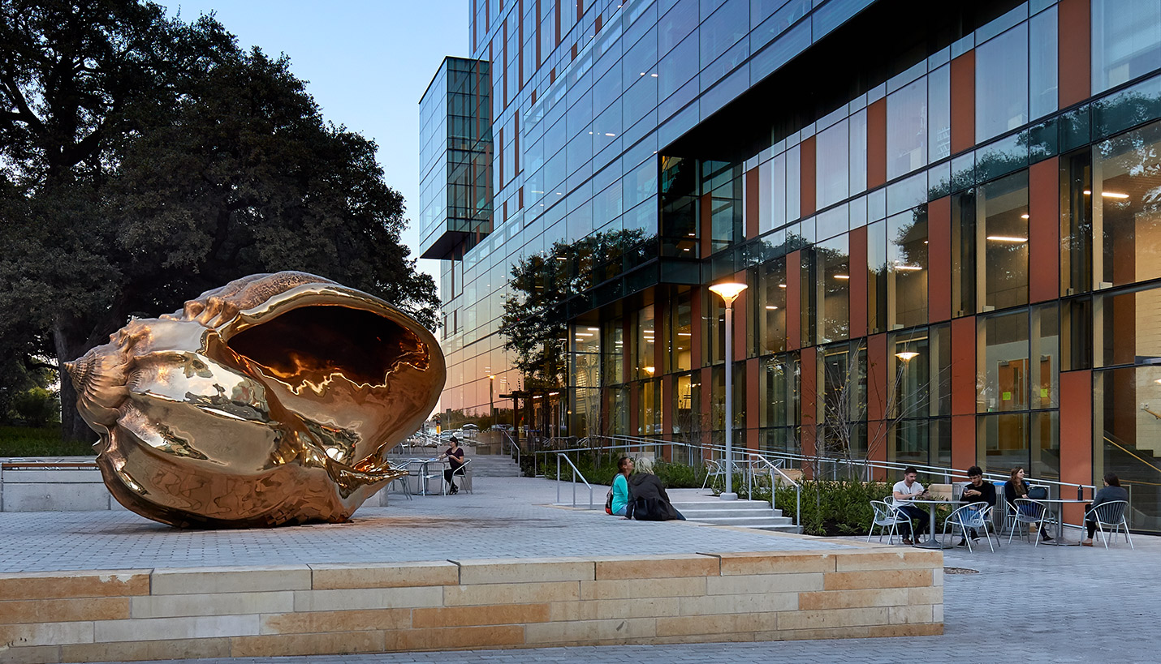
Principle 02: Define limits of the UTHSC campus environment – designated by campus landmarks
UAB Campus Gateway
Dell Medical School, UT Austin
UTHSC Property
Branded Campus Environment
Primary Gateway Landmark
Secondary Perimeter Landmark
Tufts University HSC, Campus Signage

Slide 19
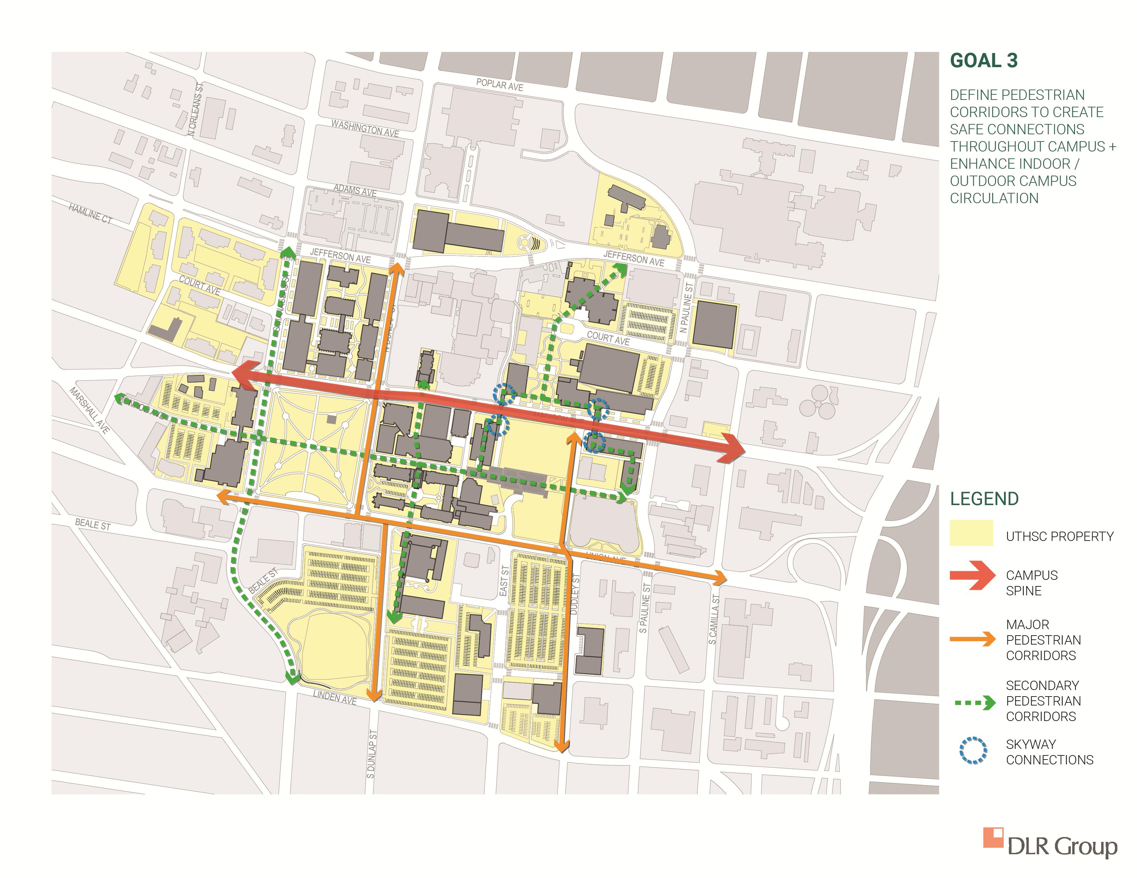
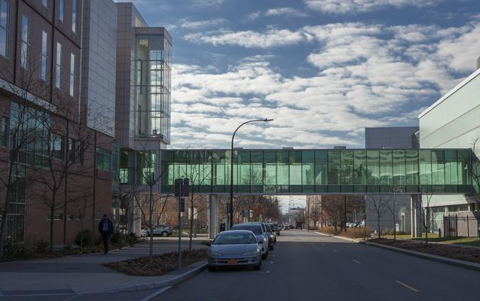
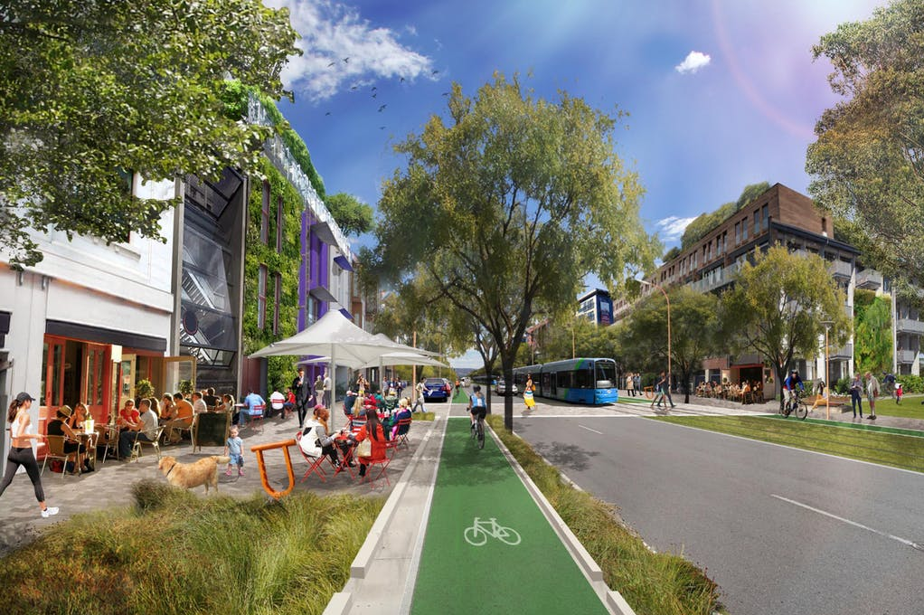
Principle 03: Define pedestrian corridors to create safe connections throughout campus and enhance indoor and outdoor campus circulation.
Buffalo-Niagara Medical Campus, Pedestrian Bridge
Temple University HSC, Ground Floor Visibility
UTHSC Property
Campus Spine
Major Pedestrian Corridors
Secondary Pedestrian Corridors
Skyway Connections
Complete Streets

Slide 20
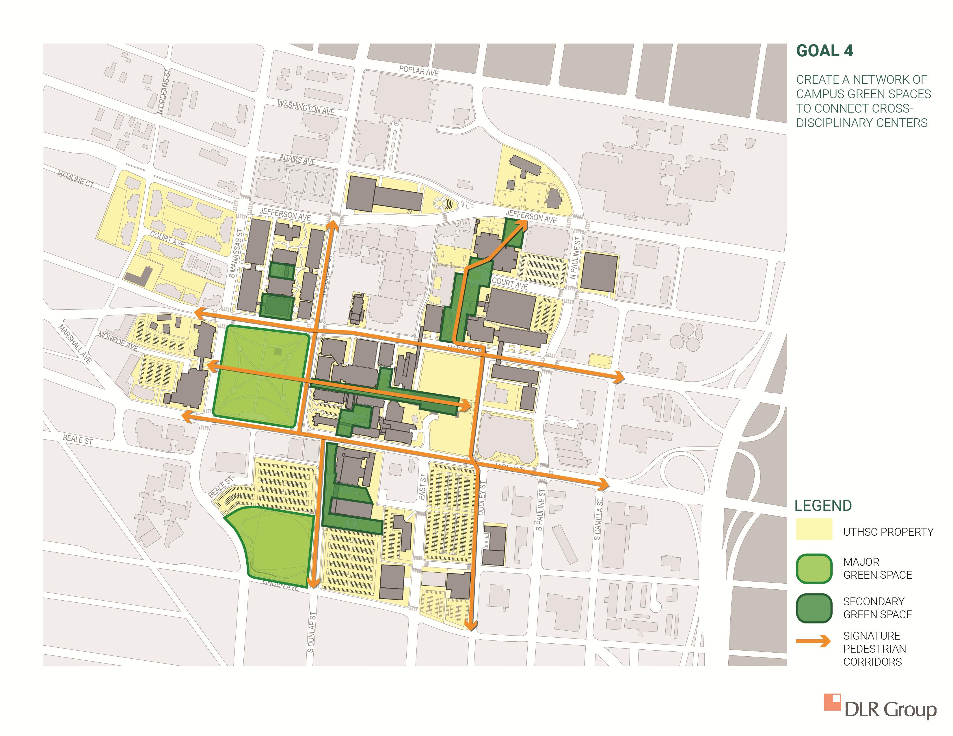
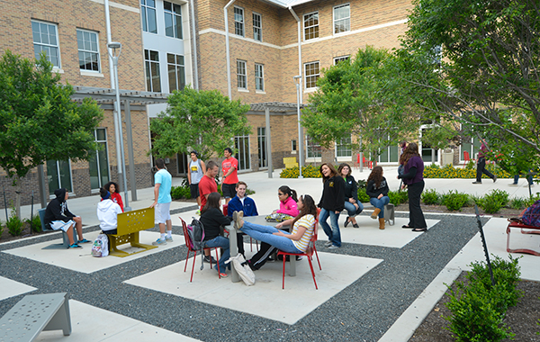
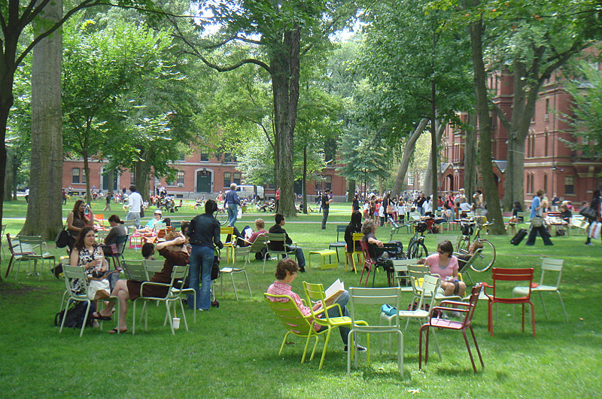
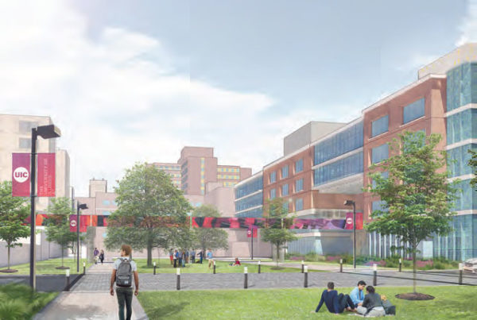
Principle 04: Create a network of campus green spaces to connect cross-disciplinary centers
Texas Lutheran University, Centennial Courtyard
Harvard Yard, Harvard University
UTHSC Property
Major Green Space
Secondary Green Space
Signature Pedestrian Corridors
Health Sciences Greenway, UIC

Slide 21
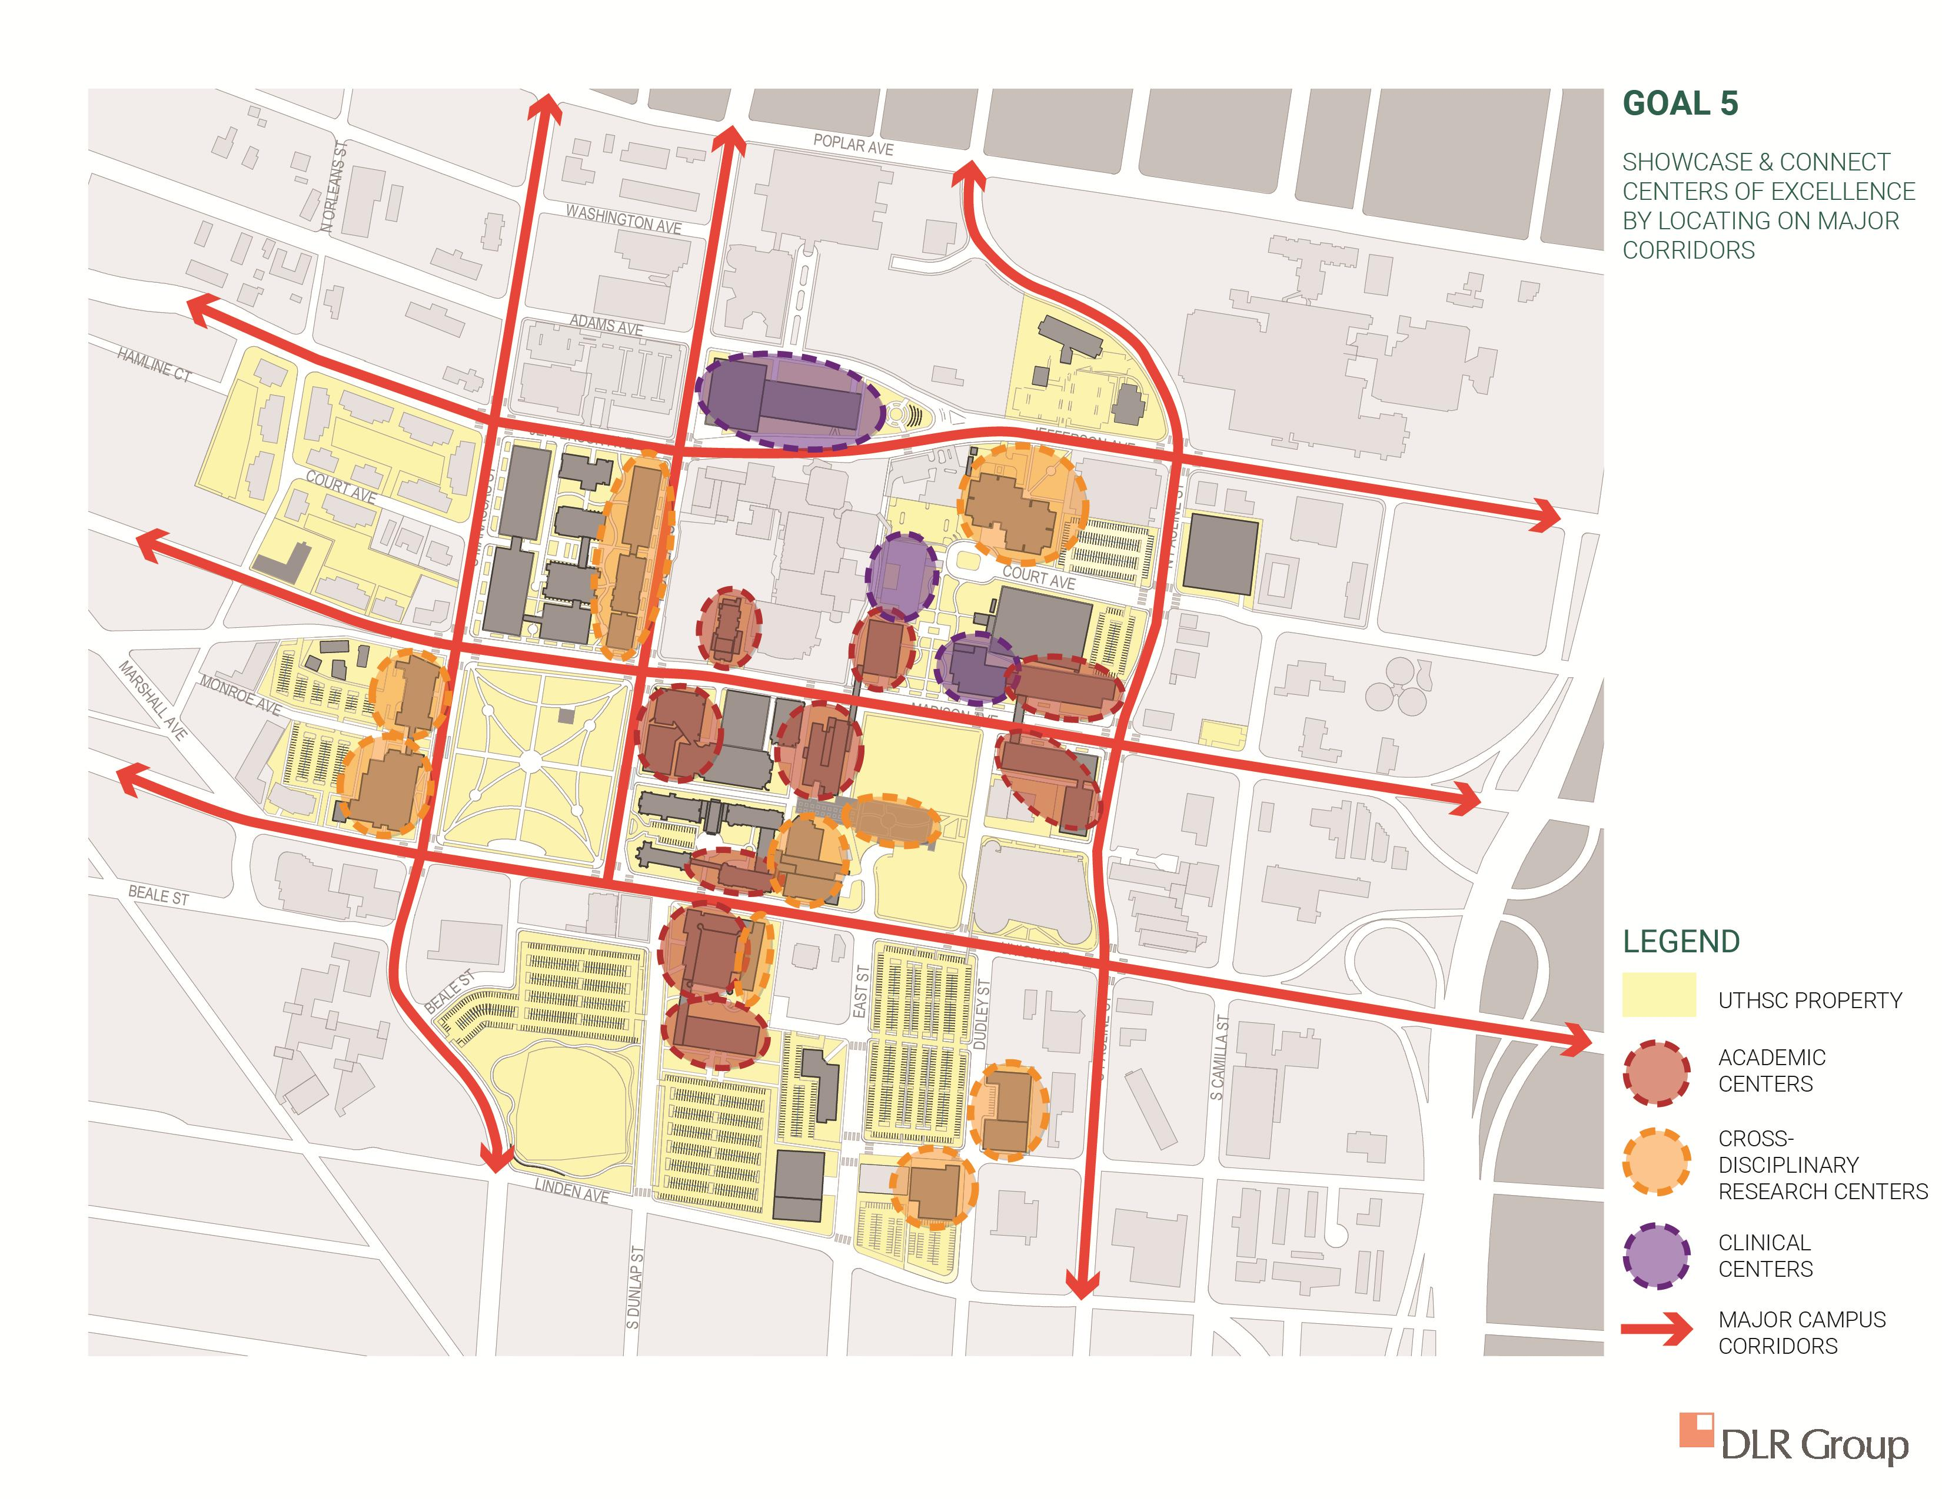
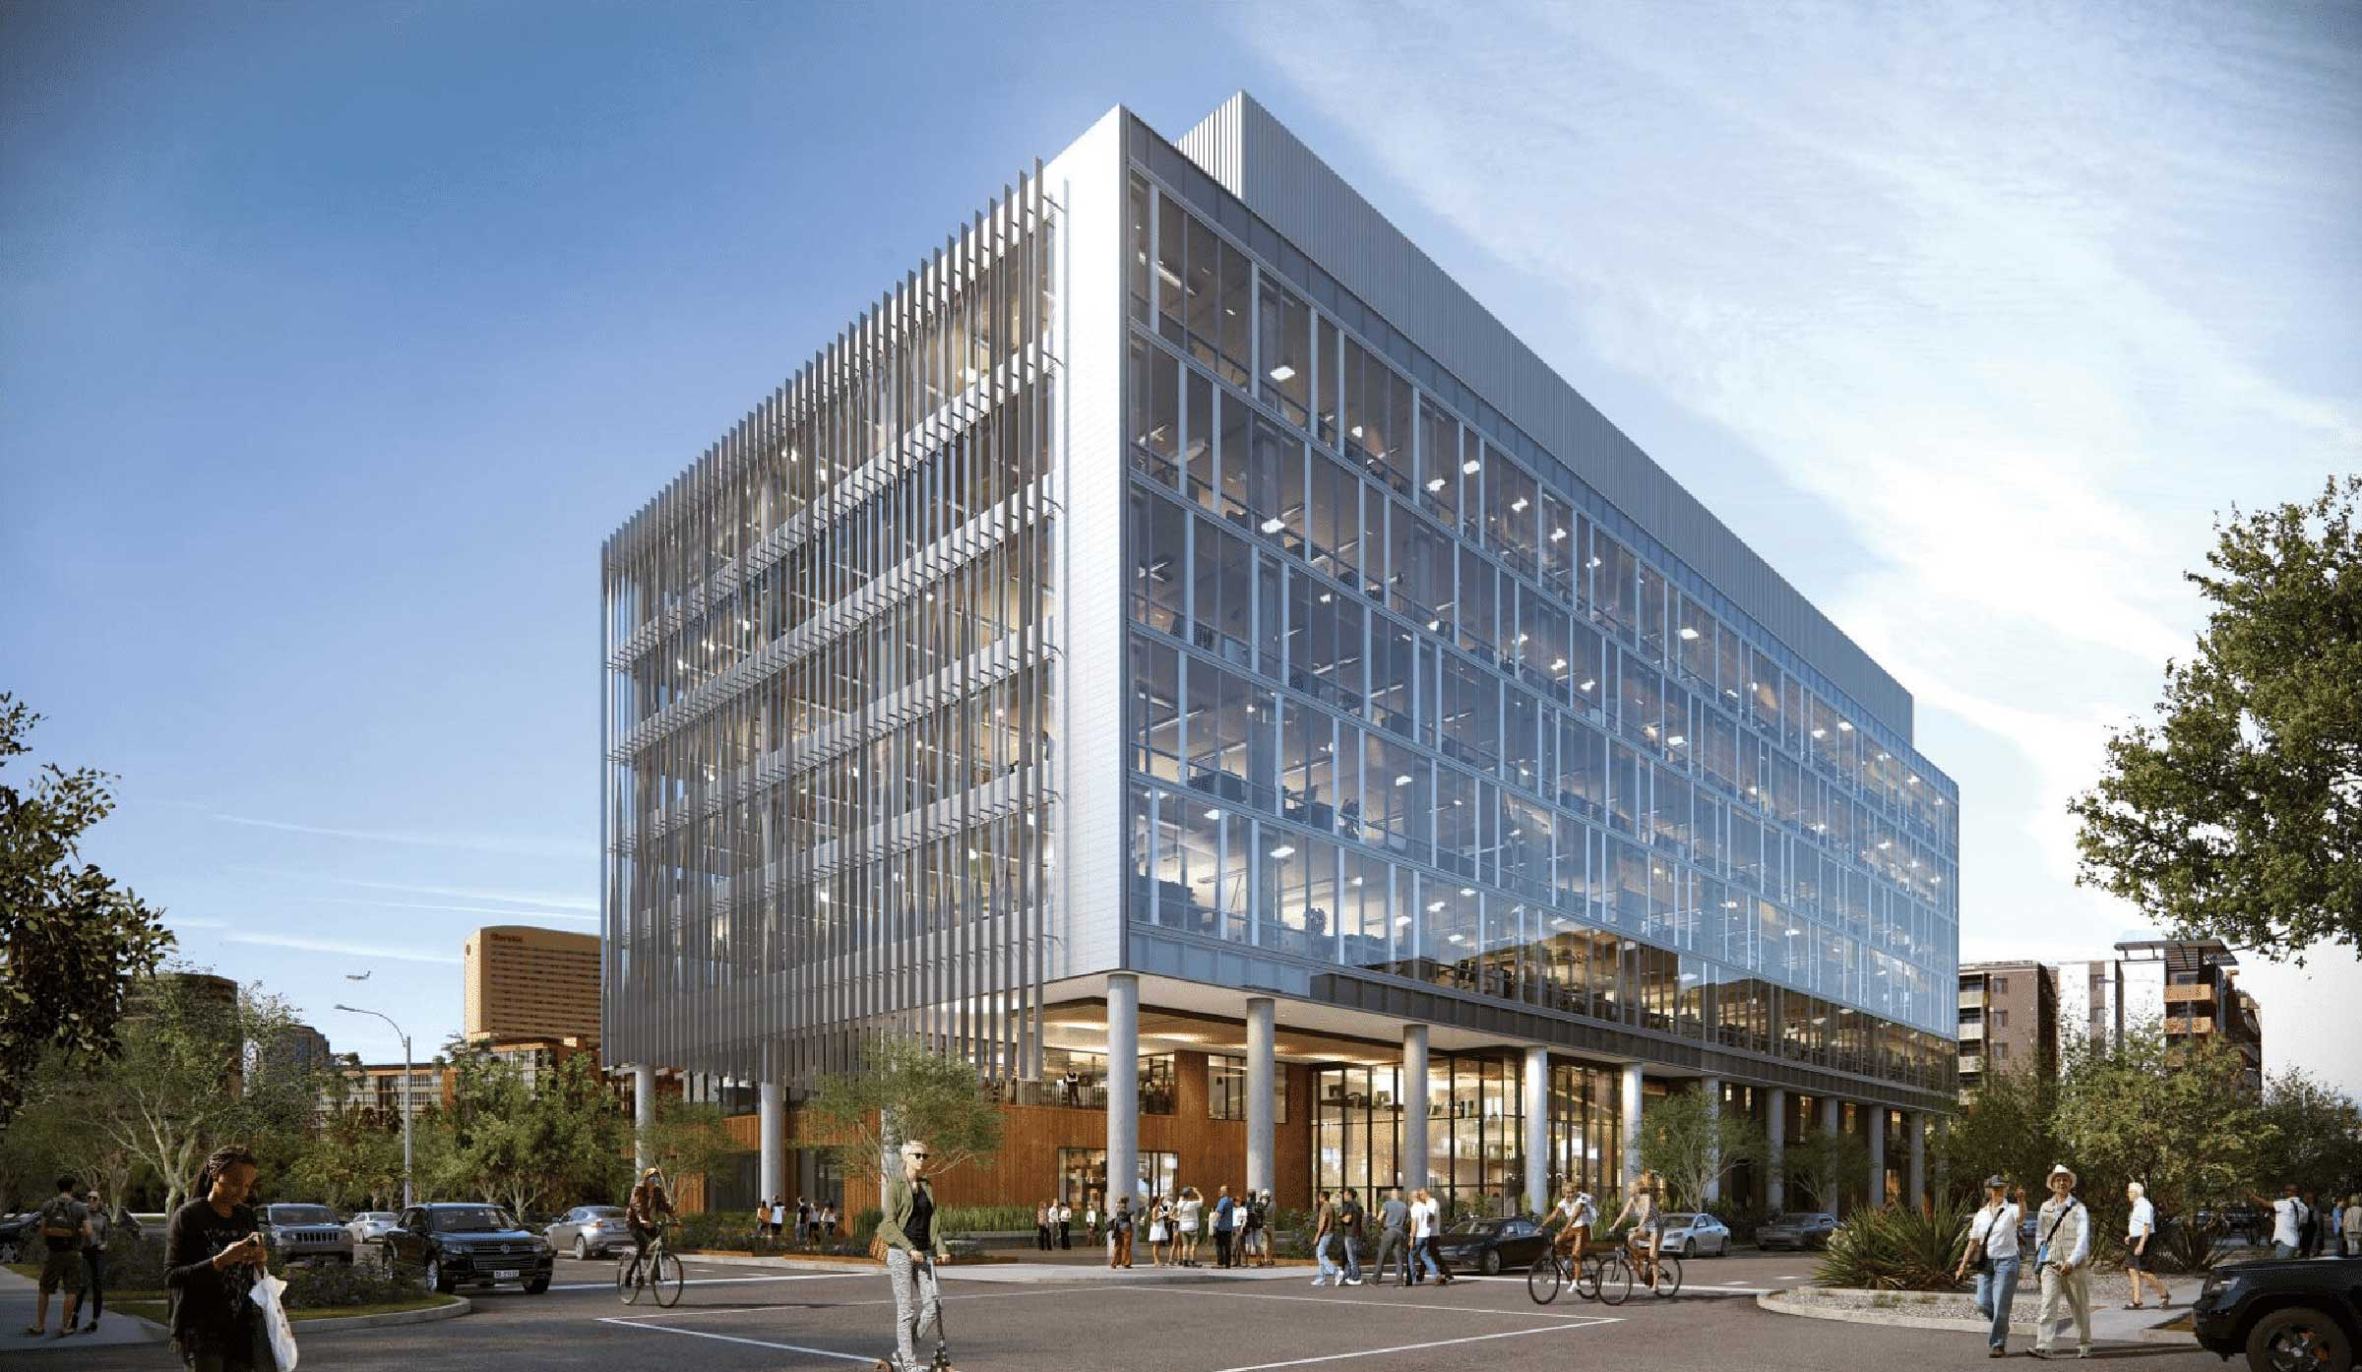
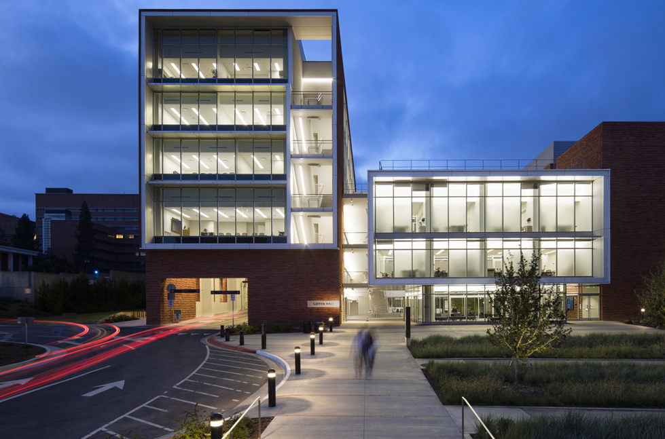
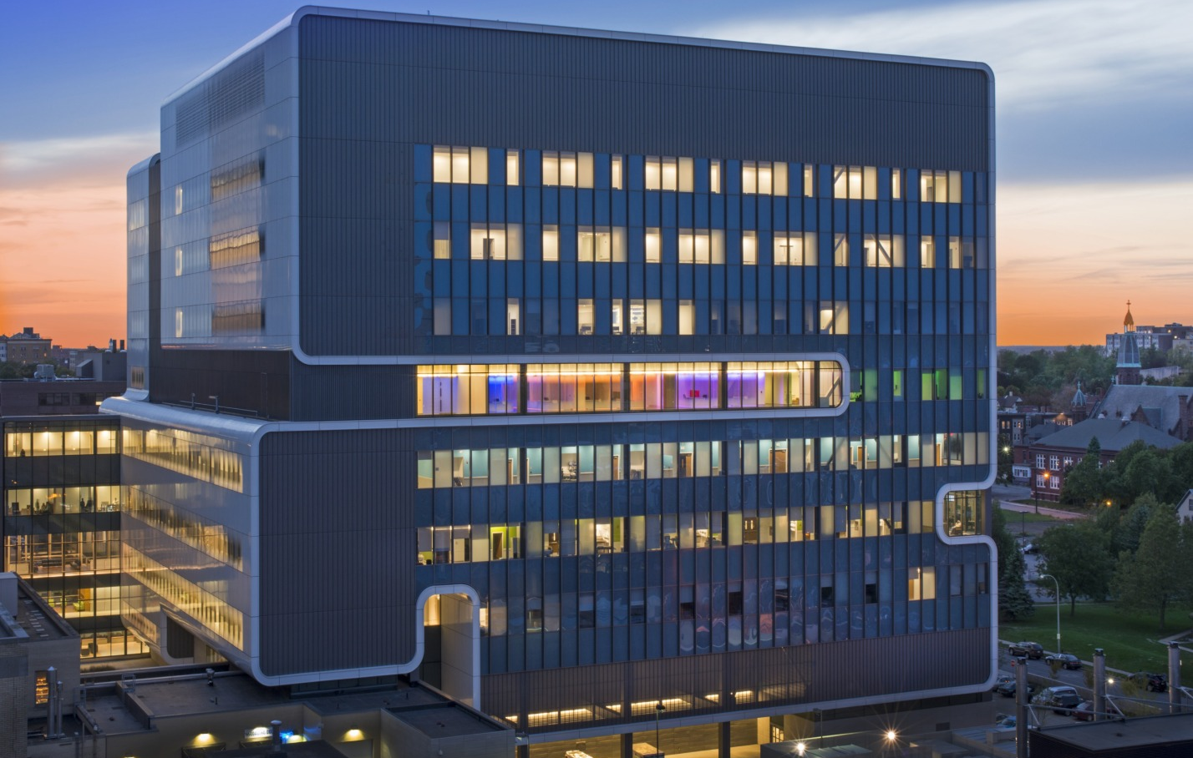
Principle 05: Showcase and connect centers of excellence by locating on major corridors
ASU/Wexford Science and Technology Building (Research)
Geffen School of Medicine, UCLA (Academic)
UTHSC Property
Academic Centers
Cross-disciplinary Research Centers
Clinical Centers
Major Campus Corridors
Gates Vascular Institute (Clinical and Translational Research)

Slide 22
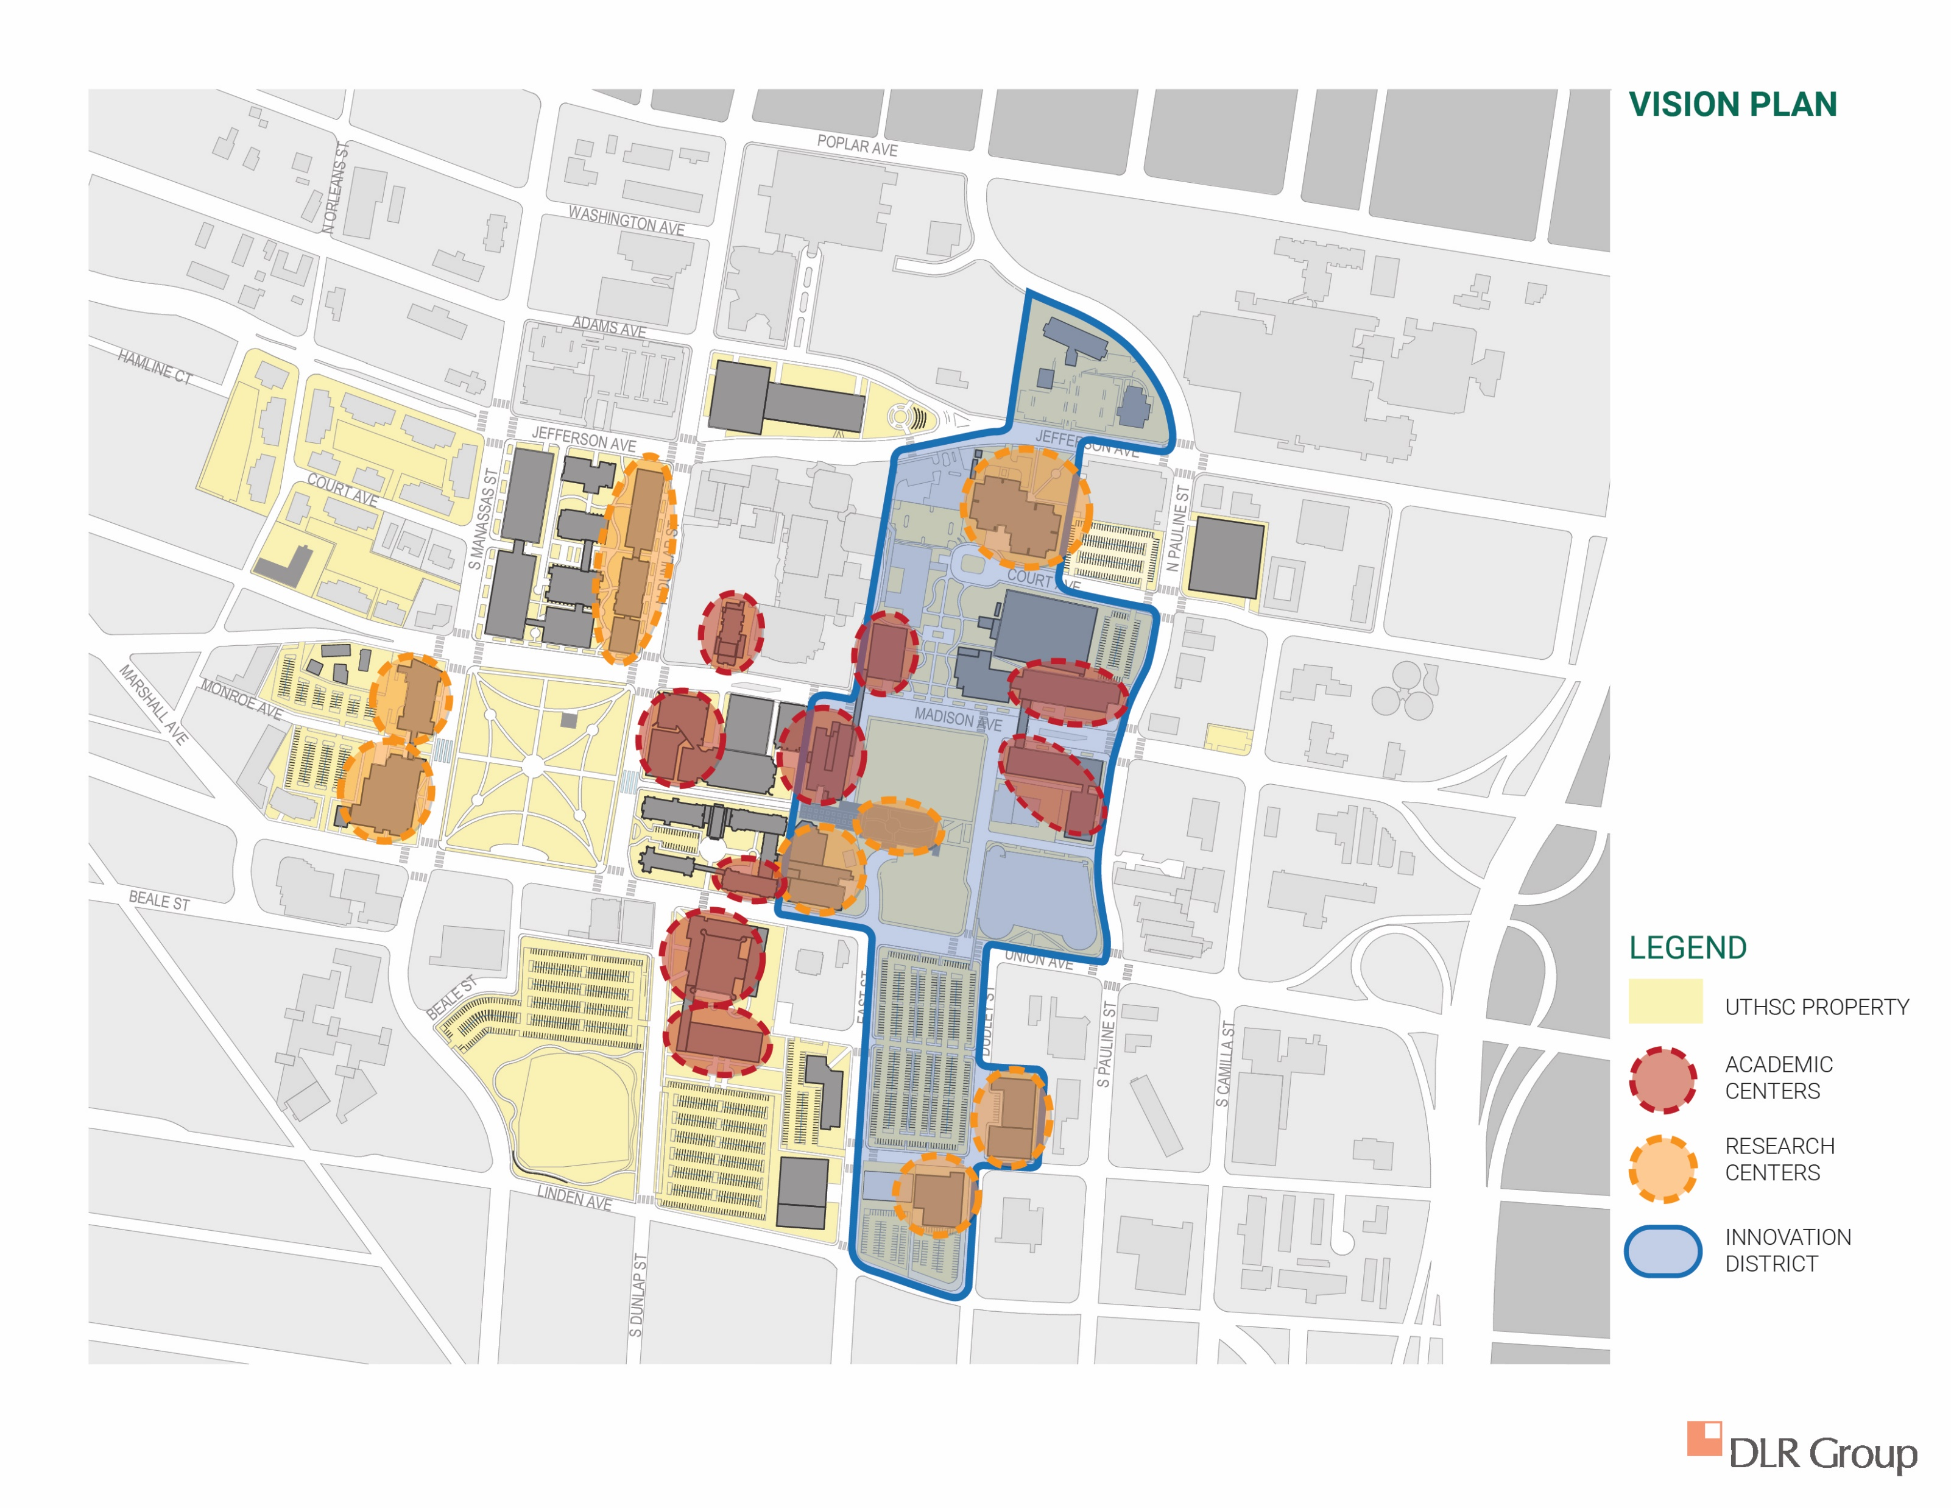
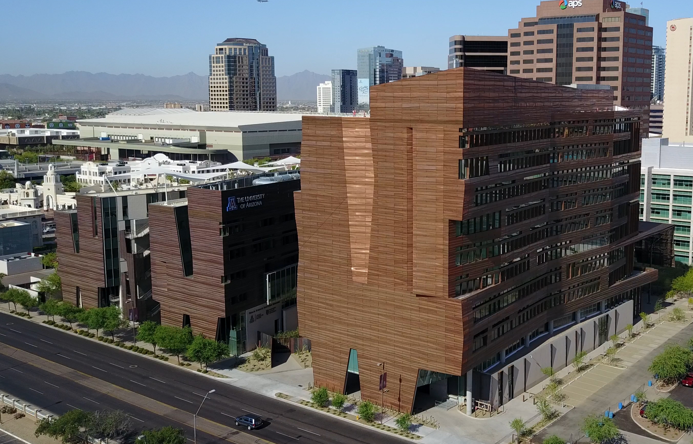
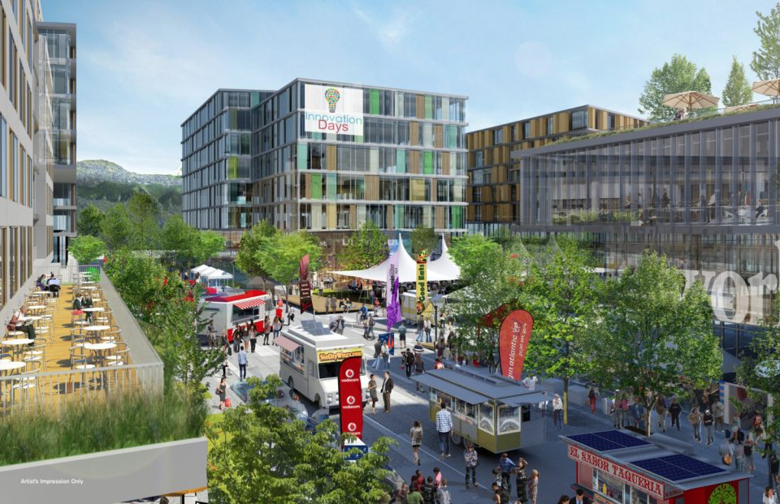
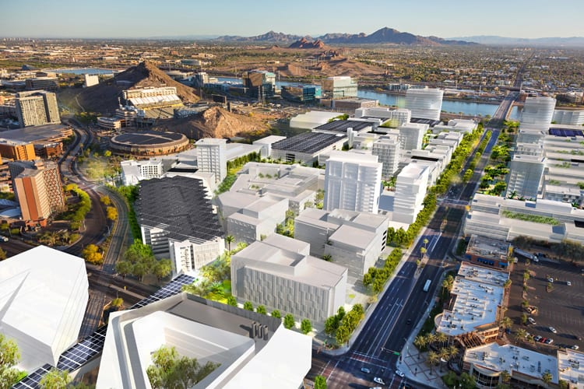
Vision plan
UArizona, Phoenix Biomedical Campus
North Shore Innovation District, Vancouver, BC
UTHSC Property
Academic Centers
Research Centers
Innovation District
Novus Innovation Corridor, Tempe, AZ

Slide 23
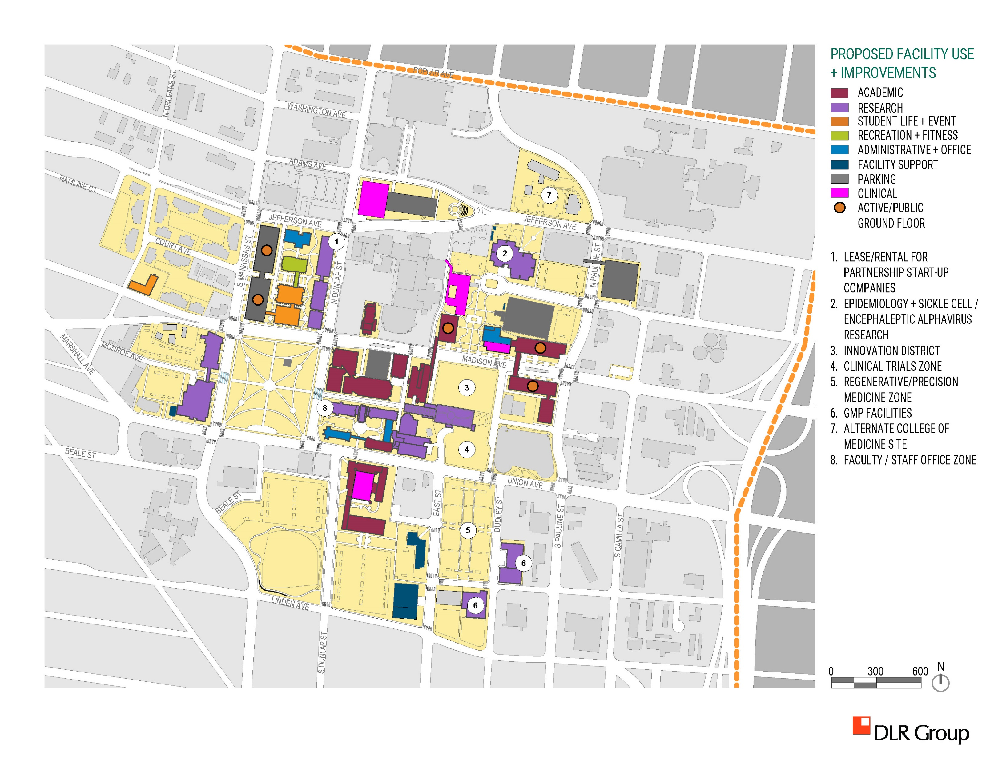
Proposed Facilities
Academic
Research
Student Life + Event
Recreation + Fitness
Administrative + Office
Facility Support
Parking
Clinical
Active/Public Ground Floor
Lease/Rental for Partnership Start-up Companies
Epidemiology + Sickle Cell/Encephaleptic Alphavirus Research
Innovation District
Clinical Trials Zone
Regenerative/Precision Medicine Zone
GMP Facilities
Alternate College of Medicine Site
Faculty/Staff Office Zone

Slide 24
Long-term Plan

Slide 25
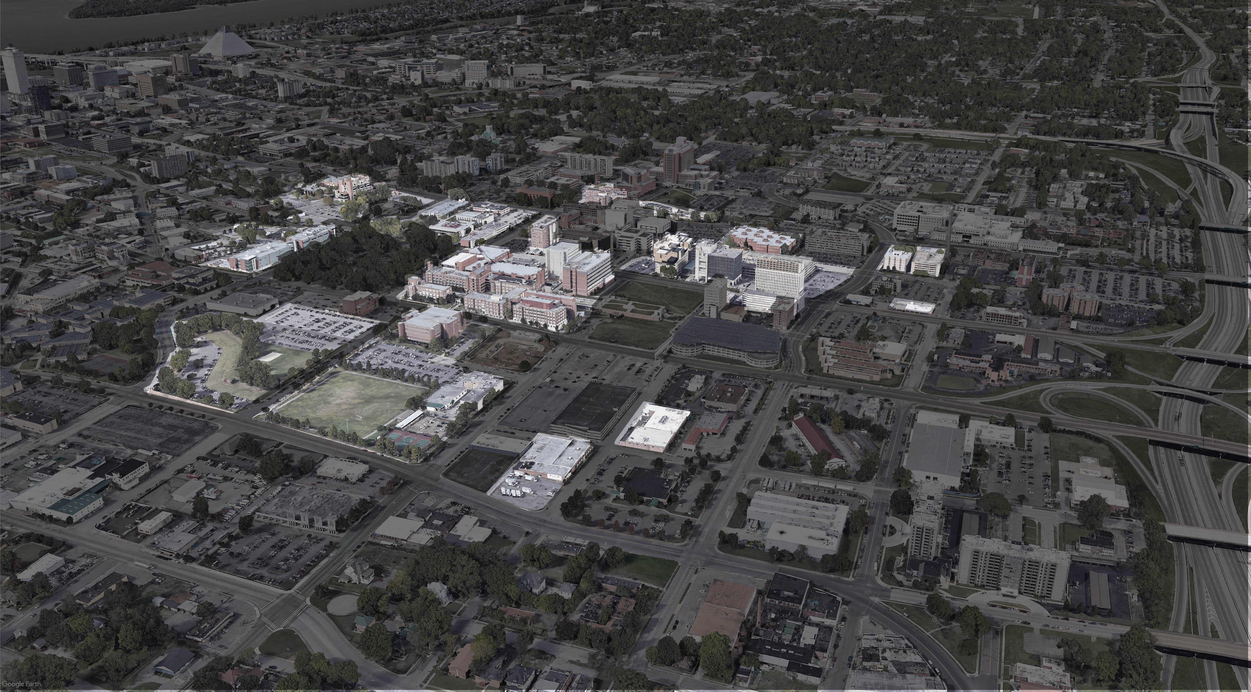
uthsc TODAY

Slide 26
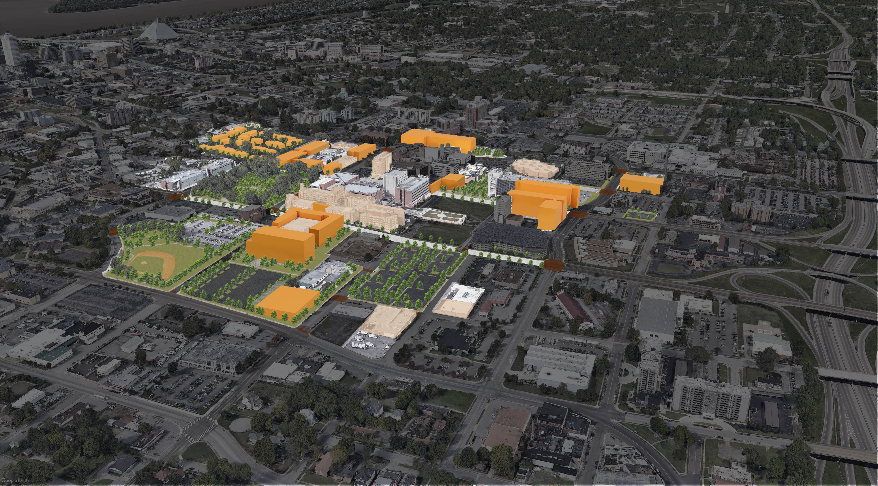
UTHSC Long-term Plan
uthsc LONG-TERM PLAN

Slide 27
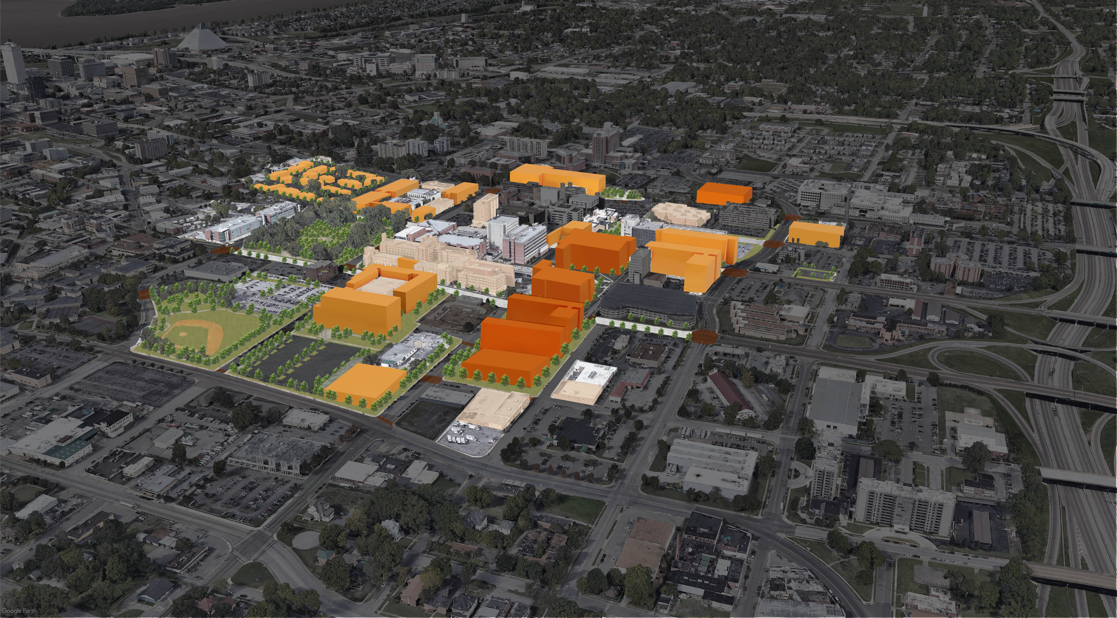
UTHSC Vision Plan
uthsc VISION PLAN

Slide 28
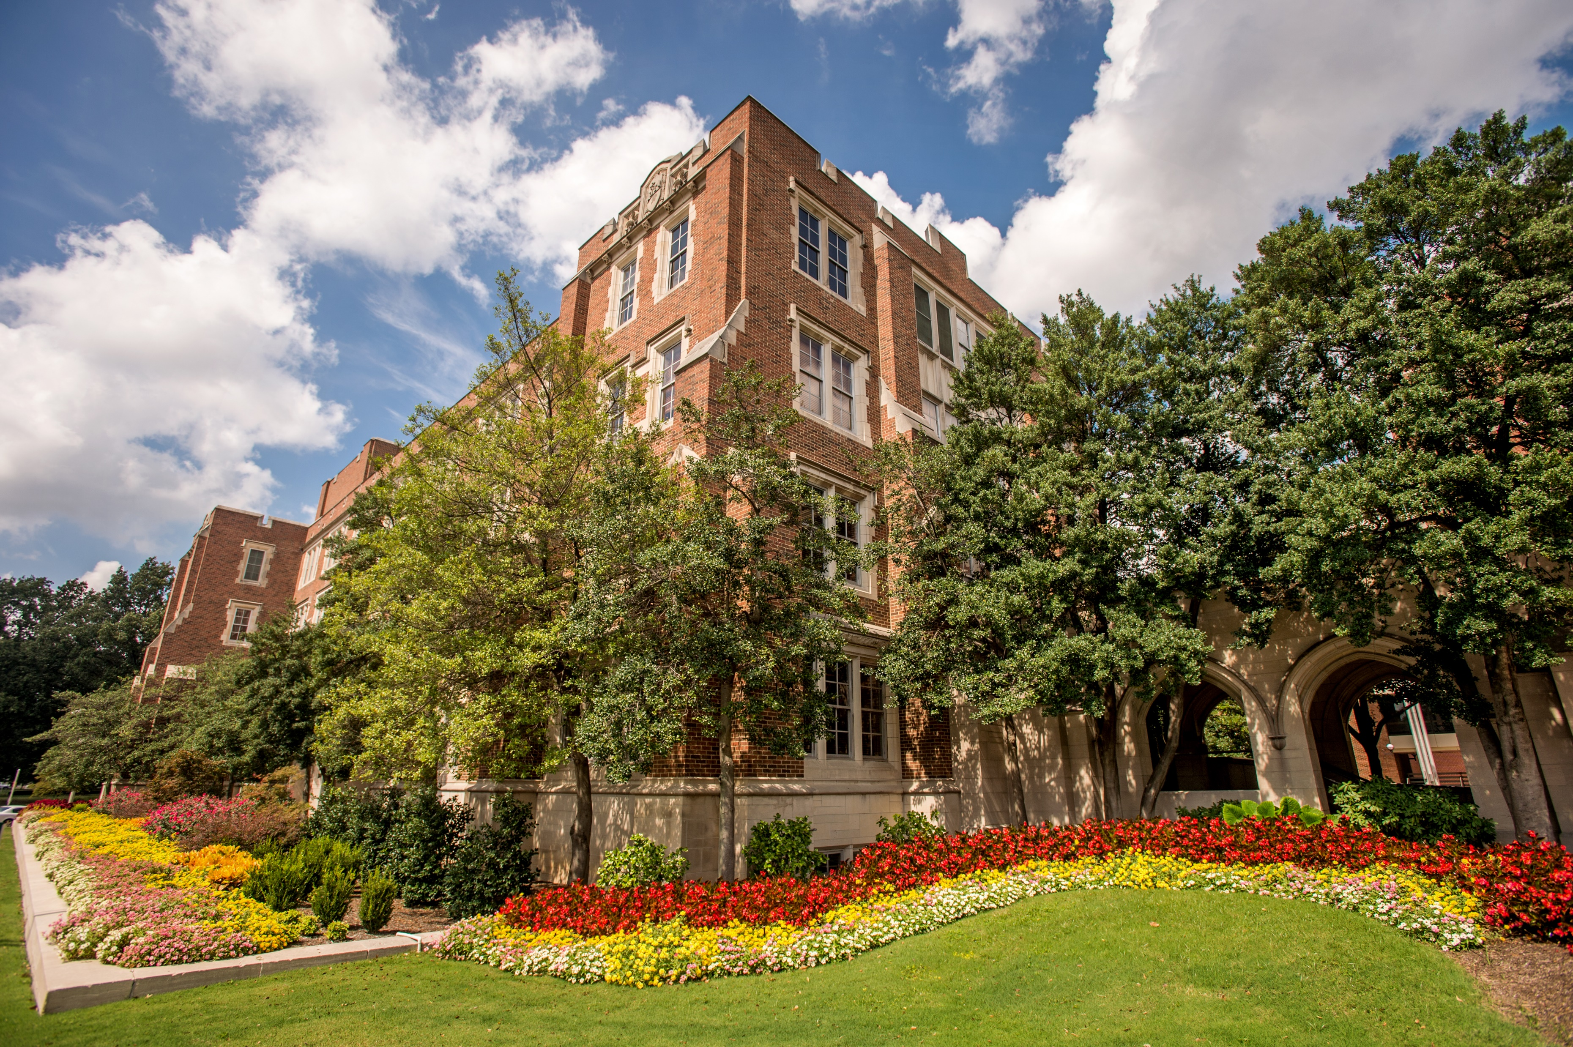
Diagrams and engagement stations

Slide 29
2020
Campus Master Plan Update
Open House
February 4, 2020

