Slide 1
The Annual Performance and Planning Review for Faculty Members and Evaluators
Dr. Cindy Russell, Vice Chancellor, AFSA
Dr. Kristi Forman, Director, Faculty Affairs

Slide 2
Topics
APPR: What is it, who requires it, why is it important, when is it done
General goals of the APPR and specific processes
APPR procedure
Indicators of a well-done APPR
Clarifying assignments and goals
Performance ratings
Resolving disagreements about the APPR

Slide 3
Relevant Faculty Handbook Guidance
Appendix J Procedure for the Annual Performance and Planning Review
Section 4.14 Career Development and Evaluation of Tenure Track Faculty Members
Section 4.16 Career Development and Evaluation of Tenured Faculty Members
Section 5.3 Career Development and Evaluation of Nontenure Track Faculty
Appendix K Procedure for the Interim Probationary Review for the Award of Tenure

Slide 4
The What, Why, Who, and When of APPR

Slide 5
APPR is a formal review that…
…examines the current/previous year’s activities and planning what should occur during the current/coming year.
…proceeds from guidelines and criteria which are appropriate to the department, college, and UTHSC.
…should take place in the context of longer-term goals for the campus, college, and department.
…focuses on the faculty member’s contributions to the University’s missions through teaching, research (including scholarly and artistic work), service, and clinical care.
…is a key element in determinations of merit pay or performance-based salary adjustments.
Board of Trustees BT0006 – Policies Governing Academic Freedom, Responsibility, and Tenure

Slide 6
Why an APPR?
Provides clarity to faculty regarding progression toward career milestones
Clarifies areas of exemplary performance
Points out areas where improvement may be warranted
Provides an annual review upon which to judge positive or negative performance
Foundation to build on yearly
Provides a history of corrective feedback/recommendations to address performance issues
Provides information for regular processes, such as tenure, promotion, Post-Tenure Review (PTR), Enhanced Post-Tenure Performance Review (EPPR)

Slide 7
What is the goal of the APPR?
Facilitate communication
Clarify short- and longer-term goals and expectations
Clarify departmental goals and the faculty member’s role
Recognize areas of exceptional performance
Identify areas of performance that deserve additional effort
Develop documentation to use for determination of salary, promotion, and tenure recommendations
Essentially,
To review your performance
To receive your work assignment
To mutually establish your goals

Slide 8
Who requires an APPR?
All regular faculty members, full or part-time
  Tenured
  Tenure-Track
  Non-tenure Track
Includes administrators who also hold regular faculty appointments
  Chancellor
  Some Vice Chancellors & some modified VC titles
  Deans & some modified Dean titles
Volunteers
Friends
Affiliates

Slide 9
Who requires an APPR by start/termination
Recently hired
(anytime during year under review)
Planning to resign/retire (in the early part of the year in which the APPR will occur)
Actually resigns/retires (prior to March 31 of the year in which the APPR will occur)
APPR is required.
APPR provides a quick check and opportunity for a tune-up in case any redirection may be required.
APPR reinforces goals and assignments for the calendar year.
APPR is required.
Until gone, the faculty member is here.
Require the performance review portion for the year under review.
May hold on the planning of goals and assignments. If resignation/retirement doesn’t occur, then need to conduct the planning portion.
APPR is optional.
Performance review could be appropriate.
No need to do the planning portion.
If the faculty member remains past March 31, the full APPR is required.

Slide 10
When is APPR conducted?
Between January 1* and March 15 of each year
  Reviewing activities and performance for the preceding calendar year
  Setting the plan for the current calendar year through the setting of goals and assignments
*Faculty submission step opens in Digital Measures on December 1

Slide 11
The Process

Slide 12
Digital Measures: APPR Workflow
Digital Measures User Guide https://libguides.uthsc.edu/digitalmeasures
APPR User Guide https://libguides.uthsc.edu/digitalmeasures/APPR
  Includes information on how to access your workflow, common questions, and tips on reviewing your annual report.
APPR Video Tutorials https://libguides.uthsc.edu/digitalmeasures/APPR-videotutorials
  User Guide includes faculty/chair videos, as well as PDF versions of the video scripts and workflow steps
General schedule of sessions:
  Introduction to Digital Measures, Tuesdays, 1-2pm
  Faculty APPR training, Tuesdays, 8-8:30am CDT; Thursdays, 4:30-5pm CDT
  Evaluator APPR training, Wednesdays, 12:00-12:30pm; Fridays, 12:00-12:30pm CDT
  We will schedule a unique session for your unit!

Slide 13
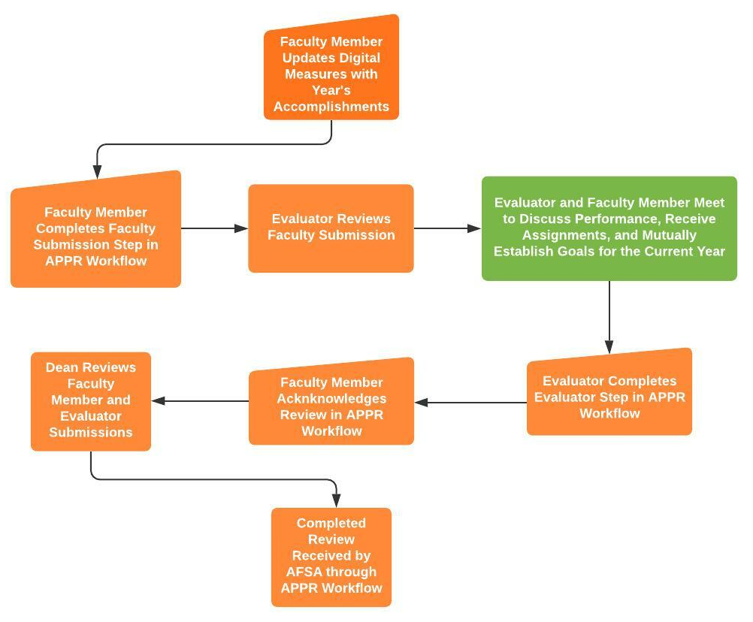
Procedural Steps for the APPR
Faculty member provides required documents
  Summary of activities and accomplishments
  Summary of proposed academic goals
Evaluator reviews documents
Faculty member and Evaluator meet
  Review performance
  Receive work assignment
  Mutually establish academic goals
Evaluator prepares narrative summary of discussion including expectations of the faculty member for the upcoming year
Faculty receives and acknowledges review with option to write response

Slide 14
The Role of the Evaluator
Meet with faculty member to discuss performance review and career development
Provide an appraisal of performance based on prior year’s assignment(s) and goal(s)
Provide current year’s assignment(s) and mutually agreed upon goals
Assign overall performance rating and rating in each mission area
Assign effort allocation for current year

Slide 15
Specific processes concurrent with the APPR
Tenure-Track Faculty Members
Mandatory Interim Probationary Review for Tenure
  Conducted in year 3 or 4 of the probationary period at the Chair’s discretion
  Departmental or, if insufficient tenured faculty, Collegiate Appointment, Promotion, and Tenure Committee involved
Progress towards Tenure
  Each annual review required to include a statement of progress
As Appropriate
Progress towards Promotion
Initiating or Reviewing Annual Review Improvement Plan
Reviewing Progress on Enhanced Post-Tenure Performance Review (EPPR) Improvement Plan

Slide 16
Indicators of a Well-Done APPR

Slide 17
What makes a good APPR
Authentic
Accurate
Genuine
Meaningful
Synergistic
In both
process
and
substance

Slide 18
What makes a good APPR
Covers all required elements and follows all applicable procedures
Focuses simultaneously on faculty member’s and departmental/collegiate needs
Covers a year, but looks backward and forward to provide meaningful input to professional growth and academic achievement
Allows for sufficient time for conversation and discussion; not perfunctory; not merely a review of documents sent back and forth
Clearly elaborates any relevant performance issues with specific recommendations for the future
When possible, provides faculty with an indicator of their performance in comparison with departmental colleagues
Is written uniquely each year
At each rank, provides continued encouragement and strategies for moving to the next level with expectations for gradual achievement
If already a professor, speaks to expectations of ongoing contributions for the department, college, and profession
As appropriate, speaks to:
  Progress toward tenure (each year, plus the mandatory interim probationary review in year 3 or 4)
  Initiating or reviewing an Annual Review Improvement Plan
  Performance on the Enhanced Post-tenure Performance Review
  Progress toward promotion

Slide 19
Assignments and Goals

Slide 20
Clarifying Assignments and Goals
Assignments
Area of assigned responsibility
Goals
Broad statement of desired outcome
Equitable and fair
Not identical
Considers mission, goals, and needs of the college and its academic programs
Considers the talents and needs of individual faculty
Variable over the years
Some portion achievable in the next year
Builds toward larger career goals
Set for each assigned mission area
Variable over the years

Slide 21
Faculty Handbook: Assignments
The specific academic assignment of the individual faculty member is determined cooperatively by the faculty member and the University, with appropriate regard given to both the academic interests of the faculty member and the academic needs of The University (Section 4); however, the final decision regarding the faculty member’s specific academic assignment rests with the Chair and/or Dean (Section 4.3.1). [Section 1.3: The Faculty of UTHSC]
The Chair is responsible for the management of the department's activities, including direction of the work of the faculty. The assignment of faculty workloads and work sites is the responsibility of the Chair, in consultation with the Dean when appropriate. The Chair is responsible for the equitable assignment of faculty responsibilities and assures that an appropriate balance of time and effort is committed within the department to teaching, research, service, and, if applicable, patient care. [Section 4.4.1: Role of the Department Chair]
… In addition to individual efforts, each faculty member is expected to function as part of a departmental team and to demonstrate a sense of collegiality. As such, he/she should show an interest in the success of the department as a whole by accepting assignments, actively serving on departmental, college, University, or national committees; attending departmental / college functions; and actively participating in community-based service projects. [Section 6.7: Guidelines for Promotion in Rank]
The assignment of faculty workloads is the delegated responsibility of the Department Chair. The Chair is responsible for the equitable assignment of faculty responsibilities and assures an appropriate balance of time and effort committed to teaching, research, public service, and if applicable, patient care. … Specific teaching assignments are usually made on a semester basis by the Department Chair. … As is customary in most health science centers, faculty at UTHSC are assigned to specific duties consonant with their individual expertise in teaching, research, or patient care. [Appendix J: Procedure for the Annual Performance-and-Planning Review]

Slide 22
Faculty Handbook: Goals
Tenure-track/Tenured
  Annually, each … tenure track faculty member in his/her probationary period (or tenured faculty member) must meet with the Chair to review his or her performance in achieving previously established academic goals, to receive the work assignment, and to mutually establish the academic goals to be achieved by the faculty member during the coming year [Section 4.14.3.2: Annual Performance and Planning Review; Section 4.16.3: Annual Performance and Planning Review]
Non-tenure track
  That Annual Performance and Planning Review is based on criteria and guidelines appropriate to the specific department, college, and campus, and the meeting serves at least four purposes: 1. To review and discuss the faculty member's performance in achieving previously established goals; 2. To convey the faculty member’s work assignment for the upcoming year or other appointment period; 3. To discuss and establish the academic goals to be achieved by the faculty member during the upcoming year or other appointment period; and 4. To provide the faculty member with a routine opportunity to seek and receive advice and guidance. [Section 5.3.2: Evaluation Through the Annual Performance and Planning Review]

Slide 23
Example Assignments and Goals
Serve as the instructor of record for XYZ101: Course name.
Submit at least two data-based manuscripts as primary/corresponding/lead author for publication in peer-reviewed journals.
Present a refereed presentation at a national professional conference.
Incorporate and evaluate the use of one new pedagogical practice in XYZ508: Course name.
Obtain initial certification [or complete recertification requirements] for ABC Specialty.
Implement MNO-strategy and assess for improved patient satisfaction in clinic.
Enroll in and complete the [whichever-is-relevant] track of the Teaching and Learning Center’s Teaching Excellence Institute.

Slide 24
Performance Ratings

Slide 25
Faculty Performance Ratings
UTHSC has a 4-point rating scale for faculty performance
  Exceeds Expectations for Rank
  Meets Expectations for Rank
  Needs Improvement for Rank
  Unsatisfactory for Rank
Both ratings are considered negative ratings.

Slide 26
Faculty Performance Ratings Through the Years
Rating | 2020 |  | 2018-2019 |  | 2017-2018
 | # | % | # | % | # | %
Exceeds | 555 | 34.8% | 562 | 37% | 532 | 40%
Meets | 975 | 61.1% | 926 | 62% | 785 | 59%
Needs Improvement | 9 | <1% | 9 | <1% | 17 | 1%
Unsatisfactory | 4 | <1% | 2 | <1% | 4 | <1%
TOTAL | 1543 |  | 1499 |  | 1338

Slide 27
Positive Faculty Performance Ratings
Exceeds Expectations for Rank
Meets Expectations for Rank
Achieved and consistently exhibited unique and highly meritorious levels of professional performance beyond the agreed-upon goals and objectives.
Assigned to an individual who achieves uncommon levels of meritorious performance in his or her field; and makes meaningful and significant contributions to the mission, goals and objectives of the department, college, and university, as well as to his or her professional field.
Achieved and consistently exhibited the level of the expected performance on the agreed-upon goals and objectives.
Assigned to an individual who has contributed to the mission, goals and objectives of the department, college, and university, as well as to his or her professional field.

Slide 28
Negative Faculty Performance Ratings
Needs Improvement for Rank
Unsatisfactory for Rank
Exhibited a level of performance that did not consistently meet all the agreed-upon goals and objectives.
Assigned to an individual who may require some assistance or feedback in achieving and sustaining a level of professional performance necessary to meet the agreed-upon goals and objectives.
Intended primarily as a means of formally communicating that a special effort must be made in addressing specific performance deficiencies.
Failure to demonstrate professional competence in teaching, research, or service*; or
Failure to perform satisfactorily the duties or responsibilities of the faculty position, including but not limited to (1) failure to comply with a lawful directive of the Chair, Dean, or UTHSC Vice Chancellor for Academic Affairs with respect to the faculty member’s duties or responsibilities; or (2) inability to perform an essential function of the faculty position, given reasonable accommodation, if requested.

Slide 29
Financial Implications
Exceeds Expectations: Eligible for significant merit pay or performance-based salary adjustment that is consistent with campus, college, and departmental fiscal situations.
Meets Expectations: Eligible for minimum merit pay or performance-based salary adjustment that is consistent with campus, college, and department fiscal situations.
Needs Improvement for Rank: Not eligible for merit pay or performance-based salary adjustment.
Unsatisfactory for Rank: Not eligible for any salary adjustment.

Slide 30
Other implications of negative rating
Needs Improvement for Rank
Unsatisfactory for Rank
Tenured faculty:
  If 1st NI during any 4 consecutive APPRs, an Annual Review Improvement Plan (ARIP) is required.
  If 2nd NI during any 4 consecutive APPRs, an EPPR must be initiated.
Tenure-track faculty:
  ARIP or non-renewal of appointment.
Non-tenure track faculty:
  ARIP or non-renewal of appointment.
Tenured faculty:
  Enhanced Post-Tenure Performance Review (EPPR) is required.
Tenure-track faculty:
  ARIP or non-renewal of appointment.
Non-tenure track faculty:
  ARIP or non-renewal of appointment.

Slide 31
Disagreements About APPR &
How to Resolve Them

Slide 32
Resolving disagreements about the APPR
I didn’t get to meet with my department chair. They just sent me my documents to sign.
  Request a meeting. It’s your right.
I don’t mutually agree with the goals as they _______ (are too hard, are too easy, take my focus away from where I’d rather it be, don’t take my interests and skillset into account, etc…).
  Continue discussion to resolution
  Increase the goal | Decrease the goal | Change the goal | Omit the goal
I don’t agree with the chair’s narrative summary as it doesn’t contain some explanations and narrative that I consider important in understanding my performance in the period under review.
  Talk with the chair
  Write an optional response
I don’t agree with the rating. It should be higher.
  Talk with the chair
  Write an optional response

Slide 33
Resolving disagreements about the APPR
I don’t agree with the assignment and I’m not going to do it.
Remember the Handbook language about assignments?
  The specific academic assignment of the individual faculty member is determined cooperatively by the faculty member and the University, with appropriate regard given to both the academic interests of the faculty member and the academic needs of The University (Section 4); however, the final decision regarding the faculty member’s specific academic assignment rests with the Chair and/or Dean (Section 4.3.1). [Section 1.3: The Faculty of UTHSC]
  Your disagreement with an assignment does not permit you to ignore the assignment. You are expected and required to fulfill the assignment. Obey a lawful directive of the chair while you work to address your concerns.
Write an optional response.
File a grievance.

Slide 34
Any questions. Any time.
Cindy Russell, PhD
Vice Chancellor, Academic, Faculty, and Student Affairs
crussell@uthsc.edu
o: 901.448.6158
Kristi Forman, DBA
Director, Faculty Affairs
kforman1@uthsc.edu
o: 901.448.3285 || c: 901.484.3325

