Slide 1
2020-2021
Advisory Board
Steve J. Schwab, MD
Chancellor

Slide 2
Finances Budget

Slide 3
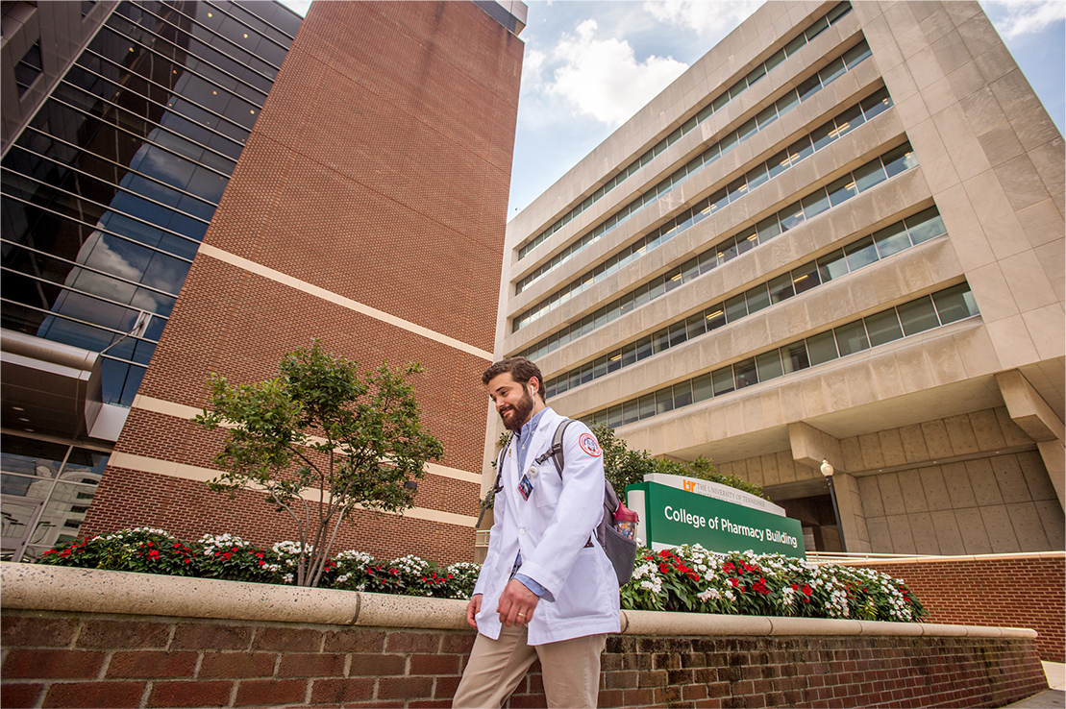
State Budget
• Very Strong Budget Year from State
• Specifics
- Operating Funds restored to UTHSC Budget as permanent Item
- 4% raise for on state portion of salary for faculty and staff
- Renovation of UTHSC Police Building
- Buildout of remaining floors Nash Research building
- Multiple Capital Maintenance Projects for campus funded
- GME State funded Primary care positions created
Specifics- Tuition (In general) frozen this year

Slide 4
Total Revenue Excludes Clinical
Sales & Svc
Sponsored Programs
Gifts
General Operating

Slide 5
In Person Campus

Slide 6
In Person Graduation
• Specifics (COVID Guidelines followed)
- Audiology Speech Pathology May 7
- Graduate Health Sciences May 10
- Pharmacy and Health Professions May 11
- Medicine- Nursing- Dentistry May 19

Slide 7
In Person Fall Semester
• On Campus Plan
Pending Shelby County and City of Memphis Guidelines
Clinical ---unchanged in person
• Specifics
- Vaccine Reporting required (University must report status to partner clinical facilities)
- Clinical Partner Vaccine Guidelines honored—Follow rules of partner institutions
- COVID vaccination encouraged
- Masking Guidelines
- Social Distancing
- Proposed guidelines to be announced post Shelby County/ Memphis City Policies

Slide 8
Facilities

Slide 9
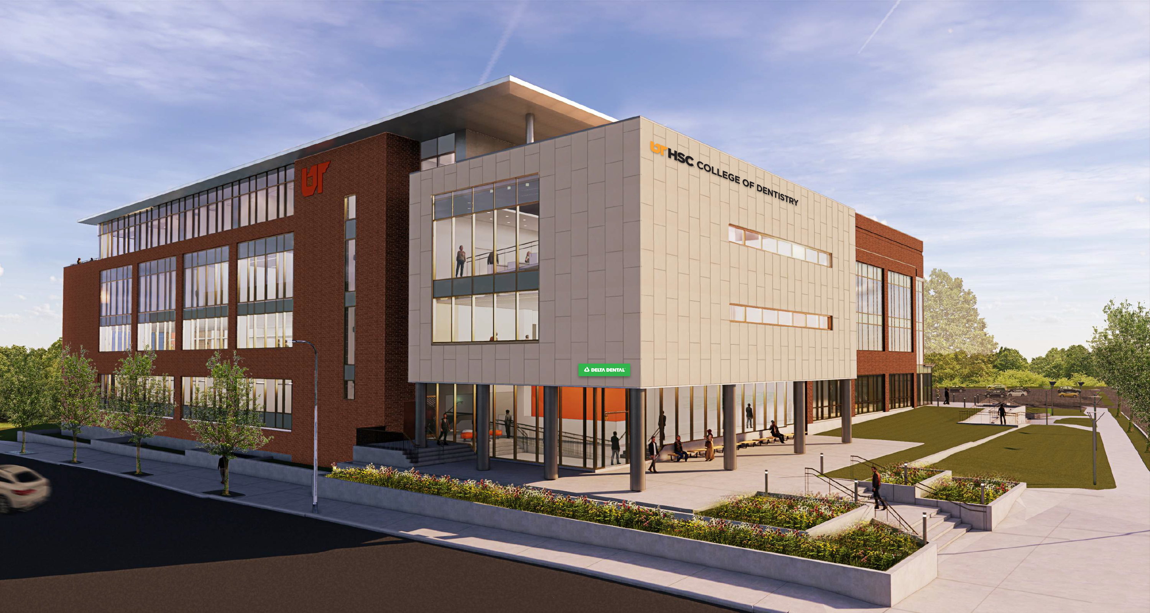
CAMPUS MASTER PLAN
College of Dentistry Building

Slide 10
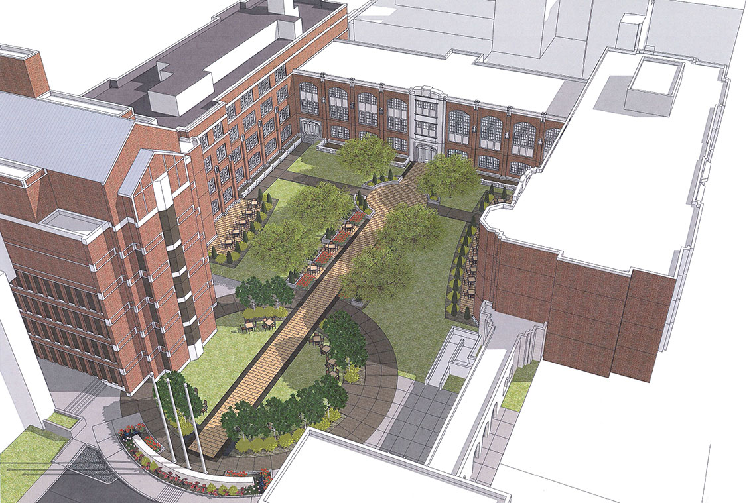
CAMPUS MASTER PLAN
Quadrangle Re-Build

Slide 11
Challenges next year
Facilities
• Speech Pathology and Audiology---Knoxville
Rural Dental D-4 Clinics
Mixed use development

Slide 12
Academic Programs

Slide 13
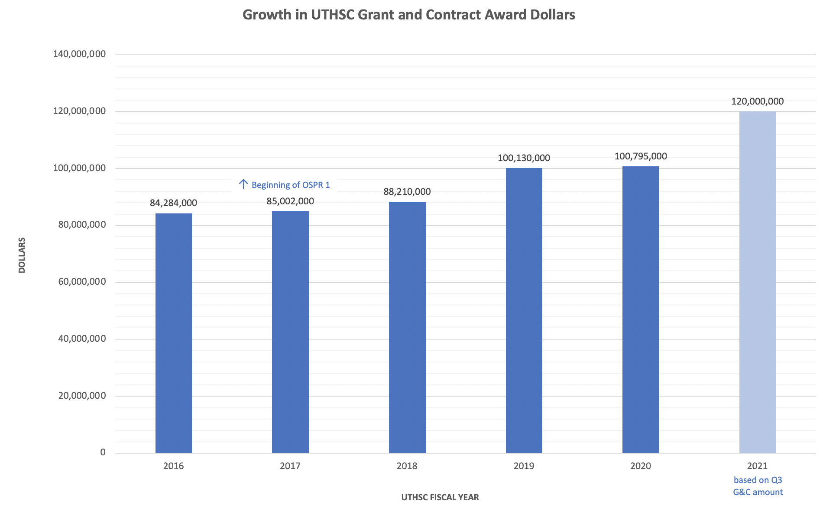

Slide 14
Challenges next year
Academic Programs
• On time graduation 2019-2020-2021 despite COVID
Graduation rate: 96% Graduate Programs… 95% total Programs
Ist attempt Board Pass Rate….. Stellar at 97% Overall
Medicine 100% step 1
Nursing BSN 100%
Residents and Fellows: Largest most diverse

Slide 15
Challenges next year
Academic Programs
• Nursing ---highly successful 1 yr (2nd degree) BSN program (2 classes yr)
----- 2 year traditional BSN restarting
Medicine---- Primary care 3 year accelerated program (Class size +10)
Pharmacy---- Accelerated 3 yr program (class size constant)
Dentistry ---Rural Dental D-4 Clinics---(Class expansion)
Health Professions--- New BS and other Doctoral programs

