Slide 1
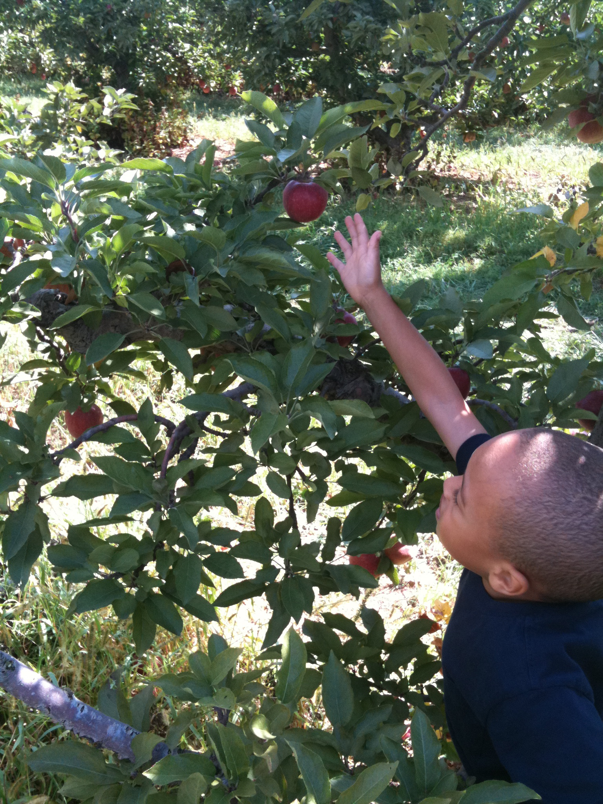
Getting Ahead: How Does Education Affect My Health?
Michelle Taylor, MD, MS
Saturday, December 8, 2012

Slide 2
Introduction
Why is health important?
Why is education important?
Do they work together?

Slide 3
Life Expectancy
The number of years a person expects to live
Did you know that life expectancy can be different based on where you live and what you look like?
On average, women live longer than men
Whites live longer than Blacks
People who earn more money in their lifetime live longer.....

Slide 4
Life Expectancy

Slide 5
Life Expectancy

Slide 6
Is Memphis Healthy?
Population: 652,050
26% <18 years old
63% Black
29% White
In 2010:
3.7% reported heart attacks
4.7% reported strokes
35% were obese and 35% were overweight

Slide 7
Is Memphis Healthy?
9th-12th grade students in Memphis reported:
21% rode with a driver who had been drinking
35% had been in a physical fight
32% tried cigarettes
62% ever had sex
50% ate vegetables less than one time per day!!!!!

Slide 8
Is Memphis Educated?
Between 2007 and 2011, of the people older than 25,
82% graduated from high school
23% had their Bachelor’s degree or higher
Memphis City Schools had a graduation rate of 70% in 2011
Where are the other 30%????????

Slide 9
What does this mean for YOU??

Slide 10
Education can save your life!!!!
In Shelby County, in 2011,
6,699 people were living with HIV or AIDS
People between the ages of 20 and 24 reported the highest rates!
The rate of diagnosis of HIV IS 8 TIMES HIGHER IN BLACKS!!

Slide 11
Conclusion
Education and health are definitely connected.
Finishing your education has benefits beyond getting a good job.
It’s never too late to improve your health through education!

Slide 12
References
cdc.gov
Census.gov
Shelby County Health Department

Slide 13
Stay educated to stay healthy!!
THANK YOU!!

