Slide 1
Budget Background and FY 2020 Budget Proposal

Slide 2
Definitions
Unrestricted Funds: (E-accounts) Funds provided to meet the primary educational mission of the university (sometimes referred to as Educational & General Funds)
Restricted Funds: (R-accounts) Funds provided to meet a designated purpose – research, scholarships, endowed chairs, etc.
General Operating Budget: Funding provided across campus to meet operational needs – referred to as ORANGE dollars.
Sources are from State Appropriations, Tuition & Fees, and F&A Revenue
F&A Revenue: indirect cost funding received from sponsors on grants
What’s the difference between Unrestricted and General Operating Budget?: Unrestricted Funds includes some self-supporting activities like continuing education, conferences and auxiliaries.

Slide 3
Definitions (cont.)
Campus General: Campus General represents campus-wide costs not allocated out to units –
Staff Benefit Cost (e.g., health, life, and retirement) – about $50 million
Debt Service Payments – about $6 million
UT Foundation, UT Research Foundation, and other assessments by the UT System Administration for services provided – about $8 million
Physician Practice Plans: Note that the HSC’s physician practice plan partnerships (ULPS, UTMP, UTROP, UCH, etc.) which had approximately $430 million in revenue in calendar year 2017 are EXCLUDED from all the financials we will review

Slide 4
Total Revenue

Slide 5
Total Revenue
 | FY 10 | FY 11 | FY 12 | FY 13 | FY 14 | FY 15 | FY 16 | FY 17 | FY 18 | FY 19 Budget
General Operating | $190.5 | $192.1 | $201.7 | $207.6 | $221.9 | $225.2 | $236.5 | $246.4 | $259.1 | $264.2
Gifts & Endow Income | 18.7 | 17.9 | 18.6 | 19.8 | 18.9 | 17.5 | 20.3 | 29.7 | 31.7 | 20.3
Sponsored Programs | 156.1 | 176.4 | 185.0 | 187.1 | 187.9 | 192.0 | 203.5 | 277.8 | 236.0 | 261.2
Sales & Service | 34.9 | 23.6 | 25.1 | 42.5 | 26.3 | 23.7 | 28.1 | 29.0 | 31.0 | 27.9
TOTAL Budget | $400.2 | $410.0 | $430.4 | $457.0 | $455.0 | $458.4 | $488.4 | $582.9 | $557.8 | $573.6
Sales & Svc
Sponsored Programs
Gifts
General Operating

Slide 6
Total Expenditures

Slide 7
Total Expenditures
 | FY 10 | FY 11 | FY 12 | FY 13 | FY 14 | FY 15 | FY 16 | FY 17 | FY 18 | FY 19 Budget
Colleges | $288.0 | $299.6 | $313.4 | $324.5 | $331.1 | $351.2 | $355.5 | $393.4 | $417.6 | $416.4
Divisions | 56.6 | 54.4 | 58.6 | 62.1 | 63.9 | 74.0 | 79.7 | 83.4 | 94.8 | 82.3
Campus General | 36.0 | 37.9 | 43.1 | 45.6 | 50.4 | 52.8 | 53.3 | 54.8 | 55.1 | 63.3
Debt Service | 3.6 | 4.3 | 4.2 | 2.8 | 3.4 | 4.5 | 6.5 | 6.3 | 6.2 | 6.2
Systems Chrg | 3.9 | 3.9 | 2.8 | 3.0 | 3.1 | 3.0 | 4.0 | 4.5 | 5.0 | 5.4
TOTAL Expenditures | $388.1 | $400.1 | $422.1 | $438.0 | $451.9 | $485.5 | $499.0 | $542.4 | $578.7 | $573.6
Campus General
Divisions
Colleges

Slide 8
Total General Operating

Slide 9
Total General Operating
 | FY 10 | FY 11 | FY 12 | FY 13 | FY 14 | FY 15 | FY 16 | FY 17 | FY 18 | FY 19 Budget
State Appropriations | $122.7 | $117.6 | $119.2 | $122.5 | $132.2 | $133.9 | $140.8 | $147.1 | $156.1 | $161.2
Tuition & Fees | 52.1 | 58.6 | 68.3 | 72.1 | 76.6 | 78.8 | 83.2 | 86.1 | 89.2 | 90.4
F&A Recoveries | 15.7 | 15.9 | 14.2 | 13.0 | 13.1 | 12.5 | 12.5 | 13.2 | 13.8 | 12.6
TOTAL General Operating | $190.5 | $192.1 | $201.7 | $207.6 | $221.9 | $225.2 | $236.5 | $246.4 | $259.1 | $264.2
F&A Recoveries
Tuition & Fees
State Appropriations

Slide 10
FY 2018 All Funds Expenditures

Slide 11
Expenditures by College / Division
FY 2018 FINAL |  |  | Unrestricted Funds | Restricted Funds | TOTAL ALL FUNDS
Colleges | Health Professions |  | $8,391,338 | $1,637,818 | $10,029,156
 | Dentistry |  | 27,548,771 | 1,888,446 | 29,437,217
 | Graduate Health Sciences |  | 2,114,314 | 379,302 | 2,493,616
 | Medicine
 |  | Memphis | 65,162,009 | 187,098,667 | 252,260,676
 |  | Chattanooga | 2,279,414 | 34,828,086 | 37,107,500
 |  | Knoxville | 14,650,175 | 38,001,197 | 52,651,372
 | Nursing |  | 8,846,769 | 383,724 | 9,230,493
 | Pharmacy |  | 15,350,982 | 8,920,279 | 24,271,261
Administration | Chancellor's Office |  | 742,100 | 241,910 | 984,010
 | Chief of Staff |  | 13,409,454 | 4,467,318 | 17,876,772
 | Academic, Faculty, & Student Affairs |  | 16,292,651 | 1,626,031 | 17,918,682
 | Facilities & Utilities |  | 32,102,705 | 0 | 32,102,705
 | Finance & Operations |  | 3,953,359 | 0 | 3,953,359
 | Information Tech Services |  | 8,778,265 | 0 | 8,778,265
 | Research |  | 12,413,800 | 796,944 | 13,210,744
 | Campus General Development & Alumni Aff |  | 63,103,491 3,108,095 | 133,820 0 | 63,237,311 3,108,095
 | TOTAL HSC |  | $298,247,692 | $280,403,542 | $578,651,234

Slide 12
FY 2020 Proposed Budget

Slide 13
Budget Recommendation Process
The as required by the UT Focus Act, the Board of Trustees has established a format for the recommendation of the Operating Budget.
One addition category is used – Auxiliary Funds
The HSC has limited auxiliary funds and includes them in the General Operating Budget figures shown earlier.
Auxiliary Services are general self-supporting activities such as housing and food service.
For the HSC, our primary auxiliary service is in Parking.

Slide 14
Operating Budget Recommendation Format
As shown earlier | Required Format
Subtotal: Unrestricted Funds (General Operating Funds) | Unrestricted Educational & General (E&G) Funds
 | Unrestricted Auxiliary Funds
 | Subtotal: Unrestricted Funds
Restricted Funds | Restricted Funds
Total Current Operating Funds | Total Current Operating Funds

Slide 15
Unrestricted General Funds Funding Increases
Salary Increase funding from the State -- $3,950,000
Tuition Increase – $451,200
Generally, a $200 increase on In-State rates
Also reduced out of state tuition for Pharmacy and the Graduate School, resulting in a reduction in the need for waivers – ($3,066,500)
Change in the management of the Family Medicine Program in Jackson – ($6,010,500)
Miscellaneous changes – $559,400

Slide 16
Proposed Budget Increments
2% Salary Increase -- $2,930,000
Set $15 / hour minimum salary -- $619,200
Library Acquisitions -- $451,200
Infrastructure Needs -- $389,600

Slide 17
Unrestricted E&G Funds
FY 2019 Unrestricted E&G Funds | $289,496,800
2% Salary Increase Set $15/hr min salary Library Acquisitions Infrastructure Needs Jackson Family Medicine Wavier Reduction Miscellaneous | $2,930,000 619,200 451,200 389,600 (6,010,500) (3,066,500) 559,400
FY 2020 Unrestricted E&G Funds | $285,380,500

Slide 18
Unrestricted Auxiliary and Restricted Funds
FY 2019 Unrestricted Auxiliary Funds | $2,316,100
Reduction in Print Shop | ($335,700)
FY 2020 Unrestricted Auxiliary Funds | $1,980,400
FY 2019 Restricted Funds | $281,777,500
Increase in Restricted Funds | $2,137,300
FY 2020 Restricted Funds | $283,935,800

Slide 19
FY 2020 Proposed Current Operating Budget
Fund Group | Revenues | Expenditures & Transfers
Unrestricted Educational & General (E&G) Funds | $285,380,500 | $285,380,500
Unrestricted Auxiliary Funds | 1,980,400 | 1,980,400
Subtotal: Unrestricted Funds | $287,360,900 | $287,360,900
Restricted Funds | 283,935,748 | 283,935,748
Total Current Operating Funds | $571,296,619 | $571,296,619

Slide 20
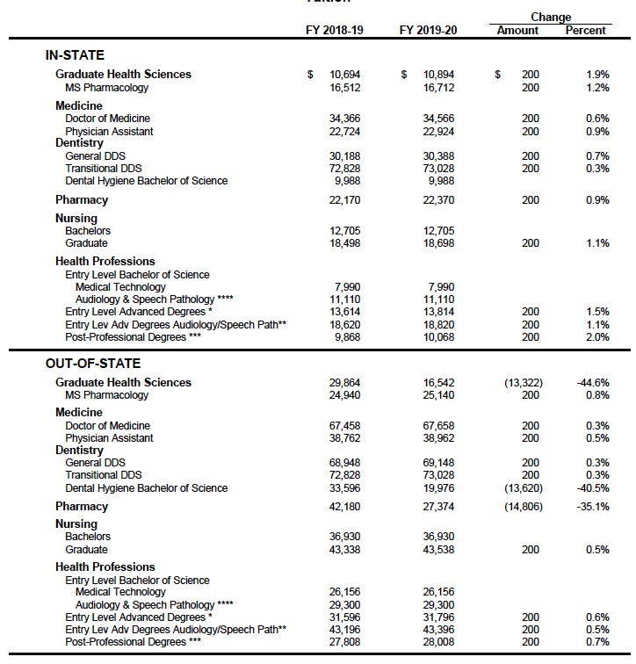
Board Approved Tuition Rates

Slide 21
Tuition & Fees (Required Format)
Maintenance Fees & Tuition | In-State Maintenance Fee |  | Out-of-State Tuition
College of Dentistry – DDS | $200 | 0.7% | $0 | 0.0%
College of Dentistry – Transitional DDS | $200 | 0.3% | $0 | 0.0%
College of Dentistry – Dental Hygiene (Undergraduate) | $0 | 0.0% | ($13,620) | -40.5%
College of Graduate Health Sciences -- PhD | $200 | 1.9% | ($13,322) | -44.6%
College of Graduate Health Sciences – Pharmacology MS | $200 | 1.2% | $0 | 0.0%
College of Health Professions – Bachelors | $0 | 0.0% | $0 | 0.0%
College of Health Professions – Advanced Degree | $200 | 1.5% | $0 | 0.0%
College of Health Professions – Audiology Advanced Degree | $200 | 1.1% | $0 | 0.0%
College of Health Professions – Post-Professional | $200 | 2.0% | $0 | 0.0%
College of Medicine – MD | $200 | 0.6% | $0 | 0.0%
College of Medicine – Physician Assistant | $200 | 0.9% | $0 | 0.0%
College of Nursing – Bachelors | $0 | 0.0 | $0 | 0.0%
College of Nursing – Graduate | $200 | 1.1% | $0 | 0.0%
College of Pharmacy – PharmD | $200 | 0.9% | ($14,806) | -35.1%

Slide 22
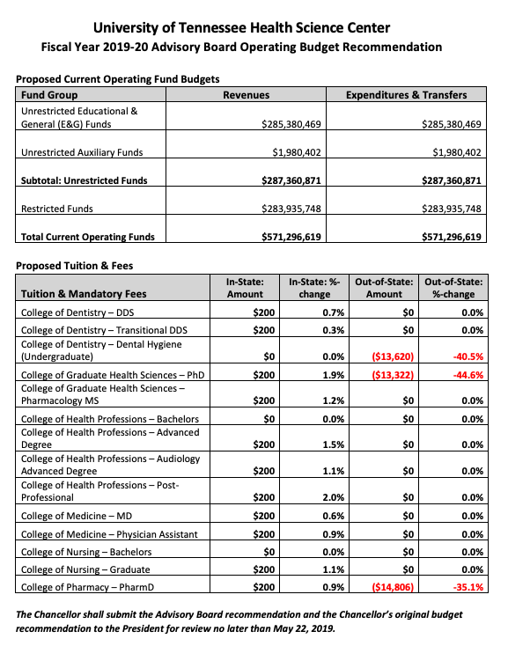
Board Approved Budget Recommendation Format

