Slide 1


THE UNIVERSITY OF TENNESSEE
HEALTH SCIENCE CENTER
ADVISORY BOARD
May 20, 2019

Slide 2
Current Program Enrollments 2018-19
Audiology and Speech Pathology
  BS in Audiology & Speech Pathology
  Doctor of Audiology (AuD)
  MS Speech Pathology
2. Clinical Laboratory Sciences
  MS Cytopathology Practice
  MS Medical Laboratory Sciences
  BS Medical Laboratory Science
  MS Clinical Laboratory Science
Health Informatics and Information Management
  MS Health Informatics and Information Management
Occupational Therapy
  MOT- Master of Occupational Therapy
5. Physical Therapy
  Doctor of Physical Therapy (OTD)
- 91
52
99
(242)
- 7
18
16
8
(49)
- 58
- 77
- 178

Slide 4
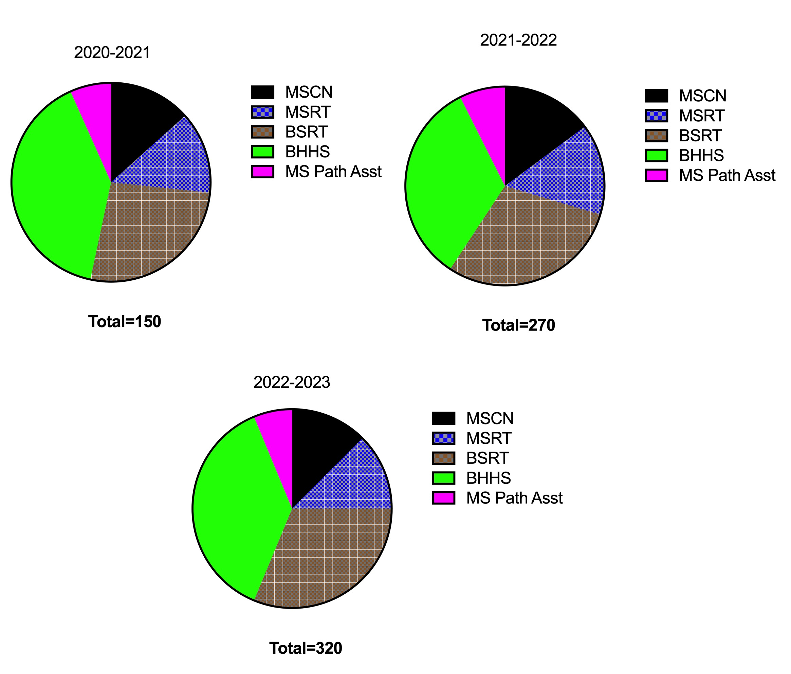
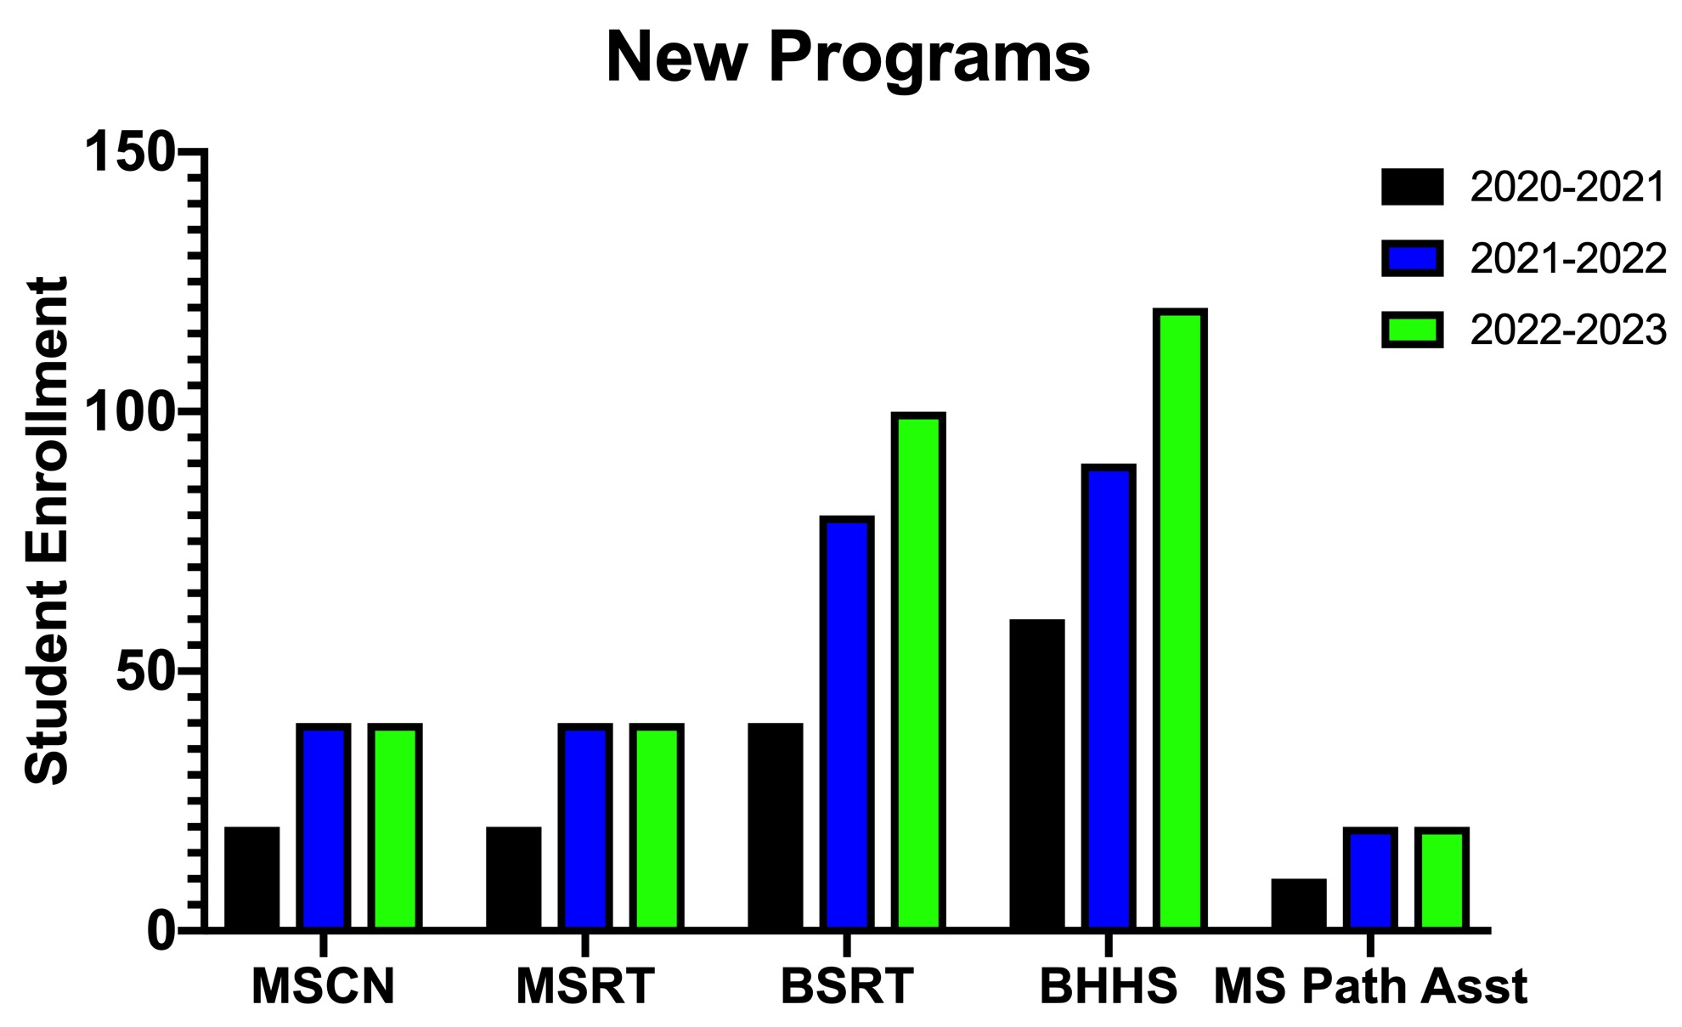
NEW PROGRAMS BEGINNING 2021
120
100
80
90
60
40
40
40
40
40
20
20
20
20
10

Slide 5
1060
990
840
740
659
690
720
659
320
270
150
0

