Slide 1

College of Graduate
Health Sciences Overview
Research training arm of UTHSC
11 Ph.D. and M.S. programs
~320 students
~140 Postdoctoral Fellows
~560 credentialed faculty
Three departments

Slide 2
College of Graduate Health Sciences Incoming Class (preliminary)
Still filling some degree program slots. Thus far:
Applications increased by 13% over last year
On-track to have ~5% increase in enrollment this year
51% from TN and surrounding states
45% White, 20% African-American, 35% Asian
19% first-in-family, 17% economically disadvantaged

Slide 3
College of Graduate
Health Sciences Key Metrics
Top quartile of biomedical sciences programs in U.S.
#7 Top-value M.S. degree program in U.S. in Pharmacology
94% On-time completion rate for Ph.D.
93% On-time completion rate for M.S.
2.2 year completion time for postdoctoral Fellows

Slide 4
UTHSC College of Graduate Health Sciences
Strategic Map: 2015-2020
Promote Education and
Research Training to Advance
the Health Sciences through
Scientific Discovery
Approved:
Graduate Studies
Council 04/21/15
A
B
C
D
Recruit, Educate
and Graduate Suc-
-cessful Scientists
And Research
Professionals
Enhance the
Impact of
Research
Develop
Productive and
Effective Faculty
and Post-Docs
Ensure Sufficient
Resources to
Meet Strategic
Priorities
Enhance the
Pool of Qualified,
Committed, and
Diverse Applicants
Create an Institutional
Repository that
Fosters the Sharing
of Research and Tools
Foster and Reward
Excellence in
Teaching and
Mentoring
Actively Engage
in UTHSC Faculty
Recruitment and
Retention
1
Improve the
Efficiency and
Effectiveness of the
Application Process
Increase Trainee
Presentations in Local,
Regional, National and
International Meetings
Develop Effective
Career Mentors
and Advisors
Recruit
and Retain
Qualified and
Diverse Staff
2
Provide Research
Experiences that
Enhance Recruitment
Increase
Collaboration
Opportunities for
CGHS Researchers
Develop
Grantsmanship
Engage UTHSC
Development and
Alumni Offices
3
Provide Career and
Essential Skill
Development on a
Path to Independence
Promote
Entrepreneurship
Opportunities for
Trainees and Faculty
Foster Interprofessional
and Interdisciplinary
Collaboration across
Diverse Programs
Secure Institutional
and Extramural
Investment
4
Expand Students’/
Advisors’ Awareness
of and Access
to Course Offerings
Increase
Development
of Translational
Research
Provide Professional
Skills and Career
Development
5
Increase
Community
Awareness of
CGHS Research
Enhance
the Post-Doc
Applicant Pool
6
E
Nurture a Healthy, Ethical, and Respectful Culture in the Conduct of Research
F
Expand the Value and Visibility of the College to UTHSC and the Community
G
Embed Interprofessional and Interdisciplinary
Education and Research in the Work of the College

Slide 5
UTHSC College of Graduate Health Sciences
Strategic Map: Accomplishments 2015-2018
Promote Education and
Research Training to Advance
the Health Sciences through
Scientific Discovery
Approved:
Graduate Studies
Council 04/21/15
A
B
C
D
Recruit, Educate
and Graduate Suc-
-cessful Scientists
And Research
Professionals
Enhance the
Impact of
Research
Develop
Productive and
Effective Faculty
and Post-Docs
Ensure Sufficient
Resources to
Meet Strategic
Priorities
Enhance the
Pool of Qualified,
Committed, and
Diverse Applicants
Create an Institutional
Repository that
Fosters the Sharing
of Research and Tools
Foster and Reward
Excellence in
Teaching and
Mentoring
Actively Engage
in UTHSC Faculty
Recruitment and
Retention
1
Improve the
Efficiency and
Effectiveness of the
Application Process
Increase Trainee
Presentations in Local,
Regional, National and
International Meetings
Develop Effective
Career Mentors
and Advisors
Recruit
and Retain
Qualified and
Diverse Staff
2
Provide Research
Experiences that
Enhance Recruitment
Increase
Collaboration
Opportunities for
CGHS Researchers
Develop
Grantsmanship
Engage UTHSC
Development and
Alumni Offices
3
Provide Career and
Essential Skill
Development on a
Path to Independence
Promote
Entrepreneurship
Opportunities for
Trainees and Faculty
Foster Interprofessional
and Interdisciplinary
Collaboration across
Diverse Programs
Secure Institutional
and Extramural
Investment
4
Expand Students’/
Advisors’ Awareness
of and Access
to Course Offerings
Increase
Development
of Translational
Research
Provide Professional
Skills and Career
Development
5
Increase
Community
Awareness of
CGHS Research
Enhance
the Post-Doc
Applicant Pool
6
E
Nurture a Healthy, Ethical, and Respectful Culture in the Conduct of Research
F
Expand the Value and Visibility of the College to UTHSC and the Community
G
Embed Interprofessional and Interdisciplinary
Education and Research in the Work of the College
Notes:
Mentor academy

Slide 6
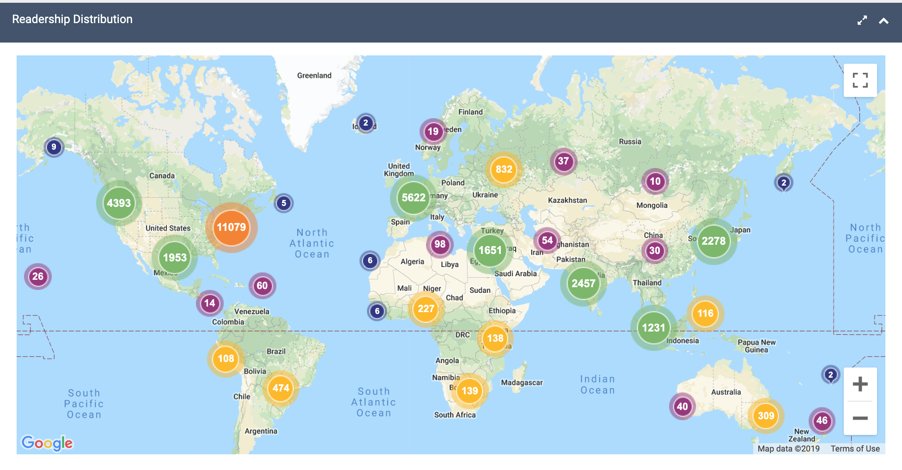
Strategic Objectives 2015-2018
Significantly Accomplished
Improve the Efficiency and Effectiveness of the Application Process - Implemented the Liaison UniCAS system
Create an Institutional Repository that Fosters the Sharing of Research and Tools – Collaborated with the library to place ETDs and other materials on Digital Commons

Slide 7
Strategic Objectives 2015-2018
Well Underway
Enhance the Pool of Qualified, Committed, and Diverse Applicants – Summer Research Scholars Program, targeted recruiting, CRM module, program expansion
Provide Career and Essential Skill Development on a Path to Independence
Provide Professional Skills and Career Development – Lunch ‘n Learn series, career development seminars, SciPhD boot camp, 3-Minute Thesis Competition

Slide 8
Strategic Objectives 2015-2018
Nascent
Foster and Reward Excellence in Teaching and Mentoring – Mentoring Academy, faculty awards
Develop Effective Career Mentors and Advisors – SciPhD boot camp for mentors

Slide 9
UTHSC College of Graduate Health Sciences
Strategic Map: Priorities 2018-2020
Promote Education and
Research Training to Advance
the Health Sciences through
Scientific Discovery
Approved:
Graduate Studies
Council 04/21/15
A
B
C
D
Recruit, Educate
and Graduate Suc-
-cessful Scientists
And Research
Professionals
Enhance the
Impact of
Research
Develop
Productive and
Effective Faculty
and Post-Docs
Ensure Sufficient
Resources to
Meet Strategic
Priorities
Enhance the
Pool of Qualified,
Committed, and
Diverse Applicants
Create an Institutional
Repository that
Fosters the Sharing
of Research and Tools
Foster and Reward
Excellence in
Teaching and
Mentoring
Actively Engage
in UTHSC Faculty
Recruitment and
Retention
1
Improve the
Efficiency and
Effectiveness of the
Application Process
Increase Trainee
Presentations in Local,
Regional, National and
International Meetings
Develop Effective
Career Mentors
and Advisors
Recruit
and Retain
Qualified and
Diverse Staff
2
Provide Research
Experiences that
Enhance Recruitment
Increase
Collaboration
Opportunities for
CGHS Researchers
Develop
Grantsmanship
Engage UTHSC
Development and
Alumni Offices
3
Provide Career and
Essential Skill
Development on a
Path to Independence
Promote
Entrepreneurship
Opportunities for
Trainees and Faculty
Foster Interprofessional
and Interdisciplinary
Collaboration across
Diverse Programs
Secure Institutional
and Extramural
Investment
4
Expand Students’/
Advisors’ Awareness
of and Access
to Course Offerings
Increase
Development
of Translational
Research
Provide Professional
Skills and Career
Development
5
Increase
Community
Awareness of
CGHS Research
Enhance
the Post-Doc
Applicant Pool
6
E
Nurture a Healthy, Ethical, and Respectful Culture in the Conduct of Research
F
Expand the Value and Visibility of the College to UTHSC and the Community
G
Embed Interprofessional and Interdisciplinary
Education and Research in the Work of the College
Notes:
Recruiting, travel award req loosening, grant submission incentives - OCEAN

Slide 10
Strategic Objectives 2018-2020
Continued emphasis
Enhance the Pool of Qualified, Committed, and Diverse Applicants
Provide Career and Essential Skill Development on a Path to Independence
Provide Professional Skills and Career Development
Foster and Reward Excellence in Teaching and Mentoring
Develop Effective Career Mentors and Advisors

Slide 11
Strategic Objectives 2018-2020
Nascent
Increase Trainee Presentations in Local, Regional, National, and International Meetings - Travel awards, announcements, 3-MT
Promote Entrepreneurship Opportunities for Trainees and Faculty – Formal coursework, seminar series and workshops
Develop Grantsmanship – Submission and award incentives, Hanover Research contract
Actively Engage in Faculty Recruitment and Retention – Messaging to colleges and departments
Engage UTHSC Development and Alumni Offices – Bi-weekly meetings, Advisory Board

Slide 12
Thank You!

