Slide 1
Strategies For Self-Care: Stress Management
UTHSC College of Nursing & the Office of student Academic Support Services & Inclusion (SASSI)
Notes:
Thank you for viewing our presentation on stress management.
This presentation is a collaboration between the College of Nursing and the Office Of Student Academic Support Services and Inclusion also known as SASSI.

Slide 2
Aims and Objectives
Aim
To provide BSN students with strategies and resources to support their stress management in nursing school
Objectives
Recognize the negative impact of stress
Identify stress management strategies
Practice stress management prior to the academic year
Identify campus resources to incorporate in the fall
Notes:
This recording will provide BSN students with strategies and resources to support their stress management throughout nursing school and perhaps as the enter their respective areas of practice.
It will also assist students with identifying their current levels of stress and stress management, fine tune those or implement new ones. This recording will assist students with becoming knowledgeable about campus resources that support stress management and that can be accessed during the academic year.

Slide 3
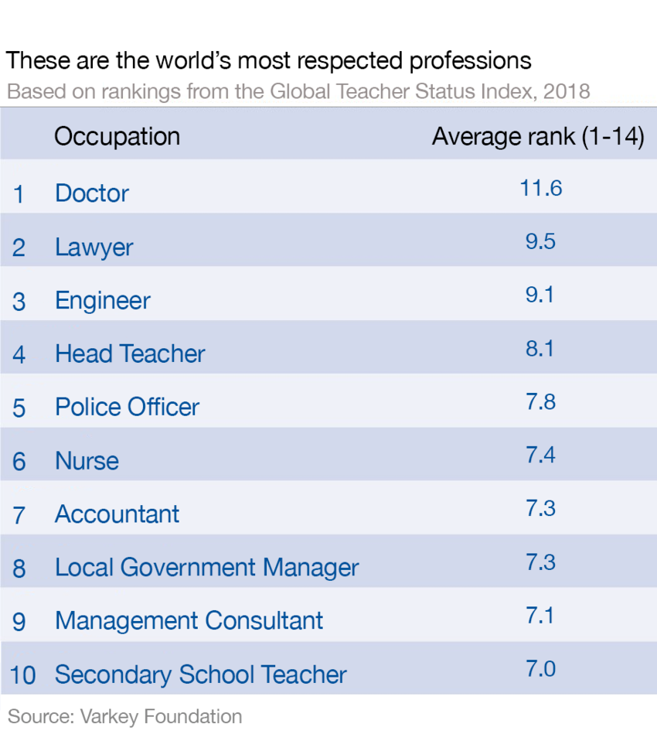
Nursing
Notes:
Congratulations on being accepted into nursing school.
The World Economic Forum lists nursing as one of the world’s most respected professions.

Slide 4
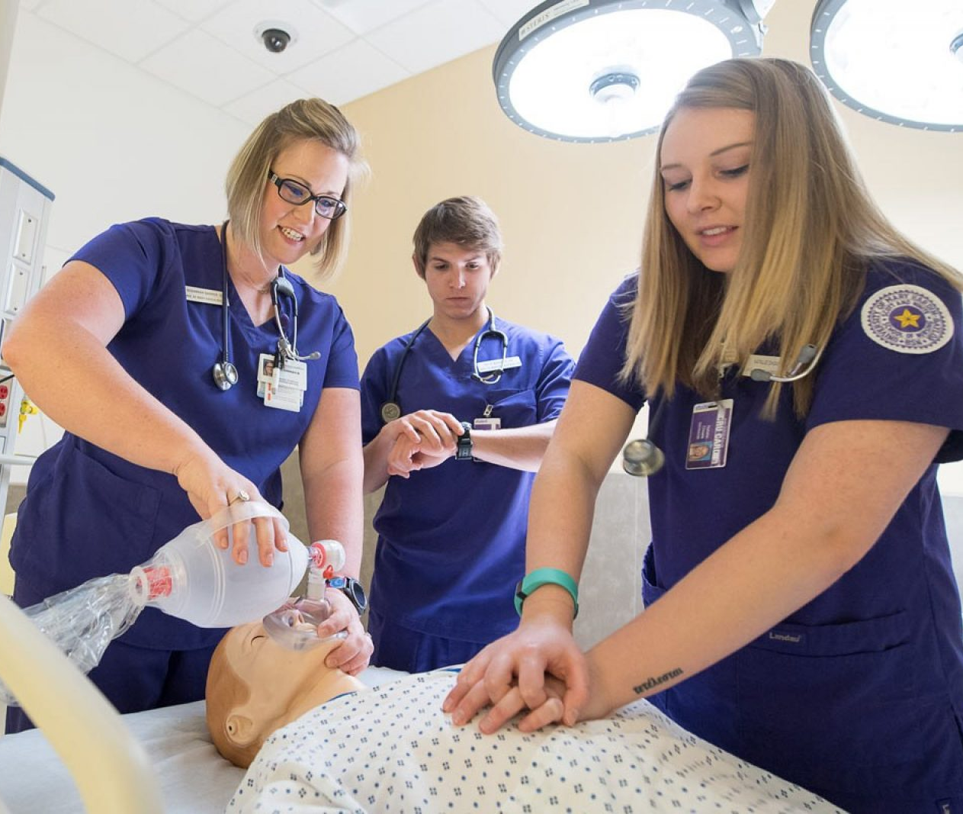
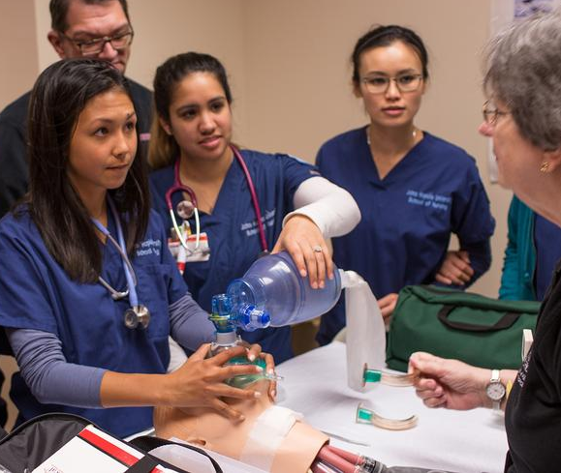
Notes:
As you may know or imagine, the day to day life a of nurse in practice can be quite demanding and stressful. The same can also be said for nursing school.

Slide 5
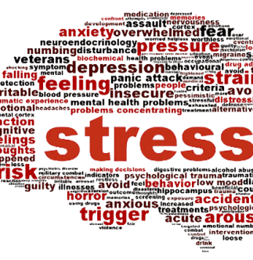
Notes:
Research shows that stress can significantly impact our body, brain, behavior, and cognition. Our cognition involves our thinking, memory, problem solving and learning. Each of these areas impacts our academic performance and success.

Slide 6
Notes:
Stress can lead to poor physical and mental health and as well as burn out. Again, these are areas that will impact our academic performance and success.

Slide 7
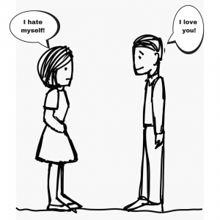
Notes:
Additionally, stress can have a significant negative effect on our relationship with self and others.
These are just some of the reasons we want to start talking about stress management early and encourage our students to take a proactive approach to its management.

Slide 8
Notes:
Many of you viewing this presentation may already have plans for or even engage in activities that reduce your stress. If what you’re doing has worked for you in the past, keep doing it when you initially begin the program. However, we encourage you to reflect periodically. Ask yourself, what are am I doing to manage my stress? Is what I’m doing working? If the answer is yes, what is your evidence? If there is no evidence or the answer is no, what are you willing to do to get the results you want? That something may be reaching out and utilizing our campus resources.

Slide 9
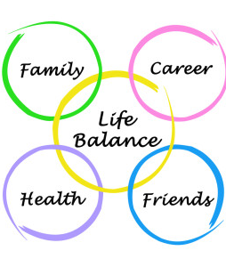
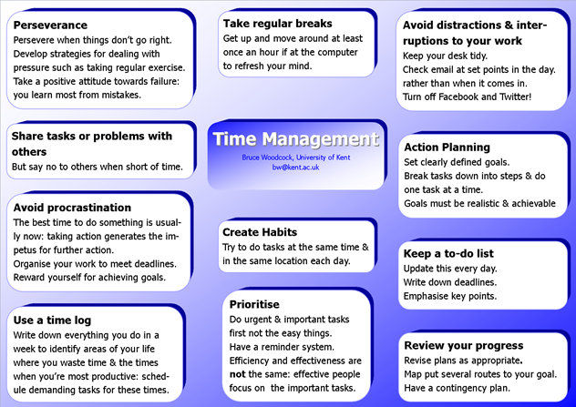
Notes:
Our goal is to encourage you to take a proactive approach to stress management as well as share additional strategies that students have found valuable and that you may consider.
First on the list is time management. Effective time management is key to stress management. I encourage you to listen to our recording on time management. In general, time management includes setting goals, prioritizing and balancing everything that has to be done. It allows us to achieve the work-life balance that we need to maintain our physical and mental wellbeing.
Work-life balance includes time for academics and professional pursuits as well as time for self, others, and the things we enjoy. Oftentimes students underestimate the value of family, friends, pets, and breaks. Those breaks even include the responsible use of social media and video streaming services like Netflix and Hula. These are all central parts of our academic success and performance.

Slide 10
Notes:
As mentioned in the previous slide, stress management entails managing your mental and physical health.
Managing your mental and physical health requires proper nutrition, sleep, relaxation, exercise, time with self, and time with others.
All of this can be achieved through effective time management.
I’ve mentioned time management several times now to reiterate its importance in nursing school and nursing practice. If this is an area in which you need assistance, please contact us.

Slide 11
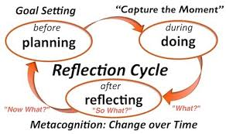
What can I do now? Practice Makes Perfect
Reflect on your stress and stress management
Identify at least 2 stress management goals
Identify at least 1 stress management strategies
Try it out
Reflect
Modify as needed
Notes:
So what can you do now before the semester starts?
One thing is to start thinking about what you already have in place or even what you think you might need or want to do. Start trying it out. It could be exercising or meditating. Start slowly. You may a few minutes, see how you feel, and modify as you go. You may also find a meditation video on YouTube.
If it’s not for you, try something else. JUST DON’T GIVE UP!

Slide 12
What can I do now? Speak to someone
College of Nursing Learning navigator
SASSI (Student Academic Support Services & Inclusion)
Missy Robinson, MAT
https://www.uthsc.edu/nursing/success.php
920 Madison, Room 928
(901) 448-3080
mrobins6@uthsc.edu
Educational Specialists
Counselors
http://www.uthsc.edu/sassi/staff.php
http://www.uthsc.edu/sassi/
(901) 448-5056
sassi@uthsc.edu
Notes:
We want you to reach out!
The College of Nursing Learning Navigator, SASSI educational specialists, and SASSI counselors are available and can start building a relationship with you.
Oftentimes, when incoming students here academic support, they think remediation. I assure you this is not the case. Our services not remedial at all. That’s not what you need at this level. Students tell us what they need is someone to assist them with taking what they’re they’ve done in the past and assist them with taking it to the next level so that they can be successful in this environment. That’s what we’re here to do.
Therefore, there is no stigma associated with talking to someone or utilizing the learning navigator and SASSI services which are at no cost to you. The services are also confidential.
The learning navigator and educational specialists can assist you with time management, learning, study, and reading strategies, and also stress management.
SASSI counselors provide individual, family, and group counseling sessions. Group counseling is available one night each week.

Slide 13
What can I do now: preview resources
Peruse the UTHSC website beginning with student resources
https://www.uthsc.edu/students/index.php
Notes:
I encourage you to take a look at the student page on the UTHSC website to see what’s available and what captures your interest. Doing this will help familiarize you with campus services and decrease the added stress that the lack of familiarity can bring.
Students say that looking through the website and services helps them feel prepared and less anxious about accessing those services.

Slide 14
In the Fall: Campus Resources to Support Mental & Physical Hygiene
Mind Body and Wellness Center (Launching fall 2019)
https://news.uthsc.edu/announcements/mind-body-and-wellness-center/
Yoga, Pilates, meditation studios, and a Zen lounge
Campus Rec Center
Group fitness
Intramurals
Individual fitness activities
SASSI
Counselors (also available through University Health Services)
Massage chairs
Special events
Break for boards
Break for finals
Student Life
Back to school events
Ice cream socials
Notes:
So where on campus can you go to get the assistance you need to support your mental and physical well-being?
This fall, the Mind Body and Wellness Center will open on the 3rd floor of the SAC. Ms. Kimberlee Strome, the director, will offer yoga, pilates, meditation, and a Zen lounge for students.
Additionally, the campus rec center is available to provide students with individual, group, and intramural fitness opportunities.
SASSI provides counseling free of charge, educational specialist who provide educational coaching, disability services, and success strategies.
SASSI also has three massage chairs. SASSI also co-sponsors special events throughout the year with the Office of Student Life. That’s free food and free activities.
Information about campus rec, SASSI, student life, university health and other offices relevant to your academic success can be found on the student page of the uthsc website or by calling each respective office.

Slide 15
REACH OUT! Reach out Early!
https://www.uthsc.edu/sassi/care-navigator.php
careteam@uthsc.edu
Yourself
Others
After hours
#TakeCare after hours line: 901.690.CARE
Confidential submission form
https://pavesuite.com/UTHSC/PublicPortal/CustomIncidentReport?code=concern
Notes:
We know that students’ overall wellbeing is crucial to their academic and professional success. We also know that this success does not happen in isolation. We need each other.
If you or a peer are in distress, please reach out to the campus Care Navigator, Rachel Bolick. Rachel is a licensed social worker who can connect you with campus and community resources to assist with a variety of needs ranging from food insecurity, suicide prevention, to domestic violence. You are not in this alone.

Slide 16
Nurses: Creating a culture of Caring: It begins with Us
Notes:
Remember that nurses are instrumental in creating a culture of caring. That culture begins with caring for ourselves. We can’t effectively care for others if we’re not caring for ourselves.

Slide 17
Self-Care for Nurses: additional resources
Blum, C. (2014 September 30) Practicing self-care for nurses: A nursing program initiative. The Online Journal of Issues in Nursing, 19(3). Retrieved from http://ojin.nursingworld.org/MainMenuCategories/ANAMarketplace/ANAPeriodicals/OJIN/TableofContents/Vol-19-2014/No3-Sept-2014/Practicing-Self-Care-for-Nurses.html
American Nurses Association. (2017). Executive summary: American Nurses Association health risk appraisal. Retrieved from https://www.nursingworld.org/~4aeeeb/globalassets/practiceandpolicy/work-environment/health--safety/ana-healthriskappraisalsummary_2013-2016.pdf
Notes:
These are additional resources related to nursing self-care that you may consider viewing.

Slide 18
Additional Questions or Comments
Missy Robinson, MAT
College of Nursing Learning Navigator
mrobins6@uthsc.edu
(901) 448-3080
Keri Snyder
SASSI Educational Specialist
ksnyde21@uthsc.edu
(901) 448-7745
Notes:
If you would like to schedule a time to talk about stress management, time management, or if you have questions in general, please feel free to contact myself, the learning navigator, or Keri Snyder, one of the educational specialist in SASSI who works closely with the College of Nursing.
We look forward to seeing and working with you in the fall.

