Slide 1
Financial Aid & Financial Literacy for The University of Tennessee Health Science Center College of Medicine
Christopher M. Pollard, M.S.
Financial Literacy Coordinator/
Financial Aid Counselor for the College of Medicine

Slide 2
Financial Aid at UTHSC
How do I apply for financial aid?
Step One: Apply for a PIN code: www.pin.ed.gov
Step Two: Complete the Free Application for Federal Student Aid
Complete the FAFSA at www.fafsa.gov (School Code: 006725) each year by March 15th for timely processing.
Use the IRS Data Retrieval Tool to minimize error and federal verification)
Step Three: Provide additional information if requested
If you are selected for Verification, you must complete the verification process before any awards will be finalized. Our office will contact you about submitting additional required documents. The Financial Aid Office will submit any and all changes required as a result of Verification.

Slide 3
Financial Aid at UTHSC
Applying for Financial Aid at UTHSC
Step Four: Review Your Award Offer
Go to www.uthsc.edu
Click on the Banner link
Click on the Financial Aid tab
Click on the Financial Aid Status link
Click on the Award link
Click on the Terms and Conditions tab
You will then need to review the Terms and Conditions of your financial aid and click the accept button on that page. Once you do so, this requirement will be satisfied.

Slide 4
Types of Financial Aid for College of Medicine Students
Scholarship (College of Medicine)
Federal Work Study (no slide)
Stafford Loan – Unsubsidized
Perkins Loan
Title VII Funds
Graduate PLUS Loan

Slide 5
Scholarships
Incoming Merit Scholarships
Matriculated Merit Scholarships
Non-Medical Student Scholarship Opportunities
https://www.uthsc.edu/Medicine/students/policies/scholarships.php

Slide 6
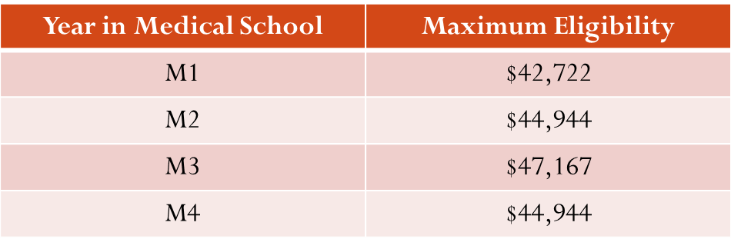
Federal Direct Unsubsidized Stafford Loan
Direct Unsubsidized Loans are available to College of Medicine students; there is no requirement to demonstrate financial need.
You are responsible for paying the interest on a Direct Unsubsidized Loan during all periods.
If you choose not to pay the interest while you are in school and during grace periods and deferment or forbearance periods, your interest will accrue (accumulate) and be capitalized (that is, your interest will be added to the principal amount of your loan).
Payments begin six months after graduation (Residency Forbearance)
6.21% Interest
Aggregate Limit is $224,000

Slide 7
Perkins Loan
Available to students with exceptional financial need.
Interest rate for this loan is 5%
No payments while in school
Payments begin nine months after graduation
Based on financial need and availability of funds
$4,000 per aid year ($2000 per semester)

Slide 8
Title VII Funding
Loans for Disadvantaged Students (LDS)
The Loan for Disadvantaged Students Program is a long-term, low-interest (5 percent) loan to assist students who are undertaking the course of study in Medicine. These loans are made by the University from funds provided by the federal government. The amount of the loan is based on the student's need and availability of funds. Eligibility and award amounts are determined by the Financial Aid Office.
Parent information must be entered into FAFSA for consideration of Title VII funding.
LDS requires parents' contribution for all students without regard to age, tax, marital or independent status.
http://bhpr.hrsa.gov/scholarshipsloans/tools/guidelines/lds.pdf

Slide 9
Title VII Funds Eligibility Requirements
An individual from a disadvantaged background is defined as someone who:
comes from an environment that has inhibited the individual from obtaining the knowledge, skill and abilities required to enroll in and graduate from a school; or
comes from a family with an annual income below a level based on low-income thresholds according to family size published by the U.S. Bureau of the Census, adjusted annually for changes in the Consumer Price Index, and adjusted by the Secretary of Health and Human Services for adaptation to this program.

Slide 10
Graduate PLUS Loan
PLUS loans are federal loans that graduate or professional degree students can use to help pay education expenses.
The maximum loan amount is the student’s cost of attendance minus any other aid received.
The borrower must not have adverse credit history (may require an endorser/co-signer to be approved)
Interest rate for this loan is 7.21%
No payments while in school (in school deferment)
Payments begin six months after graduation (Residency Forbearance)
Students are not initially awarded up to your cost-of-attendance in Graduate PLUS Loan funds. You must apply and completed the ADLRF.
Apply online at: www.studentloans.gov

Slide 11
Additional Loan Funds Request Form

Slide 12
2014-2015 In-State Cost of Attendance ESTIMATE
Tuition $33,030
Fees $3,447
Books and Supplies $3,825
Living Expenses $19,380
Total $59,682

Slide 13
2014-2015 Out-of-State Cost of Attendance ESTIMATE
Tuition $65,460
Fees $3,447
Books and Supplies $3,825
Living Expenses $19,380
Total $92,112

Slide 14
Excess Financial Aid Estimate (Refund)
In-state
$59,632 Total Aid
-$36,477 Tuition & Fees
$23,155 Excess Aid
-$3,825 Books & Supplies
Out-of-state
$92,112 Total Aid
-$68,907Tuition & Fees
$23,205 Excess Aid
-$3,825 Books & Supplies
$9,665 per semester
$1,933 per month for living expenses
(Monthly Savings → Checking Transfer)
$9,690 per semester
$1,938 per month for living expenses
(Monthly Savings → Checking Transfer)

Slide 15
F.L.I.G.H.T. Financial Literacy Information for Graduate/Professional Health Science Students of Today
The Financial Literacy Information for Graduate/Professional Health Science Students of Today (F.L.I.G.H.T.) program is designed to educate students for their journey by providing financial literacy and debt management resources. F.L.I.G.H.T. is the ability to understand money, to initiate clear informed financial decisions to save, manage and better protect their finances. UTHSC Financial Aid Office is committed to helping students develop healthy financial habits during and after school...Take F.L.I.G.H.T.

Slide 16
GOLD STANDARD
Go for the Gold! Be proactive with your Personal Finance and follow the Gold Standard
Create a personal budget/spending limitations
Creating an account with your student loan servicer
Knowing your total loan amount and estimated standard and extended monthly payments
Understanding the Federal Public Service Loan Forgiveness Program
Understanding income base repayment plans
Attending at least one FLIGHT presentation each school year
Reading an article related to personal finance every week (newsletter)
Pulling a copy of your credit report each school year at www.annualcreditreport.com
Filing your FAFSA by March 15th each school year
Liking the FLIGHT Facebook page

Slide 17
Financial Literacy Overview
Part I – Personal Finances
Budgeting
Banking
Keep Records
Credit
Part II –Student Loan Borrowing
Master Promissory Note
National Student Loan Database System
Federal Loan Servicers
Loan Repayment Options
Postpone Payment
Loan Exit Counseling

Slide 19
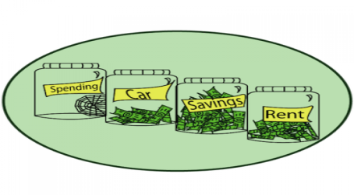
Budgeting
A budget is a plan for your future income and expenditures that you can use as a guideline for spending and saving. Although many Americans already use a budget to plan their spending, the majority of Americans also routinely spend more than they can afford. The key to spending within your means is to know your expenses and to spend less than you make. A good monthly budget can help ensure you pay your bills on time, have funds to cover unexpected emergencies, and reach your financial goals.
Establishing a budget and sticking to it isn’t easy, but it’s the best way to be in control of your finances and make sure your money is going toward the expenses that matter most to you.

Slide 20
Questions to the students…..
What are some of your practices that you have found works when it comes to restricting your spending?
How do you proactively monitor your spending?

Slide 21
Creating A Budget
First, document all of your incoming funds. If you are married, calculate your spouses income as well. Any incoming funds, such as your refund check from financial aid, should be included in your income calculations.
Secondly, identify all of your monthly expenses or monies that are outgoing. Classify your expenses as either fixed or variable. See examples…
Expenses
Fixed | Variable
Rent | Groceries
Car Payment | Entertainment
Insurance | Clothing
Student loan payment | Dining Out
 | Credit Cards (debt)

Slide 22
Budgeting (continued)
Lastly, once all income and expenses have been honestly accounted for and properly subtracted, the remaining number is your bottom line, also known as discretionary income. If you’re being completely honest in your planning, you may find that your discretionary income is a negative number. If so, go back and adjust accordingly until you break even.
TIP: Choose to live like a student when you are a student, so you don’t have to live like a student later.

Slide 23
Banking
Managing your bank accounts, whether savings or checking, by reconciling them to your bank records is a responsibility – and one of the best money management habits you can keep.
Types of Accounts include
Student Checking Account w/ Debit Card (checks needed for expenses)
Savings Accounts – Deposit student financial aid refunds
**Transferring funds between accounts, you can reduce utilizing all your funds before the semester is over.

Slide 24
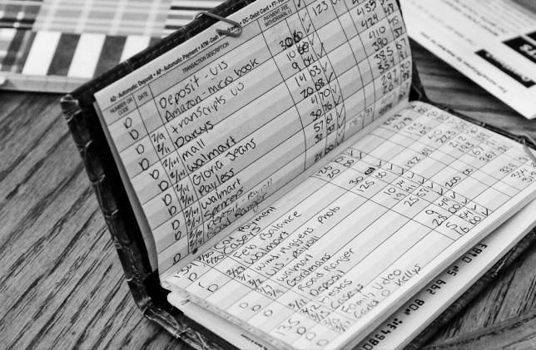
Record Keeping
Even if you have online banking access, you should keep your own records of account activity.
Using a checkbook register (or bank book), you should keep track of all additions in your accounts (direct deposit of wages/ refunds etc.)
Log withdrawals from your accounts (purchases on a debit card, automatic bill payments, ATM withdrawals, transfers, etc.)

Slide 25
Credit
Your Credit Scores – It Matters!!!!!
Payment history – 35%
(Accounts paid on time)
Amount owed – 30%
(# of accounts w/ balances)
Length of credit history – 15%
(The lengthier the better)
New Credit – 10%
Types of credit used – 10%
(Variety is better)

Slide 26
Impact of Bad Credit
The 10 Side Effects of Bad Credit (credit.about.com)
High Interest rates on your credit cards and loans
Credit and loan applications may not be approved
Difficulty getting approved for an apartment
Security deposits on utilities
You can’t get a cell phone contract
You might get denied for employment
Higher Insurance Premiums
Calls from debt collectors
Difficulty starting your own business/practice
Difficulty purchasing a car

Slide 27
Protect Against Identity Theft
Guard your Social Security Number (SS#)
Keep in a secure place
Check your credit report ANNUALLY
Verify for accounts
Password - difficult to guess
Don’t use birthdays or mother’s name
Be alert to sign of Identity Theft
Being denied or contacted by debt collectors

Slide 28
Credit Bureaus
Equifax www.equifax.com
1-800-685-1111
Experian www.experian.com
1-888-397-3742
Transunion www.transunion.com
1-800-888-4213
**Free credit report authorized by the Federal Trade Commission: www.annualcreditreport.com

Slide 29
Part II – Student Loan Borrowing

Slide 30
Master Promissory Note (MPN) The MPN includes important language about rights and responsibilities as a borrower and applies to both subsidized and unsubsidized Stafford Loans.

Slide 31
Completing the Master Promissory Note
When you accept all or part of the loan offered in your financial aid award package your school will send your loan request to a state guarantee agency for approval.
Today most MPNs are digitally signed online at StudentLoans.gov. Reminder: You will need your FAFSA PIN in order to sign! To request a duplicate PIN, visit PIN.ed.gov.
In addition to signing your Master Promissory Note, first-time borrowers will be scheduled for an entrance counseling interview when starting school. Entrance counseling must be completed before loan is disbursed.

Slide 32
National Student Loan Database System (NSLDS)
The National Student Loan Data System (NSLDS) is the U.S. Department of Education's (ED's) central database for student aid. NSLDS receives data from schools, guaranty agencies, the Direct Loan program, and other Department of ED programs. NSLDS Student Access provides a centralized, integrated view of Title IV loans and grants so that recipients of Title IV Aid can access and inquire about their Title IV loans and/or grant data.

Slide 33
Federal Loan Servicers
A loan servicer is a company that handles the billing and other services on your federal student loan. The loan servicer will work with you on repayment plans and loan consolidation and will assist you with other tasks related to your federal student loan. If you are unsure of your loan servicer, please visit the National Student Loan Data System website at: www.nslds.ed.gov. To obtain your loan servicer’s website and to establish an online account, please visit: www.studentaid.ed.gov/repay-loans/understand/servicers. We encourage all students to create/establish an online account with their servicer for better management of their student loans.
Federal Student Loan Servicers
American Education Services 1-800-233-0557 www.aessuccess.org | Great Lakes Educational Loan Services, Inc. 1-800-236-4300 www.mygreatlakes.org
Aspire Resources Inc. 1-855-475-3335 www.aspireresourcesinc.com | MOHELA 1-888-866-4352 www.mohela.com
CornerStone Education Loan Services 1-800-663-1662 www.mycornerstoneloan.org | Nelnet 1-888-486-4722 www.nelnet.com
EdFinancial Services 1-855-337-6884 www.edfinancial.com | OSLA Servicing 1-866-264-9762 www.osla.org
FedLoan Servicing (PHEAA) 1-800-699-2908 www.myfedloan.org | Sallie Mae 1-800-722-1300 www.salliemae.com
Granite State Management and Resources 1-888-556-0022 www.gsmr.org | VSAC (Vermont Student Assistance Corporation) 1-888-932-5626 www.vsacfederalloans.org

Slide 34
Loan Repayment Options

Slide 36
Interest Rates for Federal Student Loans
Interest Rates for Direct Loans First Disbursed on or After July 1, 2013
Loan Type | Borrower Type | Loans first disbursed on or after 7/1/13 and before 7/1/14 | Loans first disbursed on or after 7/1/14 and before 7/1/15
Direct Subsidized Loan | Undergraduate | 3.86% | 4.66%
Direct Unsubsidized Loan | Undergraduate | 3.86% | 4.66%
Direct Unsubsidized Loan | Graduate or Professional | 5.41% | 6.21%
Direct PLUS Loan | Parents and Graduate or Professional Students | 6.41% | 7.21%
It is important to note that interest rates for federal student loans are determined by federal law and set by Congress.

Slide 37
Capitalization
 | If you can’t or don’t pay | If you pay
Original Loan Balance | $20,000 | $20,000
Capitalized Interest accrued while in school | $5,700 | $0
Total Interest paid prior to repayment | $0 | $5,700
Loan Balance when entering repayment | $25,700 | $20,000
Interest Rate | 6.8% | 6.8%
Monthly Payment | $295.76 | $230.16
Total Repayment | $35,489.54 | $33,318.29 *Includes the $5,700 in interest you previously paid
In the example above a student would save more than $65 per month if they paid the outstanding interest before it capitalized (was added to the principal balance).

Slide 38
Postpone Payment
Under certain circumstances, you can receive a deferment or forbearance that allows you to temporarily postpone or reduce your federal student loan payments. Postponing or reducing your payments may help you avoid default.
During a deferment, you do not need to make payments. What’s more, depending on the type of loan you have, the federal government may pay the interest on your loan during a period of deferment.
With forbearance, you may be able to stop making payments or reduce your monthly payment for up to 12 months. Interest will continue to accrue on your subsidized and unsubsidized loans (including all PLUS loans).

Slide 39
Postponing Loan Repayment During Residency
As a medical resident, you are entitled to a mandatory residency forbearance, which is available in annual increments, and can be used to postpone payments throughout residency. It is important to clearly identify yourself as a medical resident in order to be approved for this forbearance from your servicer, and it is equally important to complete the proper forbearance paperwork in a timely manner.
To request a deferment or forbearance, contact your loan servicer(s).

Slide 40
Residency and Relocation Loans
Unlike federal student loans, Residency and Relocation Loans are referred to as private (or alternative) loans. Taking out this loan is strictly between you (the borrower) and the lender. Your medical school’s financial aid office is not involved and will not certify your eligibility for this loan.
The fees and interest rate you will pay will be based on your credit-worthiness, or the creditworthiness of you and your co-signer.
Be discriminating when you choose these loans and compare all information before making a decision. It’s important to know what you’re getting into – remember this is money that you will have to pay back, and typically, private loans can cost you more than other loans.

Slide 41
Loan Exit Counseling (Federal Student Loans)
Is required before you withdraw, graduate, or drop below half-time attendance (even if you plan to transfer to another school)
Helps you understand your rights and responsibilities as a student loan borrower
Provides useful tips and information to help you manage your loans
Can be completed online at: www.studentloans.gov

Slide 42
Loan Exit Counseling (Perkins Loans)
Students who have Perkins loans may complete the Perkins exit counseling online at (ECSI) Educational Computer System, Inc. - http://www.heartlandecsi.com/. Perkins loans must be repaid to UTHSC. Each student must contact the Bursars Office at http://www.uthsc.edu/finance/bursar / or 901- 448-5550 to discuss repayment options.
Students are notified by paper mail and email from Educational Computer System, Inc. regarding completing exit loan counseling. Once the students receive the notification, the student must follow the instructions listed. The exit is completed online with instructions that are very simple to follow. A student can make Perkins loan payments online with ECSI.
Students will first have to login to their account and profile, using their school code, account number, and self-selected password/pin.
Each institution that ECSI services are assigned a unique school code – received from ECSI once Exit Counseling is required.

Slide 43
Additional Resources
Association of American Medical Colleges (AAMC)
www.aamc.org
FIRST (Financial Information, Resources, Services, & Tools) for Medical Education designed to help students navigate the complexities of student debt.
www.aamc.org/FIRST
Transitioning to Medical School
Mandatory One-on-One Counseling Session with your Financial Aid Counselor

Slide 44
Contact Information
Christopher M. Pollard, MS
Financial Literacy Coordinator
Financial Aid Counselor – College of Medicine
910 Madison Avenue, One Stop Shop
Memphis, TN 38163
(901) 448-2190
Email: cmpllard@uthsc.edu

Slide 45
Federal Work Study
The Federal Work-Study (FWS) Program provides funds for part-time employment to help needy students to finance the costs of postsecondary education.
Every academic year each student must complete the Free Application for Federal Student Aid (FAFSA) to determine eligibility for FWS.
A Federal Work-Study award CANNOT be used to meet registration fees because this money is not paid "upfront."
Students are paid for the number of hours (up to 20 per week) they work based on timesheets submitted by the appropriate department to the University payroll system (bi-weekly).
http://www.uthsc.edu/finaid/cost/federal-work-study-program.php

