Slide 1
Office of Equity and Diversity
Michael Alston, EdD
Assistant Vice Chancellor
Title IX Coordinator

Slide 2
What is it?
“No person in the United States shall, on the basis of sex, be excluded from participation in, be denied the benefits of, or be subjected to discrimination under education program or activity receiving Federal financial assistance.”

Slide 3
Then vs. Now
1972 Title IX signed into law.
1980 Alexander v. Yale incorporated sexual harassment as sex discrimination
1980 Department of Education established and given oversight of Title IX through the Office of Civil Rights
2001 Revised Sexual Harassment Guidance: Harassment of Students by School Employees, Other Students, or Third Parties
2011 Dear Colleague Letter
2013 VAWA Reauthorization: Campus SaVE Act
2014 Q & A
2017 Department of Education rescinds 2011 Dear Colleague Letter and 2014 Q & A
2018 Department of Education releases
Proposed Title IX regulations – November 16, 2018
Public Comment – 60 days – January 28, 2019
Final Rule - TBD

Slide 4
UTHSC’s Title IX Commitment
Policy
Prevention and Education
3. Support and Interim Measures
4. Investigation and Resolution
5. Patterns and Trends

Slide 5
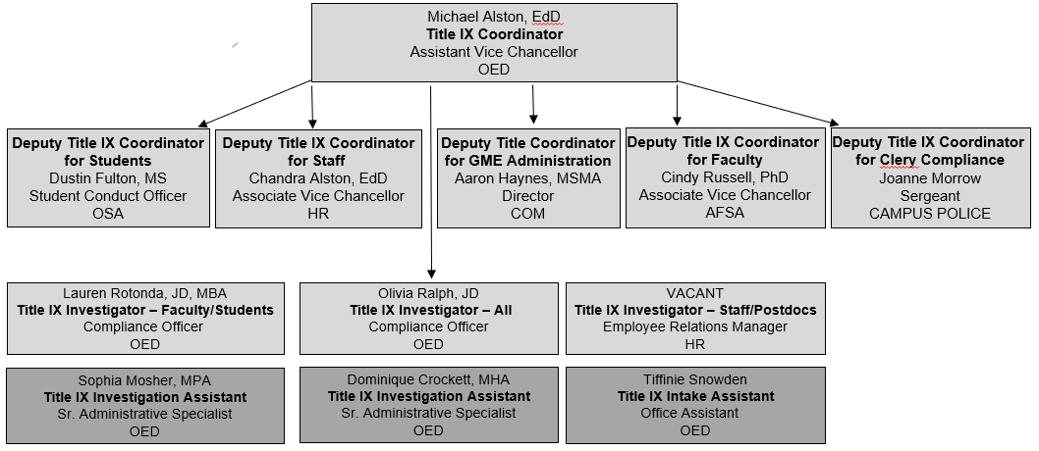
Title IX Team

Slide 6
SMRVS Information
Policy (http://uthsc.edu/oed/sexual-misconduct.php)
Statistics (http://uthsc.edu/oed/documents/2018-title-ix-report-final.pdf)
Handouts (http://uthsc.edu/oed/handouts.php)

Slide 7
Reports by type comparison 2017 to 2018

Slide 8
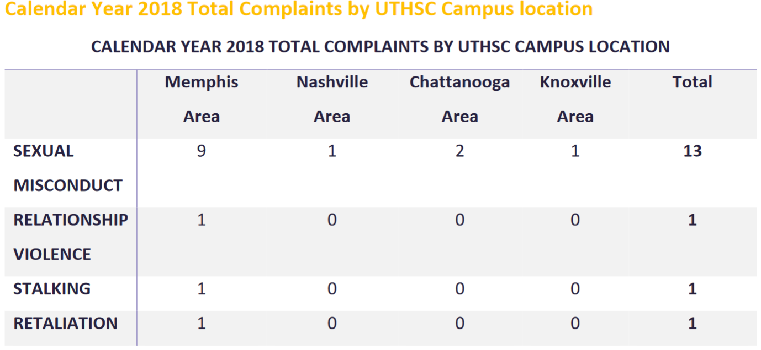
Reports by location for 2018

Slide 9
Prevention and Education

Slide 10
Questions?

