Slide 1
Immersive PharmD Accelerated Track (ImPAcT) Pathway Marie Chisholm-Burns, PharmD, PhD, MPH, MBA Dean and UTHSC Distinguished Professor, UTHSC College of Pharmacy

Slide 2
Why Offer ImPAcT, a 3-year Accelerated PharmD?
Immersive PharmD Accelerated Track

Slide 3
SCRIPT
Student debt reduction
Choice augmentation
Recruiting enhancement
Increase student access
Program quality
Transformative

Slide 4
Immersive PharmD Accelerated Track (ImPAcT) Pathway
Will provide an option for students to complete the PharmD program in three years.
Offered to 10-25 students matriculating in August 2021.
No increase to target class size.
The ImPAcT program is consistent with UTHSC and College missions and strategic plans, it:
Aligns with College's core values of advancing excellence, increasing access, being futuristic, and continuous quality improvement;
Attract prospective students who desire to graduate sooner; and
Reach a broader audience of applicants, thus providing education in a more inclusive manner.

Slide 5
Design of ImPAcT
ImPAcT is comprised of the same number of hours (148.5), the same course content, and the same learning objectives as the traditional 4-year pathway.
Delivered in an accelerated manner by shortening breaks and redistributing classes.
Students will complete all P1 fall semester activities, including orientation, with 4-year pathway students since they are not granted entry to ImPAcT until after completion of P1 fall.
At least the first two cohorts will be at the Memphis campus for their didactic education.
Face-to-face access for all support services, including the Director of ImPAcT (a new hire to support this pathway).
Close monitoring and assessment of student progress.
Same academic policies for progression and graduation as the 4-year pathway.
Exit strategy: If a student is unable to progress in the ImPAcT, may fall back into the 4-year pathway.

Slide 6
Approval of ImPAcT
In December 2020, the College of Pharmacy Faculty voted and overwhelmingly approved the ImPAcT pathway.
In April 2020, the College of Pharmacy Alumni Board expressed their full support of the ImPAcT pathway.
At the conclusion of their April 26-27, 2021 site visit, the Accreditation Council for Pharmacy Education enthusiastically approved the start of the ImPAcT pathway in August 2021.

Slide 7
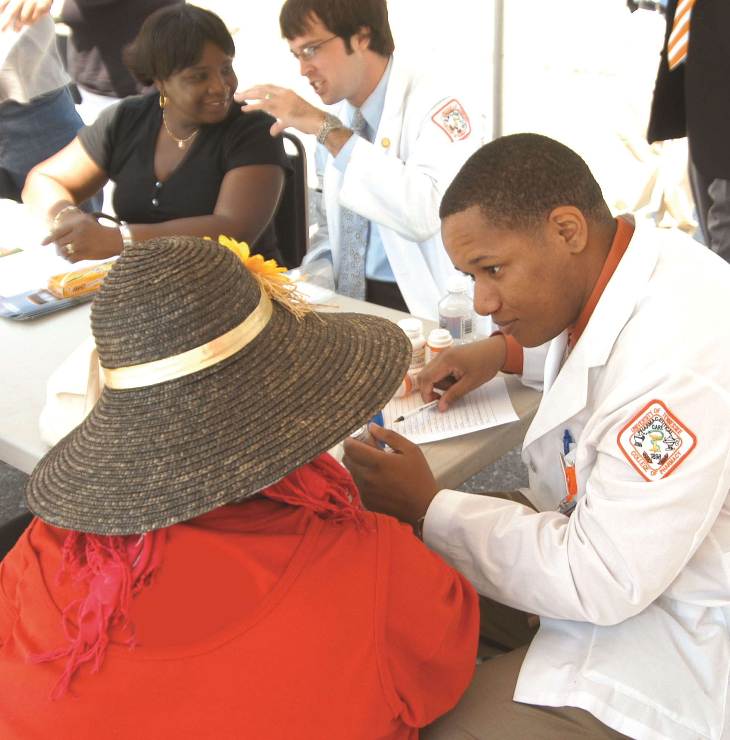
Summary: ImPAcT Pathway
ImPAcT (Immersive PharmD Accelerated Track) will be a high-quality pathway.
ImPAcT gives students greater choices for their education.
The ImPAcT Pathway is in alignment with the College’s core values and with our theme of access, affordability, and accountability.

