Slide 1
Mindfulness for Medical Students
MANOJ JAIN MD MPH
April 27, 2017

Slide 2
Washington Post:

Slide 4
Your Mind
You
We do not seem to be in control our minds.

Slide 5
Relaxation

Slide 6
Attention

Slide 7
Science and Meditation

Slide 8
What is mindfulness and what is meditation?
Mindfulness is a state of moment-to-moment awareness, which emphasizes attention without judgment.
Meditation is a group of practices for cultivating mindfulness, insight, wisdom and compassion.

Slide 9
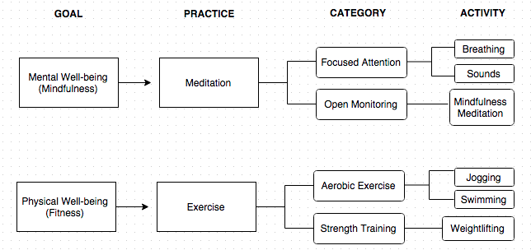

Slide 10
Impact of Mindfulness at 8 week and at 3-6 month
Notes:
This is a meta-analysis of the short term (8 wk, top) and longer term (3-6 month, bottom) outcomes compared to placebo control. We find statistically significant effect sizes favoring mindfulness of .38 at 8 wks and .22 at 3-6 months.

Slide 11
Impact of Mindfulness at 8 week and at 3-6 month
Notes:
This is a meta-analysis of the short term (8 wk, top) and longer term (3-6 month, bottom) outcomes compared to placebo control. We find statistically significant effect sizes favoring mindfulness of .30 at 8 wks and .23 at 3-6 months.

Slide 12
Impact of Mindfulness at 8-10 week on pain
Notes:
This is a meta-analysis of the pain outcomes, showing an effect size of .33.

Slide 14
Empathy Score over 4 years Medical School

Slide 15
Empathy Score over 4 years in Male and Medical School

Slide 17
Does Meditation Make You More Compassionate?
8 weeks of meditation increased compassionate response from 16% to 50%.

Slide 19
4 C’s of Being a Good Doctor
Competent
Communicative
Compassionate
Convenient

Slide 20
CONTACTS
www.AdvacingMindfulness.com
@MJainMD Twitter
www.MJainMD.com

