Slide 2
UTHSC College of Nursing:
Legacy of Leadership
First School of Nursing in Tennessee (1927)
First BSN program in the state (1950)
First PhD nursing program in the state (1988)
First DNP program in the state, second in the U.S. (1999)
Currently No. 1 CON in Tennessee for NIH grant funding

Slide 3
Vision: Nurses leading innovative transformation of health care.
Mission statement: To prepare exceptional nurse leaders to meet the health needs of the people of Tennessee, the nation and beyond through:
Cultivating creativity and passion to improve health care
Leading scientific innovations and clinical practice
Using innovative academic approaches
Serving society
Building community partnerships

Slide 4
College of Nursing programs
Accelerated BSN
RN to BSN
Doctor of Nursing Practice (DNP): 7 concentrations, 2 dual concentrations
Doctor of Philosophy (PhD)
Dual PhD/DNP program
Registered Nurse First Assistant (RNFA) certificate

Slide 5
Total College of Nursing Enrollment: 408
DNP programs: 256
BSN program: 136
Grad Certificate: 7
RN to BSN: 9

Slide 6
DNP program by enrollment and concentration
63 Nurse Anesthesia
61 Adult Gerontology Acute Care
53 Family Nurse Practitioner
47 Psychiatric Mental Health
15 Pediatric Acute Care
13 Pediatric Primary Care
7 Neonatal
17 Dual Adult Gerontology Acute Care/Family Nurse Practitioner*
11 Dual Psychiatric mental Health/Family Nurse Practitioner*
*These numbers are included in the primary concentration above.

Slide 7
Student Demographics: Fall enrollment
BSN Program DNP Program
Male: 10% Male: 18%
Minority: 40% Minority: 41%
In-state: 74% In-state: 73%
First-generation: 32% First-generation: 22%
Post-baccalaureate: 80%
UTHSC alumni: 25%

Slide 8
Partnership Enrollment Program
Allows automatic enrollment for graduates of these colleges. Fall enrollment follows:
Three
0
0
Four
Eight
Contract completed; implementation under way.

Slide 9
Continuing the legacy of leadership
No. 1 school in Tennessee for the most DNP graduates.
U.S. News and World Report ranked our DNP program 24th in the nation.
Recipient of nearly $3 million HRSA grant to educate Nurse Practitioners and Nurse Midwives to practice in rural and underserved areas.
Development of Center for Community and Global Partnerships

Slide 10
HRSA Grant: $2,799,996
Funding source: Health Resources and Service Administration
Grant: Advanced Nursing Education Workforce for Health Delta Moms and Babies
Goal: Support new and innovative academic practice partnerships to educate and graduate Nurse Practitioners and Nurse Midwives who will practice in rural and underserved areas.
Timeline: Four years
Leadership: Sarah Rhoads, PhD, DNP, WHNP-BC, RNC-OB, FAAN

Slide 11
Center for Community and Global Partnerships
Mission:
Develop sustainable partnerships with health systems the Mid-South and Tennessee.
Advance integrated health care systems
Reduce health disparities
Improve health outcomes
Activities:
Nurse scholars program at Methodist Healthcare and St. Jude Children’s Research Hospital
De-Escalation training for nurses at hospitals throughout the Mid-South
Shelby County Health Department initiatives
Community grants
In process: Developing a nursing career counseling program.

Slide 12
CON: Planning for the future
Onboarding all ULPS nurse practitioners as faculty.
Hiring Director of Clinical Affairs.
Opening DNP concentration in Midwifery in 2021.
Adding traditional BSN program??.
Moving the CON to a renovated building in historic quadrangle.
Looking toward opening nurse-managed healthcare centers..

Slide 13
Defining DNP and why it matters
The Doctor Nursing Practice (DNP) degree is designed for nurses seeking a terminal degree in nursing practice.
As the healthcare delivery system grows more complex, the DNP degree reflects the rigorous education that nurse practitioners need to lead and deliver quality healthcare.
In 2018, the National Organization of Nurse Practitioner Faculties committed to move all entry-level nurse practitioner education to the DNP degree by 2025.¹
The DNP offers an alternative to research-focused doctoral programs in nursing.
DNP-prepared nurses are equipped to implement the science developed by nurse researchers prepared in research-focused nursing doctorates.

Slide 14
U.S. Trends in primary care
Studies show access to primary care is positively correlated with overall population health.²
The American Medical Association predicts a primary care physician shortage between 21,000 and 55,200 by 2032.
In 2018, only 2,730 medical school graduates entered primary care residencies.³
In 2017, more than 22,500 nurse practitioners graduated from primary care programs.³
Only 8% of medical residency matches in 2018 occurred in primary care specialties; 84% of nurse practitioner graduates are from primary care programs.³

Slide 15
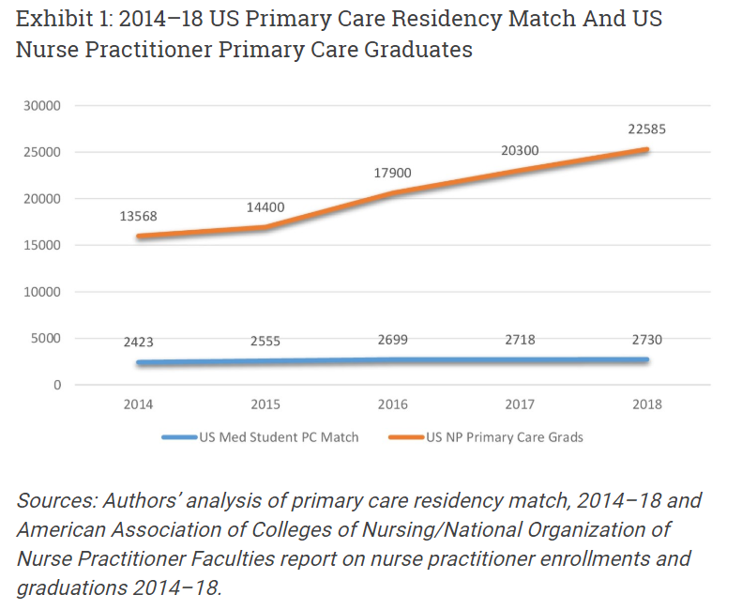

Slide 16
The DNP role in primary care
Multiple studies show that nurse practitioners provide care that is patient-centered, effective, affordable and comparable in quality to that of their physician colleagues.⁴
Patients under the care of NPs also have higher patient satisfaction and fewer unnecessary emergency room visits and hospital readmissions than patients under the care of physicians.⁴
The percentage of nurse practitioners among primary care providers has grown from 17.6% to 25% in rural areas and from nearly 16% to 23% in non-rural areas from 2008 to 2016. Physician percentages have decreased in both rural and urban settings over the same time period.⁵

Slide 17
Full practice authority
Full Practice Authority (FPA) is the authorization of nurse practitioners to evaluate patients, diagnose, order and interpret diagnostic tests and initiate and manage treatments, including prescribing medications, under the exclusive licensure authority of the state board of nursing.⁶
Twenty-two states and the District of Columbia have adopted FPA licensure laws for nurse practitioners.³
Within five years of adopting FPA, the number of Arizona-licensed NPs increased by 52%, with the largest increase occurring in rural classified counties.³
Most states that rate highly in national health rankings are states with FPA.³
In 2018, 10 of the top 13 states for health rankings had FPA, while 12 of the 13 lowest-rates states in national health rankings restricted NP practice, according to the Commonwealth Fund.³

Slide 18
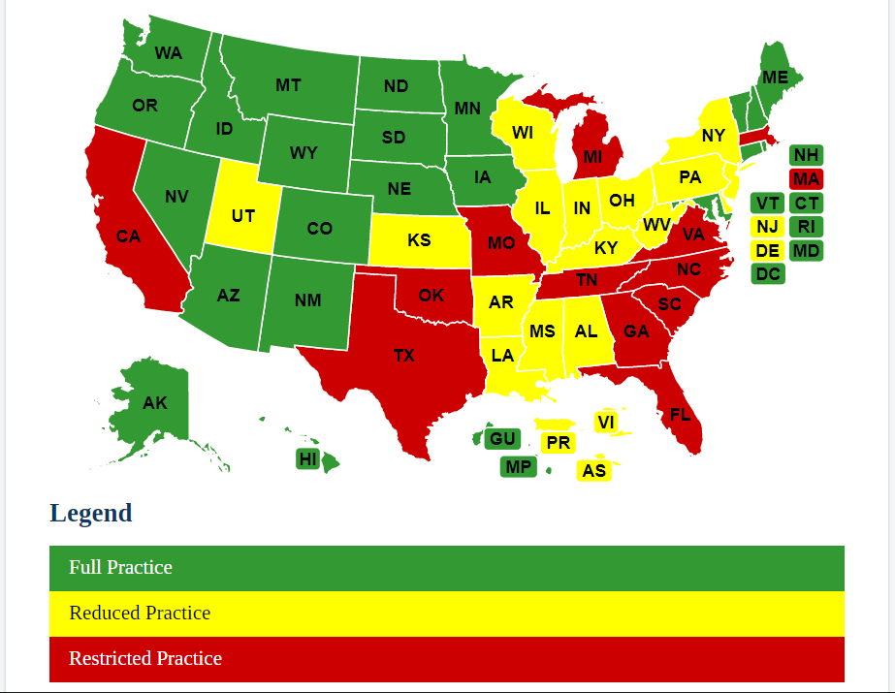
Tennessee NPs have restricted practice authority.*
*Source: American Association of Nurse Practitioners

Slide 19
Policy priorities
We are advocating for nurse practitioners to have the opportunity for full practice authority licensure in the state of Tennessee. We believe this will help address the shortage of primary care providers and improve overall health outcomes.
In addition, we are advocating for nurse practitioners in the state of Tennessee to be permitted to prescribe Buprenorphine, which is used in medication-assisted treatment to help people reduce or quit using heroin or other opiates.
Tennessee is the only state where a nurse practitioner cannot prescribe this drug for opioid addiction. Buprenorphine was approved for clinical use in 2002 by the Food and Drug administration.⁷
Tennessee ranks 14th among states in the U.S. for opioid-involved overdose deaths. There were 19.3 such deaths per 100,000 people in the state in 2017.⁸

Slide 20
Questions/ Discussion.

Slide 21
Thank you for your kind attention.

Slide 22
References
Statement on The Doctor of Nursing Practice Degree: Entry to Nurse Practitioner Practice by 2025. National Organization of Nurse Practitioner Faculties, May 2018.
“Quantifying the Health Benefits of Primary Care Physician Supply in the U.S,” International Journal of Health Services, Vol. 37. No. 1, pages 111-126, 2007.
“Primary Care Workforce Data and the Need for Nurse Practitioner Full Practice Authority,” Health Affairs Blog, Dec. 13, 2018.
Position Statement on the Quality of Nurse Practitioner Practice, American Association of Nurse Practitioners, 2015.
“Rural and Non-Rural Primary Care Physician Practices Increasingly Rely on Nurse Practitioners,” Health Affairs Journal, June 2018.
Policy Brief: Full Practice Authority, American Association of Nurse Practitioners, revised Oct. 24, 2018.
Substance Abuse and Mental Health Services Administration.
National Institute on Drug Abuse Opioid summaries by state.

