Slide 1
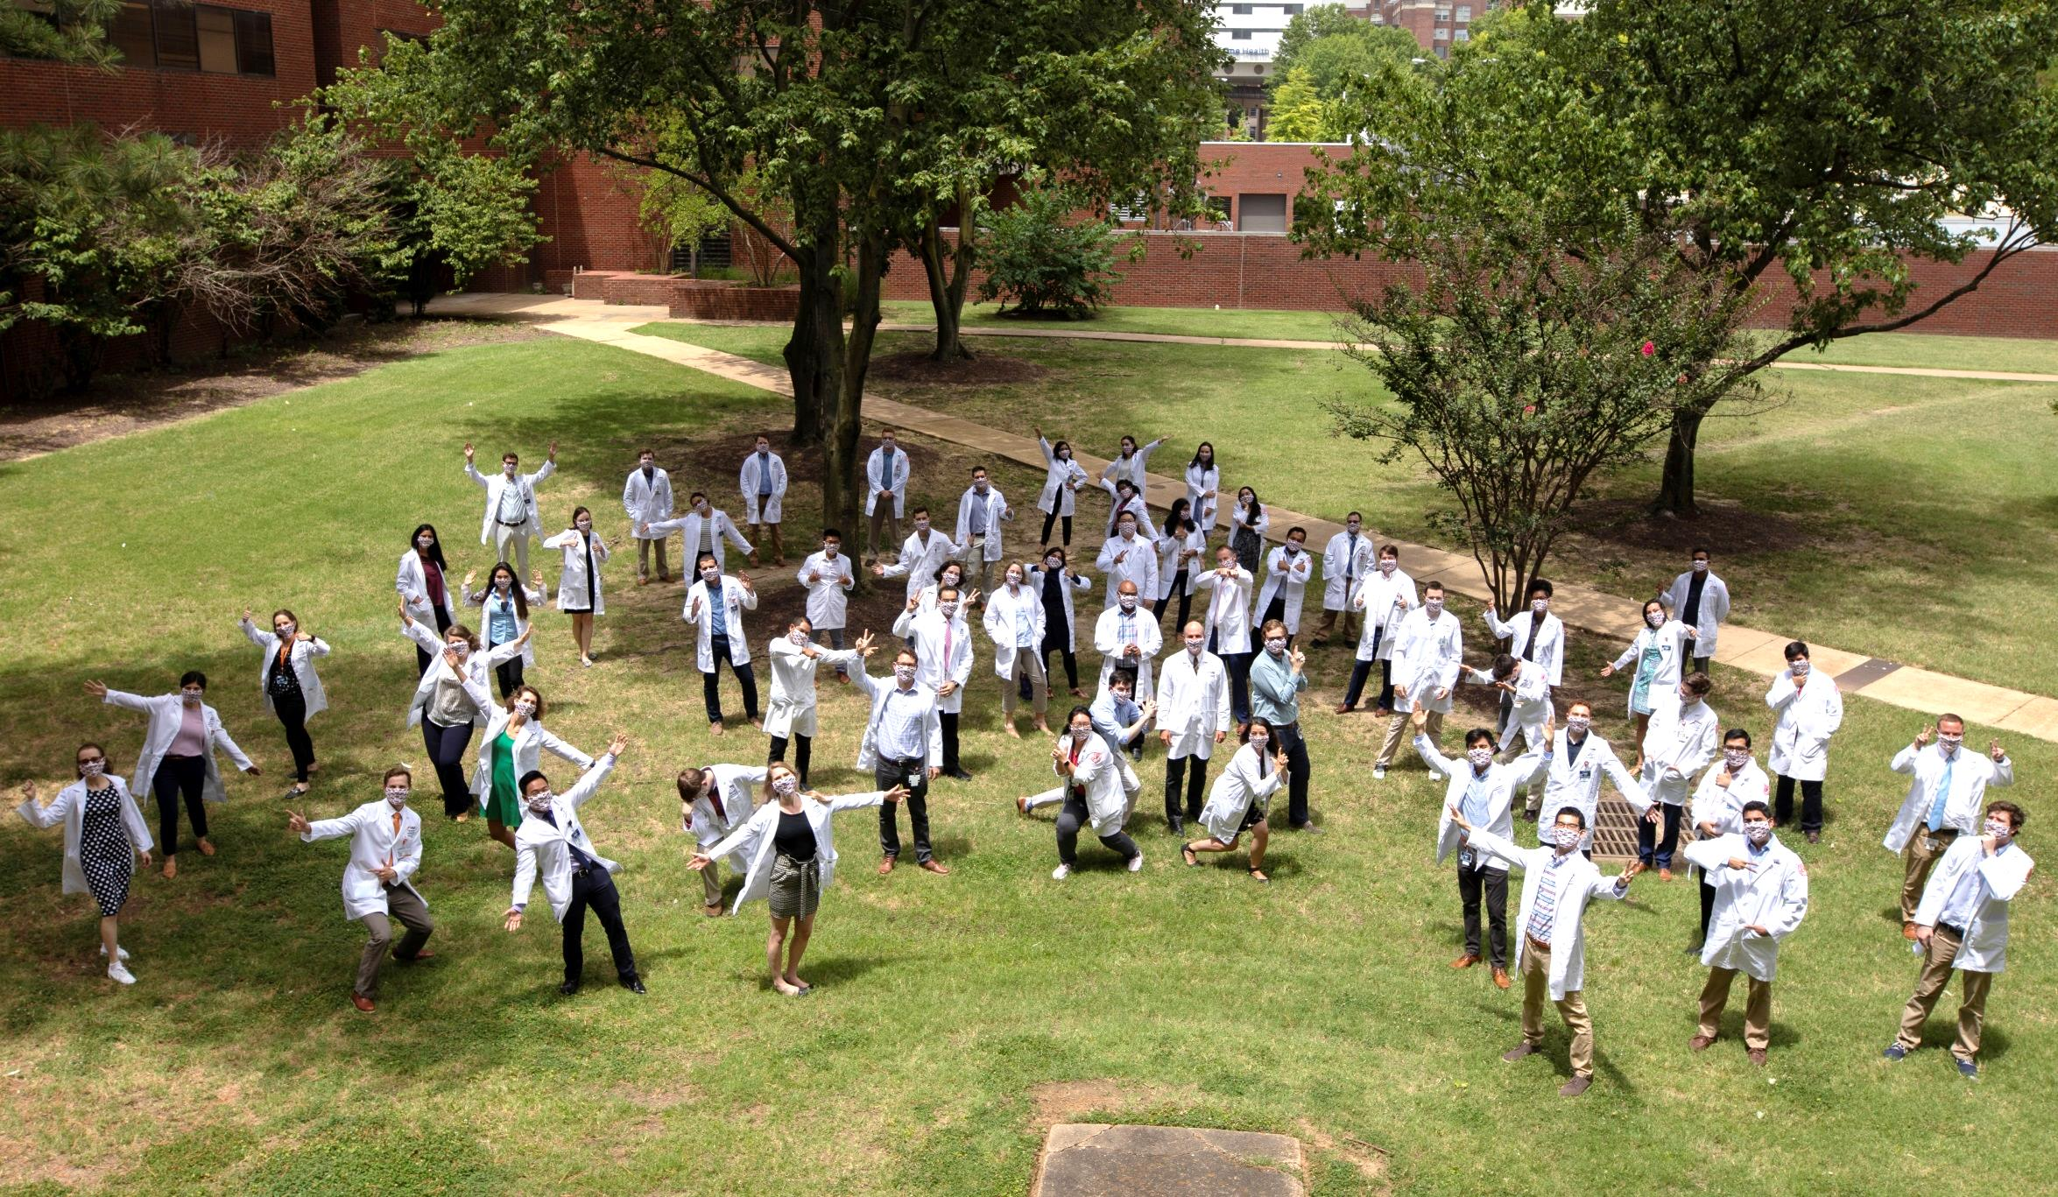
Medical Education Focus:
MD Program Three Year Curriculum
Scott E. Strome, MD Robert Kaplan Executive Dean of the College of Medicine
Vice Chancellor of Heath Affairs
University of Tennessee Health Science Center

Slide 2
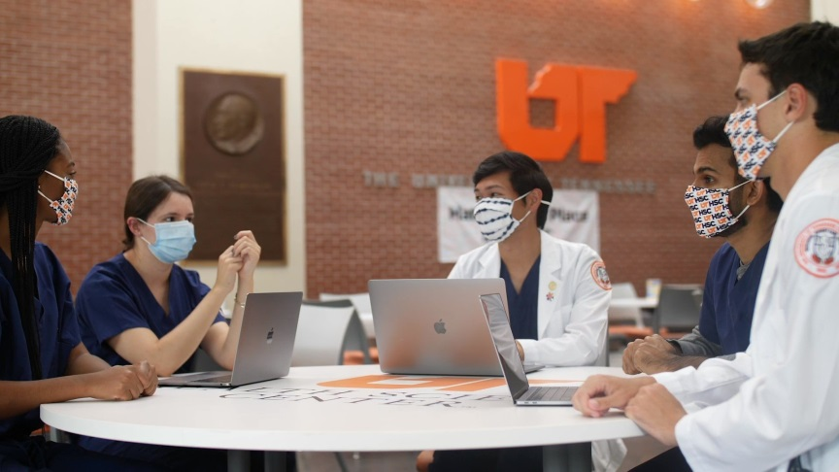
Why a 3-year Curriculum?
Increase the numbers of physicians in Primary Care. There is a shortage of primary care physicians in Tennessee that is projected to reach a shortfall of 19.2% in 2025.
Attract high-caliber, highly motivated applicants to the University of Tennessee College of Medicine MD program.
Retain these high-quality students as residents at UTHSC COM, and, ideally, beyond as physicians in Tennessee and faculty members at UTHSC COM.
Reduce student debt.

Slide 3
Comparison 4-Year Vs 3-Year Curriculum
4-Year Curriculum | 3-Year Curriculum
Accredited by LCME | Approved by LCME Oct 2020
Candidates for admission have not selected their medical specialty. | Candidates for admission pre-determine specialty area as primary care. Thus Internal Medicine, Pediatrics, Medicine-Pediatrics, Obstetrics-Gynecology, Psychiatry or Family Medicine.
All students have identical program objective and curricular goals
All students complete basic science courses and CORE clerkships. Core Clerkships: Internal Medicine (8 weeks), Surgery (8 weeks), Family Medicine (6 weeks), Pediatrics (6 weeks), Obstetrics-Gynecology (6 weeks), Neurology (4 weeks), and Psychiatry (4 weeks)
16 Weeks of Electives | 8 Weeks of Electives
20 Weeks of Option Blocks* | 6 Weeks Option Blocks*
4th Year focus on electives that allow for career exploration | 4th Year Residency begins
Option Blocks: No courses, used to study for licensing exams and interview for residency

Slide 4
Minimum Criteria
Admissions to 3-Year Curriculum
Candidates must first be accepted to the 4 year program
They are then interviewed again by the 3 year curriculum leadership and the appropriate residency program leadership
Candidates must pre-identified a desire to go into primary care

Slide 5
Admissions to 4-Year MD Program
2065
Applicants
514
Interviews
247
Acceptances
170
New Students
Class of 2024 Profile MD Degree Program
• Gender: 94 Men/ 76 Women
• Average Age: 24
• Average GPA: 3.76 (↑ 0.04 pts from 2019)
• Average MCAT: 512
• 100% Baccalaureate Degrees
• Top Five Undergraduate Majors
Biochemistry, Biology, Chemistry,
Neuroscience, Psychology

Slide 6
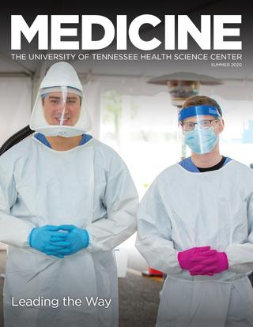
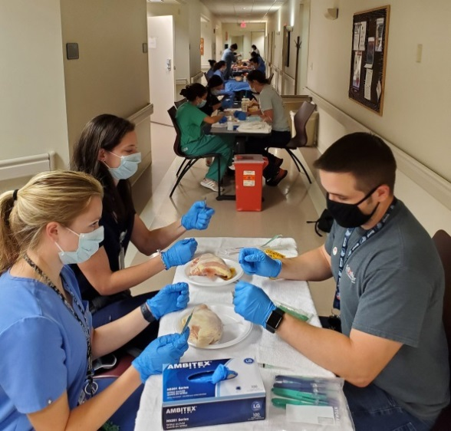
Incoming Class 3-Year Curriculum
Eight offers extended in 2021
6 TN Residents, 2 Nonresidents
6 women, 2 men
Average overall GPA 3.90
(3.76 for 4-Year M1s)
Average MCAT 516
(512 for 4-Year M1s)
At this Time: 3 have committed to come to UTHSC

Slide 7
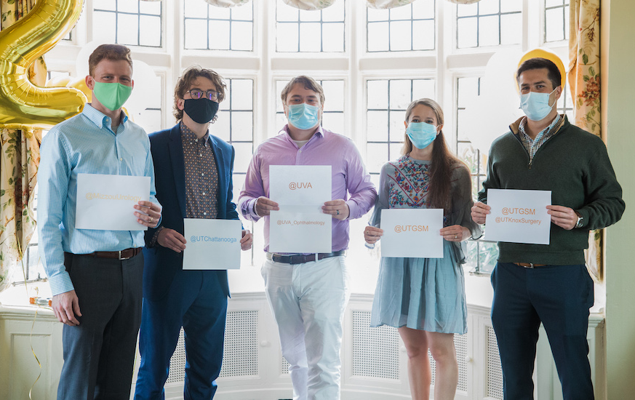
Important Added Points 3-Year Curriculum
Entry comes with conditionally guaranteed position in UTHSC residency
Students may opt out/decelerate to 4-year
Early and strong mentorship program
Close monitoring to ensure academic and professionalism goals are met
Students must maintain a > 50th percentile GPA compare to 4-year class
Residency Match Day 2021

